Slide 1
Unit 1: Week 1
Grade K

Slide 2
Copyright © Savvas Learning Company LLC. All Rights Reserved.
This publication is protected by copyright, and permission should be obtained from the publisher prior to any prohibited reproduction, storage in a retrieval system, or transmission in any form or by any means, electronic, mechanical, photocopying, recording, or otherwise. For information regarding permissions, request forms, and the appropriate contacts within the Savvas Learning Company Rights Management group, please send your query to:
Savvas Learning Company LLC, 15 East Midland Avenue, Paramus, NJ 07652
or
k12learningpermissions@savvas.com
myView Literacy® is an exclusive trademark of Savvas Learning Company LLC in the U.S. and/or other countries.

Slide 3
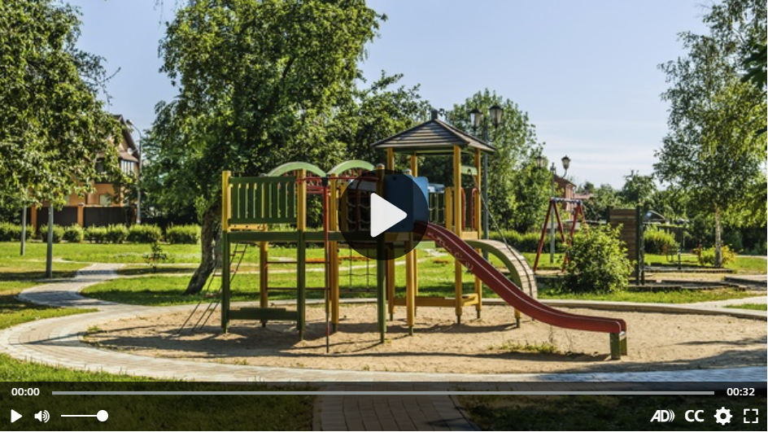
Introduce the Unit
Essential Question: What makes a place special?
What places are in your community?
Notes:
Introduce the Essential Question for Unit 1: What makes a place special? Tell students that they will read many texts to learn about the ways different places are special. Explain that reading texts of various genres and by different authors is important because each author gives his or her own ideas about the theme. Watch the Unit Video Tell students that a multimedia text can use both sound and pictures. One kind of multimedia text is a video. Have students recognize the characteristics of multimedia text by paying attention to the sound and pictures as they watch “My Community.”?” Click Path: Table of Contents -> Unit 1: Going Places> Unit 1: Introduction
Have partners discuss the characteristics of multimedia text that they recognized by watching video. Use the following questions to guide their discussions:
What did you hear in the video?
What did you see in the video?

Slide 4
Page 12
Unit Goals
Turn to page 12 in your Student Interactive.
Color the picture.
Notes:
Read to students the goals from p. 12 of the Student Interactive.
Have students color in the shape next to each goal as it is read aloud.
Talk with students about what makes a place special. Use the picture on p. 12 as an example.

Slide 5
Page 13
Academic Vocabulary
Expand: Something that is special is unique or different.
Ask: What is a place that is special to you?
Expand: When you move, you change the place where you live.
Ask: Where can a person move to?
Expand: A map shows locations of things.
Ask: How can you find this school on a map?
Expand: Land is the ground we walk on.
Ask: What do you see on land?
Notes:
Academic vocabulary is language used to discuss ideas. Explain to students that, as they work through the unit, they will learn and use these academic words as they discuss what makes different places special. Have students turn to p. 13 in the Student Interactive.
Read aloud the words and sentences. Then use the EXPAND and ASK questions below for each word. Have students respond using the newly acquired Academic Vocabulary as appropriate.
Call students’ attention to how they responded to each sentence with a colored thumbs up or thumbs down. Have students talk with a partner about their answers using the Academic Vocabulary words.

Slide 6
Lesson 1

Slide 7
Page 16
Phonological Awareness
Notes:
Tell students that today they will learn a new sound. Listen carefully: /m/ /m/ /m/. The sound /m/ is made by pressing your lips together while making a sound. Have students practice the sound /m/.
Have students turn to p. 16 in the Student Interactive. Tell them they will be circling pictures that begin with the sound /m/. Point to the picture of the mouse. Listen to the sounds as I say this word: /m/ /ou/ /s/.
Continue with the picture of the cat. Repeat both words, emphasizing the initial sounds: /m/ /m/ /m/ /ou/ /s/, /k/ /k/ /k/ /a/ /t/. The word mouse has the initial sound /m/. Let’s circle the mouse.
Name each picture on p. 16. Then have students circle the words with the initial sound /m/.

Slide 8
Page 17
Phonics
Trace the words on page 17 in your Student Interactive.
Notes:
Hold up the Alphabet Card for Mm and point to the picture of the motorcycle. Have students say motorcycle with you. Let’s say the sound at the beginning of the word /m/ -otorcycle. The beginning sound /m/ is spelled with the letter m.
Point to the letters Mm on the Alphabet Card. Tell students the word motorcycle begins with the sound /m/, so it begins with the letter m.
Write the letters M and m on the board. Have students turn to p. 17 in the Student Interactive and trace the letters on the first line.
Tell students that you will say a group of words.
Direct them to identify the words that begin with the sound for m and match the sound and letter by tracing the letter in the air as you say each word that begins with the sound /m/.
Use the following words for this activity, emphasizing the initial sounds: mop, top, mat, mail, hop, more, Meg.

Slide 9
High-Frequency Words
I
am
the
Notes:
Display the high-frequency words I, am, and the.
Point to the word am and read it.
Have students identify the word am by pointing to it, and then have them read it.
Repeat for I and the.

Slide 10
Page 14,15
Interact with Sources
Where do you go in your imagination? Write about the places you imagine.
Notes:
Reintroduce students to the Unit Essential Question: What makes a place special?
Then point out the Weekly Question: How does imagination make a place seem different?
Ask: What is imagination? It’s making pictures or ideas in your mind. Using your imagination can help you picture a place and think about what might make the place special.
Have students turn to p. 14 of the Student Interactive. Read aloud the heading and the sentence on this page. Point to the picture of the girl who has built a rocket out of cardboard. Ask students what she is imagining.
Guide them to understand that she is imagining that she is traveling into space in the rocket ship. Then read aloud the information on p. 15. Ask students what the boy on this page is imagining.
Guide students to understand that he is imagining what it would be like to walk on the moon. Use the following prompts to guide discussion:
Ask students to close their eyes and picture traveling to space in a rocket ship or walking on the moon.
Tell students that making pictures in your mind is one way to use your imagination.
Ask students to imagine what they would do in space if they rode in a rocket ship, or what they would do if they were on the moon.
Tell them that imagining what you would do is another way to use your imagination. Encourage students to ask questions about the infographic to clarify any information they do not understand.
Ask students to turn, talk, and share with a partner about where they like to “go” in their imagination when they play, draw, or write.
Point out the Week 1 Question: How does imagination make a place seem different? Tell students that they have just learned about where people might go in their imagination.
Tell them that over the week they will learn about other ways that imagination can change a place.

Slide 11
Listening Comprehension
Jackie and her Imagination
1.
2.
3.
4.
Notes:
Tell students that they will listen to a realistic fiction story called “Jackie and Her Imagination.”
Realistic fiction is a made-up story. Tell them that you are going to read a story about a girl named Jackie.
As you read aloud the realistic fiction story, have students listen actively by looking at you and thinking about what you are saying.
Have students confirm understanding of the read aloud text by asking and answering questions about key details.
Ask them to think about whether Jackie could be a real child and whether the things she does might happen in real life.
Purpose: Have students listen actively for elements of realistic fiction, such as whether the events in the story could really happen.
Read: the entire text aloud without stopping for the Think Aloud callouts.
Reread: the text aloud, pausing to model Think Aloud strategies related to the genre.

Slide 12
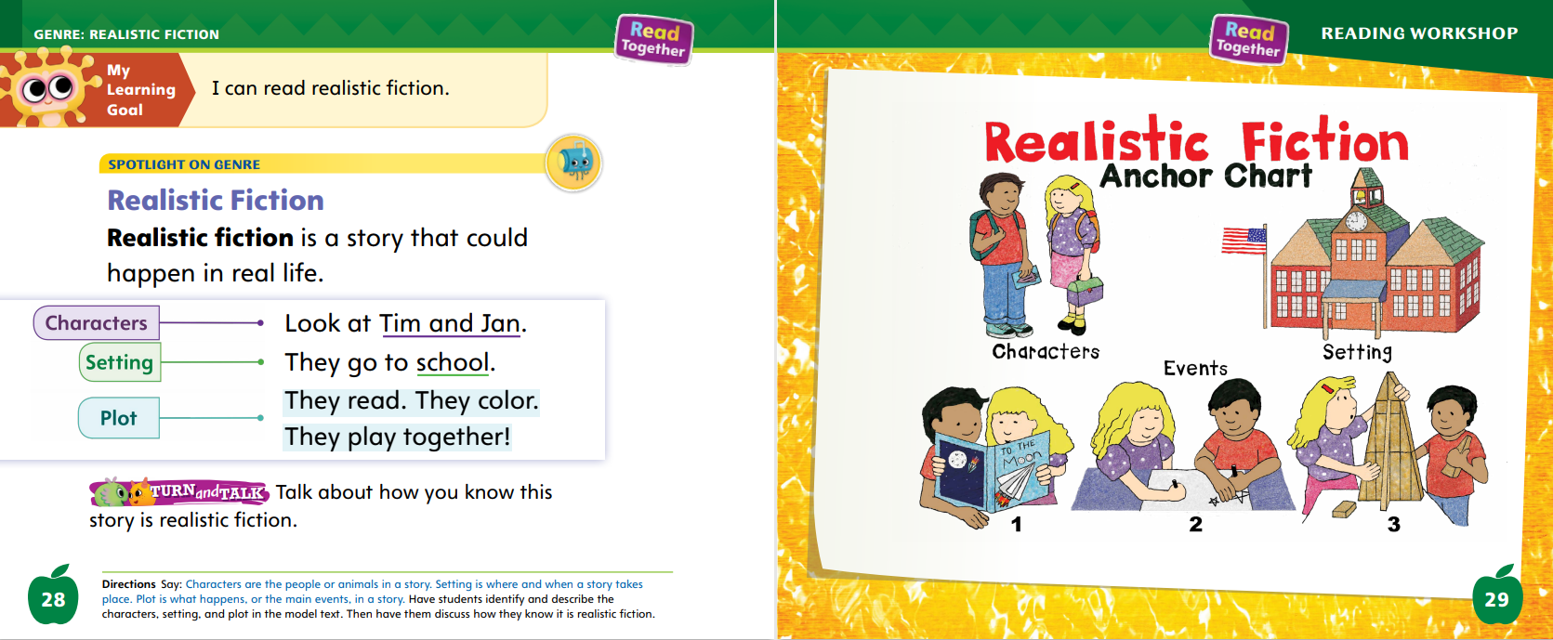
Page 28,29
Realistic Fiction
Turn to page 28 in your Student Interactive.
Notes:
Tell students that realistic fiction is a type of story that could happen or be real. Explain that the story will have realistic characters.
Tell students that identifying these characters, and other parts of a realistic fiction story, will help them understand and connect with the story.
The people, or characters, in realistic fiction do or say things that real people might do or say.
The place where a realistic fiction story takes place, or the setting, is a place that is real, like a school or a park.
Whatever happens in realistic fiction, the plot or main events, could happen in real life.
3. Have students turn to p. 28 in the Student Interactive. Point out that the model text is about Tim and Jan. These are the characters
Ask students where the story about Tim and Jan takes place.
Guide them to understand that it happens at school, which is a real place. Editable Anchor Chart Click Path: Table of Contents -> Reading Anchor Charts -> Unit 1 Week 1: Realistic Fiction Editable Reading Anchor Chart

Slide 13
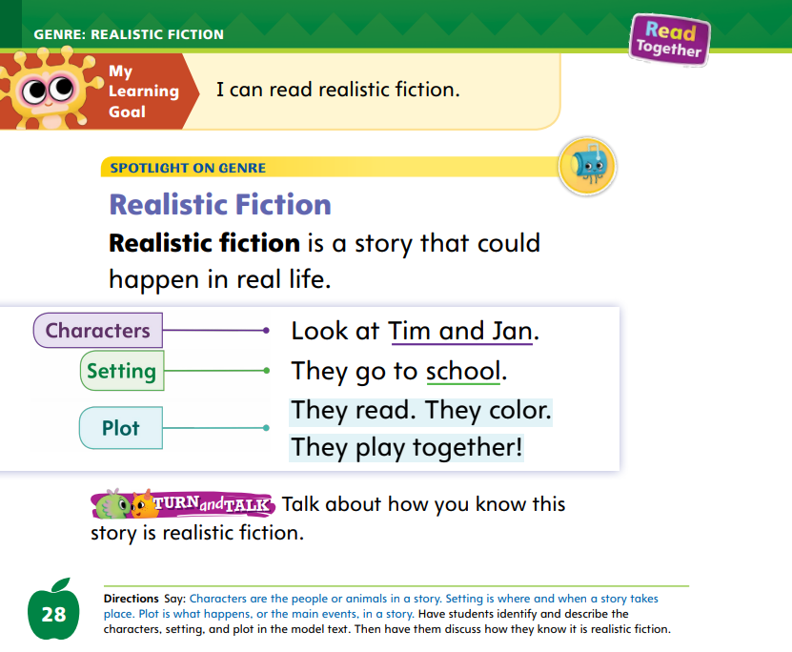
Page 24
Apply
Talk about how you know this story is realistic fiction.”
Notes:
Have students turn and talk with a partner about how they know this is a realistic fiction story. Then have partners share their ideas with the class.

Slide 14
Academic Vocabulary
hand | do | map | try
hands | redo | maps | retry
Notes:
Explain to students that word parts can be added to words to make new words.
Sometimes word parts are added to the ending of a word.
Sometimes word parts are added to the beginning of a word.
When word parts are added, they change the meaning of the word.
Hold up your hand. Ask students what it is. They should say that it is your hand.
Write the word hand on the board. Now hold up both hands. Ask students what they see (two hands). Add an s to the word hand on the board. Circle the s. This word part is added. It shows I have more than one hand. I can also add a word part to the beginning of a word. For example, I might ask you to do something.
Write do on the board. If we want more practice, I might ask that we redo it. Re- is a word part.
Write redo on the board and circle re-. Repeat this activity by writing words with and without word parts: map/maps; try/retry.
Ask students to identify the word part.

Slide 15
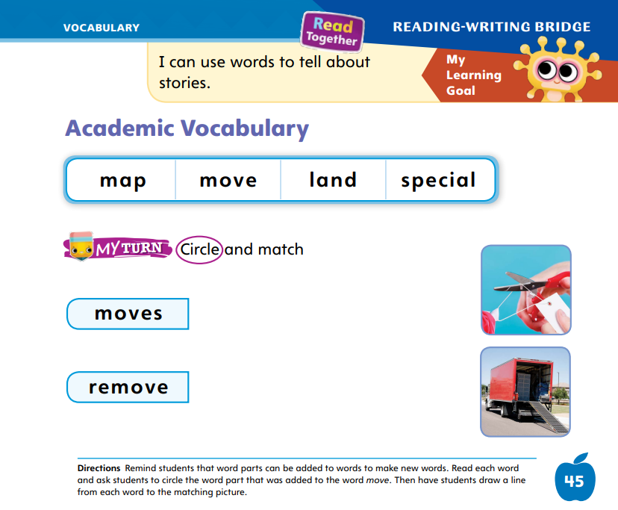
Page 45
Apply
Circle and match on page 45 in your Student Interactive.
Notes:
Have students complete the activity on p. 45 in the Student Interactive

Slide 16
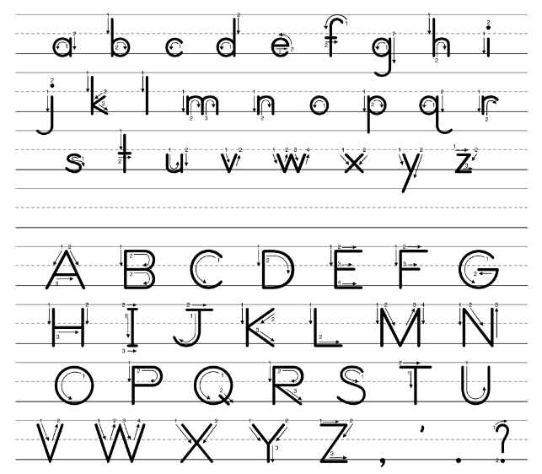
Handwriting
Notes:
Show students the alphabet. Point out that the letters in the alphabet include different types of lines. Some letters include straight lines. Others include curved lines. Still others include both straight and curved lines. Before you can write letters, you must be able to write straight and curved lines! Today we’ll start by practicing with straight lines.
Make a vertical line on the board. Point out that it goes straight up and down.
Tell students that when they write a letter they should always start at the top.
Have students draw vertical lines in the air, starting at the top and moving their fingers straight down. (Make sure that they do this with their dominant hand, so that right-handed students are using their right hand and left-handed students are using their left hand. Click path: Realize -> Table of Contents -> Resource Download Center -> Handwriting Practice -> U1W1L1 Handwriting Practice

Slide 17
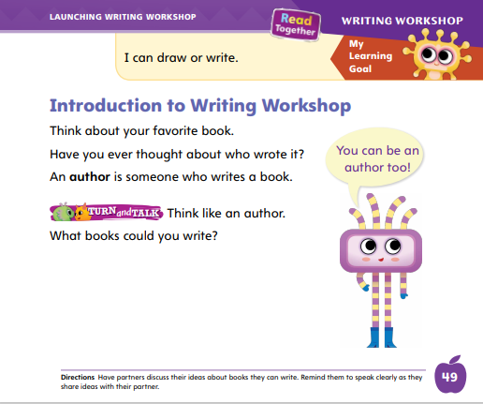
Page 49
Writing – Launching Writing Workshop
Turn to page 49 in your Student Interactive.
Notes:
An author is someone who writes a book. Before writers start to write, they have to come up with an idea.
They think about how they can turn that idea into a book. They learn about the subject. They may talk to other people about their ideas.
Inform students that you will work together during Writing Workshop to come up with ideas and learn how to write about them.
Hold up a stack book and explain that a writer wrote the book. Tell students that they will write books this year, too.
Read aloud at least three stack books of different genres to help students understand the different parts of a book.
As you read, pause to ask questions about the parts of the books, such as the cover, title page, sentences, and pictures.
Note how the pictures and words on the page go together.
Have students turn to p. 49 in the Student Interactive and read it to them. Say: This page says you can be an author too. Remember that authors start with an idea. Let’s think like an author. What are some things you can write about? Write their ideas on the board or chart. Ask students to write down some of their favorite ideas that were listed on the board or chart.

Slide 18
Independent Writing
Read more stack books to gain a better understanding of the different parts of the book.
Notice how the text and pictures work together to tell a story or give information.
Notes:
Tell students that during their independent writing time they can read more stack books to gain a better understanding of the different parts of a book. They should pay attention to how the text and pictures work together to tell a story or give information.
Modeled: Talk through how to choose an idea. Model drawing a simple picture and writing a sentence for it.
Shared: With students’ input, make a list of ideas. Talk through what they could draw or write about.
Guided: Have students say what they want to write or draw before they do so.
If students show an understanding, they can begin writing in stapled booklets.
If time allows for individual conferences, use the Conference Prompts on p. T302.

Slide 19
Language and Conventions
common nouns
people | animals
Notes:
Tell students that nouns can name people and animals.
Write the categories people and animals on the board. Have volunteers name examples of common nouns and help you classify them as either people or animals.
Pair students and have them take turns telling nouns that name people and animals. Their partner should say which category the word falls into.

Slide 20
Lesson 2

Slide 21
Page 18
Phonics
Turn to page 18 in your Student Interactive.
Notes:
Hold up the man Picture Card and tell students that it is a picture of a man. Listen to the sounds in the word man: /m/ /a/ /n/. I hear the sound /m/ at the beginning of man. Say the sound /m/ with me.
Show students the spelling of the word on the back of the card. Read the word, pointing to each letter as you say the sound: /m/ /a/ /n/. Do you hear the sound /m/? Which letter spells the sound /m/? Click path -> Table of Contents -> Unit 1 Week 1 Realistic Fiction -> Lesson 1
Have students identify the letter m. Let’s trace the letter in the air. When we see this letter in a word, what sound will we say? Students should say the sound /m/.
Have students turn to p. 18 in the Student Interactive.
Help them name the first picture. Let’s say the word and listen to the beginning sound: /m/ /ou/ /s/. The beginning sound is /m/. What letter spells that sound?
Have students trace the letters Mm by the word mouse.

Slide 22
Page 18
Apply
Turn to page 18 in your Student Interactive and complete the activity.
Notes:
Have students finish p. 18 of the Student Interactive.

Slide 23
High-Frequency Words
I
am
the
Notes:
Tell students that high frequency words are words that they will hear and see over and over in things they read.
Write and read the sight words I, am, and the.
Have students
repeat the words after you.
spell each word, clapping as they say each letter.

Slide 24
Page 30
Preview Vocabulary
cube
circle
square
triangle
Notes:
Tell students you will start by learning some words that are in the text. Introduce the words cube, circle, square, and triangle on p. 30 in the Student Interactive.
Prompt students to share what they know about the words. What things can you name that are shaped like a cube? What things are shaped like a circle? How about a square? Can you find things in our classroom that are shaped like a triangle?
Have students demonstrate what they know about the words. They can use their hands to make some of the shapes.
These words will help us understand what the text is about.
Have students hold up their Student Interactive. Explain that every book has a front cover, back cover, and title page. Have them identify each part.

Slide 25
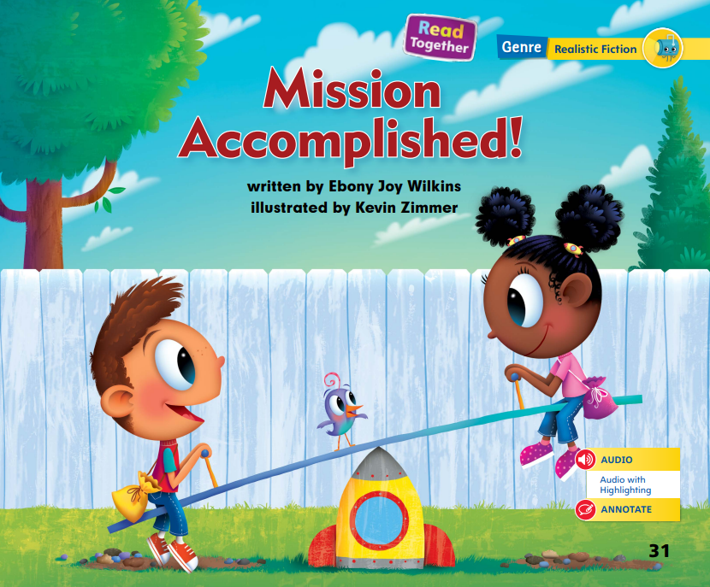
Page 31
First Read – Mission Accomplished!
Notes:
Discuss the First Read Strategies. In this first read, explain the importance of setting a purpose, or reason, for reading an assigned text. One reason I read realistic fiction is to enjoy a good story.
Have students establish a purpose for reading Mission Accomplished! with adult assistance. After students complete the First Read, ask, What did you like? What did you learn? What surprised you?
READ: Have students listen and read along, tracking the print, as you read the text aloud.
LOOK: Look at the pictures. How do they help you understand the text?
ASK: Ask questions to help you understand the text better.
TALK: Talk to a partner about the text.
Help students read the whole text independently, in pairs, or as a whole class.
Use the First Read notes to help students connect with the text and to monitor comprehension

Slide 26
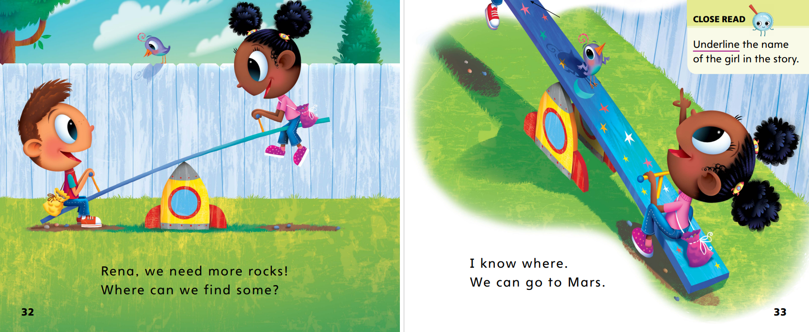
Page 32,33
First Read – Mission Accomplished!
Notes:
Think Aloud: I wonder where this story takes place. Oh, there is a seesaw! I think these children are at a playground or park. That is where I usually see seesaws, swings, and other play equipment. The children are playing at the park, but they are imagining that they are in a rocket ship. That looks like fun!

Slide 27
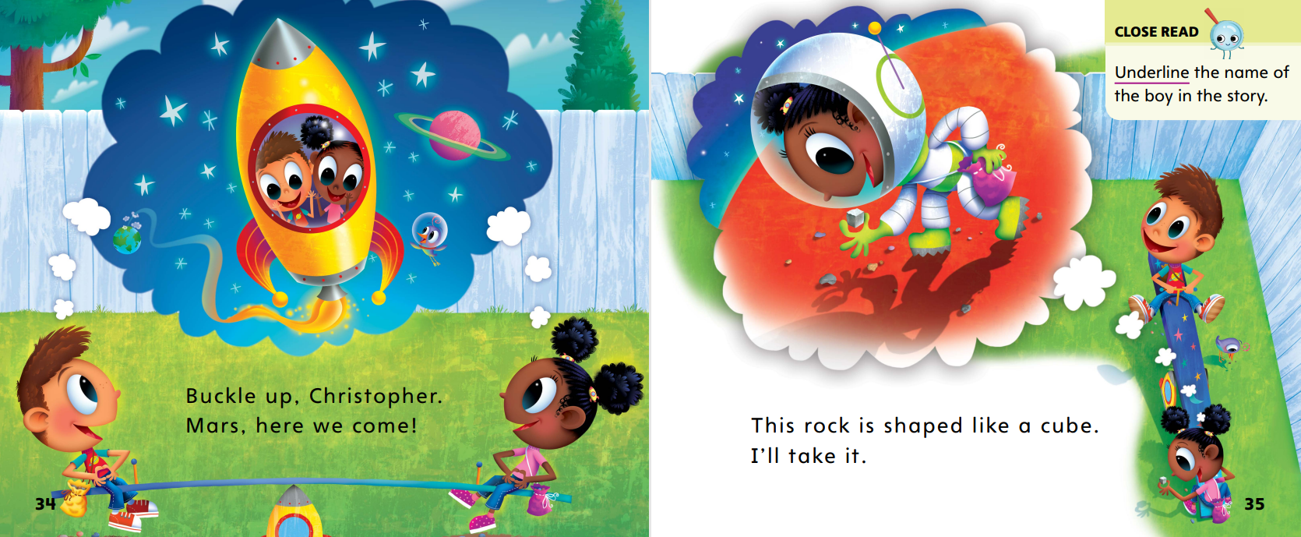
Page 34,35
First Read – The Life of a Frog
Notes:
Read together.

Slide 28
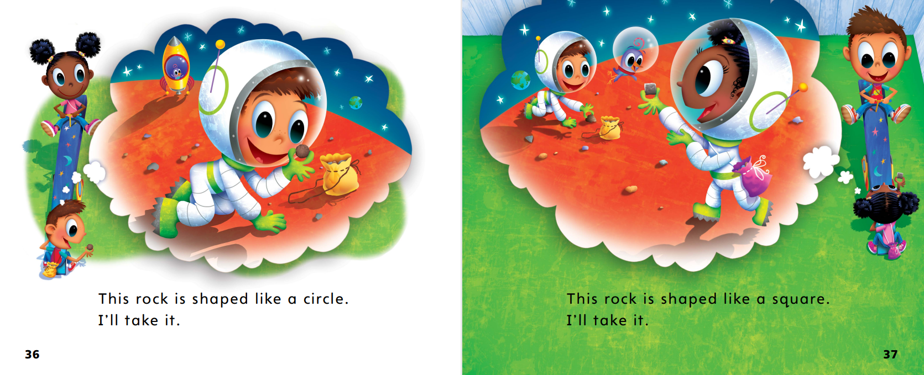
Page 36,37
First Read – Mission Accomplished!
Notes:
Read together.

Slide 29
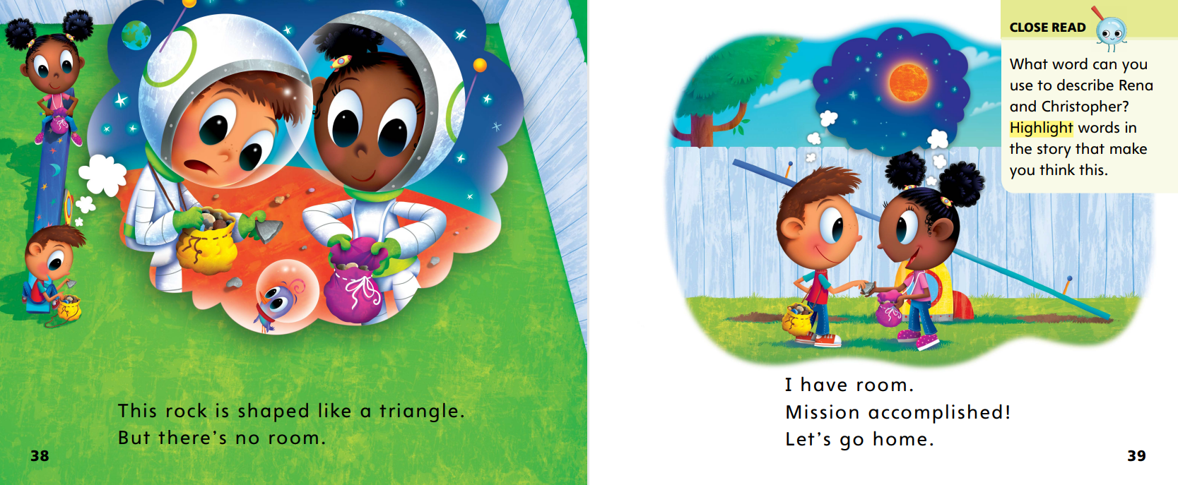
Page 38,39
First Read – Mission Accomplished!
Notes:
Read together.
THINK ALOUD I read the word triangle on page 38, but I cannot remember what a triangle is. What can I do? I will look at the picture. Christopher is holding a rock that has three sides. Yes, that is what a triangle looks like! Now I know.

Slide 30
Respond and Analyze
Talk Tell a partner whether you would like to play with Rena and Christopher. Use examples from the text to explain your ideas.
Illustrate Characters Draw your favorite character from the story. Tell your partner about your drawing and why that character is your favorite.
Notes:
Use these suggestions to prompt students’ initial responses to reading Mission Accomplished!
Talk Tell a partner whether you would like to play with Rena and Christopher. Use examples from the text to explain your ideas.
Illustrate Characters Draw your favorite character from the story. Tell your partner about your drawing and why that character is your favorite.

Slide 31
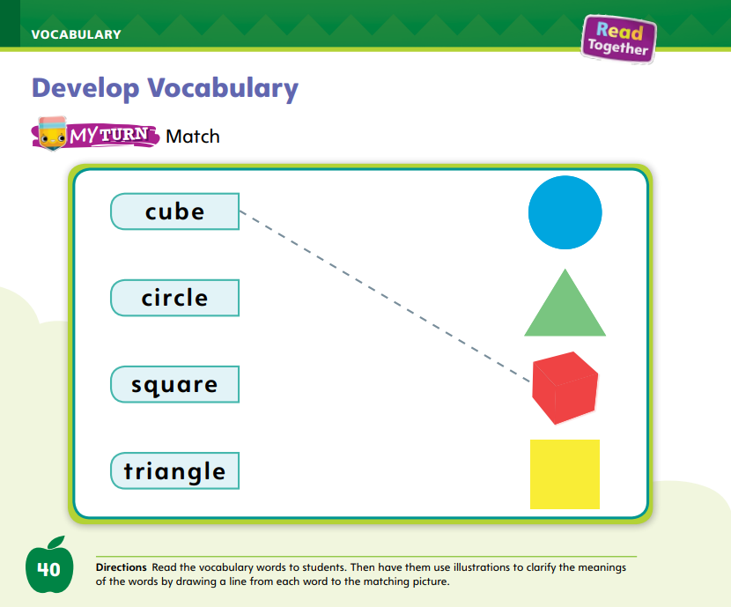
Page 40
Develop Vocabulary
Turn to page 40 in your Student Interactive and complete the activity.
Notes:
Explain to students that the author chose to use the words cube, circle, square, and triangle.
Point out that all of these words tell about the shape of the rocks the children found. Authors use special words to help tell about the topic in a clear way. You may not know the meanings of these words at first, but when you learn them you will know that much more about the topic!
READ: Say the first word.
THINK: Think about the meaning of the word. Try to picture it in your mind.
ASK: What does it look like? How does this word help you understand the topic better?
Have students turn to p. 40 in the Student Interactive. Model how to complete the activity using the word cube.
Read aloud the word cube and have students repeat it chorally.
Then ask students to look at the pictures at the bottom of the page. Which is a picture of a cube?
Model drawing a line from the word cube to the picture. Invite a volunteer to tell you how the word is used in the story.
Have students practice developing vocabulary by completing p. 40 in the Student Interactive.

Slide 32
Page 41
Check for Understanding
Notes:
Have students complete the Check for Understanding on p. 41 of the Student Interactive.
Then explain that familiar words can have more than one meaning. Have students identify another meaning for the verb to park and use it in a sentence.

Slide 33
Writing – Launching Writing Workshop
Good writers
Ask questions
Share ideas
Listen
Notes:
Good writers follow certain steps when they choose an idea and write.
Good writers
ask questions to learn about an idea.
share ideas with each other.
listen to what others say about their writing.
Tell students that they will be writing a lot of books this year. Today, they will spend time reading books and seeing examples of what other authors have written.
Read aloud several stack books so students learn what good writers do and what they will do as they write their own books.
As you read, point out the things students will need to do to write their books: they will learn, they will write, they will talk, and they will share.
As you read each book aloud, have students think about books they could write.

Slide 34
Independent Writing
Let’s read stack books of different genres to gain a better understanding of books.
What did the author have to do to write the book?
Notes:
Focus on understanding books.
Have students read additional stack books of different genres. Students should be reading to gain a better understanding of books.
Encourage them to think about what the author had to do to write the book (learn, write, share, and talk).
WRITING SUPPORT
Modeled Choose a stack book and do a Think Aloud to explain the idea or topic of the writing.
Shared Have students choose a stack book. Prompt students to identify the idea of the text by looking at the pictures in the book.
Guided Use the stack books to provide explicit instruction on how to choose an idea for a writing piece.
Intervention Refer to the Small Group Guide for support
If students show understanding, have them continue writing their own books in stapled booklets.
Call on a few students to share what they think the authors had to do to write books. Encourage them to explain what the author might have learned, shared, or talked about when writing the book.

Slide 35
Page 46
Pre-Spelling
Turn to page 46 in your Student Interactive and complete the activity.
Notes:
Explain that things can be sorted into groups.
For example, the children in the classroom include two groups: boys and girls. Have boys stand in one part of the room and girls in another to demonstrate a concept sort.
Have students turn to p. 46 in the Student Interactive. Explain that they are going to circle pictures of animals.
I see some pictures of animals and some pictures that are not animals. Is a cat an animal? Yes! Let’s circle it. Have students circle the cat.

Slide 36
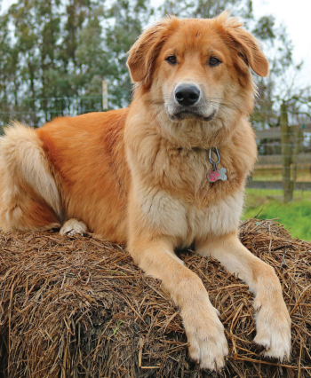
Language and Conventions
Dog
Notes:
Oral Language: Singular Nouns
Tell students that nouns name people and animals.
Point to yourself and say teacher. I am a teacher. The word teacher is a noun that names a person.
Show students a picture of an animal.
Ask what it is. Explain that the word animal is a noun and the word [name of animal on picture] is a noun, too. This is one animal. Its name is one singular noun.
Call on students to name nouns that are animals or people

Slide 37
Lesson 3

Slide 38
Page 19
Phonological Awareness
Turn to page 19 in your Student Interactive.
Notes:
Today we are going to learn a new sound. Listen carefully: /t/ /t/ /t/. The sound /t/ is made by placing your tongue behind your top teeth and then pushing air through, making the sound /t/. Show students how to make the sound /t/ and have them practice it.
Display the tub Picture Card. This is a picture of a tub. Listen to the beginning sound as I say this word: /t/-ub. What sound does tub begin with? Students should supply the sound /t/. Click path -> Table of Contents -> Unit 1 Week 1 Realistic Fiction-> Lesson 3
Then say the following words and have students use a thumbs-up if they hear the sound /t/ at the beginning of the word and a thumbs-down if they hear the sound /t/ at the end of the word: time, pot, fit, toe.
Point to the picture of the tire on p. 19 of the Student Interactive. Listen to the sound at the beginning of this word: /t/ -ire. Tire has the sound /t/ at the beginning.
Have students complete the top half of the page. Continue with final /t/ using the bottom half of the page.

Slide 39
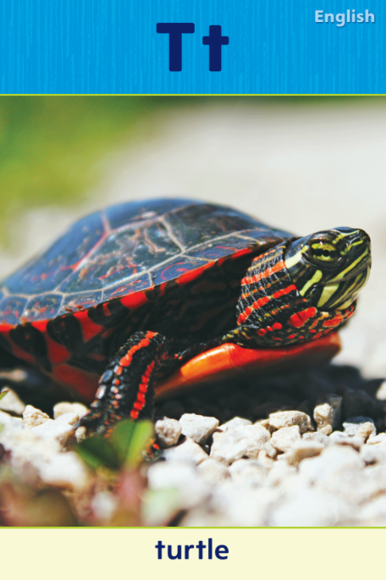
Page 20
Phonics
Turn to page 20 in your Student Interactive and complete the activity.
Notes:
Tell students that the sound /t/ is spelled with the letter t. Display the Tt Alphabet Card. Point to the picture of the turtle and tell students the word turtle begins with t. Point to the letters on the card, and tell students the names of these letters are uppercase T and lowercase t. Click path -> Table of Contents -> Unit 1 Week 1 Realistic Fiction-> Lesson 3
Write Tt on the board and slowly trace the letters as you say the sound /t/.
Have students turn to p. 20 in the Student Interactive. Let’s say the word ten and listen to the beginning sound: /t/ -en. The word begins with /t/. Point to the letter t. Can you identify, or tell me, what letter spells the sound /t/? Students should trace the uppercase and lowercase letters on the page.
Have them point to the letter t and tell you what sound it represents.
Have students complete the activity on p. 20 of the Student Interactive to identify and match the sound for Tt.
If students need additional practice with letter recognition, use the Letter Recognition Unit on SavvasRealize.com or on pp. xvii–xliii in this Teacher's Edition. The unit includes instruction, activities, and student practice sheets.

Slide 40
Page 21
High-Frequency Words
Turn to page 21 in your Student Interactive and complete the activity.
Notes:
Tell students that some words are not spelled the way they sound. These words need to be learned by remembering the letters. Say: When you remember the letters in these words, you will be able to identify and read them.
Have students read the words at the top of p. 21 in the Student Interactive with you: I, am, the.
Have students look at the words at the top of p. 21. Tell them to identify, or point to, the words when you say them. Say the. Pause to let students find and point to the word. Say am. Say I. Repeat the activity until students are familiar with each word.

Slide 41
Page 32
Identify and Describe Characters
Notes:
Remind students that all stories have characters. Characters are the people or animals that the story is about. Authors tell about characters in what they do, say, and think. Identifying and describing the main characters is important for understanding the story.
Look at the pictures. You might be able to tell about characters from what they look like.
Read the text. What do the characters say? Think about what the characters do. Think about how the characters treat each other.
Remind students that they just read a piece of realistic fiction. I will go back and look at the pictures of the characters. From the pictures I can see that they are young children, just like you! Now I will read the text.
Read aloud the first sentence. From this sentence, I learn that the girl’s name is Rena. Now I will look at what the characters say and do.
Flip through the pictures and have students tell you what the characters do, say, and think.
Finally, point out the Close Read notes on pp. 33 and 35 and guide students to underline the names of the characters.

Slide 42
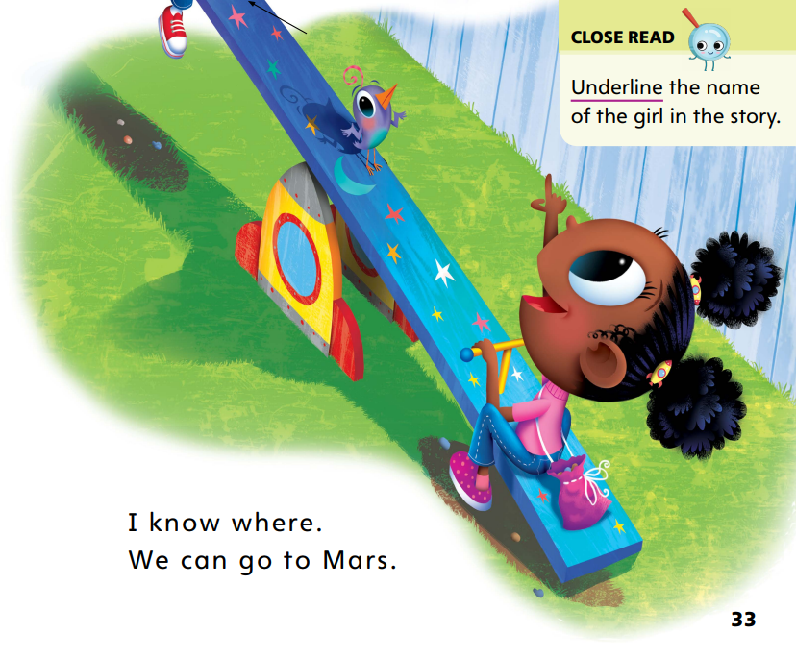
Page
33
Close Read - Identify and Describe Characters
Turn to page 33 in your Student Interactive
Notes:
Close Read: Identify Characters: Remind students that the characters are the people in a story. Who are the characters in this story?
Point out that on the first page the reader learns the girl’s name because the boy is talking to her.
Reread the page and have students underline her name. Then have them find and underline the boy’s name on p. 34. DOK 1

Slide 43
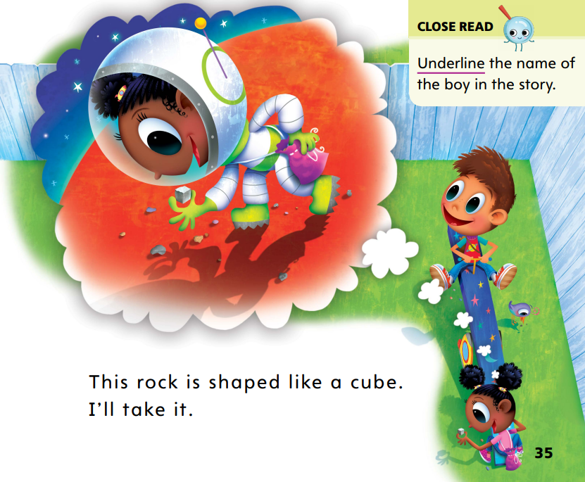
Page 35
Close Read - Identify and Describe Characters
Turn to page 35 in your Student Interactive
Notes:
Describe Characters How would you describe Rena and Christopher?
Tell students that when we describe a character, we use words to tell about him or her.
We can describe how a character looks or how a character acts. Reread the pages and ask students to highlight words that help them understand the characters. (The characters are imaginative and adventurous. They like to share.) DOK 1

Slide 44
Page 42
Identify and Describe Characters
Turn to page 42 in your Student Interactive and complete the activity.
Notes:
Have students complete the My Turn activity on p. 42 by writing in the names of the characters.
Have them find the names they underlined and write them on the lines on p. 42.

Slide 45
Handwriting
Notes:
Show students the alphabet. Remind them that some letters in the alphabet include straight lines and others include curved lines.
Tell them that they practiced drawing vertical lines that go up and down. Have them draw a vertical line in the air. Letters also have lines that go across. These are called horizontal lines.
Make a horizontal line on the board. Tell students that when they write a letter, they should always start at the left and go right.
Have students draw horizontal lines in the air as you model. Check to see that they are starting from the left and drawing to the right (because some students will not know their left from their right).
Have students make a horizontal line with their fingers on their desks. Click path: Table of Contents -> Resource Download Center -> Handwriting Practice -> U1W1L1 Handwriting Practice
Provide students with paper and pencils or trays of sand and ask them to practice drawing horizontal lines.
Remind them to start at their left and move straight to the right. Have them practice making long lines and short lines.

Slide 46
Page 50
Writing – Launching Writing Workshop
Turn to page 50 in your Student Interactive and complete activity.
Notes:
Authors think about an idea for their writing, learn about the topic, write about the idea, and talk about their work.
Read aloud several stack books of different genres.
Tell students that they can choose to write any kind of book in this unit and about any idea.
As you read, point out that there are words and pictures on each page. Ask students what they notice about each book.
For example, students might notice that the words and pictures go together to give information or tell a story.
After reading the books, ask students to think of ideas they can write about. Make a list on the board.
Remind students to share and talk about different ideas to help them think of topics for their own books and how they will write them
Have students complete p. 50 in the Student Interactive

Slide 47
Independent Writing
Let’s focus on parts of books.
Let’s look at some stack books to better understand how words and pictures work together.
What do good writers do?
Notes:
Focus on parts of books
Provide students with additional stack books to gain a better understanding of books, how words and pictures work together, and what good writers do.
WRITING SUPPORT
Modeled: Using a stack book, do a Think Aloud about how the author can stay on topic.
Shared: Guide students to think of three sentences that stay on topic with their idea.
Guided: Prompt students to talk about ways they will stay on topic. Intervention Refer to the Small Group Guide for support
If students show an understanding of the parts of books and what good writers do, they can begin writing in stapled books.
If time allows for individual conferences, see the Conference Prompts on p. T302.
Call on a few students to share what they learned about good writing from the stack books. Students can also share some of the ideas they have for writing their own books

Slide 48
Language and Conventions
The cat is fat.
This is a girl.
This chalk is white.
Notes:
Write the following sentence on the board: The cat is fat.
Read the sentence. Then have students read with you as you point to each word. Ask them to say the word that is a noun. Remind them that a noun names people or animals.
Model another example.
Using pictures from the Student Interactive text, point out examples of a person and an animal.
Ask partners to look through their books to find pictures of people and animals.
Continue by pointing to other things in the room and asking which word in the sentence is a noun: This is a girl. This chalk is white.

Slide 49
Lesson 4

Slide 50
Phonics
mat
tap
Notes:
Hold up the ten Picture Card and tell students that it is the number ten. I hear the sounds /t/ /e/ /n/ in the word ten. The sound /t/ is at the beginning of the word. Say the sound /t/ with me. Turn over the card and show students the spelling of the word. Point to the t and say /t/. Do you hear the sound /t/? What letter spells the sound /t/? Click path -> Table of Contents -> Unit 1 Week 1 Realistic Fiction-> Lesson 4
Have students identify the letter t. Write the letters Tt on the board. Have students trace the letters Tt in the air as you lead them.
Point to the letters Tt on the board. Listen carefully to the following words: mat, tap. Both words have the sound /t/ in them. Listen again: /m/ /a/ /t/, /t/ /a/ /p/. Do you hear the sound /t/ in each word?
Have volunteers identify the word that begins with /t/ and the word that ends with /t/.

Slide 51
Page 22
Apply
Turn to page 22 in
your Student Interactive and complete activity.
Notes:
Have students complete p. 22 in the Student Interactive to identify and match the sound for Tt.

Slide 52
Page 23
Decodable Story
Turn to page 23 in your Student Interactive. Read “I Am” with your partner.
Notes:
Have students turn to p. 23 in the Student Interactive. We are going to read a story today about a man and some animals. Point to the title of the story. The title of the story is I Am. I hear the sound /m/ in the word am. In this story, we will read other words that have the sounds /m/ and /t/.
Remind students of this week’s high-frequency words: I, am, the. Tell them they will practice reading these words in the story I Am. Display the words. Have students read them with you. When you see these words in the story I Am, you will know how to identify and read them.
Read: Have students whisper read the story as you listen in. Then have students reread the story page by page with a partner. Listen carefully as they use letter-sound relationships and the rebus pictures to read words with the sounds /m/ and /t/.
After students have read the story, call their attention to the title. I see the letter m. What sound does the letter m spell?
Help them identify, or say, the sound /m/.
Then have students find and highlight the word with the sound /m/ in the title. I see two words we learned this week in the title. What words do I see? Help students identify, or say, I and am.
Call students’ attention to the sentence on pg. 23. Which words include the sound /m/? Point to them.
Help students identify, or say, the sound /m/. Then have them match the sound and the letter by finding and highlighting the words with the sound /m/.

Slide 53
Page 24,25
Decodable Story
Notes:
Have students turn to pages 24-25. Which words include the sound /t/? Point to them.
Help students identify, or say, the sound /t/.
Then have them match the sound and letter by finding and underlining the words that start with the sound /t/.

Slide 54
Page 31
Use Text Evidence
Notes:
Tell students that readers need to be able to support their answers to questions by using evidence or examples from the text.
Remember that text evidence is a word or picture clue that backs up an answer or idea you have.
Think about the words that tell what a character says or does. What do the words tell you about the character?
Look at the pictures. What do they show you about how the character looks? What do they show you about how the character feels?
Remind students that they are reading realistic fiction and the characters are pretending that they are on Mars. Model how you would find text evidence to learn more about the characters in Mission Accomplished! I believe the characters in Mission Accomplished! are happy because they are pretending they are on Mars. They are smiling as they pick up different rocks. Now I will read the text. Rena is suggesting that they go to Mars. She is using her imagination. I can tell that she has a good imagination from what she says.

Slide 55
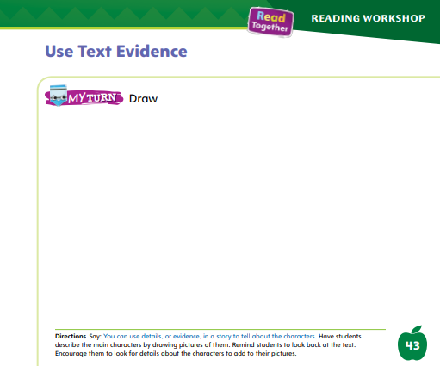
Page 43
Use Text Evidence
Turn to page 43 in your Student Interactive.
Notes:
Have students use the strategies for identifying and describing characters through text evidence.
Have students draw a picture of Rena and Christopher to show details from the story that show what they are like.

Slide 56
Writing – Launching Writing Workshop
Authors have conferences with people called editors.
Editors help writers improve their writing.
Notes:
Writers share their writing with others.
Writers listen to what people say and then make changes to improve their writing.
Explain that during Independent Writing, students will independently write their books every day.
They will work quietly at their desks in their stapled booklets and produce texts just like authors do.
Explain that authors also have conferences with people called editors. Editors help writers improve their writing.
Tell students that while they work independently, you will have individual conferences to help them improve their writing.
Ask: What do you think of conferencing? How could it help with your writing?
Read a stack book aloud. Before reading, say: Let’s read this book and think about how the writer might have had a conference with an editor to improve the book.
After you read the book, have students discuss how conferences might have helped to make the book better.

Slide 57
Independent Writing
Now you will begin writing in your stapled booklets.
Notes:
Focus on writing
Have students begin or continue writing in their stapled booklets.
WRITING SUPPORT
Modeled: Use a stack book to make suggestions for improvement.
Shared: Prompt students to add descriptive details to their writing so others can learn more about the idea.
Guided: Use the stack books to provide explicit instruction on how details add more information to a text.
Intervention Refer to the Small Group Guide for support.
See the Conference Prompts on p. T302.
Call on a few students to share what they think writers might learn by having conferences with their editors.
Have students share how they think having a conference will help them with their writing. Click path: Table of Contents -> Resource Download Center -> Writing Workshop Conference Notes
At the end of writing time, have a few students share their topic ideas and how they chose them.

Slide 58
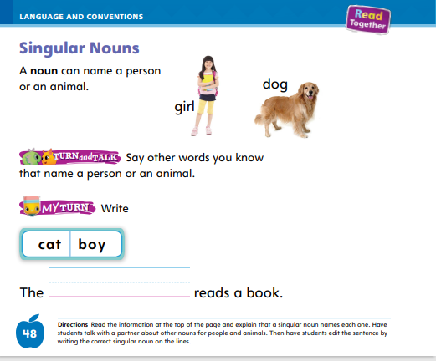
Page 48
Language and Conventions
Turn to page 48 in your Student Interactive and complete the activity.
Notes:
Have students say and write singular nouns to complete the practice activity on p. 48 in the Student Interactive.

Slide 59
Lesson 5

Slide 60
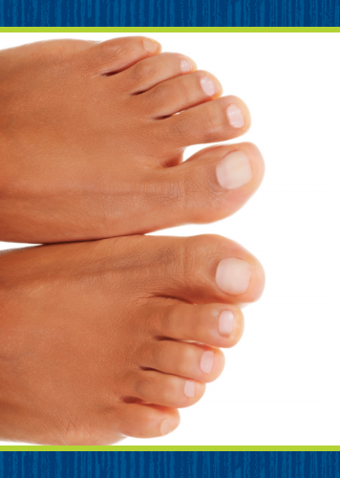
Phonological Awareness
Notes:
Tell students that alliteration is when a group of words all begin with the same sound. Listen to this sentence: Tommy Tiger tickles toes. What sound does the word Tommy begin with? (/t/) Continue with Tiger, tickles, and toes. All the words begin with the same sound. What sound do the words Tommy Tiger tickles toes begin with? Yes, /t/. Have students repeat the sentence after you.
Display the taxi, tulip, and toes Picture Cards. These picture words all begin with the same sound. Let’s say these three words. Click path -> Table of Contents -> Unit 1 Week 1 Realistic Fiction-> Lesson 4
Say the words and have students repeat after you. What sound do you hear at the beginning of taxi, tulip, and toes? Students should supply the sound /t/.
Then say the following groups of words and have students touch their toes if the words all begin with the same sound.
Have them stand still if the words do not all begin with the same sound: top, tidy, Tim; John, fan, feather; man, map, mud.
Repeat the alliterative groups of words again and have volunteers tell you what sound the words all begin with.

Slide 61
Phonics
Mm
Tt
man
mop
tan
mill
tin
ton
mat
Tim
Notes:
Write the letters Mm and Tt on the board. Have students identify the letters as you point to them. Then review the sound for each letter: m /m/, t /t/.
Ask students to say the sound as you point to each letter.
Tape an Mm or a Tt card on each student.
Then write the word man on the board. I will read this word. If you hear the sound /m/, stand up if you have an m taped to you. If you hear the sound /t/, stand up if you have a t taped to you.
Point to the letter m as you read the word aloud. Repeat with the words mop, top, tan, mill, tin, ton, mat, and Tim.

Slide 62
Page 26
Apply
Turn to page 26 in
your Student Interactive and complete activity.
Notes:
Have students turn to p. 26 in the Student Interactive and read the words with a partner.

Slide 63
High-Frequency Words
I
am
the
Notes:
Remind students that high frequency words are words that appear over and over in texts.
Remind them they will be learning many of the words this year, and the words will help them become better readers.
Say the word I and ask students what letter spells the word.
Have students
say the word I as you write it on the board.
repeat with am and the.
read the words aloud.

Slide 64
Page 44
Reflect and Share
Turn to page 44 in
your Student Interactive.
Notes:
Explain to students that they will often be asked to write or draw to tell about what they have learned.
There are several steps students can do to prepare to write or draw to tell something about a story.
They can
listen carefully to the question that the teacher is asking.
think about what they know about this topic.
look back at the picture and text to find text evidence that supports their answer.
think about how to tell this answer in a drawing or words.
look at the drawing or writing after they have drawn it or written it to check that it answers the question.
Model sharing ideas and information about other characters you have read about.
I am going to think about a character in another book I read. I read a book about a girl named Lily. She reminds me of Rena because she also had a good imagination. Lily used her imagination when she played with blocks to make her living room into a big city!

Slide 65
Page 44
Apply
How does imagination make a place seem different?
Notes:
Have students use the strategies for making comparisons across texts.
Have students turn to p. 44 in the Student Interactive and draw a picture of a character from another book to show how the character is similar to Rena or Christopher. Then have students share their pictures with the class.
Have students talk to a partner to respond to the Weekly Question. Tell them to share examples from the stories they have read and their own experiences.

Slide 66
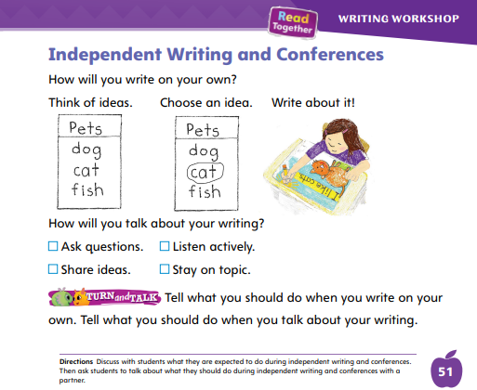
Page 51
Writing – Launching Writing Workshop
Turn to page 51 in your Student Interactive and complete the activity.
Notes:
Authors listen to suggestions that other people give them about their writing. Authors may change words, characters, ideas, and other parts of a writing piece because they listened to the suggestions.
They do this by
asking for suggestions or ideas;
listening closely to what others say; and
changing words or sentences to edit the book.
Tell students that during Conferences, they will meet with you to receive feedback, or information about what they are doing well and how they might improve their book.
Say: Let’s talk about what it means to make suggestions and what we could do to make changes based on those suggestions.
Pretend you are the author of a stack book. Model asking students for suggestions and responding to them.
Ask: What can I change about the book to make it better?
Model how to respond to suggestions.
Rewrite parts of the book to include some student suggestions. Have students complete p. 51 in the Student Interactive
If desired, distribute Speaking and Listening tips from the Resource Download Center. Click Path: Table of Contents -> Resource Download Center -> Speaking and Listening

Slide 67
Language and Conventions
See the big dog.
Which word in the sentence is an example of the noun?
See
The
Big
dog
Notes:
Standards Practice Display the following sentence and guide students to complete the question.
(1) See the big dog.
Which word in the sentence is an example of a noun?
A see
B the
C big
D dog
Have students complete Language and Conventions, p. 24, from the Resource Download Center. Click path: Table of Contents -> Resource Download Center -> Language and Conventions -> U1 W1

Slide 68
Unit 1: Week 1
Grade K

