Slide 1
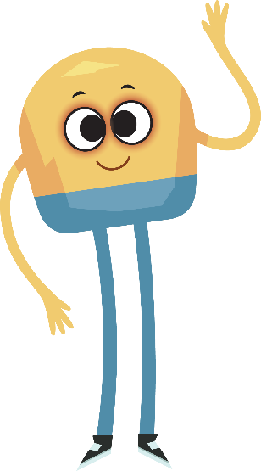
Unit 1: Week 2
Grade K

Slide 2
Copyright © Savvas Learning Company LLC. All Rights Reserved.
This publication is protected by copyright, and permission should be obtained from the publisher prior to any prohibited reproduction, storage in a retrieval system, or transmission in any form or by any means, electronic, mechanical, photocopying, recording, or otherwise. For information regarding permissions, request forms, and the appropriate contacts within the Savvas Learning Company Rights Management group, please send your query to:
Savvas Learning Company LLC, 15 East Midland Avenue, Paramus, NJ 07652
or
k12learningpermissions@savvas.com
myView Literacy® is an exclusive trademark of Savvas Learning Company LLC in the U.S. and/or other countries.

Slide 3
Lesson 1

Slide 4
Page 54
Phonological Awareness
Notes:
Tell students that today they will learn a new sound. Listen carefully as I say the sound: /a/ /a/ /a/.
When you make the sound /a/, feel where your tongue and jaw are. Your tongue and jaw should be down.
Have students turn to p. 54 in the Student Interactive. Tell them that they will be circling the pictures that have the sound /a/ in the middle.
Point to the picture of the sack. Listen to the sounds as I say this word: /s/ /a/ /k/. Does sack have the sound /a/ in the middle? Yes, it does: /s/ /a/ /k/. Let’s circle the sack.
Name each picture on p. 54 with students. Then have them circle the pictures with the middle sound /a/.

Slide 5
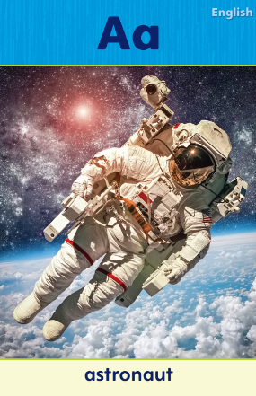
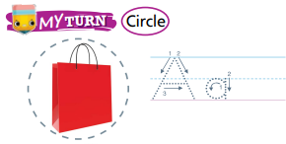
Page 55
Phonics
Trace the words on page 54 in your Student Interactive.
Notes:
Hold up Alphabet Card Aa. Have students say astronaut with you. Let’s say the sound at the beginning of the word: /a/ /a/ /a/. The sound /a/ is spelled with the letter a. Point to the letters Aa on the Alphabet Card. Click path -> Table of Contents -> Unit 1 Week 2 Realistic Fiction -> Lesson 1
Write the letters A and a on the board and have students trace the letters in the air with their fingers. Tell them that you will say a group of words. Direct students to clap when they hear a word with the middle sound /a/. Use the following words: map, tap, mom, top, mat, sat, rice, ran, had.
Have students turn to p. 55 in the Student Interactive.
Point to the letter a and tell me the sound it makes. Now we will circle each picture that has the sound /a/. Say the word bag, emphasizing the sound /a/. Does this word have the sound /a/? Yes, it does, so we will circle it.
Tell students to complete the activity, circling the pictures that have the sound /a/ and tracing the letters Aa on the lines by each picture they circled.
If students need additional practice with letter recognition, use the Letter Recognition Unit on SavvasRealize.com or on pp. xvii–xliii in this Teacher’s Edition.
The unit includes instruction, activities, and student practice sheets.

Slide 6
High-Frequency Words
like
to
a
Notes:
Display the high-frequency words like, to, and a.
Point to the word like and read it.
Have students identify the word like by pointing to it, and then have them read it.
Repeat for to and a.

Slide 7
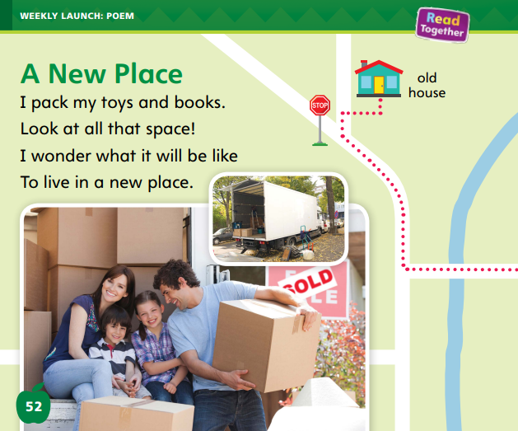
Page 52,53
Interact with Sources
Essential Question: What makes a place special?
Weekly Question: What is exciting about moving to a new place?
Notes:
Remind students of the Unit Essential Question: What makes a place special?
Then introduce them to the Weekly Question: What is exciting about moving to a new place?
Tell them that a new place is somewhere that we have not been to before. A place can be special because it is new and exciting.
Have students follow along as you turn and point to the poem on p. 52 of the Student Interactive.
Explain that moving to a new place can be exciting because you get to experience new things.
Then read the poem “A New Place.”
Ask students how the author feels about moving to a new place.
Have students explain what the map and pictures show about moving to a new place.
Have students tell about how they would feel about moving to a new place. Encourage students to ask questions about the poem to clarify anything they do not understand
Have students interact with sources by using the pictures and text on pp. 52–53 to talk about moving to a new place.
Point out the Week 2 question: What is exciting about moving to a new place?
Tell students that they just read about some of the fun experiences people can have when they move. Moving can include making new friends and going to new places.
Ask students to think about the weekly question, and tell them that over the week they will have more chances to think about moving to new places.

Slide 8
Listening Comprehension
Plot
Problem:
Resolution:
Notes:
Read Aloud: Tell students that they will listen to a realistic fiction story. Realistic fiction is a made-up story that could really happen.
Stories have a problem, and the problem is usually solved by the end of the story. When a problem in a story is solved, it is called a resolution. Have students listen as you read aloud the realistic fiction story.
Encourage students to be active listeners by looking at you and thinking about what you are saying as you read aloud.
Purpose Have students listen actively for the problem and how it is solved (the resolution).
READ: the entire text aloud without stopping for the Think Aloud callouts.
REREAD: the text aloud, pausing to model Think Aloud strategies related to the genre.
Use the chart to help students identify the problem at the beginning and the resolution at the end of the story.

Slide 9
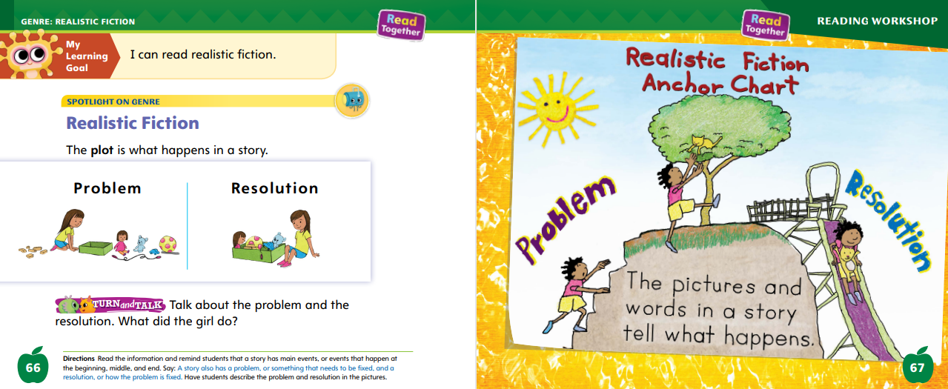
Page 66
Realistic Fiction
Turn to page 66 in your Student Interactive.
Notes:
Tell students that realistic fiction has a plot, or the events in a story.
Every story has a problem, or something that needs to be fixed. The events in a story usually work toward fixing the problem.
Stories have made-up events, or things that happen during the story.
The resolution is how the problem is fixed. It usually happens near the end of the story. Readers look for the problem, events, and resolution in a story. Knowing them helps a reader better understand a story.
Have students turn to p. 66 of the Student Interactive.
Read aloud the line of text. Say: When I read, I will think about the problem that a character needs to solve and how it is solved. In the first picture, there are toys all over. This is a problem that the character, a girl, needs to solve. The second picture shows the resolution, or how the problem was solved. It shows all of the toys put in the toy box. The girl cleaned up her toys. Read the Anchor Chart on p. 67 together.
Editable Anchor Chart Click Path: Table of Contents -> Reading Anchor Charts -> Unit 1 Week 2: Realistic Fiction Editable Reading Anchor Chart

Slide 10
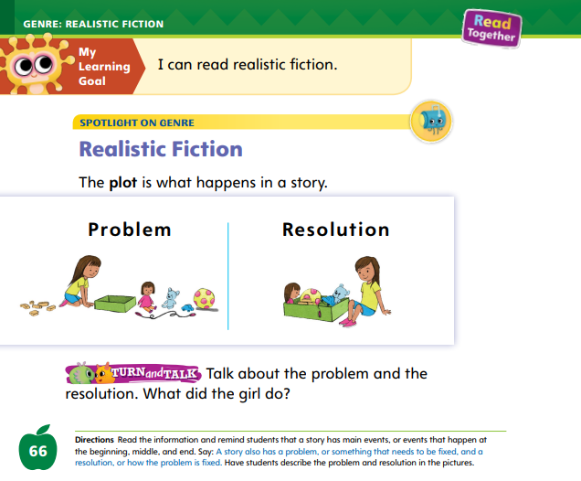
Page 66
Apply
Talk about the problem and the resolution. What did the girl do?
Notes:
Have students turn and talk with a partner about the problem and resolution shown in the pictures on p. 66 in the Student Interactive.
Students should use the words problem and resolution in their discussions.

Slide 11
Academic Vocabulary
Synonyms are words that mean the same thing.
Antonyms are words that mean the opposite.
big
large
big
small
Notes:
Explain that synonyms are words that mean the same thing, and antonyms are words that mean the opposite. Guide students to use these strategies to decide if two words are synonyms or antonyms.
Read the first word. What does it mean?
Read the second word. What does it mean?
Ask yourself if the words’ meanings are the same or different.
Model an example. Say big, and ask students to say a word that means the same thing. (large) Say big again, and ask students to say a word that has the opposite meaning. (small)
Explain that students may know that move means “to go from one place to another.” Tell them the word move here means “to go to a new home.”
Model finding synonyms and antonyms for the word move on p. 83. These people are holding boxes. They are moving to a new house. This means they are going somewhere else to live. I need to think of a word that means the same as move and the opposite of move.
Read aloud the words by the picture.

Slide 12
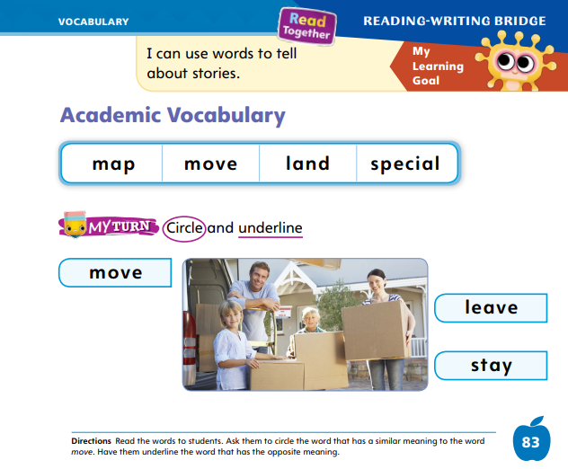
Page 83
Apply
Circle and underline on page 83 in your Student Interactive.
Notes:
Have students work independently or with a partner to circle the word that means the same as move and underline the word that has the opposite meaning.

Slide 13
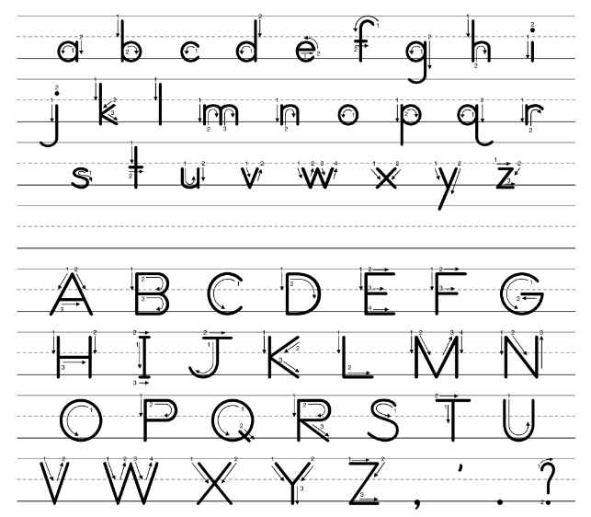
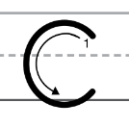
Handwriting
Notes:
Show students the alphabet. Point out letters with straight lines with which they are familiar.
Some letters have straight lines, but other letters have curved lines.
Point out letters with curved lines with which students are familiar.
The letter Cc has a curved line. To write letters correctly, you need to be able to write both straight and curved lines.
Write the name Carl on the board. Point to the uppercase C. This is uppercase C. We use uppercase letters to begin sentences and names. Watch as I trace the uppercase C. I start at the top, curve down backwards, and then curve up.
Show students where to begin the letter and how to circle around. Have students trace uppercase C in the air. Then repeat with lowercase c. Click path: Realize -> Table of Contents -> Resource Download Center -> Handwriting Practice -> U1W2L1 Handwriting Practice

Slide 14
Writing – Launch Writing Workshop
cover – shows the title, the author/illustrator names, and a picture that tells us something about the book.
back cover- gives more information about the book and sometimes contains an author biography.
title page- shows the title and the author/illustrator.
Notes:
Every book includes the following parts:
a cover that shows the title, the author/illustrator names, and a picture that tells us something about the book.
a back cover that gives more information about the book and sometimes contains an author biography.
a title page that shows the title and the author/illustrator.
Display a few stack books and identify the front cover, back cover, and title page of each book for students.
Hold up a final book and have students help you name its parts.
As you read the information on each of those pages, point to the words.
Have students notice where the title of the book is often placed.
Where are the author’s and illustrator’s names shown? Next, tell students you want to write a book about frogs. Ask: What should the title be? As you draw a mock cover, think aloud about where to place the title.
I want readers to see my title right away. I will write my title in the top center of the front cover.
Next, think aloud about where to place the author’s name. I am the author of this book, so I will write my name. I will write my name under the title of the book.
Repeat the Think Aloud as you create a back cover and title page.
Have students complete p. 87 in the Student Interactive.

Slide 15
Independent Writing
Let’s design a front and back cover for your book.
Let’s include a title page.
Where do we place information in a book?
Notes:
After the minilesson, students should begin writing independently. Remind them to design a front and back cover for their book and to include a title page.
Modeled: Think aloud as you model your work.
Shared: Create a short checklist that includes title, author name, and illustrator name for students to follow.
Guided: Prompt students to think about where to place information in a book.
Intervention Refer to the Small Group Guide for support.
If students have already created a cover and title page, they may continue writing.
See the Conference Prompts on p. T326. Click path: Table of Contents -> Resource Download Center -> Writing Workshop Conference Notes
Call on a few students to share their covers. Encourage students to talk about how they chose the titles for their books.

Slide 16
Language and Conventions
singular nouns
person | animal
teacher firefighter | rabbit dog
Notes:
Review with students that singular nouns can name a person or an animal.
Write the categories person and animal on the board. Call on volunteers to name examples of people and animals.
Provide examples of singular nouns if needed: teacher, firefighter, rabbit, dog. Ask students to help you list them in the correct category.
Pair students and have them take turns telling singular nouns that name a person or an animal. Their partner should say which category each word falls into.

Slide 17
Lesson 2

Slide 18
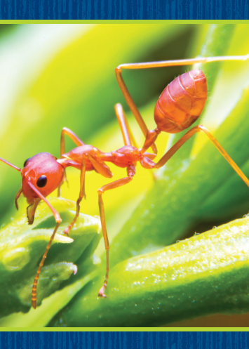
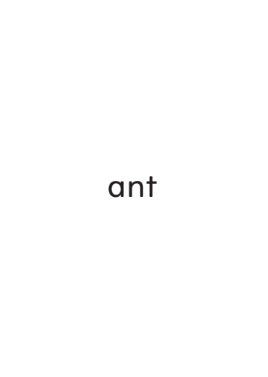
Page 56
Phonics
Turn to page 56 in your Student Interactive.
Notes:
Hold up the ant Picture Card and tell students that it is a picture of an ant. This is an ant. I hear the sound /a/ at the beginning of ant. Say the sound /a/ with me. Turn over the card and show students the spelling of the word. Point to the a and say /a/. What letter makes the sound /a/? Click path -> Table of Contents -> Unit 1 Week 2 Realistic Fiction -> Lesson 2
Have students identify the letter a. Then have students write the letters Aa in the air as you lead them.
Write the word mat on the board. Listen carefully as I read the word: /m/ /a/ /t/, mat. Do you see any of the letters you have learned already?
Have a volunteer identify the letters m, a, and t. What sounds do these letters make? Students should identify the sounds /m/, /a/, and /t/. Repeat with the name Tam.

Slide 19
Page 56
Apply
Turn to page 56 in your Student Interactive and complete the activity.
Notes:
Have students complete p. 56 in the Student Interactive.

Slide 20
High-Frequency Words
like
to
a
Notes:
Tell students that high frequency words are words that they will hear and see over and over in things they read.
Write and read the sight words like, to, and a.
Have students
repeat the words after you.
spell each word, hopping as they say each letter.

Slide 21
Page 68
Preview Vocabulary
crawls
peeks
unpacks
plunks
Notes:
Introduce the words crawls, peeks, unpacks, and plunks on p. 68 in the Student Interactive.
Explain the meaning of each word.
Prompt students to share what they already know about the words.
Ask questions such as: Have you peeked at a book to see what will happen later? Do you unpack before or after a trip? Can you think of an animal that crawls? How is crawling different from walking? Act out the words with me. These words will help us understand the story Too Many Places to Hide.

Slide 22
First Read Strategies
What questions did you have while reading?
What questions did you have after reading?
Notes:
Have students generate questions about the text with adult assistance before reading to gain new information.
Then discuss the First Read Strategies. In this first read, encourage students to read for understanding and enjoyment.
After students complete the First Read ask:
What questions did you have while reading?
What questions do you have after reading?
FIRST READ STRATEGIES
READ: Encourage students to read or listen as you read the text. During the first reading, students should work to understand what the text is about.
LOOK: Remind students to look at the pictures to help them understand the text.
ASK: Have students generate, or ask, questions to deepen understanding.
TALK: Guide students to talk to a partner about the text.

Slide 23
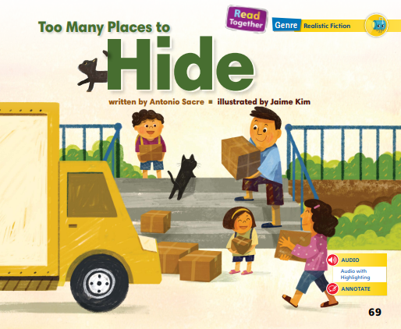
Page 69
First Read – Too Many Places to Hide
Notes:
Read Together.
Think Aloud: If I ask myself questions before I read, they can help me pay attention as I read. I see that the title is Too Many Places to Hide. This makes me wonder: “Who is hiding? Why is this character hiding?” As I read, I will see if I can find the answers to these questions in the words and the illustrations.

Slide 24
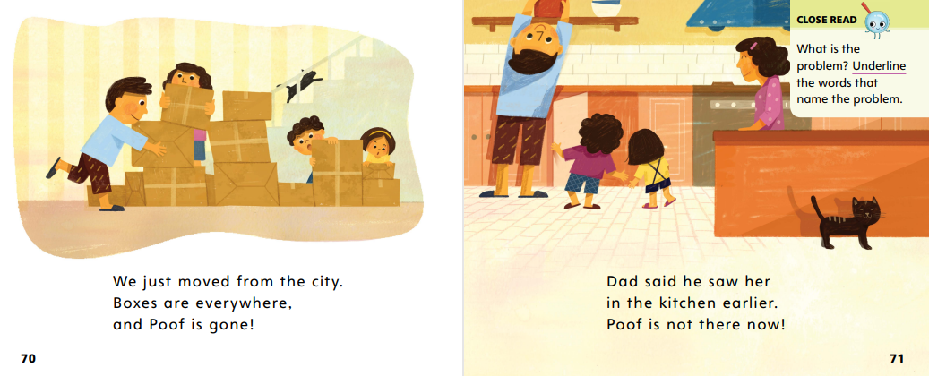
Page 70,71
First Read – Too Many Places to Hide
Notes:
Read together.

Slide 25
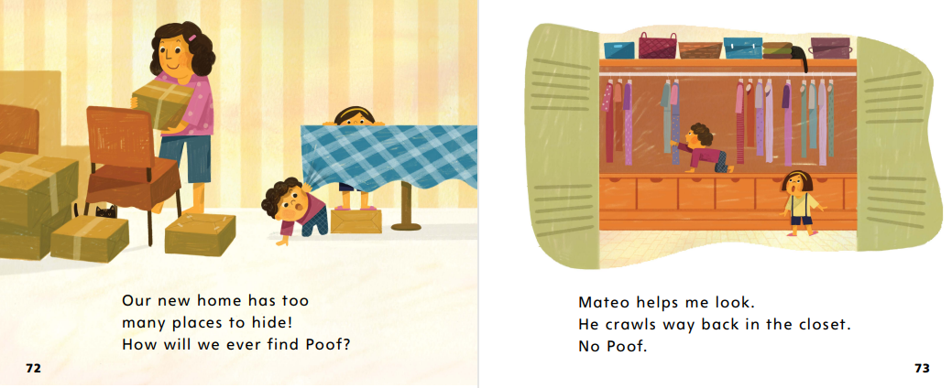
Page 72,73
First Read – Too Many Places to Hide
Notes:
Read Together.

Slide 26
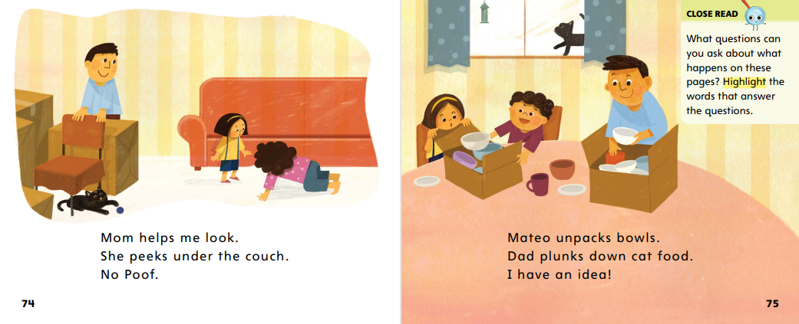
Page 74,75
First Read – Too Many Places to Hide
Notes:
Read together.
THINK ALOUD: When we talk about what we’re reading, it can help us better understand it. This story reminds me of a time when I went on vacation and brought my cat Ovi. He disappeared. I looked everywhere, but I couldn’t find him. He finally came out of his hiding place when he got hungry. Talking about my story can help us better understand this story.

Slide 27
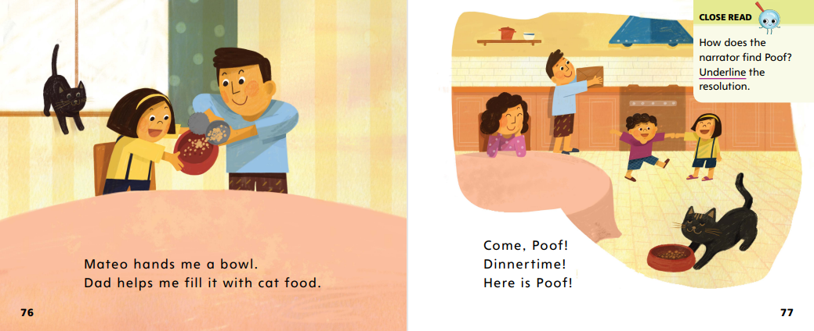
Page 76,77
First Read - Too Many Places to Hide
Notes:
Read Together.

Slide 28
Respond and Analyze
Retell- Tell a partner about the part of the story you enjoyed the most.
Illustrate Events- Draw either the problem or the resolution of the story. Then discuss with your partner how your drawings illustrate the events.
Notes:
Use these suggestions to prompt students’ initial responses to reading Too Many Places to Hide.
Retell Tell a partner about the part of the story you enjoyed the most.
Illustrate Events Have students draw either the problem or the resolution of the story.
Then have partners discuss how their drawings illustrate the events.

Slide 29
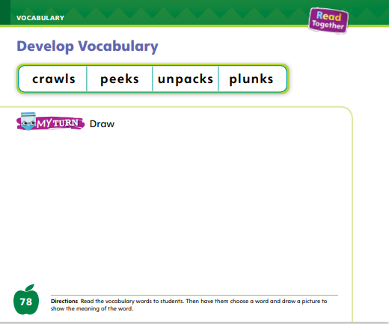
Page 78
Develop Vocabulary
Turn to page 78 in your Student Interactive and illustrate a picture using one word.
Notes:
Tell students that authors choose words carefully.
The words unpacks, plunks, peeks, and crawls can be used to talk about the problem and the resolution in Too Many Places to Hide.
Read the word and the sentence in which it is used.
Look for illustrations that help you understand the word.
Think about how this word shows what happens in the story.
Have students turn to p. 78 in the Student Interactive. Ask students to look at the words. Which word would you like to illustrate with a picture?
Have students practice developing vocabulary by completing p. 78 in the Student Interactive.

Slide 30
Page 79
Check for Understanding
Notes:
Have students complete the Check for Understanding on p. 79 of the Student Interactive.

Slide 31
Writing – Launch Writing Workshop
pages of a book- include words and pictures.
words- are written across the page from left to right.
page numbers- help reads know where they shopped reading.
Notes:
Explain that you can read a book on paper or on a screen. Whether a book is printed on paper or made on a computer, tablet, or phone, most books follow the same rules, such as:
Pages of a book include words and pictures.
Words are written across the page from left to right.
Page numbers help readers know where they stopped reading.
Choose a stack text and point out the parts of a page, such as the words, pictures, and page numbers.
Then tell the class that you are going to write a page for your book, just like these authors did. I am writing a book about frogs. On each page of my book, I will include words, a picture, and a page number. For my first page, I will write the sentence “A frog lives in a pond.” What picture could I draw on this page to go along with the words? I will draw a picture of a frog peeking out from the water. Finally, I need to add a page number. I will write the number 1 in the bottom corner of the page. Now, my first page is complete. Did I forget anything?
Model checking your work to ensure all parts of a page have been included. If time allows, write a second page for your book, allowing students to make suggestions.
Be sure to include words, a picture, and a page number.

Slide 32
Independent Writing
Let’s continue writing in our books.
Add page numbers to your book.
Notes:
During Independent Writing, have students continue writing their books. If necessary, students can begin with words or phrases and edit them to be sentences later.
Some students may only begin with pictures. Remind them to add page numbers to their books.
Modeled Choose a stack text and point out the words, pictures, and page numbers.
Shared As students work, guide them to correctly place the words and pictures in their books.
Guided Provide students with sentence frames. For example, a sentence frame for a book about frogs would be: A frog is _____. Intervention Refer to the Small Group Guide for support.
3. See the Conference Prompts on p. T326. Click path: Table of Contents -> Resource Download Center -+ Writing Workshop Conference Notes
4. Call on a few students to show their work. Ask students to show where they placed the pictures and page numbers. Encourage students to ask the author questions.

Slide 33
Page 84
Pre-Spelling
Turn to page 84 in your Student Interactive and complete the activity.
Notes:
Tell students that some words name things that are in the same group, or category. Provide an example, such as flower, tree, grass. Tell students that these things are in a group, or category, called plants.
Model naming things in the same category. I know that an apple is a food. I can think of other things that are also foods, such as carrots, oranges, lettuce, and bread. These things are all in the food category.
Have students name other things that fit into the category of food. Ask them to name some things that are not food
Have students match the pictures on p. 84 in the Student Interactive, giving help as needed, or work through the activity together to help students identify the categories “food” and “not food” and match the pictures.

Slide 34
Language and Conventions
Singular nouns name a
person, animal, place, or thing.
pencil
cup
desk
Notes:
Tell students that in addition to naming a person or animal, singular nouns also name a place or thing.
Hold up a book and tell students that a book is a thing. Point out other examples of things: pencil, cup, desk.
Tell students that school is a place. Their home is a place too. Ask them to think of other places. (park, grocery store, library)
Tell students that book and school are both singular nouns.
Pair students and have them take turns telling singular nouns that name a place or thing. Their partner should say which category each word falls into.

Slide 35
Lesson 3

Slide 36
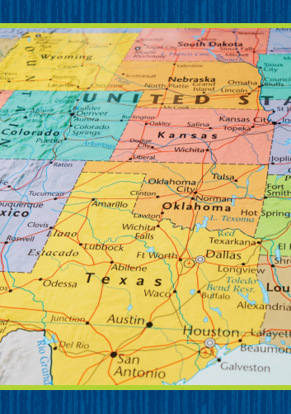
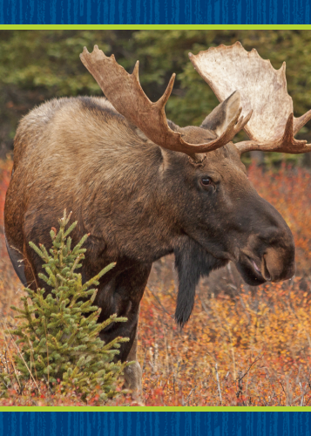
Phonological Awareness
Notes:
Sometimes a group of words begin with the same sound. Listen: Sam sings sweet songs. All the words begin with the same sound. What sound do the words begin with? Yes, /s/.
Display Picture Cards map, moon, and moose. Click path -> Table of Contents -> Unit 1 Week 2 Realistic Fiction -> Lesson 3
Say: These picture words begin with the sound /m/. When a group of words has the same beginning sound, it is called alliteration. Let’s say that word together: alliteration. Say the following groups of words, and have students touch their toes if the words all begin with the same sound: tiger, toes, top; mom, sail, tip; my, meal, mall.
Repeat the alliterative groups of words again, and have volunteers tell you what sound each group of words begins with.

Slide 37
Page 57
Phonological Awareness
Turn to page 57 in your Student Interactive and complete the activity.
Notes:
Point to the picture of the sun on p. 57 of the Student Interactive.
This is a sun. Sun has the sound /s/ at the beginning.
Have students name the pictures in the first row and circle the picture words that begin with the sound /s/. Continue with the second row.

Slide 38
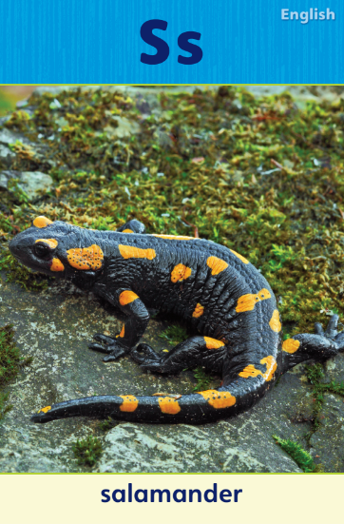
Page 58
Phonics
Turn to page 58 in your Student Interactive and complete the activity.
Notes:
Display the Alphabet Card Ss. Point to the picture of the salamander and tell students the word salamander begins with the sound /s/. The sound /s/ is spelled with the letter s. Click path -> Table of Contents -> Unit 1 Week 2 Realistic Fiction -> Lesson 3
Write letters S and s on the board. Have students turn to p. 58 in the Student Interactive and trace the letters on the first line.
Say: Point to the letter s and tell me the sound it spells. Say the picture words in the first row with students. Which words begin with the sound /s/? The words sun and sandwich begin with the sound /s/. Let’s underline those two pictures.
Have Students complete the activity on p. 58.
If students need additional practice with letter recognition, use the Letter Recognition Unit on SavvasRealize.com or on pp. xvii–xliii in this Teacher’s Edition. The unit includes instruction, activities, and student practice sheets. Click path -> Table of Contents -> Unit 1 Week 2 Informational Text -> Lesson 3

Slide 39
Page 59
High-Frequency Words
Turn to page 59 in your Student Interactive and complete the activity.
Notes:
Tell students that some words are not spelled the way they sound. Students should learn these words by looking at the letters and remembering them.
Say: When you remember the letters in these words, you will be able to identify and read them.
Have students read the words at the top of p. 59 in the Student Interactive with you: a, to, like.
Have students look at the words at the top of p. 59. Tell them to identify and point to each word when you say it. Say a. Pause to let students find and point to the word. Say to. Say like.
Repeat the activity until students are familiar with each word.
Have students read the sentences on p. 59. Ask them to identify the words a, to, and like in the sentences and underline them. Make sure students pronounce the word a /ā/, not /a/.

Slide 40
Page 69
Describe Plot
Notes:
Remind students that all stories have characters. Characters are the people or animals that the story is about. Authors tell about characters in what they do, say, and think. Identifying and describing the main characters is important for understanding the story.
Look at the pictures. You might be able to tell about characters from what they look like.
Read the text. What do the characters say? Think about what the characters do. Think about how the characters treat each other.
Have students look at Too Many Places to Hide in the Student Interactive. Point out that the story has a problem and a resolution. What is the problem in Too Many Places to Hide? What is the resolution? Assist students as they form oral sentences to describe the problem and the resolution in the story. Have students turn to the Close Read note on p. 71 and underline the words that name the problem of the story. Then have them underline the words that tell the resolution on p. 77.

Slide 41
Page 71
Close Read – Describe Plot
Turn to page 71 in your Student Interactive
Notes:
Remind students that stories have a problem that the characters must solve. Ask: What is the problem in this story?
Have students underline the words that describe the problem. Provide assistance as necessary. DOK 2

Slide 42
Page 77
Close Read – Describe Plot
Turn to page 71 in your Student Interactive
Notes:
Read aloud the Close Read note on p. 77. The resolution is how a problem is fixed, or solved. The problem is that Poof is missing. What part of the story describes how this is solved? Guide students to underline the resolution. DOK 2

Slide 43
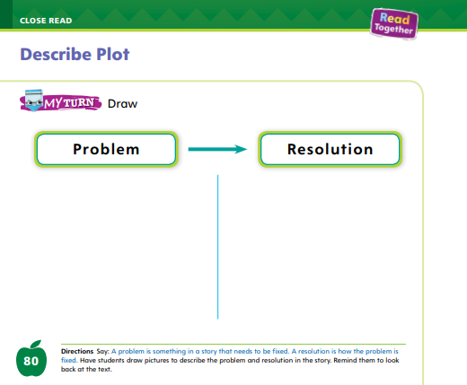
Page 80
Describe Plot
Turn to page 80 in your Student Interactive and complete the activity.
Notes:
Have students use the strategies for describing the plot of a story.
Have students complete p. 80 in the Student Interactive.

Slide 44
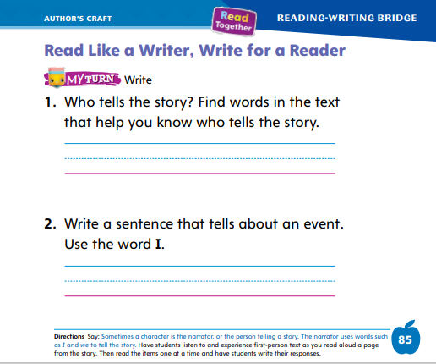
Page 85
Read Like a Writer, Write for a Reader
Turn to page 85 in your Student Interactive and complete the activity.
Notes:
Explain to students that one of the characters in the story is often the one telling the story. The character uses the words I, my, and me.
Listen to the reading on p. 70 in the Student Interactive. Which word helps you know who is telling the story? (We)
Listen to the reading on pp. 72–73 in the Student Interactive. Which words help you know who is telling the story? (Our, we, me)
Listen to the reading on pp. 74–76 in the Student Interactive. Which words help you know who is telling the story? (me, I)
Model how you use first-person. When I tell about something I did or saw, I use the first-person word I. I could say: “I saw a bird” or “I went to the park.”
Have students tell about something they did or saw, using the word I. Have students complete p. 85 in the Student Interactive.

Slide 45
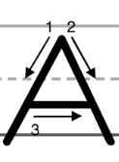
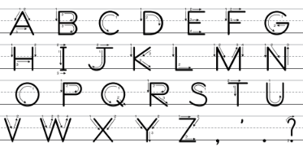
Handwriting
Notes:
Show students the alphabet. Point out letters with straight lines with which they are familiar. Some letters have straight lines, but other letters have slanted lines.
Point out letters with slanted lines with which students are familiar. The letter A has slanted lines. To write letters correctly, you need to be able to write both straight and slanted lines.
Write the word Ape on the board. Point to the uppercase A. This is uppercase A. We use uppercase letters to begin sentences and names. Watch as I trace the uppercase A. I start at the top and draw down and to the left.
Show students where to begin the letter and how to move down and left.
Have students trace this part of the A in the air. Repeat this process for the other side of the A.
Have students complete p. 85 in the Student Interactive.
Provide students with trays of sand and have them practice making slanted lines. Remind them to start at the top and slant down to the left and then down to the right.Click path: Table of Contents -> Resource Download Center -> Handwriting Practice -> U1W2L3 Handwriting Practice

Slide 46
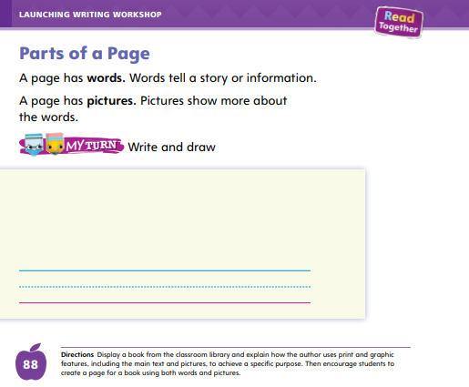
Page 88
Writing – Launching Writing Workshop
Turn to page 88 in your Student Interactive.
Notes:
When authors write, they think of drawings or pictures that match what they are writing about. Books that contain real facts, such as a book about animals, may use real pictures.
Books that tell a made-up story usually use drawings or illustrations. As authors plan their books and pages, they think about
what kind of story to tell,
what kinds of pictures to use, and
which words will match the pictures.
Show books from the stack. Have students notice which books use drawings and which use real pictures. Ask: How are these books the same? How are they different? Prompt students to think about the pictures. In a fiction book or made-up story, could authors use real pictures? In a nonfiction book or true story, could you use illustrations? Why or why not?
Create a simple story about an animal or place using a picture from a magazine or the Internet.
Glue the picture on a flip chart or large poster, thinking aloud about the picture placement on the page of a book.
Next, think aloud about the story you will write. Come up with a story idea based on the picture.
Talk about what your story will tell. Then show where you will write the words for your story on the page.
Have students turn to p. 88 in the Student Interactive. Ask students to create their own page using words and pictures.

Slide 47
Independent Writing
Let’s continue writing.
Draw or choose pictures to match what you have written.
Next, reread what you have done to make sure your pictures and words go together.
Notes:
Have students continue writing. They should write words on each page, and they should draw or choose pictures to match what they have written.
Modeled: As you write your picture story, model using capital letters to start your sentences.
Shared: As students look for pictures, ask them what kind of story they could write to match the pictures.
Guided: Walk around the room and provide feedback as students work. As students write, actively guide them to sound out the words in their stories.
Intervention Refer to the Small Group Guide for support.
If students have already drawn pictures for their book, have them reread what they’ve done and make sure the pictures and words go together.
See the Conference Prompts on p. T326. Click path: Table of Contents -> Resource Download Center -> Writing Workshop Conference Notes
Call on a few students to either read their writing or talk about it. Prompt students to explain why they chose the pictures and how they came up with their story idea.

Slide 48
Language and Conventions
places
things
Notes:
Write the following words on the board: places and things. Remind students that singular nouns name a person or animal, but they also name a place or thing.
Tell students that classroom and beach are nouns that name places.
Draw small sketches of a classroom and a beach under the heading places.
Tell students that pencil and book are nouns that name things.
Draw small sketches of a pencil and a book under the heading things.
Call on students to name other places and things they can think of.
Then place students into small groups of four to five students.
Give each group a sheet of paper with the title Nouns and the headings places and things.
Have students draw simple sketches of places and things under the correct headings.

Slide 49
Lesson 4

Slide 50
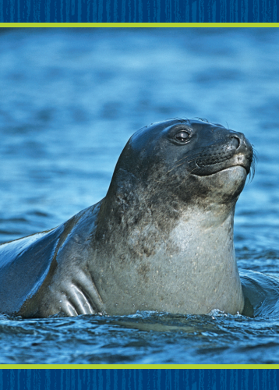
Phonics
Notes:
Hold up the seal Picture Card and tell students that it is a picture of a seal. I hear the sounds /s/ /ē/ /l/. I hear the sound /s/ at the beginning of seal. Say the sound /s/ with me. Turn over the card and show students the spelling of the word. Point to the s and say /s/. Do you hear the sound /s/? What letter spells the sound /s/? Click path -> Table of Contents -> Unit 1 Week 2 Realistic Fiction -> Lesson 4
Have students identify the letter s. Write the letters Ss on the board. Point to the letters Ss on the board. Listen carefully to the following words: /s/ /a/ /t/, sat; /s/ /ā/ /l/, sail. What sound do you hear at the beginning of each word?
Have volunteers identify the sound /s/. What letter spells the sound /s/? Students should say the letter s.

Slide 51
Page 60
Phonics
Turn to page 60 in
your Student Interactive and complete the activity.
Notes:
Have students complete Student Interactive, p. 60.

Slide 52
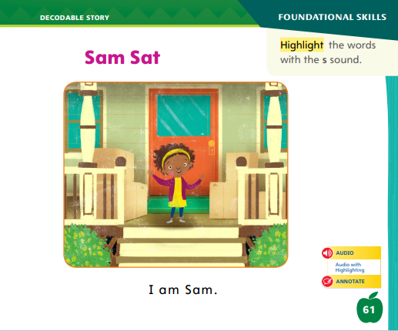
Page 61
Decodable Story
Turn to page 61 in your Student Interactive. Read “Sam Sat” with your partner.
Notes:
Have students turn to Student Interactive, p. 61.
We are going to read a story today about a girl named Sam. Point to the title of the story. The title of the story is Sam Sat. I hear the sounds /s/ /a/ /m/ in the word Sam, and I hear the sounds /s/ /a/ /t/ in the word sat. In this story, we will read other words that have the sounds /m/, /t/, /a/, and /s/.
Remind students of this week’s high-frequency words: a, to, and like.
Tell them they will practice reading these words in the story Sam Sat. Display the words.
Have students read them with you.
When you see these words in the story Sam Sat, you will know how to identify and read them.

Slide 53
Page 24,25
Decodable Story
Notes:
Have students whisper read the story as you listen in. Then have students reread the story page by page with a partner. Listen carefully as they use letter-sound relationships to read the sounds /s/ and /a/. Have partners reread the story.
After students have read the story, call their attention to the title. I see the letter s in two words. What sound does the letter s spell? Help them identify, or say, the sound /s/. Then have them find and highlight the words with the sound /s/ on p. 61. I also hear another sound we learned this week. What sound do I hear? Help students identify, or say, /a/.
Have students turn to pp. 62–63. Which words include the sound /a/? Point to them. Help students identify, or say, the sound /a/. Then have them find and underline the words with the sound /a/. Have students point out any high-frequency words they see.

Slide 54
Page 69
Ask and Answer Questions
Notes:
Tell students that they can generate questions before, during, and after reading to help them better understand a story and gain information.
Questions begin with who, what, where, when, why, or how.
Look at the title and the illustrations. Before you read, what are some questions you could ask about the story?
While you are reading the story, what questions can you ask about the problem and how a character tries to solve it?
After you read a story, think about the problem and how it is solved. Is there anything else you would like to know?
Before reading, I can look at the illustrations and the title and ask myself questions about the story.
Model reading the title to come up with a question you can ask yourself: The title of this story is Too Many Places to Hide. Why are there too many hiding places? When I read, I can try and figure out the answer to this question.
Look at the Close Read note on p. 75 of the Student Interactive.
Have students highlight the answer to a question that they think about.

Slide 55
Page 75
Close Read - Ask and Answer Questions
Turn to page 75 in your Student Interactive.
Notes:
After reading pp. 74–75, have students think of a question they could ask about the story. Then have them highlight the words that answer the question. DOK 3

Slide 56
Page 81
Ask and Answer Questions
Turn to page 81 in your Student Interactive and complete activity.
Notes:
Have students use the strategies for asking and answering questions.
Have students complete p. 81 in the Student Interactive.

Slide 57
Writing – Launch Writing Workshop
An Author is a person who writing books
An Author Bio has information about the author and his or her work or life often appears on the a back cover.
Notes:
An author is a person who writes books. Authors write about things that are made-up or true.
Information about the author and his or her work or life often appears on the back cover. This information is called an author bio.
Using stack books or your classroom library, take students on an Author Walk.
Show a book that includes an author byline on the cover, as well as an author picture and short biography on the back cover or inside the book.
Read the author name and bio aloud. Explain that sometimes the author bio tells why the author wrote the story or what the author likes about the story.
Next, have students find books with author names, pictures, and bios. Remind students to listen actively as you read the bios aloud.
Prompt students to think about why the author wrote the book. Then say: This year, you will be authors. You will write books just like these authors did!

Slide 58
Independent Writing
Write about yourself on the back cover and draw a self- portrait.
You can write about what your book is about if there is room on th back cover.
Notes:
Have students continue writing their books. Suggest that they write about themselves on the back cover and even draw a self-portrait.
If there is room, their back cover can also tell what their book is about.
Modeled Write an author biography about yourself. Talk through what you want to write in your author bio and why.
Shared As students work, have them think of things to include in their author bio.
Guided Use the stack text to encourage students to model their author stories after author bios in the stack. Intervention Refer to the Small Group Guide for support.
See the Conference Prompts on p. T326. Click path: Table of Contents -> Resource Download Center -> Writing Workshop Conference Notes
Call on a few students to share their back cover. Ask students why they included certain information.

Slide 59
Page 86
Language and Conventions
Turn to page 86 in your Student Interactive and complete the activity.
Notes:
Have students turn to p. 86 in the Student Interactive. Have students identify which noun names a thing (ball) and which names a place (park).
Then have students edit the sentence on p. 86 for singular nouns.

Slide 60
Lesson 5

Slide 61
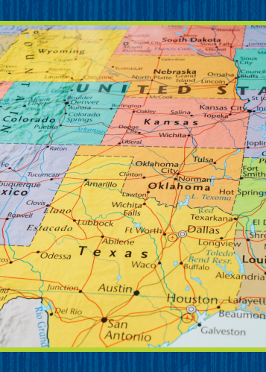
Phonological Awareness
Notes:
Please remove the blue boxes one at a time to display the current Picture Card.
Display the soap Picture Card. Words have different sounds and parts. The beginning sound in soap is /s/. The ending part is /ōp/. Listen as I say the parts together to say the word: /s/ /ōp/, soap. Click path -> Table of Contents -> Unit 1 Week 2 Realistic Fiction -> Lesson 4
Repeat with the man Picture Card.
Display Picture Cards map, six, sock, sun, and mug, one at a time.
Have students segment and blend the onset and rime in each picture word. (/m/ /ap/, map; /s/ /iks/, six; /s/ /ok/, sock; /m/ /ug/, mug)

Slide 62
Page 64,65
Phonics
Ss
Aa
map
tap
sit
sun
Sam
sip
am
Notes:
Write the letters Ss and Aa on the board. Have students identify the letters as you point to them. Then review the sound for each letter: s /s/, a /a/.
Have students say the sound as you point to each letter.
Assign students to be on the S Team or the A Team. Place the teams on opposite sides of the classroom. I am going to read some words to you. If you hear the sound /s/ in a word, the S team will clap. If you hear the sound /a/ in a word, the A team will clap. There will be one word in which both the sound /s/ and the sound /a/ will be heard, so listen carefully.
Write the following words on the board, and model using letter-sound relationships to decode: mat, tap, sit, sun, Sam, sip, am.
Have students turn to p. 64 in the Student Interactive and use letter-sound relationships to decode the words with a partner.
Have students look at p. 65 in the Student Interactive.
Have them decode the sentences and then circle the words with short /a/ and underline words with /s/.

Slide 63
High-Frequency Words
a
to
like
Notes:
Remind students that high frequency words are words that appear over and over in texts.
Say the word a and ask students what letter spells the word. Have students
read the word a as you write it on the board.
repeat with to and like.

Slide 64
Page 82
Reflect and Share
Turn to page 82 in your Student Interactive.
Notes:
Tell students that many stories have plots with similar problems that characters solve in different ways.
When talking about and comparing different stories, students should
think about the main problem in each story. How are the problems alike? How are they different?
look at how the characters react to the problem and act to come up with a solution.
compare the solutions and think about whether the solution led to a good or not-so-good ending for the characters.
Model retelling the texts to compare the plot elements of problem and resolution across texts, referring to the Weekly Question on p. 53 of the Student Interactive.
Moving to a new place can be scary, but it can also be exciting. I read a story about a boy who did not want to move. He was afraid of losing his old friends. But when he got to his new house, there was a boy next door who became his friend and invited him to a party to meet all the kids in the neighborhood. That is kind of like what the girl experienced in Too Many Places to Hide.

Slide 65
Apply
What is exciting about moving to a new place?
Notes:
Have students use the strategies for comparing across texts.
Have students complete p. 82 in the Student Interactive.
Have students use evidence from the stories they have read this week to respond to the Weekly Question. Tell them to discuss their answers in small groups.

Slide 66
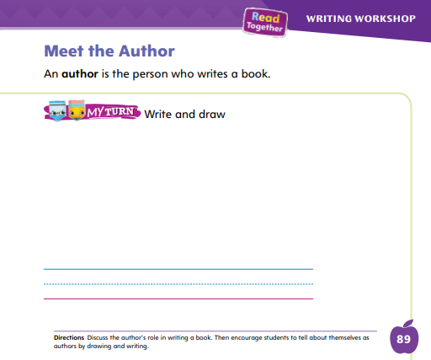
Page 89
Writing – Launch Writing Workshop
Turn to page 89 in your Student Interactive and complete the activity.
Notes:
Authors often write about things that they know a lot about, especially when writing informational text.
They do research or have worked in fields of study that they write about. We can find out about authors by reading their author bios—and by reading their books.
Tell students that authors often write about things that they know a lot about. So a teacher might write about children and a zookeeper might write about animals. Remind students that anyone can be an author.
They are going to be authors this year, just like the people who wrote these books! Show some books and stories from the stack.
Identify and read the author’s bio for these books. Say: This book is about _____. Does this author know a lot about ______?
Guide students to identify why an author might have written about a certain topic. Have students turn to p. 89 in the Student Interactive.
They should practice writing their own author bio.
If desired, distribute Speaking and Listening tips from the Resource Download Center. Click Path: Table of Contents -> Resource Download Center -> Speaking and Listening

Slide 67
Language and Conventions
Circle the singular nouns that are places and put a box around the nouns that are things.
school cup classroom
ball park
Notes:
Write the following words on the board.
Ask student volunteers to circle the singular nouns that are places and put a box around the nouns that are things.
school/ place
cup/ thing
classroom/ place
ball/ thing
park /place
Have students complete Language and Conventions, p. 25, from the Resource Download Center. Click path: Table of Contents -> Resource Download Center -> Language and Conventions -> U1 W2

Slide 68
Unit 1: Week 2
Grade K

