Slide 1

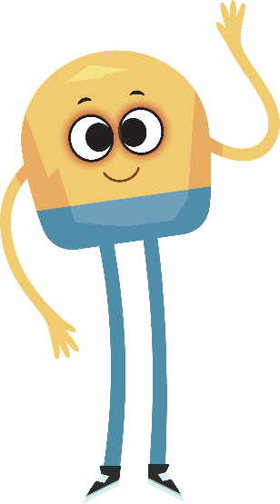

Unit 1: Week 3
Grade K

Slide 2
Copyright © Savvas Learning Company LLC. All Rights Reserved.
This publication is protected by copyright, and permission should be obtained from the publisher prior to any prohibited reproduction, storage in a retrieval system, or transmission in any form or by any means, electronic, mechanical, photocopying, recording, or otherwise. For information regarding permissions, request forms, and the appropriate contacts within the Savvas Learning Company Rights Management group, please send your query to:
Savvas Learning Company LLC, 15 East Midland Avenue, Paramus, NJ 07652
or
k12learningpermissions@savvas.com
myView Literacy® is an exclusive trademark of Savvas Learning Company LLC in the U.S. and/or other countries.

Slide 3

Lesson 1

Slide 4
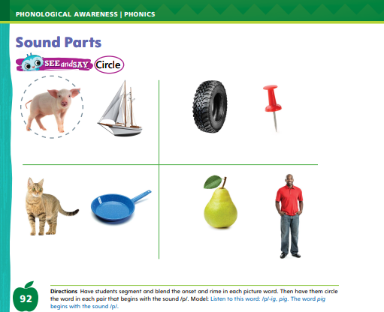
Page 92
Phonological Awareness
Turn to page 92 in your Student Interactive.
Notes:
Listen as I say a new sound: /p/ /p/ /p/. The sound /p/ is made by pressing your lips together and pushing air out.
Have students practice making the sound /p/. You can hear the sound /p/ at the beginning of some words.
Tell students that words are made up of sounds and parts. Listen as I say the beginning sound and ending part of a word: /p/, -at. Now I will say the parts together to say the word: /p/ -at, pat.
Have students turn to p. 92 in the Student Interactive. Explain that they will circle the picture words that begin with the sound /p/. Point to the first picture.
This is a picture of a pig. Listen to the beginning sound and ending part in the word: /p/ -ig, pig.
Repeat with the picture of a boat. Which picture name begins with the sound /p/? Yes, pig starts with /p/, so we will circle the pig.
Have students complete the activity on p. 92.

Slide 5
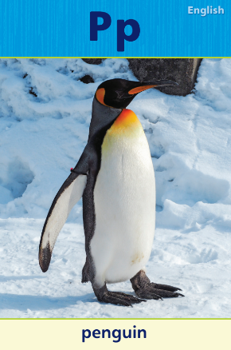
Page 93
Phonics
Pp
Tim
mom
pail
hot
pan
Meg
pet
Notes:
Hold up Alphabet Card Pp and point to the picture of the penguin. Have students say penguin with you. Let’s say the beginning sound /p/. The sound /p/ is spelled with the letter p. Click path -> Table of Contents -> Unit 1 Week 3 Informational Text -> Lesson 1
Write the letters P and p on the board.
Have students turn to p. 93 in the Student Interactive and trace the letters on the first line with their fingers.
Tell students that you will write and read words. They should clap when they hear the sound /p/.
Write the following words: pit, Tim, mom, pail, hot, pan, Meg, pet.

Slide 6
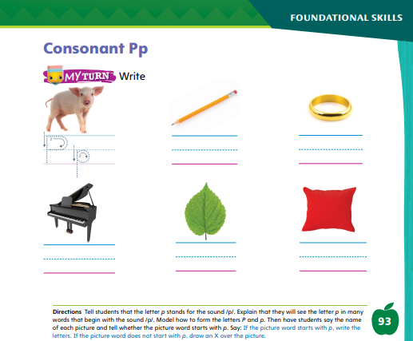
Page 93
Phonics
Trace the letters on page 93 in your Student Interactive.
Notes:
Have students look at p. 93 in the Student Interactive. Point to the letter p and tell me the sound it makes. Now write Pp under each picture word that begins with /p/.
Direct students to the first picture. Say the word pig, emphasizing the initial sound. Does this picture word begin with the sound /p/? Yes, so write Pp on the line.
Tell students to complete the activity.
If students need additional practice with letter recognition, use the Letter Recognition Unit on SavvasRealize.com or on pp. xvii–xliii in this Teacher’s Edition.
The unit includes instruction, activities, and student practice sheets.

Slide 7
High-Frequency Words
have
is
he
Notes:
Display the high-frequency words have, is, and he.
Point to the word have and read it.
Have students point to the word have and read it.
Repeat for is and he.

Slide 8
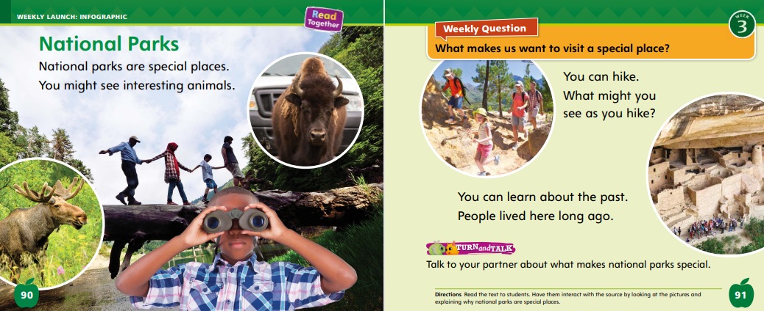
Page 90,91
Interact with Sources
Essential Question: What makes a place special?
Weekly Question: What makes us want to visit a special place?
Notes:
Prompt students to remember the Unit 1 Essential Question: What makes a place special?
Then introduce them to the Week 3 Question: What makes us want to visit a special place?
Tell students that there are many reasons that we might want to visit a special place, just like there are many reasons that a place may be special.
Have students look at the photographs on pp. 90–91 of the Student Interactive.
Ask if they know what kind of special place these photos show. Tell students that the pictures show national parks.
Ask students if they have ever been to a national park. Then read the infographic “National Parks” as students follow along.
Use the following questions for discussion:
(Photo p. 90) What animals do you see? What is this place like?
(Photo p. 91) What is the family doing? What things might they see as they hike?
Have students look at the final picture. Explain that these are ruins from houses built into the cliffs by people who lived long ago.
Tell students that this is Mesa Verde National Park in Colorado. Explain that there are other national parks in the United States that preserve history.
Encourage students to ask questions about the infographic to clarify any information they do not understand
Have students interact with sources by using the pictures and text on pp. 90–91 to talk about what makes national parks special.
Lead students to understand that national parks help us appreciate our country and provide places for people to have fun.
Point out the Week 3 Question: What makes us want to visit a special place? Ask students why they might want to visit a national park.
Explain that they will read more about different places that are special, and that they might want to visit, this week.

Slide 9
Listening Comprehension
We visit special places to
Have fun
2.
3.
4.
Notes:
Tell students that they will listen to an informational text. Informational texts give facts and details about real people, places, and things.
They have a main, or central, idea and details.
Have students listen as you read aloud the informational text, “Special Places.”
Encourage them to be active listeners by looking at you and thinking about what you are saying as you read aloud.
Purpose: Have students listen actively for elements of informational text, such as the main idea and details.
READ: the entire text aloud without stopping for the Think Aloud callouts.
REREAD: the text aloud, pausing to model Think Aloud strategies related to the genre.
Use the chart to help students identify details that tell why people might visit a special place.

Slide 10
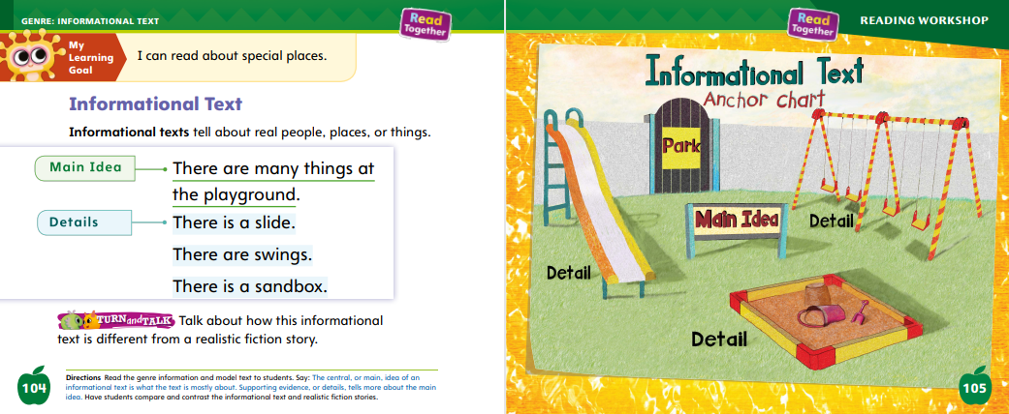
Page 104,105
Informational Text
Turn to page 104 in your Student Interactive.
Notes:
Tell students that they will now learn about informational texts. An informational text gives true information about a topic. It has a main idea and details.
The main idea is what a text is mostly about. It is the big idea of a text. It is sometimes called the central idea.
Details are bits of information that tell us about the main idea. They are sometimes called supporting evidence. Readers watch for the main idea and details to help them understand an informational text.
Read aloud p. 104 of the Student Interactive. Assist students as they identify the main idea and details.
What is this text mostly about? The first sentence tells us. The main idea is playgrounds.
What are the details that tell about the playground? The details are that there is a slide, some swings, and a sandbox.
Editable Anchor Chart Click Path: Table of Contents -> Reading Anchor Charts -> Unit 1 Week 3: Realistic Fiction Editable Reading Anchor Chart

Slide 11
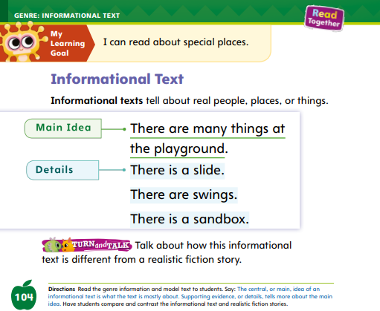

Page 104
Apply
Talk about how this informational text is different from a realistic fiction story?
Notes:
Have students turn and talk with a partner about how an informational text differs from a realistic fiction story.
Then have partners share their ideas and discuss as a class.

Slide 12
Academic Vocabulary
A frog can ______ by hopping.
Notes:
Talk about strategies students can use to learn the meanings of words they do not know.
Look at the letters in the word and think about the sounds they make.
Look at the pictures to see if they help you learn the word’s meaning.
Look at the words around the new word and see if they help you learn or clarify the meaning of the word.
Model using context clues to figure out a word. Display and read aloud the following: A frog can ____ by hopping.
I can use context clues to help me figure out this word. The sentence is about a frog. Hopping is how frogs move. So, I’m pretty sure the word is move. I will reread the sentence to see if move makes sense: A frog can move by hopping. I used the context, or the other words in the sentence, to help me figure out the word is move.
Read aloud the first sentence on p. 121 of the Student Interactive with the missing word.
Have students repeat the strategy to find the missing word.

Slide 13
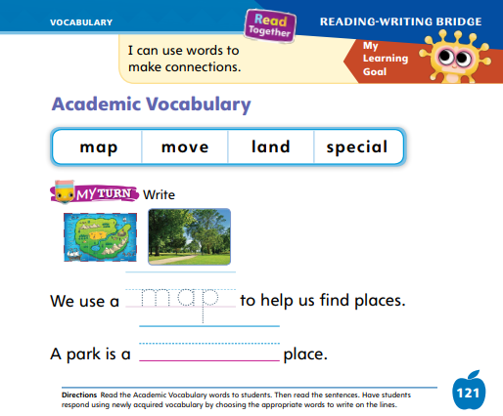
Page 121
Apply
Circle and write on page 121 in your Student Interactive.
Notes:
Choral read the four Academic Vocabulary words and discuss the two pictures.
Then have students complete the rest of p. 121 in the Student Interactive.
Provide students with trays of sand and have them practice making forward circles with their fingers.
Remind them to start at the top and curve down, around, and back to the top.

Slide 14
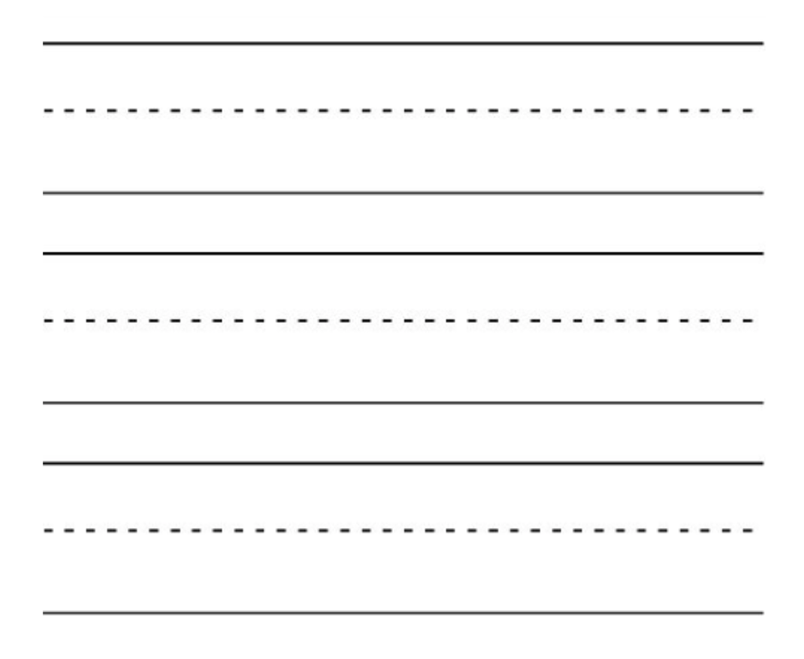
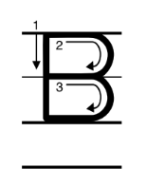
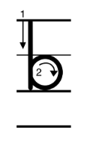
Handwriting
Notes:
Show students the alphabet and point out letters that have forward circles such as the letter Bb.
Model how to make a forward circle on the board. Explain your hand movements as you make the forward circle: I start at the top and curve around to the right and up to the top.
Click path: Realize -> Table of Contents -> Resource Download Center -> Handwriting Practice -> U1W3L1 Handwriting Practice

Slide 15
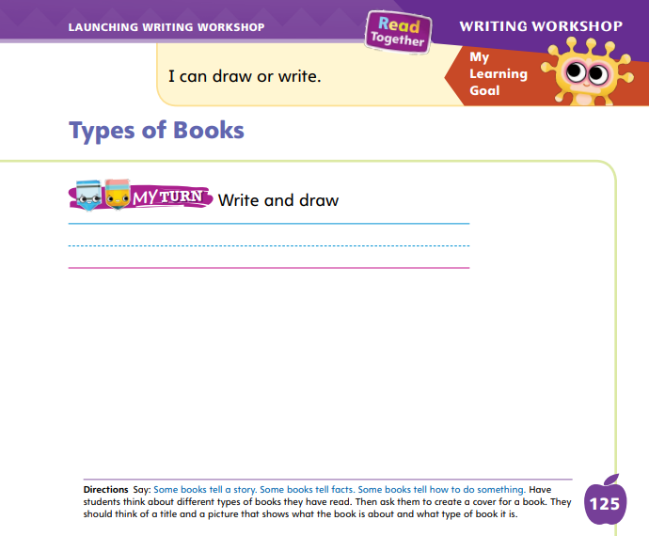
Page 125
Writing – Launching Writing Workshop
Turn to page 125 in your Student Interactive and complete the activity.
Notes:
There are many types of books. An author decides what kind of book he or she will write.
An author may write a pretend story, a book that describes how to do something, or a book that explains something.
Using the stack books, notice the different kinds of books you see.
Think aloud as you look at each cover and read the title. Say: I wonder if this book is fiction or nonfiction. Then model with a Think Aloud to explain which type of book it is. For example: When I look at the cover, I see _____. The title of this book is _____. That tells me this book will probably be about _____. When I look at the pictures, I see _____.
Continue this Think Aloud with different types of books from the stack. Then say: We can write many types of books this year too. Which type of book is your favorite? Try them all!
Then have students turn to p. 125 in the Student Interactive. Instruct them to create a cover for a book, with a title and a picture that show what the book is about and what type of book it is.

Slide 16

Independent Writing
Let’s create our own nonfiction book.
If you finish your book, you can start a new one.
Notes:
Have students continue writing their books. Students can begin a new book if they think of a topic they would prefer to write about.
Modeled: Create your own nonfiction book, “A Farm Morning.” Draw a sun and a barn on your cover. Tell if your book is fiction or nonfiction.
Shared: Create a book together; you write the title and have students draw the picture showing fiction or nonfiction elements.
Guided: As students work, walk around and prompt them to use what they already know about books.
Intervention Refer to the Small Group Guide for support.
If students have already finished writing a book, have them start a new book. Tell students that they can write as many books as they want during this unit.
Call on a few students to tell about a new idea they are writing about.

Slide 17
Language and Conventions
The tree has lots of apples.
Tom has a book.
Notes:
Review with students that nouns name people, places, animals, and things.
Provide this sentence for students: The tree has lots of apples. Read aloud the sentence, pointing to each word. I remember that a noun names a person, place, animal, or thing. I see two nouns in this sentence: tree and apples.
Underline the words.
Provide another sentence: Tom has a book. Read aloud the sentence with students. Ask: How many nouns do you see in this sentence? What are they?
Underline the nouns as students name them. Call on different students to say an example of a noun.

Slide 18
Lesson 2

Slide 19
Phonics
pat
sap
Notes:
Display Alphabet Card Pp. This is a picture of a penguin. The word penguin begins with the sound /p/. Click path -> Table of Contents -> Unit 1 Week 3 Informational Text -> Lesson 2
What letter spells the sound /p/? Students should say the letter p. Point to the letters on the card and remind students they are uppercase P and lowercase p.
Write the word pat on the board. Listen carefully as I read this word: pat. Pat begins with the sound /p/. Listen carefully: /p/ /a/ /t/. What letter spells the sound /p/? Students should say p.
Tell students that some words end with the sound /p/. Write the word sap on the board. The word sap ends with the sound /p/. Listen carefully: /s/ /a/ /p/. What letter spells the sound /p/?

Slide 20
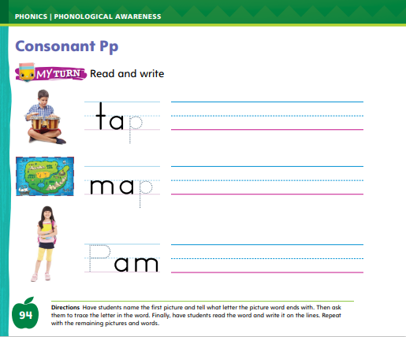
Page 94
Apply
Turn to page 94 in your Student Interactive and complete the activity.
Notes:
Have students complete p. 94 of the Student Interactive.

Slide 21
High-Frequency Words
have
is
he
Notes:
Tell students that high-frequency words are words that they will hear and see over and over in things they read.
Write and read the sight words have, is, and he. Have students
repeat the words after you.
spell each word, tapping their knees as they say each letter.

Slide 22
Page 106
Preview Vocabulary
library
librarian
computers
movie
Notes:
Read aloud the vocabulary words on p. 106: library, librarian, computers, movie. Ask students what they know about these words.
Ask questions such as: What do you do at the library? How does the librarian help you? What do you use a computer for at the library? Have you ever checked out a movie on DVD?
These words will help us understand what At the Library is about. Watch for these words as we read.

Slide 23

Print Strategies
Hold up your Student Interactive.
Notes:
Have students hold up their Student Interactive. Explain that every book has a front cover, back cover, and title page. Show them these features of the book.
Then show students an informational text. Point to the front and back covers and the title page, and have students identify each.

Slide 24

Page 107
First Read Strategies
Turn to page 107 in your Student Interactive.
Notes:
Have students point to the title of the selection and read it aloud with you.
Ask students if they have been to a library. Tell them they will read the text to find out what they can do at the library and why it is a special place.
Then discuss the First Read Strategies.
READ: Encourage students to read or listen as you read the text.
LOOK: Remind students to look at the pictures to help them understand the text.
ASK: Have students generate, or ask, questions about the text to deepen their understanding.
TALK: Guide students to talk to a partner about the text.
Students may read the text independently, in pairs, or as a whole class. Use the First Read notes to help students connect with the text and guide their understanding.

Slide 25
Page 107
First Read – At the Library
Notes:
Read together.

Slide 26
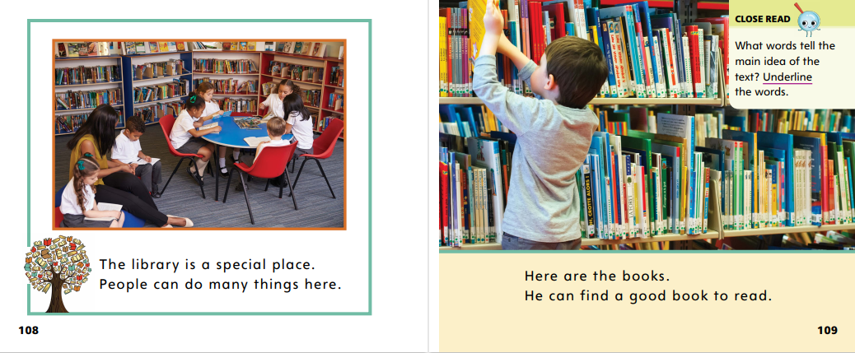

Page 108,109
First Read – At the Library
Notes:
Read together.
THINK ALOUD The first sentence tells me the main idea, that a library is a special place. I am curious to know why this author thinks the library is special. As I read, I’ll look for supporting evidence, or details, that shows a library is a special place.

Slide 27
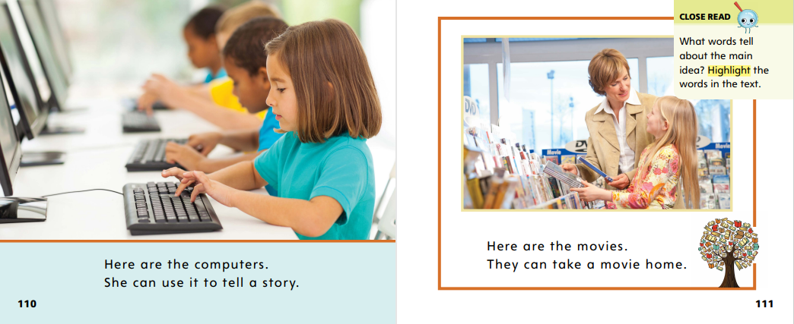
Page 110,111
First Read – At the Library
Notes:
Read Together.

Slide 28
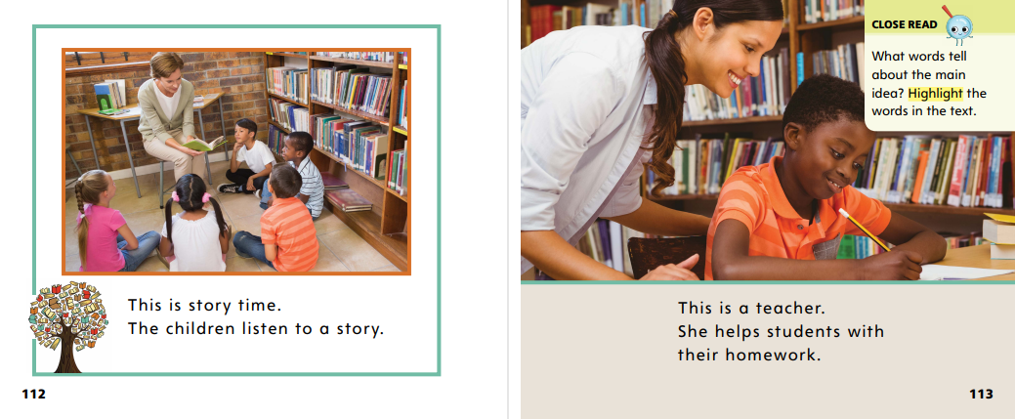

Page
112,113
First Read – At the Library
Notes:
Read together.
THINK ALOUD The picture on p. 112 reminds me of when I was little. My mom and I used to go to the library in our town. I especially liked to listen to the librarian read aloud stories. What do these pages make you think about? Turn to a classmate to talk about it.

Slide 29

Page 114,115
First Read – At the Library
Notes:
Read together.

Slide 30
Respond and Analyze
Talk- Describe a detail in the text that was new to you. What did you learn?
Illustrate- Draw a library. Talk with your partner about your drawing.
Notes:
Use these suggestions to prompt students’ initial responses to At the Library.
Talk: Describe a detail in the text that was new to you. What did you learn?
Illustrate: Draw a library. Talk with a partner about your drawing.

Slide 31
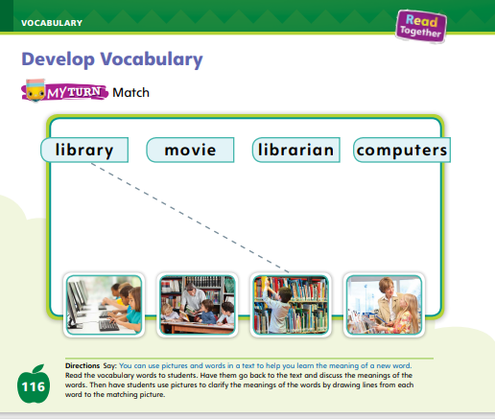
Page 116
Develop Vocabulary
Turn to page 116 in your Student Interactive and match a word to a picture.
Notes:
Explain that authors of informational texts use words that tell information about the main, or central, idea.
Every central idea has certain key words. It would be hard to write about libraries without using words such as library and librarian.
READ: Look for words that tell about the central idea. What are the key words for understanding the text?
THINK: Think about the meanings of the words and how they are related to the central idea.
ASK: Why did the author choose these words? Why are they important?
Have students look at p. 116. Read aloud each of the words and model matching the first word to a picture.
The first word is library. All the pictures show something we can do in a library, but one picture is best at showing what a library is. I’ll draw a line from the word library to the third picture.
Have students acquire vocabulary by completing p. 116 in the Student Interactive.

Slide 32
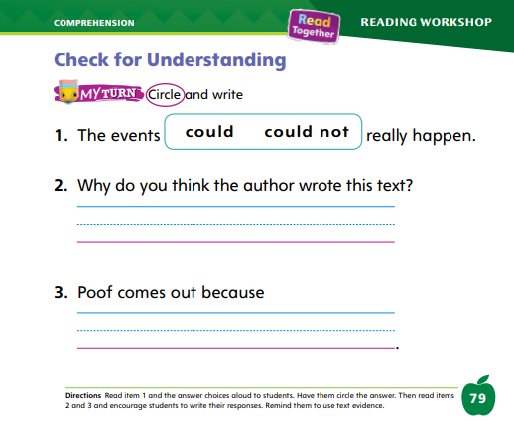
Page 79
Check for Understanding
Turn to page 79 in your Student Interactive and complete the activity.
Notes:
Have students complete the Check for Understanding on p. 79 of the Student Interactive.

Slide 33
Writing – Launch Writing Workshop
The boy went to the doctor.
Theboywentothedoctor.
The boy went to the doctor.
Notes:
Keeping the right amount of space between words is important as you write. The space shows readers where one word ends and another word begins.
Without the right amount of space, it is hard to read and follow along in a book.
Choose a book from your stack. Open it to a page and show students the spacing between each word. Point out that all of the spacing is the same.
Then copy one of the sentences onto your chart or board. As you write each word, talk about the word’s boundaries.
For example, The starts with T and ends with e. After writing The, use two fingers to create a space and then write the next word.
Again, show the word’s boundaries, continuing like this for each word in the sentence.
When you are finished, have students follow along as you read the sentence, pointing with your finger.
Make it a point to notice that the right space between words makes it easy to read.
Next, write the same sentence, this time leaving little or no space between words.
Have students notice that without the right spacing, it is hard to read a sentence.
Explain that whether you have too little spacing or too much spacing, a sentence becomes hard to read and understand. Note the difference between a letter and a word.
Tell students that most words are made up of more than one letter. Point out that spoken words, when written, are made of letters that are in a specific order.

Slide 34
Independent Writing
Let’s use proper spacing between words.
Review what you have written so far. Be sure the letters and words are spaced correctly.
Notes:
As students begin writing independently, remind them to use proper spacing between words. They should review what they have written so far to be sure letters and words are spaced correctly.
After they have done this, they can continue writing their books.
Modeled: Show the spaces between words in different types of books.
Shared: Ask students what they can use other than their fingers to create space between words.
Guided: Have students look at the spaces between words so they can transition to natural spacing without fingers or other tools.
Intervention Refer to the Small Group Guide for support.
See the Conference Prompts on p. T350.
Call on a few students to show their sentences to the class. Ask the class if the student left too little or too much space between words.

Slide 35
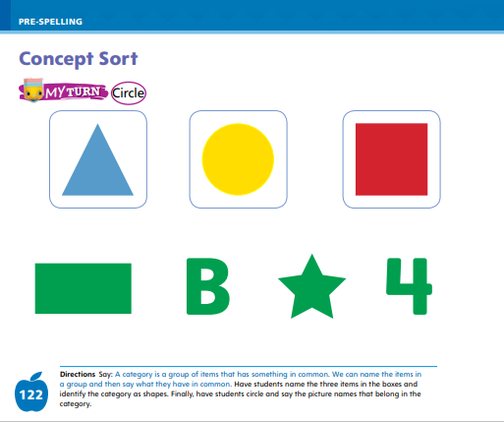
Page 122
Pre-Spelling
Turn to page 122 in your Student Interactive and complete the activity.
Notes:
Explain that a category is a group of items that has something in common. For example, a slide, a swing, and a sandbox are in a category of things found in a playground.
Tell students that when we name things in a group, it can help us discover what the category is and what the things in the group have in common.
Draw these shapes for students: a triangle, a square, and a circle.
Make the shapes different sizes and colors. Point to each one and name it. Have students repeat.
Model determining what group these things fit into. I know a triangle is a shape. I know a square is a shape, and a circle is too. The group, or category, must be shapes. It doesn’t matter if the shapes are different sizes or different colors. They are still shapes.
Have students complete the activity on p. 122 in the Student Interactive by circling the shape picture words and using the words to identify and talk about the category.

Slide 36
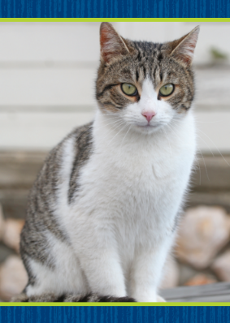
Language and Conventions – Plural Nouns
cat
cats
Notes:
Tell students that plural means more than one of something. Plural nouns name two or more people, places, animals, or things.
Draw a sketch of one cat and a sketch of two cats.
Write cat under the single cat. Tell students that the word cat is a noun. When there is more than one cat, we add an -s to the end of the word to make cats. The letter -s at the end tells us that there is more than one cat.
Write cats under the sketch of two cats and circle the s.
Hold up one book and ask how many books students see.
Then hold up two books and ask how many books they see.
Make sure they use the plural -s. Repeat with other objects, for example, three pencils, one apple, four blocks, etc.

Slide 37
Lesson 3

Slide 38
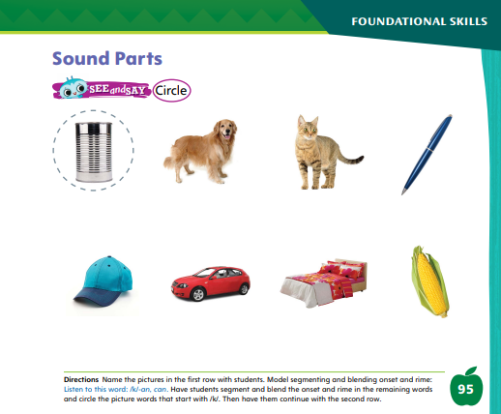
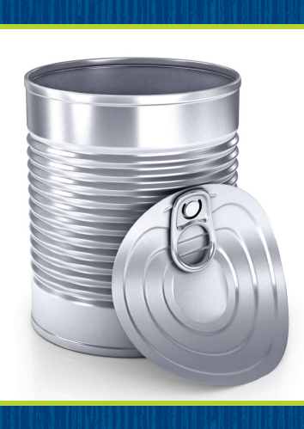
Page 95
Phonological Awareness
Turn to page 95 in your Student Interactive and complete the activity.
Notes:
Today we are going to learn a new sound /k/ /k/ /k/. The sound /k/ is made by placing the back of your tongue against the top of your mouth, near your throat. Take air in and let it go by lowering your tongue to make the sound /k/. Have students practice the sound.
Display the can Picture Card. Listen to the beginning sound and ending part as I say this word: /k/ -an, can. What sound does can begin with? Students should supply the sound /k/. Then say the following words and have students segment and blend the onset and rime. Click path -> Table of Contents -> Unit 1 Week 3 Informational Text -> Lesson 3
Direct them to give a thumbs-up if they hear the sound /k/ at the onset of the word: can, send, carry.
Point to the picture of the can on p. 95 of the Student Interactive. Listen to the sounds in this word: /k/ -an, can. Can has the sound /k/ at the beginning.
Have students complete the page.

Slide 39
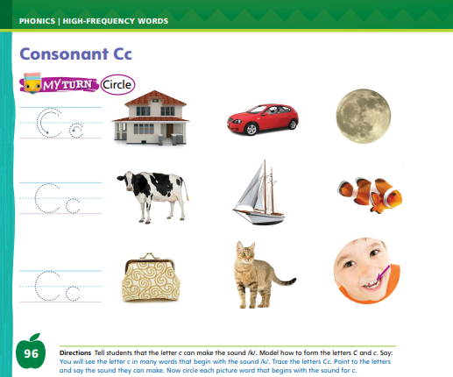
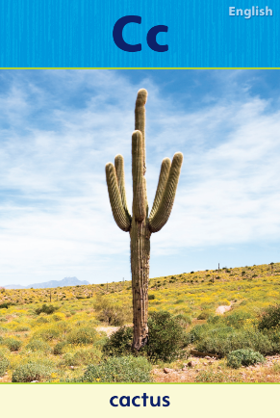
Page 96
Phonics
Turn to page 96 in your Student Interactive and complete the activity.
Notes:
Tell students that the sound /k/ can be spelled with the letter c. Display the Cc Alphabet Card. Point to the C and c at the top of the card and say the letters. Tell students the word cactus begins with the sound /k/ spelled c.
Have students turn to p. 96 in the Student Interactive. Click path -> Table of Contents -> Unit 1 Week 3 Informational Text -> Lesson 3
Write the letters C and c on the board and have students trace the letters on the first line. Let’s say the picture word house and listen to the beginning sound: /h/ -ouse. The word begins with /h/. Does that sound the same as /k/? No, it doesn’t. Let’s look at the next picture and say that word: /k/ -ar. Do you hear the sound /k/ at the beginning of car? Yes! Let’s circle it.
Have students complete the activity on p. 96. If students need additional practice with letter recognition, use the Letter Recognition Unit on SavvasRealize.com or on pp. xvii–xliii in this Teacher’s Edition. The unit includes instruction, activities, and practice sheets.

Slide 40
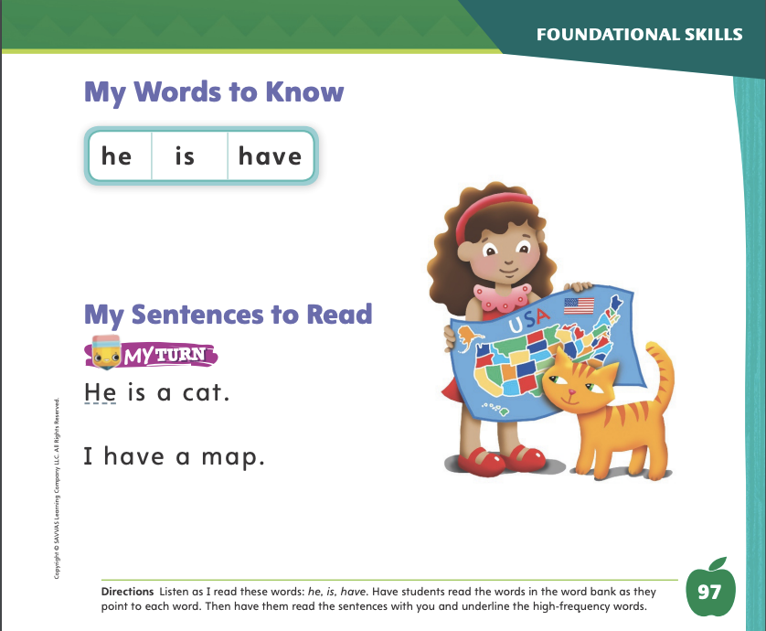
Page 97
High-Frequency Words
Turn to page 97 in your Student Interactive and complete the activity.
Notes:
Tell students that some words are not spelled the way they sound. We have to learn how to read and write them by remembering the letters.
Have students read the words at the top of p. 97 in the Student Interactive with you: he, is, have.
Have students look at the words at the top of p. 97.
Tell them to identify and point to the words when you say them. Say he. Pause to let students find and point to the word. Say have. Say is.
Repeat the activity until students are familiar with each word.
Have students read the sentences on p. 97 with you. Ask them to identify and underline the words he, is, and have in the sentences. Then have them read the sentences with a partner.

Slide 41

Page 107
Find Main Idea
Notes:
Help students use the following strategies to find the main idea of an informational text. Remind them that we sometimes call the main idea the “big idea” or the “central idea.”
Read the title of the text. It often gives us a good clue to the main idea. What clue does the title At the Library on p. 107 give us about the main idea?
Read the first sentence of the text carefully. The first sentence often tells us the main idea.
Have students look at the sentence at the top of p. 118 of the Student Interactive.
Read it aloud. Say: Sometimes the main idea is in the first sentence of the text.
Model the activity for students. Look at the two words: library and computer. One of the words tells about the main idea of the text. Which one should we circle? (library)
Continue modeling how to find the main, or central, idea. Say: Look at the first page of the text, p. 108, while I read it aloud. The first sentence tells us that a library is a special place. This is the main idea.
Guide students to find the main idea by underlining the first sentence.
Have students draw a picture that shows what the text is mostly about on p. 118 in the Student Interactive.

Slide 42
Page 108,109
Close Read – Find Main Idea
Turn to page 108 in your Student Interactive
Notes:
Ask: What is this text mostly about? What does the author want me to know? To identify the main idea, have students underline the sentence on p. 108 that answers these questions. DOK 2

Slide 43
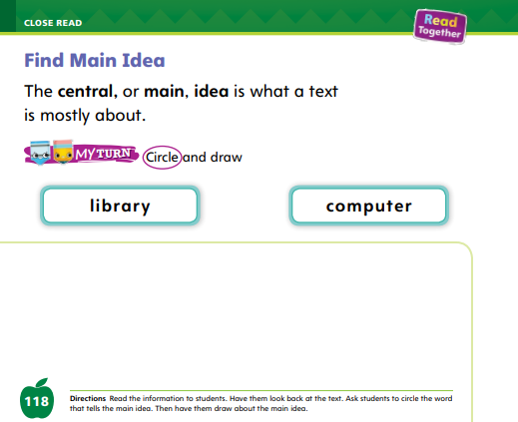
Page 118
Find Main Idea
Turn to page 118 in your Student Interactive
Notes:
Have students use the strategies for finding the main idea of a text.
Have students draw a picture that shows what the text is mostly about on p. 118 in the Student Interactive.

Slide 44
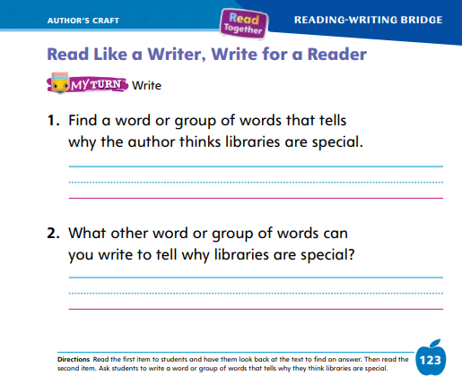

Page 123
Read Like a Writer, Write for a Reader
Turn to page 123 in the Student Interactive and complete the activity.
Notes:
Remind students that readers need to find text evidence, or details in the text, to support their thinking about the main idea and to give reasons for their answers to questions about the text.
Think about what the author's message is. What is the author trying to tell the reader?
Look for details that support the author's message. Which details are important?
Direct students to p. 123 in the Student Interactive. Model how to complete the first part of the activity.
I need to think about the words the author uses to prove that libraries are special. As I look back at the text, I see that the author uses the words story time on p. 112. The author thinks that hearing stories read aloud makes a library a special place. I can write the words story time on the line.
Work with students to find other words in the text that provide text evidence for why libraries are special.
Have students look back in the text to complete p. 123 in the Student Interactive.

Slide 45
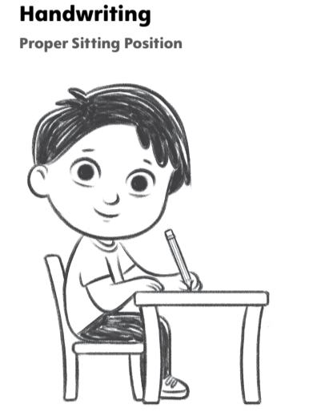
Handwriting
Notes:
Tell students that they need to sit comfortably when they write.
Model how you sit at your desk when you write. Call attention to your posture. When I write, I make sure my feet are flat on the floor. My knees are bent just about an inch from the seat of my chair. My hips touch the back of my chair. I rest my forearms on my desk in a comfortable position.
Have students complete Handwriting p. 19 in the Resource Download Center to practice proper sitting position. Click path: Table of Contents -> Resource Download Center -> Handwriting Practice -> U1W3L1 Handwriting Practice

Slide 46
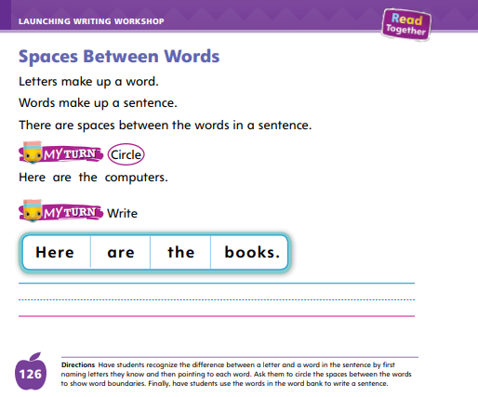
Page 126
Writing – Launch Writing Workshop
Turn to page 126 in your Student Interactive.
Notes:
Equal spacing between words makes a sentence easy to read.
Choose a stack book and show students the first page. There is a space between each word in this sentence. That makes it easy to read. Notice how all of the spaces are the same, no matter how long the word is.
Write the sentence on a chart or project it on the board. Circle each word.
Then have students copy the sentence, making sure that the words are evenly spaced.
Tell students to turn to p. 126 in the Student Interactive. Read the page with them.
Have students circle the spaces between the words and then write the sentence on the line using proper spacing.

Slide 47
Independent Writing
Let’s continue writing. Use your fingers or another tool to measure your spaces.
Reread what you have done to make sure you have spaces between words.
Notes:
As students begin their independent writing time, remind them to use the same spacing between words.
They may use their fingers or another tool to measure the spaces.
Students should continue writing books in any genre they choose.
Modeled: Write a sentence and do a Think Aloud as you leave space between the words.
Shared: Take turns writing the words to a sentence as you talk through spacing.
Guided: As students write, have them evaluate the spacing between their words and sentences.
Intervention Refer to the Small Group Guide for support.
Call on a few students to show the first page or two of their books. Point out the correct spacing in the writing.

Slide 48
Language and Conventions
dog
dogs
car
cars
one cats
two books
two pen
one car
Notes:
Remind students that a noun names a person, animal, place, or thing. Tell them that we add an -s to the end of a noun to show there is more than one.
Provide the following for student reference: one dog, two dogs, three dogs .
Circle the s at the end of the words. We put an -s at the end of a noun when we want to show there is more than one.
Provide the following words: one car, two car, three car. Ask students to tell which words need an -s added to the end to show there is more than one.
Provide additional practice. Display these words: one cats, two books, two pen, one car.
Have students read the words with you. Tell them that there are some mistakes in these words.
One by one, point to each word and ask students if it is correct.
If it is not, ask them how you should make the word correct.
Make the changes in the words as students watch.

Slide 49
Lesson 4

Slide 50

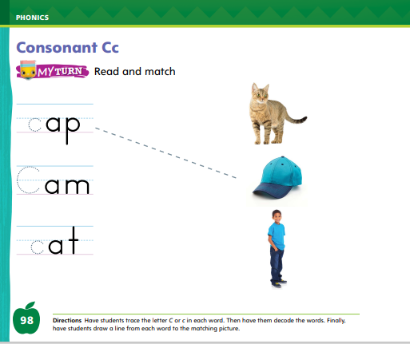
Page 98
Phonics
Turn to page 98 in your Student Interactive and complete the activity.
Notes:
Hold up the Cc Alphabet Card and show the picture of the cactus. This is a picture of a cactus. I hear the sound /k/ at the beginning of cactus. Say the sound /k/ with me. Point to the word cactus at the bottom of the card. Point to the c and say the sound /k/. Do you hear the sound /k/? What letter spells the sound /k/? Have students identify the letter c. Click path -> Table of Contents -> Unit 1 Week 3 Informational Text -> Lesson 4
Have students turn to p. 98 in the Student Interactive.
Guide students as they write C or c on each line. Listen carefully as I say the new sound: /k/. Let’s decode the first word together: /k/ /a/ /p/, cap. Can you find the picture of the cap on the page? Draw a line from the word cap to the picture of the cap. Have students complete p. 98 in the Student Interactive.

Slide 51
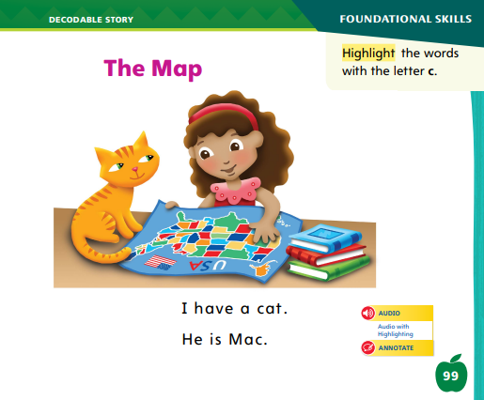
Page 99
Decodable Story
he
is
have
Turn to page 99 in your Student Interactive. Read “The Map” with your partner.
Notes:
Have students turn to p. 99 in the Student Interactive. We are going to read a story today about a girl and her cat. Point to the title of the story. The title of the story is The Map. I hear the sound /m/ in the word map. What other sounds that we learned do you hear in the word map? Students should say /a/ and /p/. In this story, we will read other words that have sounds you have learned.
Remind students of this week’s high-frequency words: he, is, have. Tell them they will practice reading these words in the story The Map. Display the words. Have students read them with you. When you see these words in the story The Map, you will know how to identify and read them.

Slide 52
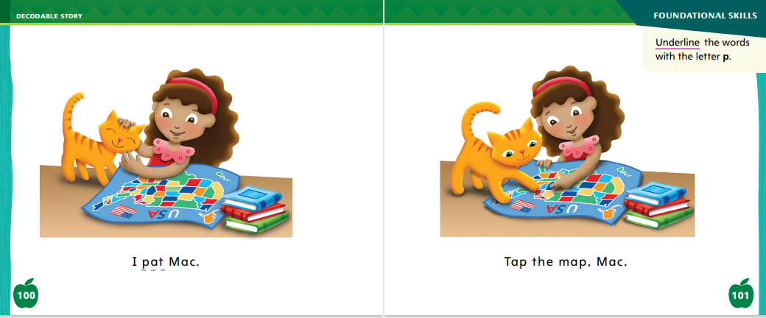
Page 100,101
Decodable Story
Notes:
Have students whisper read the story as you listen in. Then have them reread the story page by page with a partner. Listen carefully as they use lettersound relationships to read words with the sounds /p/ and /k/. Partners should reread the story. This time the other student begins.
After students have read the story, call their attention to the first sentence on p. 99. I see the letter c in the word cat. What sound does the letter c spell? Help them identify, or say the sound /k/. Then have students find and highlight the words with the sound /k/ on p. 99. I also see other words with sounds we learned before. Can you tell me the sounds? Help students identify, or say, /a/, /t/, and /m/.
Have students turn to pp. 100–101. Which words have the sound /p/? Point to them. Help students identify, or say, the sound /p/. Then have them find and underline the words with the sound /p/.

Slide 53
Page 107
Use Text Evidence
Notes:
Tell students that readers need to support their answers to questions by using evidence or examples from the text.
Explain that the evidence that supports the main idea of a text is the important details. Students should
think about questions they want to answer or ideas they want to express.
find key words in the question or prompt.
look for these key words while rereading the text to find text evidence.
Model how you would find text evidence to support the main idea of At the Library. I believe the main idea of At the Library is that libraries are special places. Now I need to use text evidence to support this main idea. I look for important details in the text. I know one detail is that the librarian can help me find books. I think this detail is evidence for why libraries are special. Direct students to the Close Read note on p. 111 and read the page aloud. Guide students to understand that taking a movie home makes a library special. Have them highlight this detail as text evidence that supports the main idea. Repeat with the Close Read note on p. 113

Slide 54
Page 110,111
Use Text Evidence
Turn to page 110, 111 in your Student Interactive
Notes:
Explain that authors give details about the main idea. Have students reread pp. 110–111 and highlight the words that tell about the main idea. DOK 2

Slide 55
Page 112,113
Use Text Evidence
Turn to page 112, 113 in your Student Interactive
Notes:
Remind students that the main idea of this text is that libraries are special places. Ask: Which words tell us about this main idea? Explain that details give more information about the main idea. Then have students highlight the supporting details on pp. 112–113 as text evidence. DOK 2

Slide 56
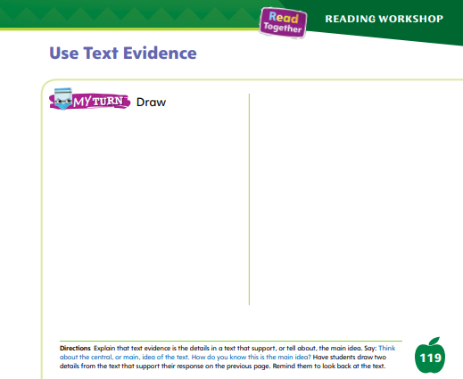
Page 119
Use Text Evidence
Turn to page 119 in your Student Interactive.
Notes:
Have students use the strategies for using text evidence
Have students draw pictures on p.119 in the Student Interactive of two things from the text that provide evidence that a library is a special place.

Slide 57
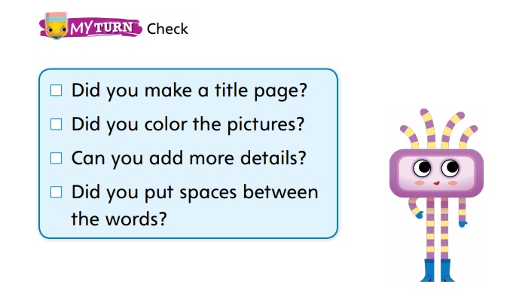
Page 127
Writing – Launch Writing Workshop
Notes:
Most authors finish writing one book before they start another one. A finished book has a cover, a title page, illustrations, and enough details.
It is also organized logically and has the correct spacing between words.
Show a book from your stack. Look at the cover that shows the title and author’s name.
Then review the title page.
Read the book aloud and show how the illustrations are complete and there are enough details on each page.
Point out that the book has an ending. Ask students what other information is needed to know that a book is complete.
Create a class checklist on the board or chart.
Display the checklist on p. 127 in the Student Interactive or use the checklist your class created.
Then show another book from your stack. Go through each item in the checklist as you look through the book.
Prompt students to tell you if the book is finished or needs more work.

Slide 58
Independent Writing
Why do you finish a book before starting another one?
What other items can you include on your checklist?
Notes:
As students begin their independent writing, have them continue writing their books.
Modeled: Think aloud about why you should finish a book before starting another one.
Shared: Ask guiding questions to help students brainstorm other items to include on their checklist.
Guided: Ask guiding questions to help students know what is missing from their books or if their books are complete.
Intervention Refer to the Small Group Guide for support.
If students have already finished writing, have them add illustrations or details and make any corrections to the text. They can refer to the checklist when they finish to make sure they have completed their books.
See the Conference Prompts on p. T350.
Call on a few students to read aloud their books. Then ask them what they still need to do to finish the book. Have them explain how they will know when the book is finished.

Slide 59
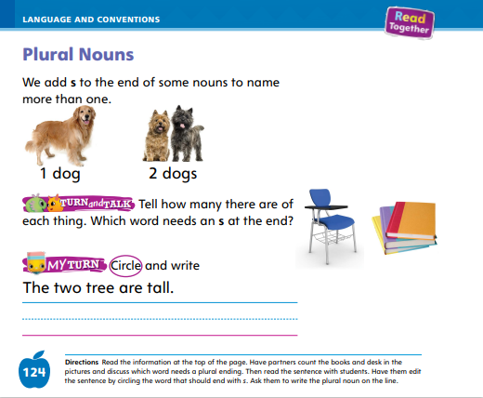
Page 124
Language and Conventions
Turn to page 124 in your Student Interactive and complete the activity.
Notes:
Provide the following words: one cats, two books, two pen, one car.
Have students read the words with you. Point to each word and ask students how to correct any mistakes.
Have students edit for a plural noun to complete the activity on p. 124 in the Student Interactive.
Depending on your students’ needs, have them work with a partner, independently, or with teacher guidance.

Slide 60
Lesson 5

Slide 61

Phonological Awareness
Notes:
Display the cap Picture Card. Listen to the beginning sound and ending part as I say this word slowly: /k/ -ap. Now I will say the beginning sound and ending part together to say the picture word: /k/ -ap, cap. Have students segment and blend the onset and rime in cap with you.
Pair students and give each pair a Picture Card, such as can, man, map, pan, pig, six, sock, ten, and tub. Have pairs segment and blend the onset and rime in their picture word. Then have pairs take turns presenting their word to the class. Click path -> Table of Contents -> Unit 1 Week 3 Informational Text -> Lesson 5

Slide 62
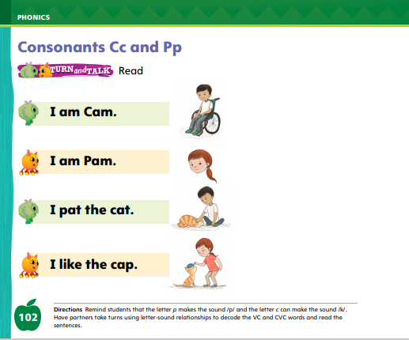
Page 102
Phonics
cat
pat
Cam
Pam
Cc
Pp
Turn to page 102 in your Student Interactive.
Notes:
Write the letters Cc and Pp on the board. Have students identify the letters as you point to them.
Then review the sound for each letter: c /k/, p /p/.
Tape a note card with Cc or Pp on each student.
Then write the word cat on the board. We will read this word together. If you hear the sound /k/, stand up if you have a letter c taped to you. If you hear the sound /p/, stand up if you have a letter p taped to you.
Point to each letter as you say the sounds and decode the word. Let’s read this word together: /k/ /a/ /t/, cat.
Repeat with the words pat, Pam, and Cam.
Have students turn to p. 102 in the Student Interactive and use the letter-sound relationships to decode the sentences with a partner.

Slide 63
High-Frequency Words
it
is
he
Notes:
Remind students that high frequency words are words that appear over and over in texts.
Remind them they will be learning many of the words this year, and the words will help them become better readers.
Say the word have and ask students what letters spell the word.
Have students
say the word have as you write it on the board.
repeat with is and he.
read the words aloud.

Slide 64
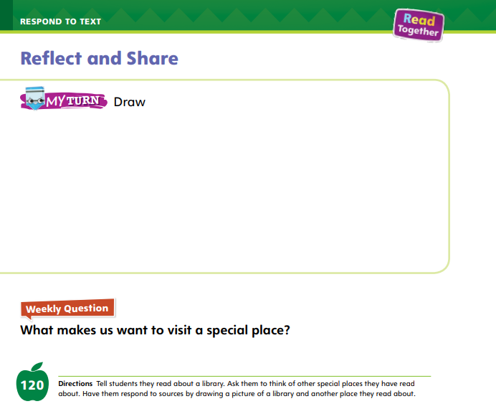
Page 120
Reflect and Share
Turn to page 120 in your Student Interactive and complete the activity.
Notes:
Remind students that writing and drawing are good ways for readers to tell what they think or feel about something they have read.
When they write or draw about a text, students should
think about what was most important, meaningful, or interesting in what they read.
think about how they feel about what they read.
choose how they want to express themselves.
take time to respond to the text by writing or drawing.
Read aloud the Weekly Question on p. 120 with students.
Model talking about special places using At the Library and “National Parks.” The text says that a library is a special place because a librarian is there to help me.
Brainstorm some places students think are special and ask them to tell why. I think the library we read about today is a pretty special place, and a national park is special, too, because it is a place where I can see wonderful landforms and interesting animals. I can relax and do fun activities in a national park.
I could draw a picture of some of the special things I have seen in a national park.
Ask partners to choose a special place and talk about why it is special.

Slide 65
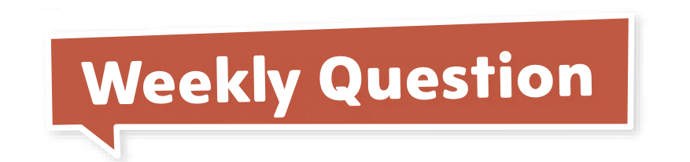
Page 120
Apply
What makes us want to visit a special place?
Notes:
Have students draw a library and another special place they have read about on p. 120 in the Student Interactive.
Have students use evidence from the texts they have read this week to respond to the Weekly Question. Tell them to discuss in small groups.

Slide 66
Page 127
Writing - Launch Writing Workshop
Notes:
To make sure a book is finished, authors go back and read their work. At that time, they can
add more details to the text.
make sure words are spelled correctly.
check to see that pictures and words are on the right pages.
Tell students that they will write many books during Writing Workshop, and it is important to know when to start a new one.
If at any time a student has a better idea, it is OK to put an unfinished book aside and begin a new one.
Otherwise, when completing a book, there are steps they can take to make sure the book they are working on is complete.
Using a stack text, have students follow along as you model checking whether it is complete.
Refer to the checklist on p. 127 in the Student Interactive or use a checklist your class created.
As you page through the book, talk aloud to check off the items in the checklist. Notice that the book has a title page.
Notice that the pictures and words match up on the pages.
Continue going through the checklist and thinking aloud so students can follow your thought process about how to check if a book is finished. Ask: Can I add more details to this book? Even when you think you’re done, you probably have a lot more work to do! There are always more details you can add.
Make note of their suggestions and decide what to add, continuing to talk through your thought process.
When you are done, have students complete the checklist on p. 127 for their own book.

Slide 67
Language and Conventions
Can you give me three pen?
We have a new car.
I have two white cat.
Bob is a big boys.
Notes:
Display the following sentences:
1. Can you give me three pen?
2. We have a new car.
3. I have two white cat.
4. Bob is a big boys.
Read each sentence.
Have students tell whether each one uses correct plural nouns.
Ask how they would make the incorrect nouns correct.
Have students complete Language and Conventions, p. 26, from the Resource Download Center. Click path: Table of Contents -> Resource Download Center -> Language and Conventions -> U1 W3

Slide 68
Unit 1: Week 3
Grade K

