Slide 1

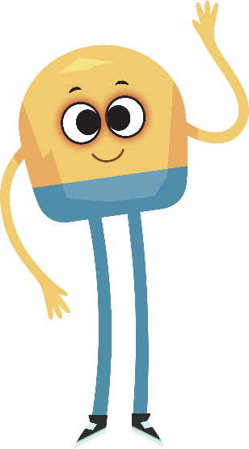

Unit 1: Week 4
Grade K

Slide 2
Copyright © Savvas Learning Company LLC. All Rights Reserved.
This publication is protected by copyright, and permission should be obtained from the publisher prior to any prohibited reproduction, storage in a retrieval system, or transmission in any form or by any means, electronic, mechanical, photocopying, recording, or otherwise. For information regarding permissions, request forms, and the appropriate contacts within the Savvas Learning Company Rights Management group, please send your query to:
Savvas Learning Company LLC, 15 East Midland Avenue, Paramus, NJ 07652
or
k12learningpermissions@savvas.com
myView Literacy® is an exclusive trademark of Savvas Learning Company LLC in the U.S. and/or other countries.

Slide 3

Lesson 1

Slide 4
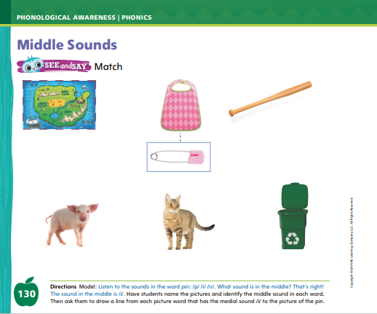
Page 130
Phonological Awareness
Turn to page 130 in your Student Interactive.
Notes:
Tell students that today they will learn a new sound. Listen carefully as I say the sound: /i/ /i/ /i/. The sound /i/ is made by opening your mouth and pushing out from your throat. Show students how to make the sound /i/ and have them practice it. Try saying the sound /i/ several times.
Have students turn to p. 130 in the Student Interactive. Tell them to look at the picture of the pin. Listen to the sounds in this word: /p/ /i/ /n/. What sound do you hear in the middle?
Tell students they will name each picture on the page and draw a line from each picture word with the middle sound /i/ to the picture of the pin. Listen to the sounds in the word map: /m/ /a/ /p/. Does map have the middle sound /i/? No, it doesn't, so you will not draw a line.
Have students complete the activity on p. 130

Slide 5

Page 131
Phonics
pit Tim
mom hip
tap fish
Pam pet
fit
Notes:
Hold up Alphabet Card li and point to the picture of the igloo. Have students say igloo with you. Let’s say the sound at the beginning of the word: /i/. The beginning sound /i/ is spelled with the letter i. Point to the letters Ii on the Alphabet Card. Tell students the word igloo begins with the sound /i/, so it begins with the letter i. Click path -> Table of Contents -> Unit 1 Week 4 Realistic Fiction -> Lesson 1
Write the letters I and i on the board. Have students turn to p. 131 in the Student Interactive and trace the letters on the first line with their fingers. Tell students that you will say a group of words that may or may not have the middle sound /i/.
Direct them to listen for the sound /i/ and trace the letter in the air when they hear it. Use the following words: pit, Tim, mom, hip, tap, fish, Pam, pet, fit.

Slide 6
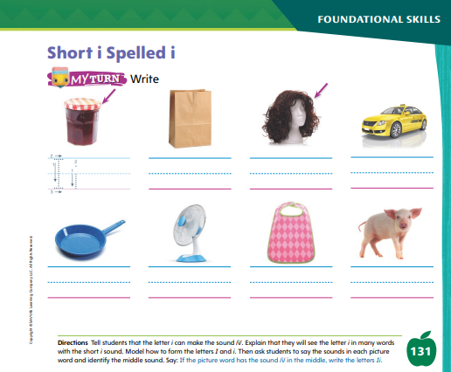
Page 131
Apply
Turn to page 131 in your Student Interactive and complete the activity.
Notes:
Have students look at p. 131 in the Student Interactive. Point to the letter i and tell me the sound it spells. Now we will name each picture and write the letters Ii on the line below each picture with the sound /i/.
Direct students to the first picture. Say the word lid, emphasizing the sound /i/. Does this word have the sound /i/? Yes, it does, so you will trace the letters Ii.
Tell students to complete the activity. If students need additional practice with letter recognition, use the Letter Recognition Unit on SavvasRealize.com or on pp. xvii–xliii in this Teacher’s Edition. The unit includes instruction, activities, and student practice sheets

Slide 7
High-Frequency Words
my
we
make
Notes:
Display the high-frequency words my, we, and make.
Point to the word my and read it.
Have students point to the word my and read it.
Repeat for we and make

Slide 8
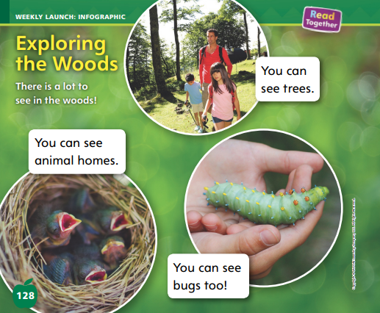
Page 128
Interact with Sources
Essential Question: What makes a place special?
Weekly Question: What is fun about exploring new places?
Notes:
Have students recall the Unit Essential Question: What makes a place special?
Then introduce them to the Weekly Question: What is fun about exploring new places?
Tell them that exploring a new place can be fun for many different reasons. Prompt them to think about the relation between the two questions by pointing out that when you explore a new place, you can discover the things that make it special.
Have students follow along as you turn to p. 128 of the Student Interactive and point to the picture of the family walking.
Explain that people can see a lot when they explore the woods. Then read the infographic, “Exploring the Woods.”
Ask students to point to the trees in the picture of the family.
Have students tell what kind of bug they see in the picture at bottom-right. Identify the caterpillar for those students who do not know what it is.
Have students tell what kind of animal home is shown in the picture at bottom-left. Guide them to realize that it is a nest for baby birds.
Encourage students to ask questions about the infographic to clarify any information they do not understand.
Have students interact with sources by coloring in response to the pictures and text on pp. 128–129.
Point out the Week 4 Question: What is fun about exploring new places? Tell students that they just learned about some ways that people can have fun while exploring the woods. In the woods, there are many things to see.
Tell them that there are other ways to have fun while exploring a new place, and there are many different new places that can be explored, in addition to the woods.
Tell students that they will learn about some of these places, and about fun ways to explore them, over the week.

Slide 9
Listening Comprehension
In the Mountains
home
2.
3.
4.
Notes:
Tell students that you are going to read aloud a realistic fiction story, “In the Mountains.” Remind them that realistic fiction stories are stories that can happen in real life.
They have characters that we could know in our everyday lives and settings that are places we could really go.
Tell students that even the events in stories are things that could happen in real life.
Ask students to actively listen to the story you will read aloud.
Have students demonstrate understanding by asking and answering questions about key details in the story. Invite them to think about the setting and characters, which make the story an example of realistic fiction.
Purpose: Have students listen actively to determine where and when the story takes place.
READ: the entire text aloud without stopping for the Think Aloud callouts.
REREAD: the text aloud, pausing to model Think Aloud strategies related to the genre.
Use the chart to help students identify where and when the story takes place. Say: This story does not happen all in the same place. Tyler is at home at the beginning of the story. I will write this on the chart. Ask: Where does Tyler go? What else do we learn about the setting?

Slide 10
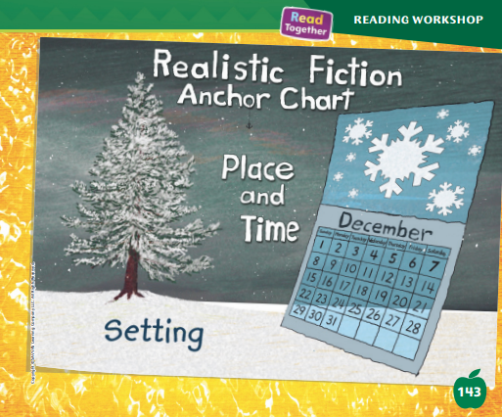
Page 143
Realistic Fiction
Turn to page 143 in your Student Interactive.
Notes:
Tell students that today they will learn about the setting of realistic fiction.
The setting is where and when the story takes place.
The setting in realistic fiction is a real place.
The events in one story can happen in more than one place.
Realistic fiction might take place in a park, at school, or any place you can visit. If it is not a real place or the events could not happen at the place that is described, it is not realistic fiction. Knowing about the setting will help the reader understand the events and what is happening to the characters.
Have students turn to p. 143 of the Student Interactive. Briefly review the anchor chart. Remind students about the Read Aloud called “In the Mountains.”
The setting is where the story takes place. The story about Tyler happens in the mountains. Tyler builds a snowman. This is something that could happen in the mountains. This helps me know it is realistic fiction. It is cold. This is part of the setting, too. Editable Anchor Chart Click Path: Table of Contents -> Reading Anchor Charts -> Unit 1 Week 4: Realistic Fiction Editable Reading Anchor Chart

Slide 11
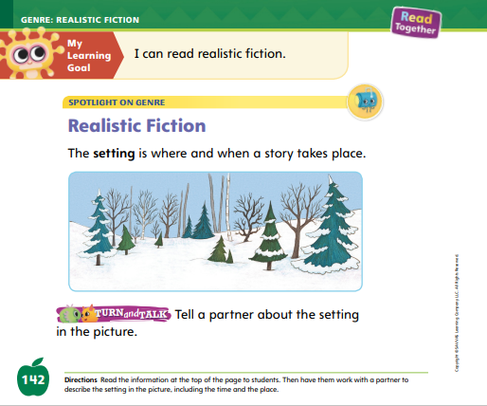

Page
142
Apply
Tell a partner about the setting in the picture?
Notes:
Have students turn and talk with a partner about the setting in the picture on p. 142 of the Student Interactive.
Then ask volunteers to share their ideas with the class.

Slide 12
Academic Vocabulary
moves
moved
Notes:
Explain to students that word parts are small parts of words that are added to a word to make a new word. Word parts can tell us when actions happen.
Ask a student to demonstrate moving around the room.
Explain that the student moves around the room. Write the word moves on the board and circle the -s. Tell students that this is the word move. The -s at the end of the word moves shows the action is happening right now.
Then ask the student to sit back down. Tell students that the student moved around the room but is now done. Write moved on the board and circle the -ed. Tell students that -ed shows that the action happened in the past.
Wave to the class and tell them that you enjoy waving at people. Then stop waving. What word part can I add to the word wave to tell that I am finished waving to you? I know that an -ed word part shows that something happened in the past. So I can say I waved to you. The -ed shows that the action is finished.
Provide additional sample words.

Slide 13
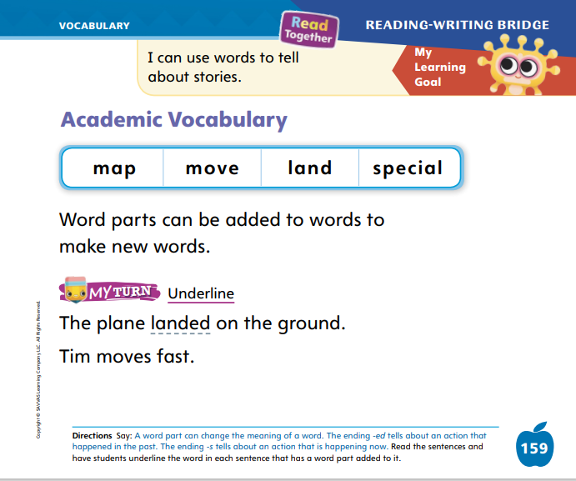
Page 159
Apply
Underline on page 159 in your Student Interactive.
Notes:
Read aloud the first sentence on p. 159 in the Student Interactive.
Ask which word tells what the plane did and shows that the action is finished.
Have students underline the word. Continue with the second sentence.
Then have students use what they know about the meaning of map and the word part -ed to tell the meaning of the verb mapped.

Slide 14
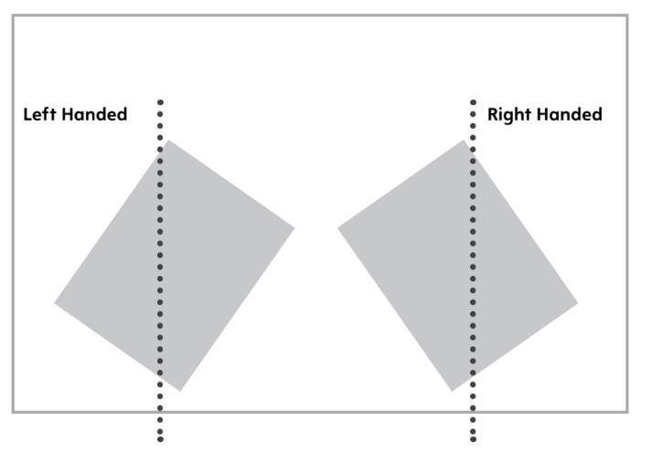
Handwriting
Notes:
Tell students that it will be easier for them to write numbers and letters if they position the paper on their desk in the right place.
Model sitting at your desk, in the correct sitting position, with the paper in the right spot. Writers who are right-handed should place their paper at a slant to the left. The paper should be moved a bit away from the edge of the desk. Left-handed writers should slant their paper to the right.
Have students follow the example for proper paper position on p. 20 of the Resource Download Center.
Click path: Realize -> Table of Contents -> Resource Download Center -> Handwriting Practice -> U1W3L1 Handwriting Practice

Slide 15
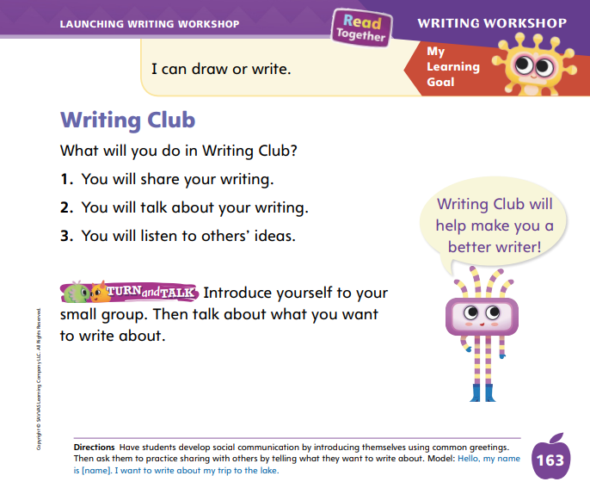
Page 163
Writing – Launching Writing Workshop
Turn to page 163 in your Student Interactive and complete the activity.
Notes:
Writing Club happens once a week and provides students with an opportunity to share their writing, talk about their writing, and listen to other people’s ideas about their writing.
Model introducing yourself using common greetings. Tell students that today you will talk more about Writing Club. Remind students that they have already spent some time in their Writing Club groups. In Writing Club, students share their work with one another and ask for feedback, just like real writers who join writing groups. Say that today you will pretend that you are part of a Writing Club too.
Choose a stack book and introduce yourself as the author. Tell the students about the idea for the book. Explain why you chose that topic. I chose this topic because _______. Next, pose a question to the class: Does anyone have an idea to help me write my story? Model listening actively and jotting notes down. As you jot notes about their suggestions, think aloud: I like that suggestion, so I will write it down. Writing down other people’s ideas helps me remember what I can do to be a better writer.
Arrange students into their Writing Club groups. Have them complete the Turn and Talk activity on p. 163 in the Student Interactive.

Slide 16


Independent Writing
What type of book did you choose?
Why did you pick that topic?
Notes:
During Independent Writing, have students continue to write or draw a book. Encourage them to think about what they would talk about with their Writing Club.
Modeled: Model how to participate in a Writing Club by introducing yourself and explaining your idea for a book. Write a list of questions you would ask the group.
Shared: Have students choose a stack book. Read the author’s name together. Have them introduce themselves as the author and tell their story idea.
Guided: Use the stack book and provide explicit instruction on what the author would do during Writing Club.
Intervention Refer to the Small Group Guide for support.
When conferring individually with students, use the Conference Prompts on p. T374.
Call on a few students to share their books. Engage students in a discussion about the type of book they made. Why did they decide to write about this topic?

Slide 17
Language and Conventions
Notes:
Tell students that nouns name people, animals, places, and things. Remind them that when there is more than one, such as two animals, we often add -s.
Draw simple sketches of one book and two books. Under the sketch of one book, write one book. Under the sketch of two books, write two books. Circle the -s. Have students hold up two hands and ask how many hands they are holding up. Repeat by asking them to hold up one pencil, show three fingers, show their thumbs, and point to their eyes.
Draw three circles, two squares, and one triangle on the board. Ask partners to state in complete sentences how many of each shape there are.

Slide 18
Lesson 2

Slide 19

Page 132
Phonics
Notes:
Display the Ii Alphabet Card. This is an igloo. I hear the sound /i/ at the beginning of igloo. Say the sound /i/ and the word igloo with me: /i/, igloo. Point to the letters on the Alphabet Card. The letter i spells the sound /i/ in igloo and other words. What letter spells the sound /i/? Have students identify the letter i. Then have them trace the letters Ii in the air as you lead them. When you see the letter i in a word, what sound will you say? Students should identify the sound /i/. Click path -> Table of Contents -> Unit 1 Week 4 Realistic Fiction -> Lesson 2
Have students turn to p. 132 in the Student Interactive.Help students name each picture in the first row. Then have them point to the word at the beginning of the row. Have students trace the letter i. Now let’s read this word together. What is the sound for the letter s? What sound can the letter i make? What is the sound for the letter p? Now let’s say the sounds together to read the word: /s/ /i/ /p/, sip. Which picture shows the word sip? Have students circle the picture for sip.

Slide 20
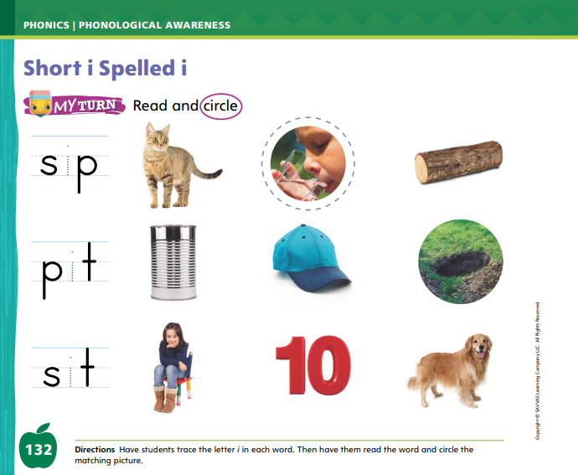
Page 132
Apply
Turn to page 132 in your Student Interactive and complete the activity.
Notes:
Have students complete p. 132 of the Student Interactive.

Slide 21
High-Frequency Words
my
we
make
Notes:
Tell students that high frequency words are words that they will hear and see over and over in texts.
Write and read the words my, we, and make. Have students
read each word.
spell each word, tugging lightly on their ear lobe as they say each letter.

Slide 22
Page 144,145
Preview Vocabulary
chasing
scrambles
slips
follows
Notes:
Introduce the words chasing, slips, scrambles, and follows on p. 144 in the Student Interactive. As you read each word, have students say the word.
Have students share what they already know about the words. Ask questions such as: Have you ever seen a squirrel chasing another squirrel? What happens when someone slips? What does it look like when an animal scrambles? When do you follow the teacher?
Have students take turns acting out each word.
These words will help us understand the story Where Is Twister?

Slide 23
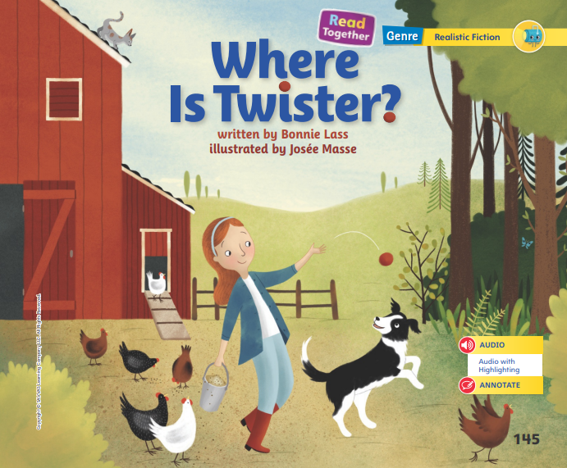
Page 145
Print Awareness
Turn to page 145 in your Student Interactive.
Notes:
Explain that the author is the person who writes a story and the illustrator is the person who makes the pictures in a story. Help students identify the names of the author and illustrator on p. 145 in the Student Interactive. Ask them to tell how each person helped to create Where Is Twister?

Slide 24
Page 145
First Read Strategies
Turn to page 145 in your Student Interactive.
Notes:
Discuss the First Read Strategies. In this first read, encourage students to enjoy the story.
After students complete the First Read ask, What did you like most about this story? Did it remind you of anything else you have read?
READ Encourage students to read or listen as you read the realistic fiction. During the first reading, students should find out who Twister is.
LOOK Remind students to look at the pictures to learn about the setting and characters.
ASK Have students ask questions about the text to deepen understanding.
TALK Guide students to talk to a partner about the text.
Help students read the whole text independently, in pairs, or as a whole class. Use the First Read notes to help students connect with the text and to monitor comprehension.

Slide 25
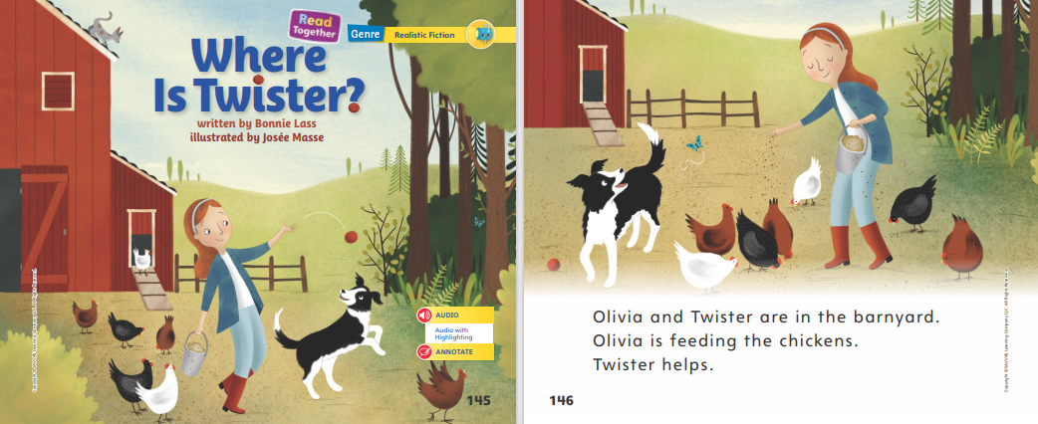

Page 145,146
First Read – Where Is Twister?
Notes:
Read together.
The pictures on these pages help me know about the setting, or the place where the story happens. I can see Olivia feeding chickens. She and Twister are in the barnyard. I can see a barn in the picture too. Barns and chickens are on farms. From the picture, I can see that the setting is a farm. The pictures on the next pages show a different place. If I look at these pictures, I can see that the setting has changed.

Slide 26
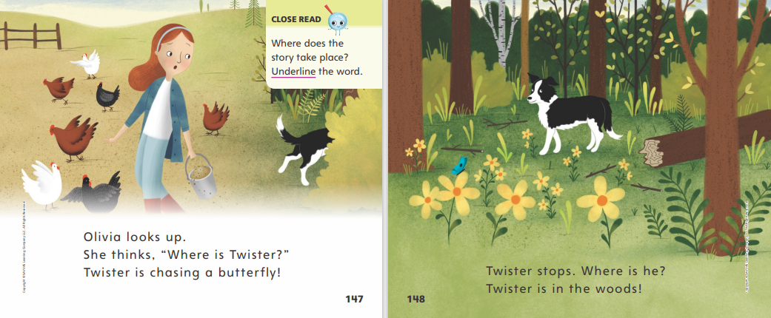
Page 147,148
First Read – Where Is Twister?
Notes:
Read together.

Slide 27
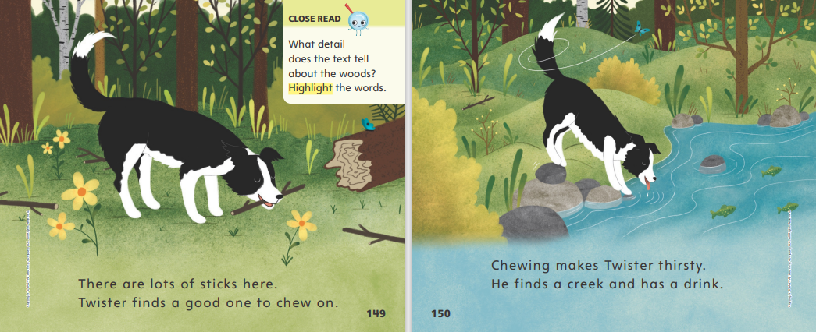

Page
149,150
First Read – Where Is Twister?
Notes:
Read together.
Twister seems to be pretty far away from Olivia now. I am going to ask myself some questions to make sure I understand what is happening in the story: Where is Twister? Does Olivia know where Twister is? Is the book titled Where Is Twister? because he seems to be getting away from where he should be?

Slide 28
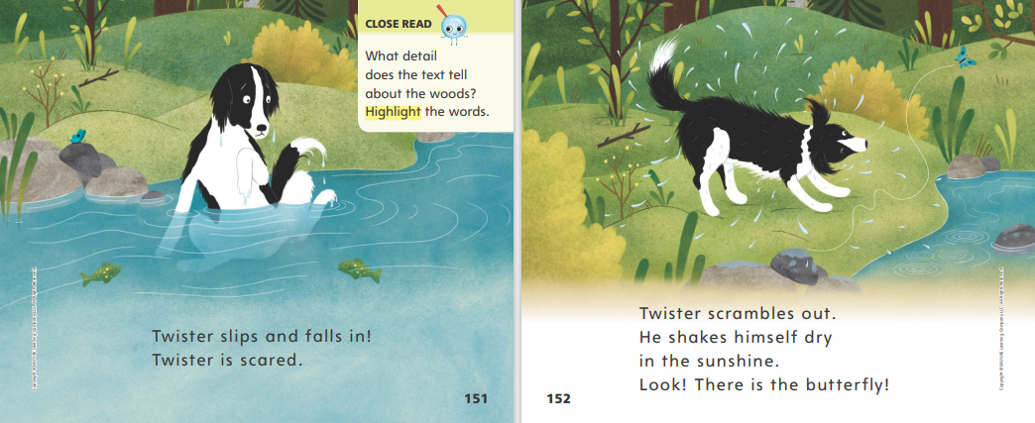
Page 151,152
First Read – Where Is Twister?
Notes:
Read together.

Slide 29
Respond and Analyze
Talk- Find a page or illustration you think is funny or interesting.
Connect- Why do you think the book is called “Where is Twister?”
Notes:
Summarize the story. Then ask students what they liked most about the story.
Talk: Ask students to find a page or illustration that they thought was funny or interesting. Invite them to tell what is happening in that part of the story.
Connect: Ask students why they think the book is called Where Is Twister

Slide 30
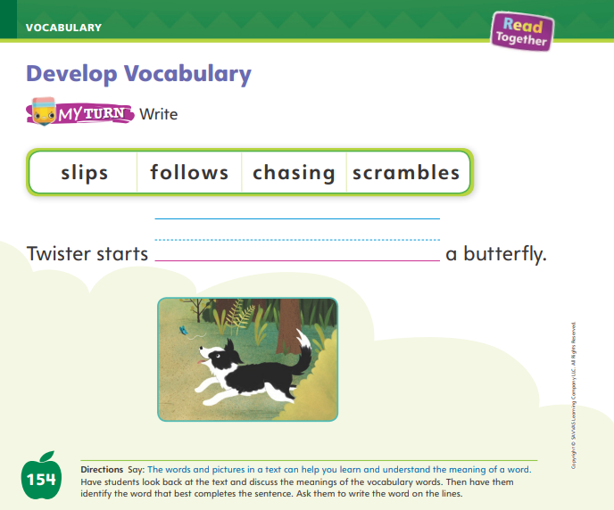
Page 152
Develop Vocabulary
Turn to page 152 in your Student Interactive.
Notes:
Explain to students that they can use context clues to find word meanings. Let them know that they can look at the words or phrases that come before and after a word to guess the meaning of the word. They can also use pictures to figure out what a word means.
Look for action words that tell you what is happening.
Ask yourself what the word means.
What other words in the sentence give us a clue about the meaning? What does the picture show?
Have students look at p. 152 of the Student Interactive. Read aloud the first two sentences. Have students discuss what is going on in the picture. Then model how they can use context clues and the pictures to find the meaning of the word scrambles.
Twister scrambles out. He shakes himself dry. I know that, on the page before, he slips and falls in the water. When I look at the picture and read the words, I see that Twister is out of the water and shaking the water off. Scrambles likely means climbing out.

Slide 31
Page 154
Check for Understanding
What happens at the end of the story?
What words help you know how Olivia feels?
Do you thin Twister will go back into the woods?
Notes:
Have students complete p. 154 in the Student Interactive.
Have students complete the Check for Understanding on p. 155 of the Student Interactive.

Slide 32
Writing – Launching Writing Workshop
Question | Answer
Notes:
We can ask questions because we need help. We can also ask questions because we want more information or because we want to make sure we understand something. We answer questions when we want to help people understand something or when we need to give someone a response to their question. To respond to a question, we have to think about our answer and then say it. Hold up a book from the stack and tell students that you will pretend to be the author, and they can ask you questions.
Make a T-Chart. On the left side, write Question; on the right, write Answer.
Read the book aloud, allowing students to look at the pictures. When you are finished reading, ask: Who has a question for me about my book? Write the question on the left side of the T-Chart. Answer the question aloud and write the answer in the right column. Continue doing this until you have several questions and answers on the board. When you can engage students to help answer a question, do so and record their answer on the chart.
Explain to students that in Writing Club they will ask and answer questions to learn about each other’s books. Tell students that they should ask each other questions if they need help, if they want more information, or if they want to make sure they understand what someone has said.

Slide 33
Independent Writing
Let’s continue writing and drawing in your book.
Think about questions that you could ask
in Writing Club.
Notes:
During Independent Writing, have students continue writing and drawing their books. Encourage them to think about questions they could ask their Writing Club.
Modeled: Show a stack book and model asking questions about it to learn more.
Shared: Show a stack book and have students ask questions to learn more about the topic. Then read some pages of the book and ask students if the author “responded” to any of their questions.
Guided: As students read books, prompt them to ask questions and/or provide answers about the text.
Intervention Refer to the Small Group Guide for support.
As you confer with students, use the Conference Prompts on p. T374.
Call on a few students with whom you conferred to share a page of their books. After each student has shared, ask a question about that student’s book and allow the student to practice answering.

Slide 34
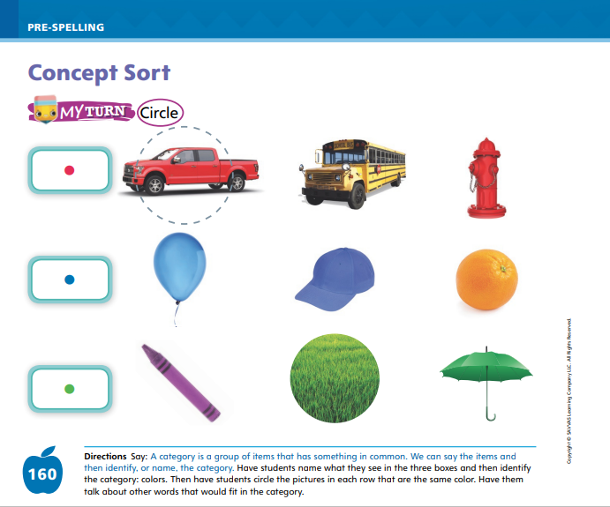
Page 160
Concept Sort
Turn to page 160 in your Student Interactive and complete the activity.
Notes:
Remind students that sorting means putting things into categories, or groups of items that have something in common. Things can be sorted by their size, such as large or small. Things can be sorted by their shape, such as circles, triangles, and squares. We can also sort things by their colors.
Show students different colored blocks and model how you can sort them into colors. These blocks are different colors. I can sort them by their color. I can put all the green blocks together, all the red blocks together, and all the blue blocks together. Mix up the blocks and call on a volunteer to sort the blocks by color. Then have students tell what each group has in common and use the words to identify the category: colors.
Have students look at p. 160 in the Student Interactive and say the colors of the dots in front of the pictures. Have them put their finger on the red dot. Ask students which pictures are red. Then have them circle the red pictures. Ask students to complete the rest of the activity.
You may want some students to work with a partner.

Slide 35
Language and Conventions
-s
-es
person
animal
place
thing
Notes:
Tell students that nouns name a person, animal, place, or thing. Plural nouns name more than one. Sometimes a noun is made plural by adding -s and sometimes a noun is made plural by adding -es.
Tell students that when nouns end with the sound /s/, /ch/, or /ks/, we add the ending -es to make a plural noun. For other nouns, we add the ending -s. Say a word, such as dress. How can I make this a plural noun? The word ends with the sound /s/, so I will add the ending -es: dresses.
Have students sit in a circle. Give one student a soft ball and ask him or her to say a noun. The student should pass the ball to the student on his or her right, who will add -s or -es to make a plural noun. Then that student names another noun and passes the ball. Continue until all students have had a turn.

Slide 36
Lesson 3

Slide 37

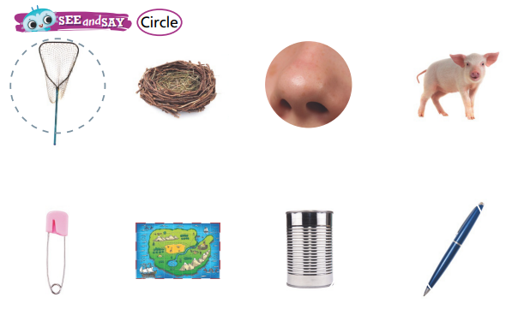
Page 133
Phonological Awareness
Turn to page 133 in your Student Interactive and complete the activity.
Notes:
Today we are going to learn a new sound. Listen carefully: /n/ /n/ /n/. The sound /n/ is made by placing your tongue just behind your teeth as you lower your mouth a little bit.
Show students how to make the sound /n/ and have them practice it.
Display the nest Picture Card. This is a nest. Listen to the beginning sound as I say this word: /n/ -est. What sound does nest begin with?
Continue with the can Picture Card for final /n/. Then say the following words and have students give a thumbs-up if they hear /n/ at the beginning of the word and a thumbs-down if they hear /n/ at the end: net, fan, run, not, nice, Jen.
Point to the picture of the net on p. 133 of the Student Interactive. Listen to the sounds in this word: /n/ /e/ /t/. Net has the sound /n/ at the beginning.
Have students complete the top half of the page by circling the picture words that begin with /n/. Then have them complete the bottom half of the page by circling the words that have the sound /n/ at the end

Slide 38

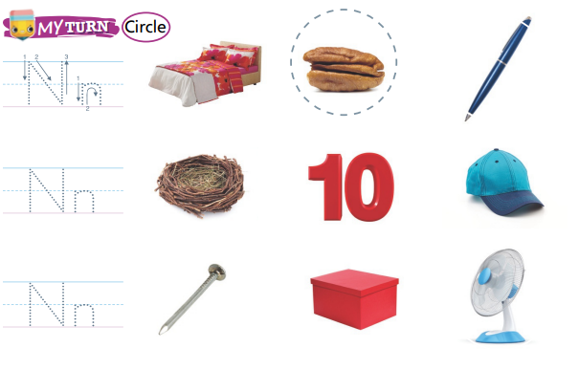
Page 134
Phonics
Turn to page 134 in your
Student Interactive and
complete the activity.
Notes:
Display Alphabet Card Nn. Point to the picture of the nest and tell students the word nest begins with the letter n. The letter n spells the sound /n/ at the beginning of nest.
Point to the letters Nn on the card, and tell students the names of these letters are uppercase N and lowercase n.
Slowly trace the letters as you say the sound /n/.
Have students turn to p. 134 in the Student Interactive. Ask them to trace the letters Nn on the first line.
What is the sound for this letter? Now we will circle the pictures that begin or end with this sound. Listen to the sounds in this word: /b/ /e/ /d/. Do you hear the sound /n/? No, so we will not circle the picture of the bed. Now listen to the sounds in the next word: /n/ /u/ /t/. Do you hear the sound /n/? Yes, so we will circle the picture of the nut. Click path -> Table of Contents -> Unit 1 Week 4 -> Lesson 3

Slide 39
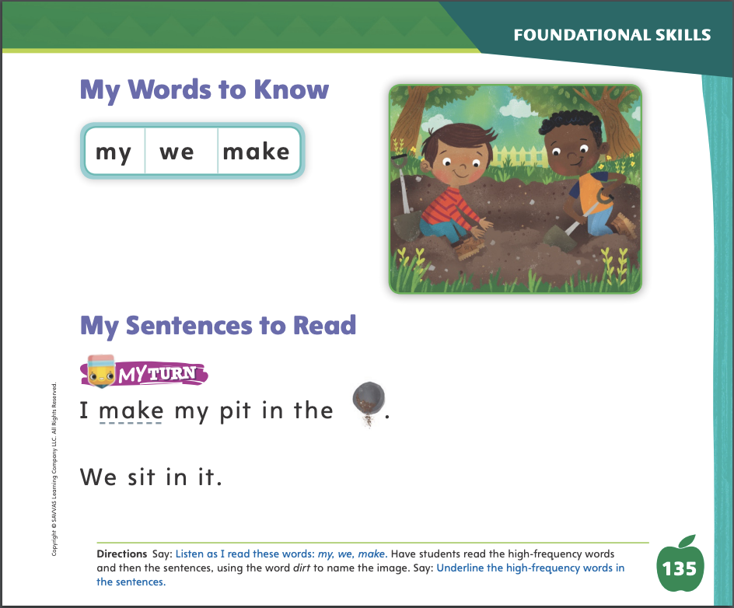
Page 135
High-Frequency Words
Turn to page 135 in your Student Interactive and complete the activity.
Notes:
Today we are going to continue working with high frequency words. Have students read the words at the top of p. 135 in the Student Interactive with you: my, we, make.
Have students look at the words at the top of p. 135. Say: I will read a word, and I want you to point to it. Then we will read the word together. Read my, and have students point to it. Now let’s read the word together: my. Repeat with the other words. Encourage students to use the words in sentences.
Have students read the sentences on p. 135. Ask them to identify the words my, we, and make in the sentences and underline the words. Then have them read the sentences again with a partner.

Slide 40
Page 145
Describe Setting
Notes:
Tell students an important part of a realistic fiction story is its setting. The setting is where and when a story takes place.
Look at the pictures. What do they tell you about the setting?
Look at the words. Which words describe the setting?
Is this setting a place you can visit in real life?
The reader can understand the setting of a story by looking at the pictures and reading the text.
Knowing about the setting helps the reader better understand the story.
Remind students that they read a selection two weeks ago called Too Many Places to Hide. Tell them that Too Many Places to Hide is a realistic fiction story, so it has a setting that can exist in real life.
The pictures help me tell where the story takes place. On p. 70, I see that the family is inside their new house. Their house must be the setting.
Details about the text can give hints about the setting, too. I read on p. 70 that the house has many places to hide. Maybe this means that the story takes place in a house that is big.

Slide 41
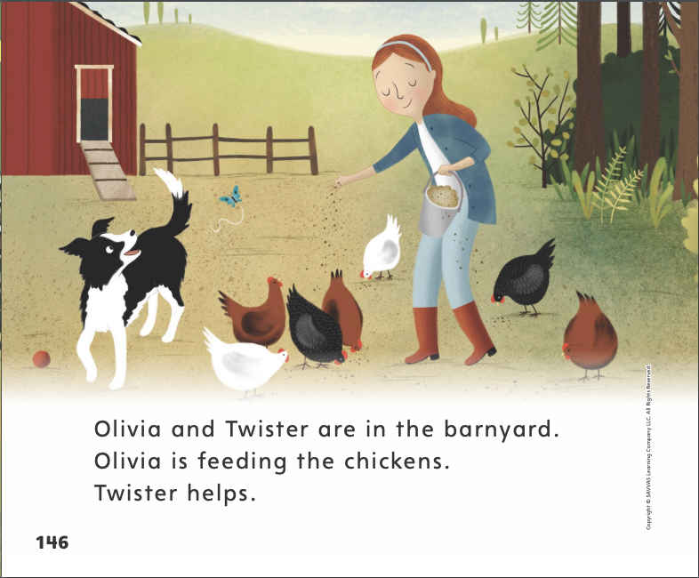
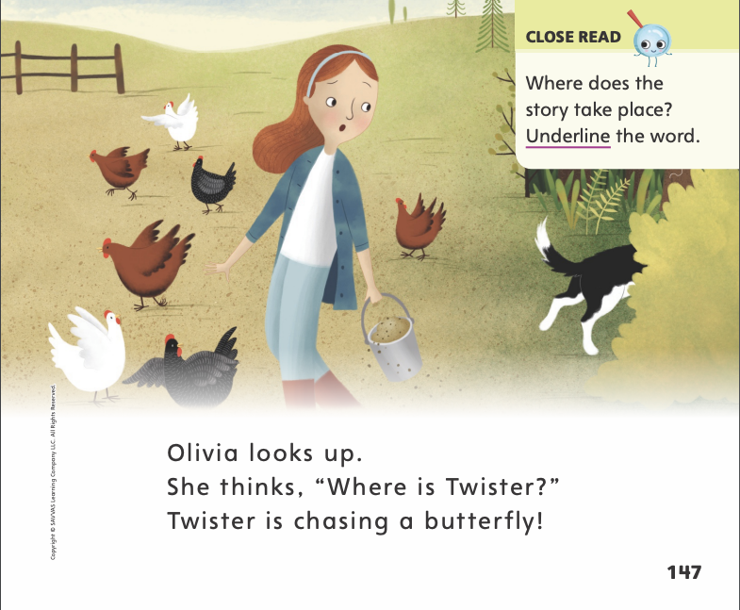
Page 146,147
Close Read – Describe Setting
Turn to page 146, 147 in your Student Interactive
Notes:
Have students discuss the setting. Reread p. 146. Have students underline the word that tells about the setting. DOK 1

Slide 42
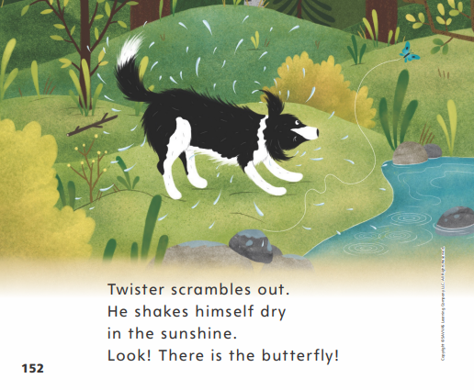
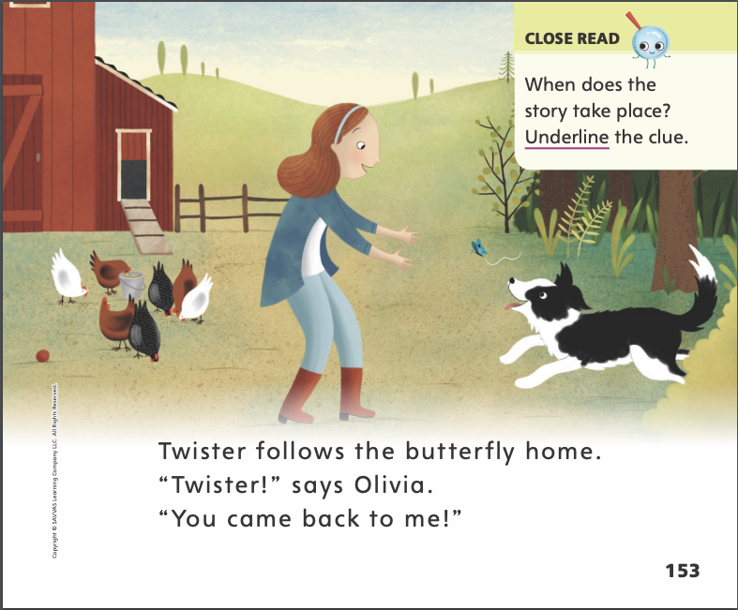
Page 152,153
Close Read – Describe Setting
Turn to page 152,153 in your Student Interactive
Notes:
Have students underline the clue that tells whether the story takes place during the day or at night. DOK 2

Slide 43
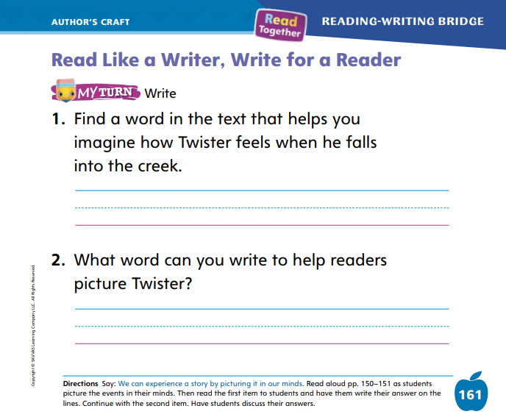

Page 161
Read Like a Writer, Write for a Reader
Turn to page 161 in the Student Interactive and complete the activity.
Notes:
Explain to students that authors choose words carefully when they write. They want to make sure that the reader can understand the story.
Authors use words to help the reader know how the characters feel.
Authors describe the setting of the story so that readers can picture the story in their head, even without the pictures.
Ask students to turn to p. 149 in the Student Interactive. Reread the text for students. The words the author uses help me understand how Twister feels. The words a good one describe the stick. Twister must feel happy to find a good one to chew on. The picture shows this too! Twister is happy. Provide additional examples of text that shows the characters’ feelings or the details of the setting.
Have students complete p. 161 of the Student Interactive. Students will need to look back into the text to respond to the questions.

Slide 44
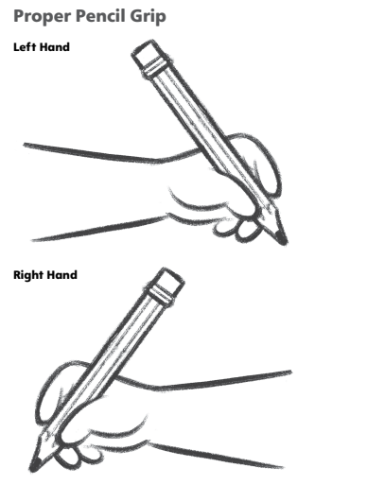
Handwriting
Notes:
Explain to students that they can get better at writing letters if they hold their pencils correctly.
Without a proper pencil grip, they will find it difficult to draw the lines that form letters.
Show students a non-example and a proper example of good pencil grip. When I hold my pencil far from the tip, it is hard to write. I cannot control the tip of the pencil well. I will hold it closer to the tip with the point. I will also hold it between my thumb and first two fingers. Click path: Table of Contents -> Resource Download Center -> Handwriting Practice -> U1W4L1 Handwriting Practice
Have students use Handwriting p. 21 in the Resource Download Center to practice proper pencil grip.

Slide 45
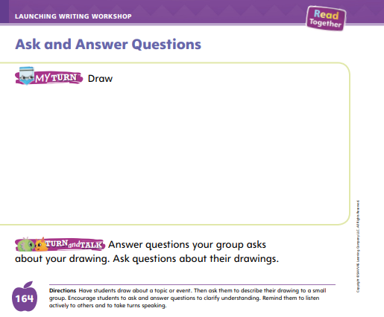
Page 164
Writing – Launching Writing Workshop
Turn to page 164 in your Student Interactive.
Notes:
Asking questions about a book is a good way to learn more or help understand something. You may ask questions before reading a book, while reading a book, or after reading a book. Questions can start with who, what, where, when, why, and how.
Use a flip chart for this lesson. Write the following question words on the top part of the chart:
Who
When
What
Why
Where
How
Show a book from the stack and look at its cover. Do a Think Aloud and use the question words to ask a question. Write down each question. Explain to students that as you read, you might find answers to your questions or you might have more questions. Ask questions such as: What will happen next? Why did the character feel this way? Write the questions on the chart. When you are finished reading, have students ask questions using the question words.
Then have students look at p. 164 in the Student Interactive. Tell them to draw a picture about a topic or event. Have them gather in small groups and ask and answer questions about their drawings

Slide 46
Independent Writing
Let’s continue writing.
Share your book with your class.
Notes:
Have students continue working on their books. As they write, they can continue to think of questions for their Writing Club.
Modeled: Show students how to take turns asking questions about a stack book.
Shared: Ask questions about a stack book and have students look through the book to try to find an answer.
Guided: Prompt students to use who, what, where, when, why, or how to ask their questions.
Intervention Refer to the Small Group Guide for support.
If students have finished writing, have them add drawings and think about questions related to those drawings. Remind students that they can begin a new book at any time.
See the Conference Prompts on p. T374.
Call on a student to share his or her book so far. Allow the rest of the class to ask questions about it.

Slide 47
Language and Conventions
I see a pretty beach.
glass
box
bus
Notes:
Display and read this sentence: I see a pretty beach.
Then have students tell you which word is a noun. (beach) Display and read this sentence: I see pretty beaches. Tell them that some nouns become plural by adding -es and others become plural by adding -s. Words ending in -ch, -s, and -x require -es.
Model adding the correct ending to a noun to make it plural. Draw a simple sketch of two glasses with the word glass under it.
I see two glasses, so I need to write the plural form. I see an -s at the end of the word glass, so I know I need to add -es.
Draw two sketches: three boxes and two buses. Label each sketch with the singular noun. Point to each drawing and ask students whether you should write an -s or an -es at the end of the word. Then write the word under the sketch. Call on students to circle the plural ending in each word.

Slide 48
Lesson 4

Slide 49

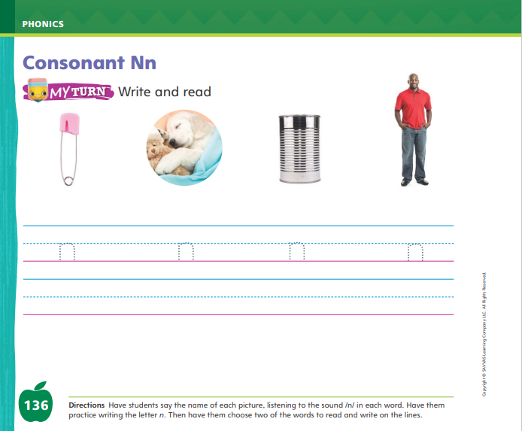
Page 136
Phonics
Turn to page 136 in your Student Interactive.
Notes:
Hold up the Nn Alphabet Card and tell students that the picture on the card shows a nest. This is a nest. I hear the sound /n/ at the beginning of nest. Say the sound /n/ with me.
Point to the n in the word nest and say /n/. Do you hear the sound /n/? What letter makes the sound /n/? Have students identify the letter n. Write the letters Nn on the board. Then have students trace the letters Nn in the air as you lead them.
Have students turn to p. 136 in the Student Interactive. Guide students as they trace the letter n on the first line. Listen carefully as I say the sound /n/. Now let’s look at the first picture on page 136 and say the picture word: pin. Write the word pin on the board. What is the sound for p? What is the sound for i? What is the sound for n? Let’s say the sounds together to read the word: /p/ /i/ /n/, pin. Have students read the word again with you.
Have students complete p. 136 in the Student Interactive.

Slide 50
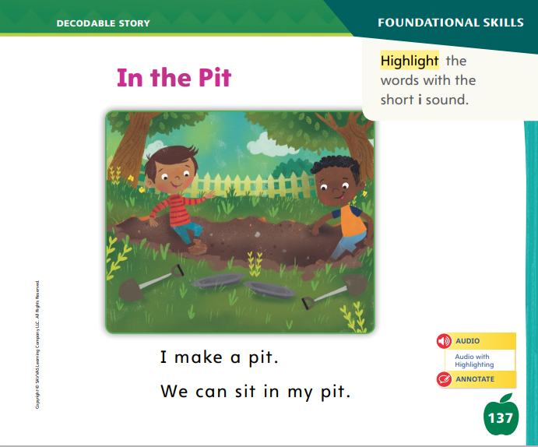
Page 137
Decodable Story
my
we
make
Turn to page 137 in your Student Interactive. Read “In the Pit” with your partner.
Notes:
Have students turn to p. 137. We are going to read a story today about two boys. Point to the title of the story. The title of the story is In the Pit. I hear the sound /i/ in the word in. What other word do we hear the sound /i/ in? Students should say the word pit. In this story, we will read other words that have sounds you have learned.
Remind students of this week’s high-frequency words: my, we, make. Tell them they will practice reading these words in the story In the Pit. Display the words. Have students read them with you. When you see these words in the story In the Pit, you will know how to identify and read them.

Slide 51
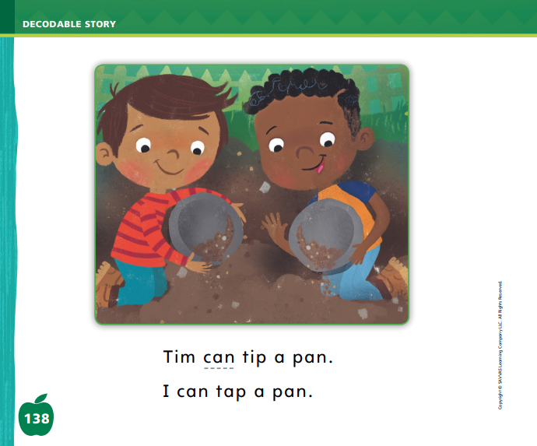
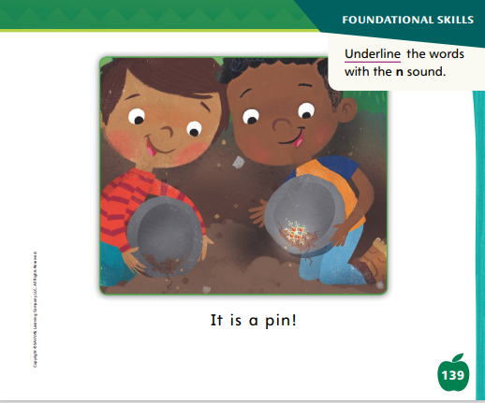
Page 138,139
Decodable Story
Notes:
Have students whisper read the story as you listen in. Then have students reread the story page by page with a partner. Listen carefully as they use lettersound relationships to read words with the sounds /i/ and /n/. Partners should reread the story. This time the other student begins.
After students have read the story, call their attention to the title. I see the letter i in the word in. What sound does the letter i spell? Help them identify, or say, the sound /i/. Then have students find and highlight the words with the sound /i/ on p. 137.
Have students turn to pp. 138–139. Which words have the sound /n/? Point to the words. Help students identify, or say, the sound /n/. Then have them underline the words with the sound /n/.
Point out the word tip on page 138. Say: In this story, what does tip a pan mean? It means to turn it over and dump out what’s in it. I can also give you a tip about printing your letters neatly. What does give you a tip mean? To give you a tip is to give someone some important information. Have students tell what the word tap means, and explain that a faucet on a sink can also be called a tap. Ask students to identify other words that have different meanings, such as race (verb: to run a race; noun: the race itself).

Slide 52
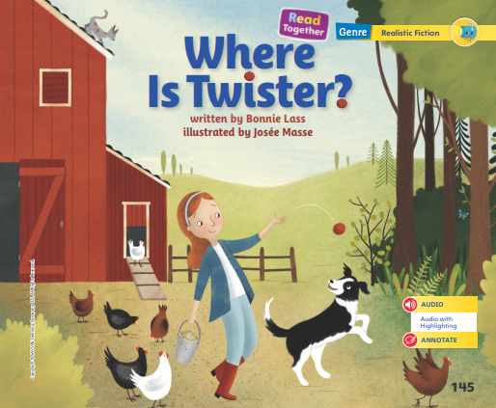
Page 145
Create New Understandings
Notes:
Tell students that reading a story more than one time can help them better understand the story. They can even begin to understand the story in new ways when they read it in more detail.
When I read a story for the first time, I read to understand it. When I read the same story again, I might see something new.
The second time I read a story, I might notice new details about the setting.
Readers synthesize information to create new understandings when they read closely. Each new read may show the reader something new about the story and even the setting.
Encourage students to leaf through the pages of Where Is Twister? and think about the setting with your assistance.
Each time I go through the pictures, I can get a new understanding about the setting.
I see that the story takes place on a farm. But I can begin to understand that the farm is a big place with woods and a stream. It’s so big that Olivia does not know where Twister goes on the farm. These details give me a new understanding of the setting. The story takes place in different places on and around the farm.

Slide 53
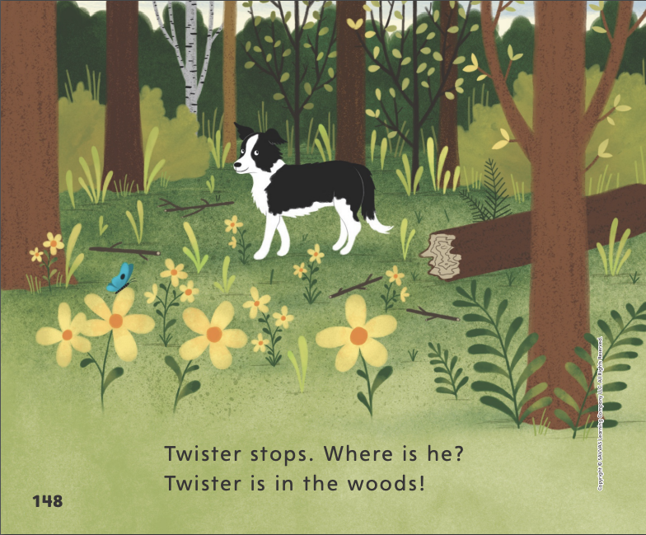
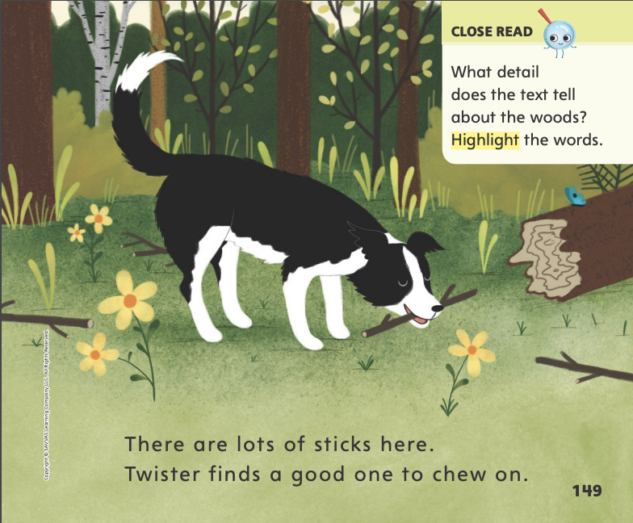
Page 148,149
Close Read - Create New Understandings
Turn to page 148, 149 in your Student Interactive
Notes:
Have students describe the woods. What do they see? Then read aloud the Close Read box on p. 149 and have students highlight the detail in the text that tells about the woods. DOK 1

Slide 54
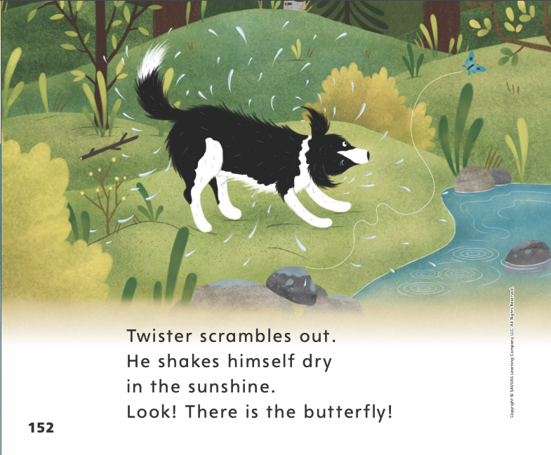
Page 152
Close Read - Create New Understandings
Turn to page 152 in your Student Interactive
Notes:
Have students describe the woods. What do they see? Then read aloud the Close Read box on p. 149 and have students highlight the detail in the text that tells about the woods. DOK 1

Slide 55
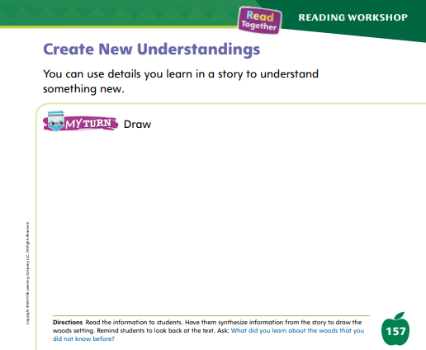
Page 157
Create New Understandings
Turn to page 157 in your Student Interactive.
Notes:
Have students draw a picture of the woods on p. 157 of the Student Interactive. Remind students to add details that they learned about the woods

Slide 56
Writing – Launching Writing Workshop
Let’s make suggestions to the Author and Illustrator.
Notes:
Making suggestions is a good way to share ideas about something. When we make a suggestion about writing, we ask the author to think about our idea.
Tell students that they can use the following phrases to make and respond to suggestions: Why don’t you _____? Maybe you could _____. Would you like to _____? That’s a good idea because _____.
I’m not sure that will work because _____. What do you mean by _____? Hold up a stack book that the students are familiar with. Look through the book and read it aloud. Model making suggestions to the author and illustrator.
Use sticky notes to write your suggestions and stick them to the book. For example, you might say: I could suggest to the author and illustrator, Why don’t you add a _____ on the cover? What about changing _____?
Then pretend you are the author and discuss ways to respond to the suggestions.

Slide 57
Independent Writing
How can we make revisions?
How can we make improvements?
Notes:
For Independent Writing, students should continue working on a book they have started.
Modeled: Use a stack book and model how to present suggestions and responses.
Shared: Using a stack book, show how to make a suggestion and have students use what they’ve learned to respond.
Guided: Prompt students to pose suggestions and responses politely.
Intervention Refer to the Small Group Guide for support.
If students have completed their books, have them think about how they could make revisions and improvements.
See the Conference Prompts on p. T374.
Call on students with whom you conferred to read aloud a few pages. Have students make suggestions. Have the writer consider how to respond to those suggestions.

Slide 58
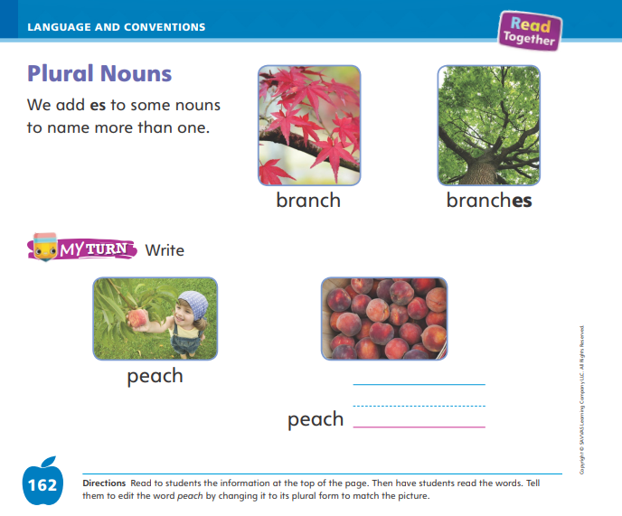
Page 162
Language and Conventions
Turn to page 162 in your Student Interactive and complete the activity.
Notes:
Have students edit for a plural noun to complete p. 162 in the Student Interactive.

Slide 59
Lesson 5

Slide 60

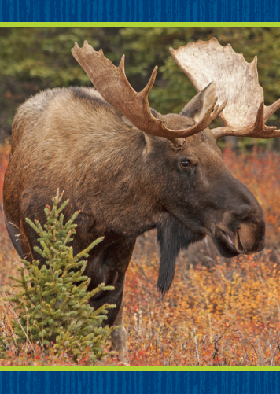




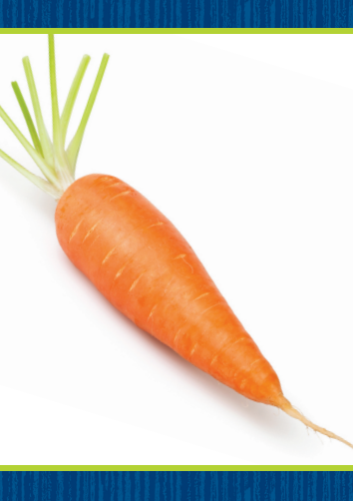
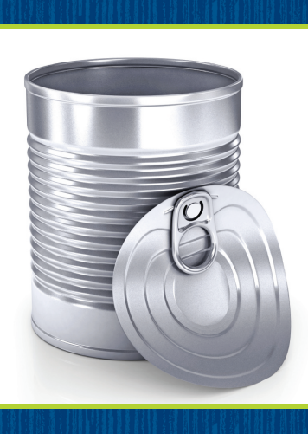
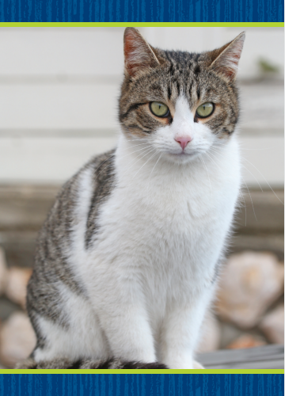
Phonological Awareness
Notes:
Tell students that some groups of words begin with the same sound. Listen carefully as I say a sentence: Ned needs nine nuts. All the words begin with the same sound. What sound do the words all begin with? Have students say the sound /n/ with you.
Display the nose, nest, and nut Picture Cards. Have students name the pictures. These picture words all begin with the same sound. What sound do you hear at the beginning of nose, nest, and nut? Click path -> Table of Contents -> Unit 1 Week 4 Realistic Fiction -> Lesson 5
Have students say the sound /n/. Then display groups of Picture Cards and have students tell whether the picture words in each group begin with the same sound.
If they do, ask students to say the sound all the words begin with. Use the following Picture Cards: mitten, moose, mug; pan, pillow, soap; carrot, can, cat.

Slide 61
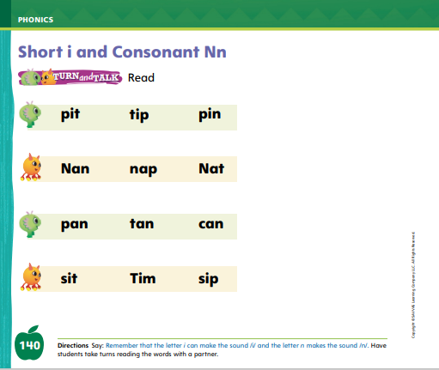
Page 140
Phonics
can
sit
nap
tip
li
Nn
Turn to page 140 in your Student Interactive.
Notes:
Write the letters Ii and Nn on the board. Have students identify the letters as you point to them. Then review the sound for each letter: i/i/, n/n/.
Create Team I and Team N. Have teams stand on opposite sides of the room. Then write the word can on the board. We will read this word together. If the word has the sound /n/ spelled n, Team N touches their toes. If the word has the sound /i/ spelled i, Team I touches their toes. Help students decode the word using letter-sound relationships. Let’s read this word together: /k/ /a/ /n/, can. Repeat with the words sit, nap, and tip.
Have students turn to p. 140 in the Student Interactive and read the words with a partner. .

Slide 62
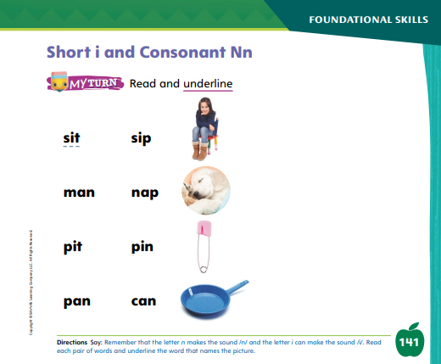
Page 141
Apply
Turn to page 141 in your Student Interactive and complete the activity.
Notes:
Have students look at p. 141 in the Student Interactive. Have them underline the word in each line that matches the picture.

Slide 63
High-Frequency Words
my
we
make
Notes:
Remind students that high frequency words are words that appear over and over in texts.
Remind them they will be learning many of the words this year, and the words will help them become better readers.
Say the word my and ask students what letters spell the word.
Have students:
say the word my as you write it on the board.
repeat with we and make.
read the words aloud.

Slide 64
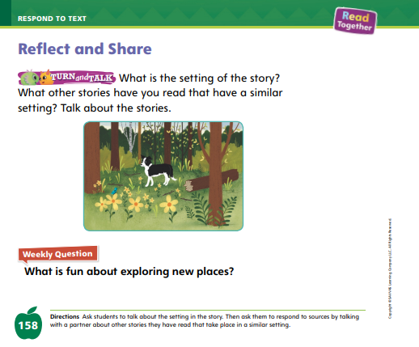
Page 145
Reflect and Share
Turn to page 145 in your Student Interactive and complete the activity.
Notes:
Explain to students that different stories have different settings. Have the class participate in a discussion about setting.
Tell students they should
recall description about setting from both texts.
listen as familiar and unfamiliar settings are discussed.
take turns speaking.
respond to others’ ideas and questions to continue the conversation.
use words and phrases they have learned in conversations and texts.
Model sharing ideas about the text Where Is Twister? and other stories with a similar setting.
My small group starts by talking about the setting of Where Is Twister? to make sure we understand the setting before we compare it to another setting. We decide it takes place on a farm. Then we can look at the other story. We have to decide if it is the same and also takes place on a farm, or if it is different and takes place somewhere else.

Slide 65

Page 158
Apply
What is fun about exploring new places?
Notes:
Have students complete the Turn and Talk activity on p. 158 by comparing the settings in Where Is Twister? with the settings in other stories they have read.
Have students use evidence from the texts they have read this week to respond to the Weekly Question. Tell them to discuss in small groups.

Slide 66
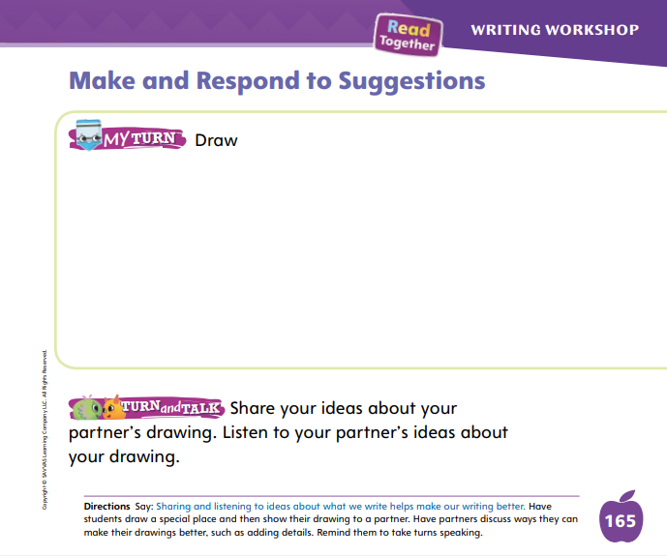
Page 165
Writing – Launch Writing Workshop
Turn to page 165 in your Student Interactive and complete the activity.
Notes:
When someone makes a suggestion, you can respond with accepting the idea or rejecting the idea. When you accept a suggestion, you agree to do what the person says. When you reject a suggestion, you don’t agree with what the person says. Sharing and responding to suggestions helps make our writing better.
Open a stack book to a page with an illustration. Ask the class for suggestions about the text or illustration. Then tell students that they will make and respond to suggestions during Writing Club today. Review with students how to introduce yourself during Writing Club. Say: My picture is about _____.
Then have students make suggestions using what they’ve learned about phrasing suggestions. Respond to the students’ suggestions by either accepting their suggestions or rejecting their suggestions. Model what to say in both cases. Thank you for that idea, I think I will do that.
When rejecting a suggestion, repeat the same frame: Thank you for that idea, but I don’t think that will work. Continue modeling until students show comprehension.
Have students complete p. 165 in the Student Interactive as time allows.

Slide 67
Language and Conventions
We lost the baseball in the bushes.
Which word in the sentence is an example of a plural noun?
A. We
B. lost
C. baseball
D. bushes
Notes:
Display the following sentence and guide students to complete the question.
We lost the baseball in the bushes.
Which word in the sentence is an example of a plural noun?
A We
B lost
C baseball
D bushes
Have students complete Language and Conventions, p. 27, from the Resource Download Center. Click path: Table of Contents -> Resource Download Center -> Language and Conventions -> U1 W4

Slide 68
Unit 1: Week 4
Grade K

