Slide 1

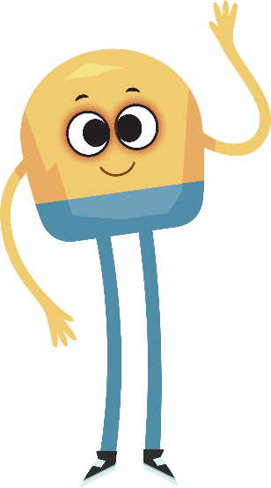

Unit 1: Week 5
Grade K

Slide 2
Copyright © Savvas Learning Company LLC. All Rights Reserved.
This publication is protected by copyright, and permission should be obtained from the publisher prior to any prohibited reproduction, storage in a retrieval system, or transmission in any form or by any means, electronic, mechanical, photocopying, recording, or otherwise. For information regarding permissions, request forms, and the appropriate contacts within the Savvas Learning Company Rights Management group, please send your query to:
Savvas Learning Company LLC, 15 East Midland Avenue, Paramus, NJ 07652
or
k12learningpermissions@savvas.com
myView Literacy® is an exclusive trademark of Savvas Learning Company LLC in the U.S. and/or other countries.

Slide 3

Lesson 1

Slide 4
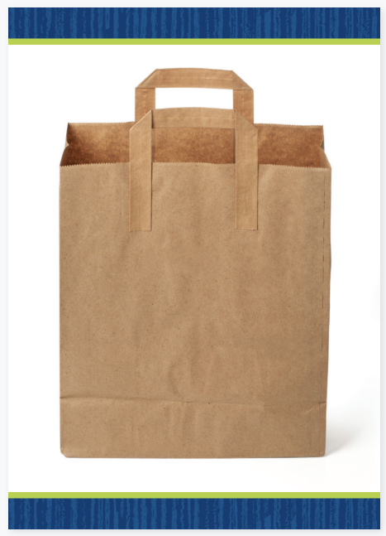

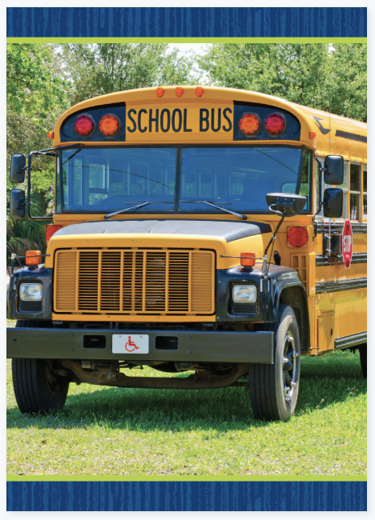
Phonological Awareness
Notes:
Display the bag, boat, and bus Picture Cards. These three words all begin with the same sound. Listen to the beginning sound of each word as I say it. Say the words and have the students repeat after you. When words have the same beginning sound, it is called alliteration. What sound did you hear at the beginning of bag, boat, and bus? (the sound /b/). Click path -> Table of Contents -> Unit 1 Week 5 Informational Text -> Lesson 1

Slide 5
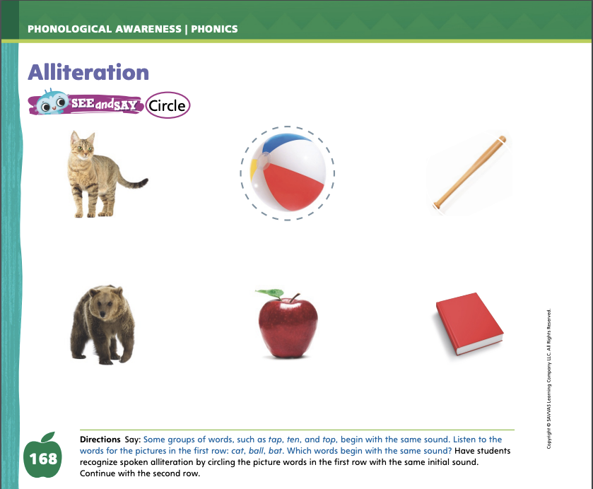
Page 168
Apply
Turn to page 168 in your Student Interactive and complete the activity.
Notes:
Point to the pictures of the cat, ball, and bat on p. 168 of the Student Interactive. Listen to the sounds as I say each word. Two of the words begin with the sound /b/. Let’s circle them. Have students circle the pictures of all the words that begin with the sound /b/ in the first row. Then have students complete the rest of the page.

Slide 6

Page 131
Phonics
bit bill
mob bowl
bush bib
bet fib
Notes:
Hold up the Alphabet Card Bb and point to the baby. Have students say baby with you. Point to the letters Bb on the Alphabet Card. Tell students that the letters Bb spell the sound /b/. The word baby begins with the sound /b/, so it begins with the letter b. Click path -> Table of Contents -> Unit 1 Week 5 Informational Text -> Lesson 1
Model how to form the letters B and b. Tell students that you will say a group of words that have either the beginning or ending sound /b/. Tell students that if the sound /b/ is at the beginning of the word, they should stand up. If the sound /b/ is at the end of the word, they should stay seated. Use the following words for this activity, emphasizing the sound /b/: bit, bill, mob, bowl, bush, bib, bet, fib.

Slide 7
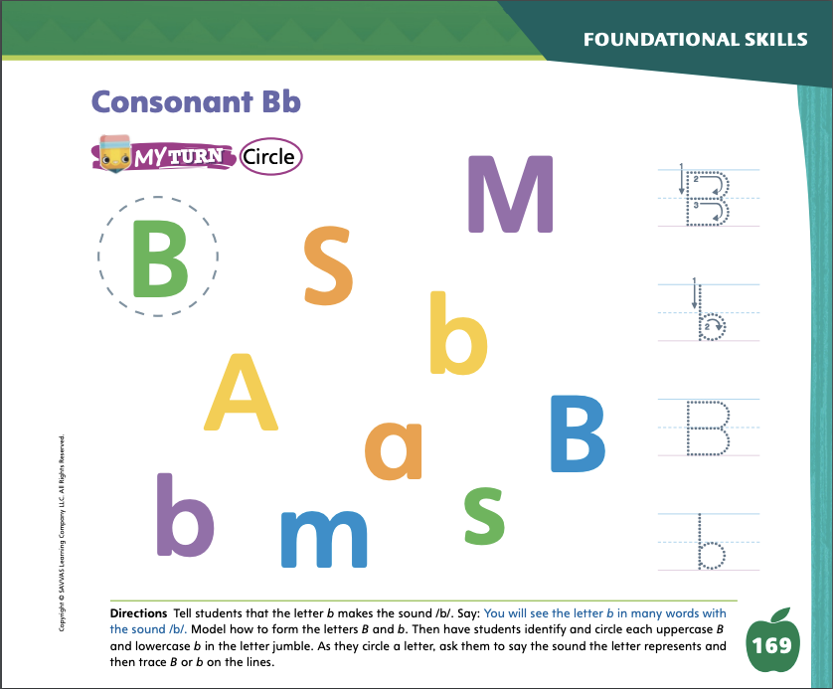
Page 169
Apply
Turn to page 169 in your Student Interactive and complete the activity.
Notes:
Have students practice writing the letter b by completing the activity on p. 169 in the Student Interactive. If students need additional practice with letter recognition, use the Letter Recognition Unit on SavvasRealize.com or on pp. xvii–xliii in this Teacher’s Edition. The unit includes instruction, activities, and student practice sheets.

Slide 8
High-Frequency Words
for
me
with
Notes:
Display the high-frequency words for, me, and with.
Point to the word for and read it.
Have students point to the word for and read it.
Repeat for me and with.

Slide 9
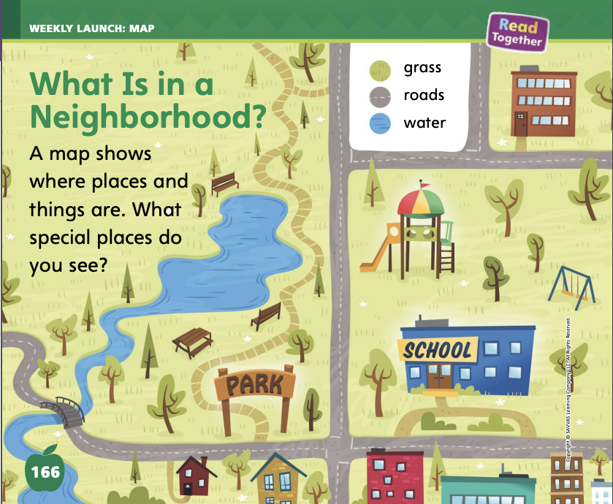
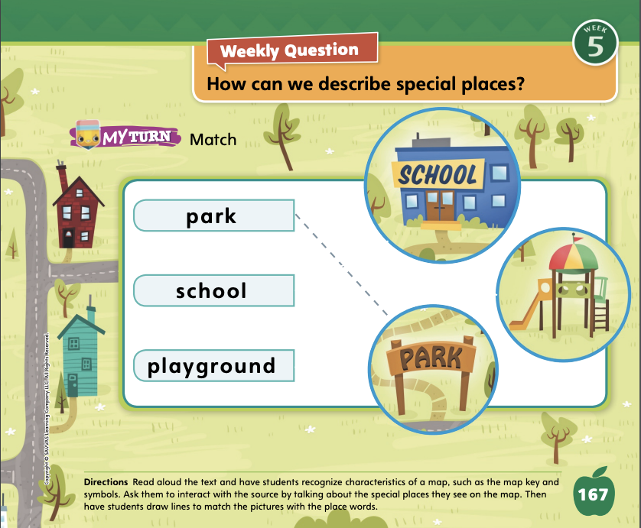
Page 166,167
Interact with Sources
Essential Question: what makes a place special?
Weekly Question: How can we describe special places?
Notes:
Remind students of the Unit Essential Question: What makes a place special? Then introduce them to the Week 5 Question: How can we describe special places? Tell students that describing a place means telling what it is like. In order to describe a special place, we need to know what makes it special. Explain that we can use words or pictures to describe a special place. A map is a tool that uses pictures to show what a place is like.
Have students follow along as you turn to pp. 166–167 in the Student Interactive. Explain that maps show the locations of different places, including a park, a playground, and a school. Go over the features of the map with students, including the key and the locations of some roads and bodies of water.
Have students find the playground on the map. Ask students to tell what it looks like or how they know it is a playground.
Have students find the bridge, the picnic table, or the swing set on the map. Have them find a road and some water.
Have students discuss the special places they see on the map.
Encourage students to ask questions about the map to clarify any information they do not understand.
After students have talked about the special places they see on the map, have them complete the matching activity on p. 167 in the Student Interactive.
Point out the Week 5 Question: How can we describe special places? Tell students that they just practiced describing some special places by talking about what they saw on the map. The map shows some special places like a school and a playground. Tell students that they will read about other special places this week and will practice describing them.

Slide 10
Listening Comprehension
Wrap-Up
Notes:
Tell students that they will listen to an informational text. Informational texts give facts and details about real people, places, and things. An informational text is written for a purpose, or reason. In this text, the author wants to tell listeners about a special place, namely a pond. Encourage students to be active listeners by looking at you and thinking about what you are saying as you read aloud.
Purpose Have students listen actively for the author’s purpose. Ask: What is the author trying to tell about or explain in this text? READ the entire text aloud without stopping for the Think Aloud callouts. REREAD the text aloud, pausing to model Think Aloud strategies related to the genre.
Work with students to use the description to draw pictures of a pond on the whiteboard. Each pond you draw should represent different details mentioned in the story: a frozen pond, a pond full of fish, a pond with insects flying around it, and so on. Have students identify the features of the different pictures that were mentioned in the story.

Slide 11
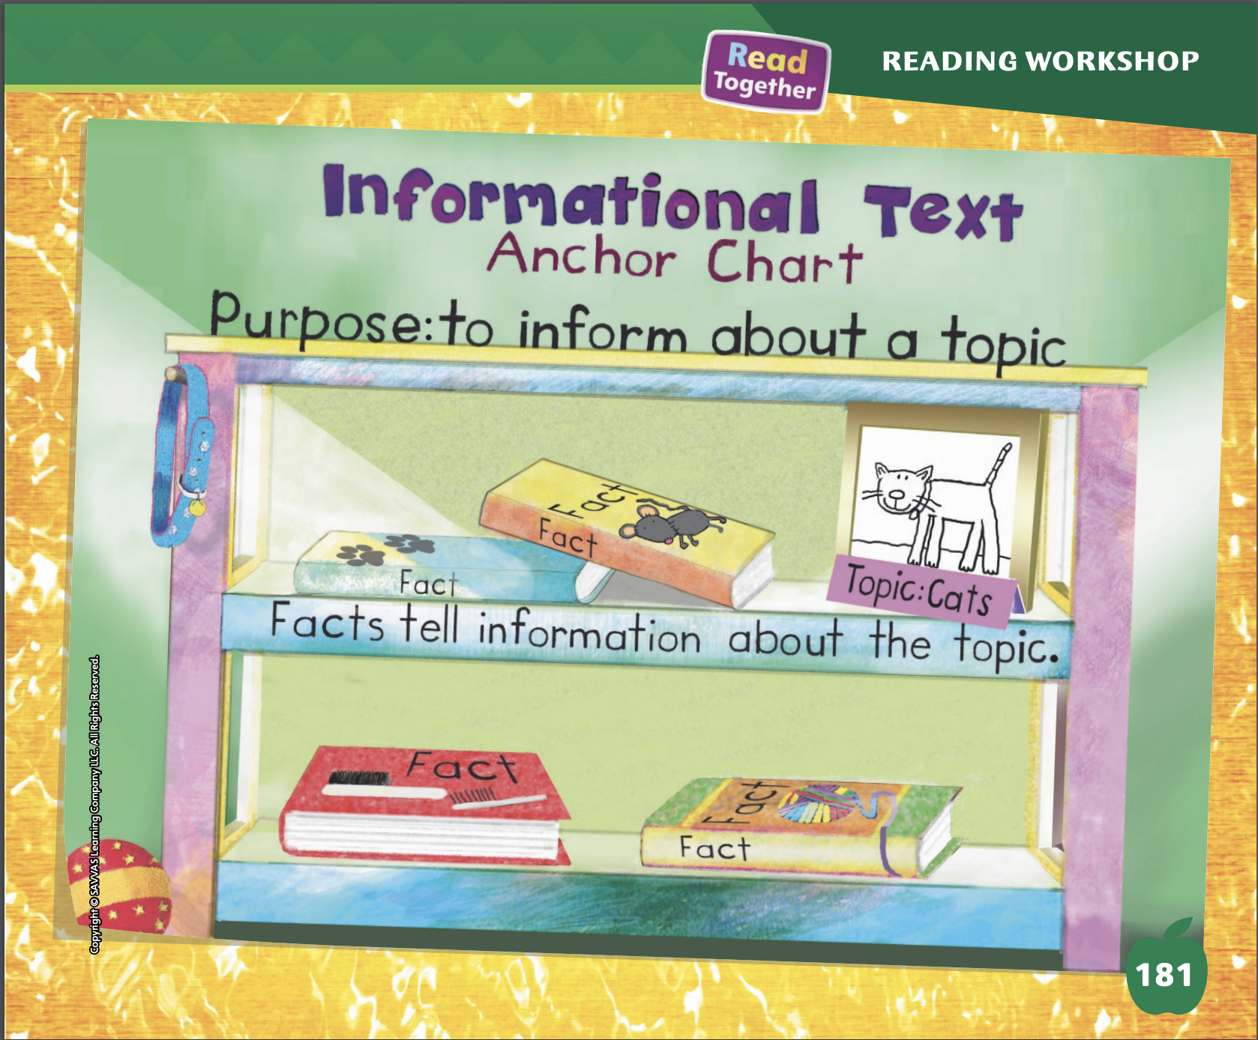
Page 181
Informational Text
Turn to page 181 in your Student Interactive.
Notes:
Explain to students that an informational text is written to inform readers about a topic or issue. To inform means to tell facts or to teach.
Informational texts do not tell readers to think or do anything. The purpose of an informational text is just to tell the facts.
Facts are bits of information. They tell readers about the topic.
Understanding the purpose of an informational text can help readers better understand the text.
Remind students that they listened to a text called “What Is at the Pond?”
‘‘What Is at the Pond?’’ has many facts. The author wants listeners to know about ponds. The author’s purpose is to inform listeners about ponds.
Have students follow along as you read the model text on p. 180 of the Student Interactive. Assist students as they discuss the author’s purpose from the model text.
Editable Anchor Chart Click Path: Table of Contents -> Reading Anchor Charts -> Unit 1 Week 5: Informational Text Editable Reading Anchor Chart

Slide 12
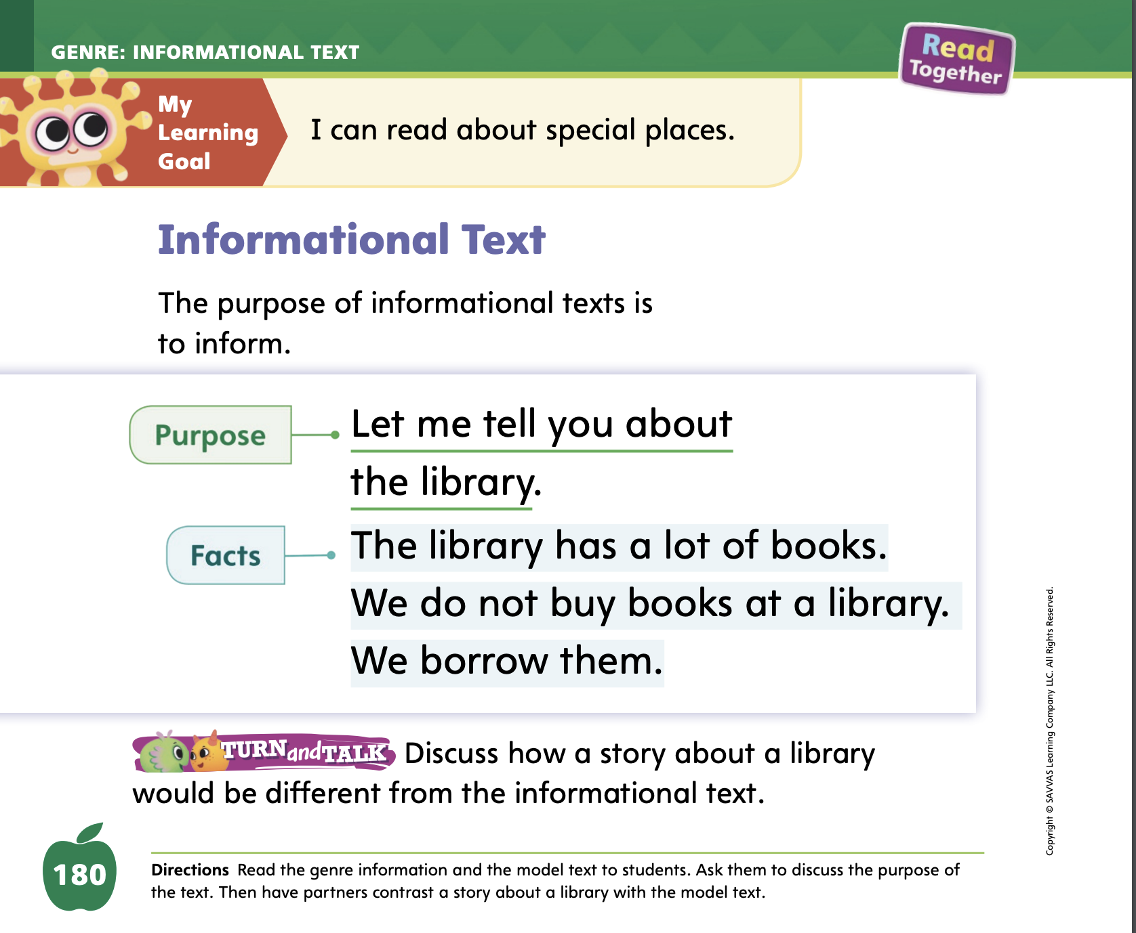

Page
180
Apply
Discuss how a story about a library would be different from the informational text.
Notes:
Have students use the strategies to identify features of informational texts.
Have students work with a partner to complete the Turn and Talk activity. Then have students share their ideas with the rest of the class.

Slide 13
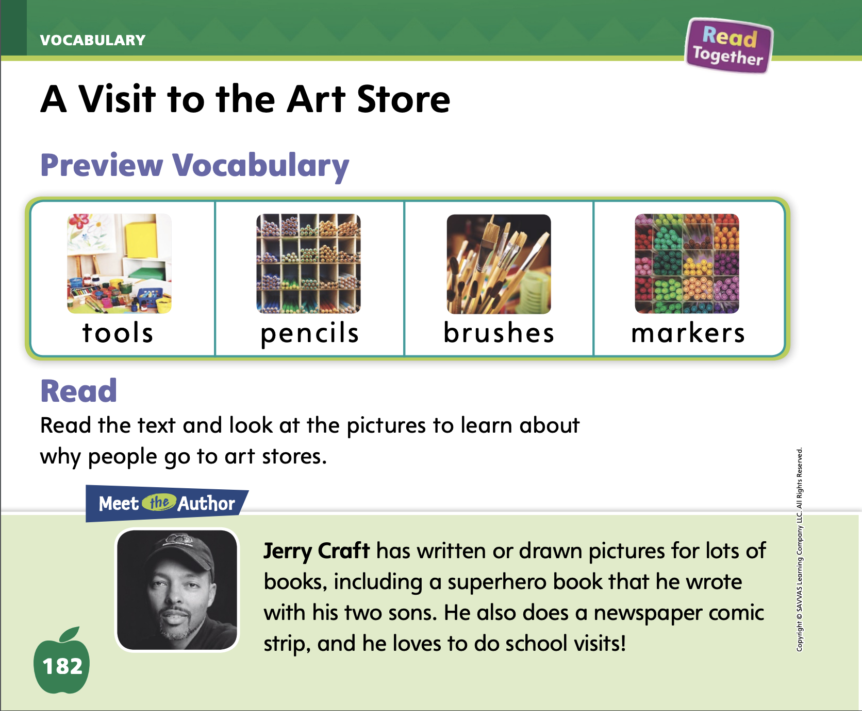
Page
197
Academic Vocabulary
map
move
land
special
Turn to page197 in your Student Interactive and complete the activity.
Notes:
Remind students of the Academic Vocabulary words in the unit: map, move, land, special. Tell students that today they are going to use these words as they talk with a partner.
Using new words as you talk with others can help you remember and understand what you have learned.
Think of different sentences you can say that show what a word means.
Model the strategy for students by making up three or four sentences that use the word special. Then say, I just said several sentences that show some ways you can use the word special when you are talking. Can you make up sentences with the word move? The sentences you make up should show me what move means. Call on volunteers. If a student says a sentence that does not make sense, review the meaning of the word move and try again, or call on another student.
Have students complete the activity on p. 197 in the Student Interactive.

Slide 14
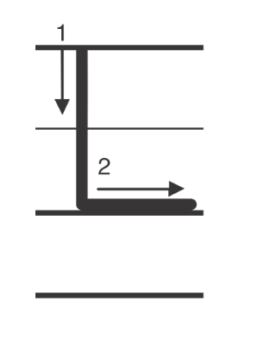
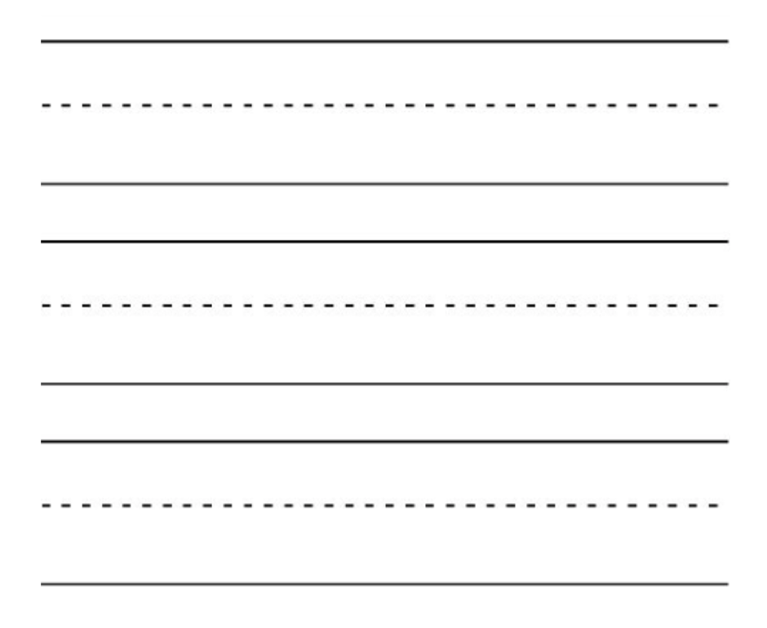
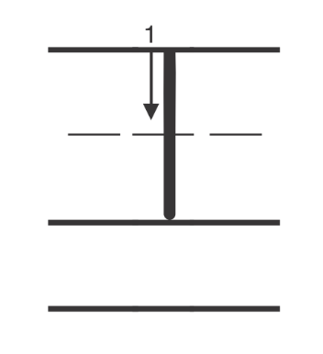
Handwriting
Notes:
Display upper- and lowercase Ll. Explain that words beginning with the letter Ll can be written with an uppercase L or a lowercase l. Ask students to identify the uppercase L and the lowercase l.
Write the name Lee on the board. Point to the uppercase L. This is uppercase L. We use uppercase letters to begin sentences and names. Watch as I trace the uppercase L with my fingers. Show students where to begin the letter. Have students trace uppercase L in the air and then on their hands.
Write the word lap on the board. This is the word lap. Point to the lowercase l. This is the lowercase l. Watch as I trace this lowercase l with my finger. Have students trace lowercase l in the air and on their hands or on the surfaces of their desks.
Have students complete Handwriting p. 22 from the Resource Download Center to practice writing Ll. Click path: Realize -> Table of Contents -> Resource Download Center -> Handwriting Practice -> U1W5L1 Handwriting Practice

Slide 15
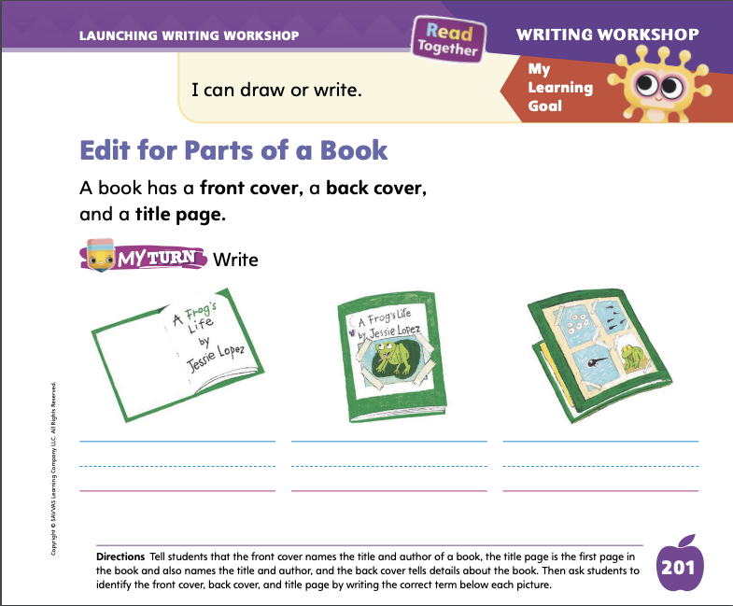
Page 201
Writing – Launch Writing Workshop
Turn to page 201 in your Student Interactive and complete the activity.
Notes:
A book has a front cover, back cover, and title page. When authors edit a book, they make sure that all of the parts are there.
Hold up a stack book. Point to the front cover. Say: This is the front cover. The front cover names the title, author, and illustrator. It also has a picture or drawing.
Point to the title page. Say: This is the title page. The title page also lists the title, author, and illustrator.
Point to the back cover. Say: The back cover gives the reader information about the book. Writers accept or reject suggestions for these parts of their book. They edit the covers because it is the first thing readers see. Tell students that the front and back cover must be interesting so that people will read the book.
Show students a stack text and let them know you will ask questions about it before reading by looking at the front cover, back cover, and title page. Think aloud: I can see from the cover and title page that the title is ______. I wonder what this story could be about. I think it tells a story about _____. I’d like to make a suggestion for the illustrator/photographer. He or she might consider adding or changing ______.
Continue thinking aloud, asking questions and making suggestions about the back cover. Encourage students to participate with you.
Have students turn to p. 201 in the Student Interactive. They will practice identifying the title page, front cover, and back cover of the book pictured.

Slide 16

Independent Writing
We will review the books you have written and choose one you would like to present.
Your book should have a front cover, a back cover, and a title page.
Notes:
During Independent Writing, tell students to review the books they have written this unit and choose the one that they would like to present. They will spend the next few days editing and preparing it for the celebration that will happen at the end of the week.
Today, tell them to make sure their book has a front cover, a back cover, and a title page. Then have them continue to put the finishing touches on their book.
Modeled Use a stack book and make a new front/back cover and title page.
Shared Ask students how they would make changes to the parts of a book.
Guided Prompt students to consider how an author edits the covers and title page.
As students write, use the conference prompts in the Teacher’s Edition or Resource Download Center to provide support. Click path: Table of Contents -> Resource Download Center -> Writing Workshop Conference Notes
Call on a few students to share their work. Encourage students to ask questions and make suggestions about the front cover, title page, and back cover.

Slide 17
Language and Conventions
Plural nouns mane more than one person, animal place, or thing.
Plural nouns end with –es.
Notes:
Tell students that plural nouns name more than one person, animal, place, or thing. Remind them that some plural nouns end with -es.
Do a call-and-response activity with the class: name a singular noun, and have the class respond with the plural version of the same noun. Use nouns that have an -es plural ending. You can structure the activity so that individual volunteers are called on to respond, or so that the whole class is expected to respond each time.
Have students play the same call-and-response game in pairs or in small groups. Have them take turns naming singular nouns and responding with plural nouns.

Slide 18
Lesson 2

Slide 19
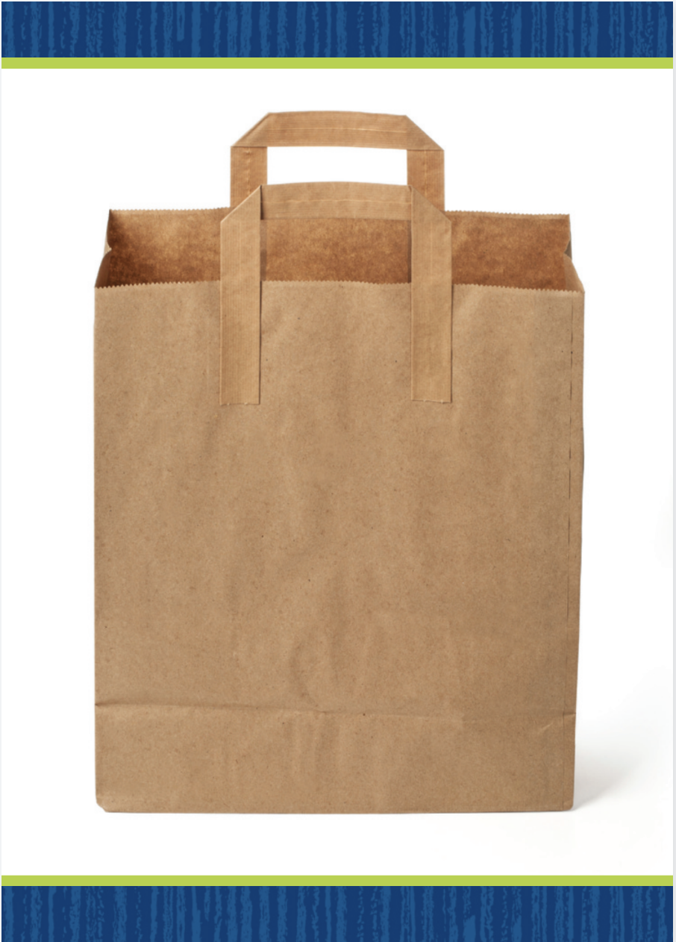

Phonics
Notes:
Hold up the bag Picture Card. This is a bag. I hear the sounds /b/ /a/ /g/. I hear the sound /b/ at the beginning of bag. Say the sound /b/ with me. Click path -> Table of Contents -> Unit 1 Week 5 Informational Text -> Lesson 2
Flip over the card and show students the spelling of the word. Point to the b and say /b/. Do you hear the sound /b/? What letter spells the sound /b/? Have students identify the letter b. Write the letters Bb on the board. The uppercase letter b is made of a line and two curves. The lowercase letter b is made of a line and one curve. Have students draw the letters Bb in the air as you lead them.
Point to the letters Bb on the board. Write the word bat on the board. Listen carefully to the following word: /b/ /a/ /t/. Do you hear the sound /b/ in this word? Repeat the word and sounds. Ask students where in the word they hear the sound /b/. Have a volunteer provide the answer that the sound /b/ is at the beginning of the word bat.

Slide 20
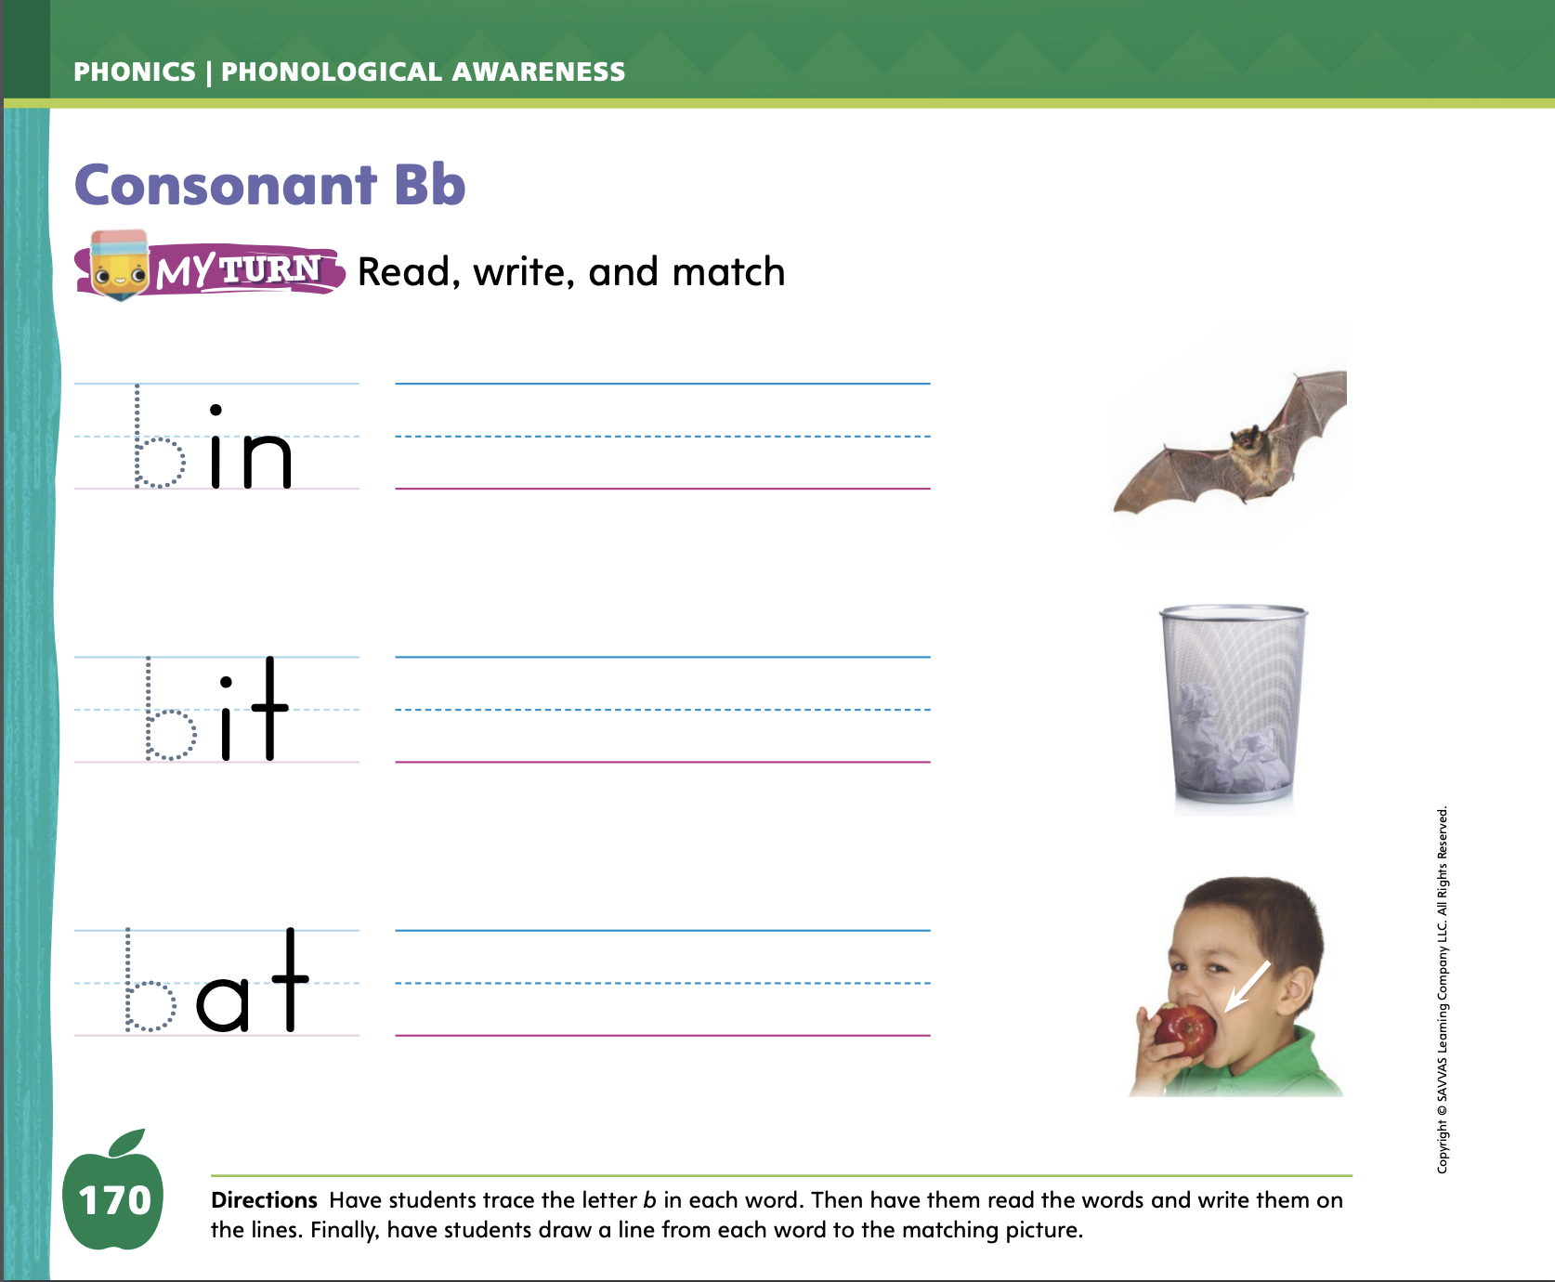
Page 170
Apply
Turn to page 170 in your Student Interactive and complete the activity.
Notes:
Have students complete the rest of p. 170 in the Student Interactive. They should decode each CVC word and match each word to its picture.

Slide 21
High-Frequency Words
for
me
with
Notes:
Tell students that high-frequency words are words that they will hear and see over and over in texts. Write and read the words for, me, and with. Have students
read each word.
spell each word, clapping as they say each letter.

Slide 22

Page 182
Preview Vocabulary
Notes:
Introduce the words tools, pencils, brushes, and markers on p. 182 in the Student Interactive. Have students look at the pictures and share what they already know about the words.
Provide prompts as needed: What tools do people use to build things? Where do we keep our pencils? Have you ever used brushes to paint? What colors are these markers? Can you guess what the text will be about, based on the vocabulary words?

Slide 23
Print Awareness
Notes:
Write two simple sentences on the board. Point out where each sentence begins and where it ends. To check understanding, have students find and point to a sentence in their Student Interactive.

Slide 24

Page 183
First Read Strategies
Turn to page 183 in your Student Interactive.
Notes:
Discuss the First Read Strategies. In this First Read, encourage students to read for understanding and enjoyment. After students complete the First Read ask, What did you like? What did you learn? What surprised you? What did you already know?
READ Encourage students to read or listen as you read the text. During the first reading, students should work to understand why people go to art stores.
LOOK Remind students to look at the pictures to better understand why people go to art stores.
ASK Have students generate or ask questions about the text to deepen their understanding of why people go to art stores.
TALK Guide students to talk to a partner about the text, and have partners discuss why people might go to art stores.
Students may read the text independently, in pairs, or as a whole class. Use the First Read notes to help students connect with the text and guide their understanding.

Slide 25
Page 183
First Read – A Visit to the Art Store
Notes:
Read together.

Slide 26
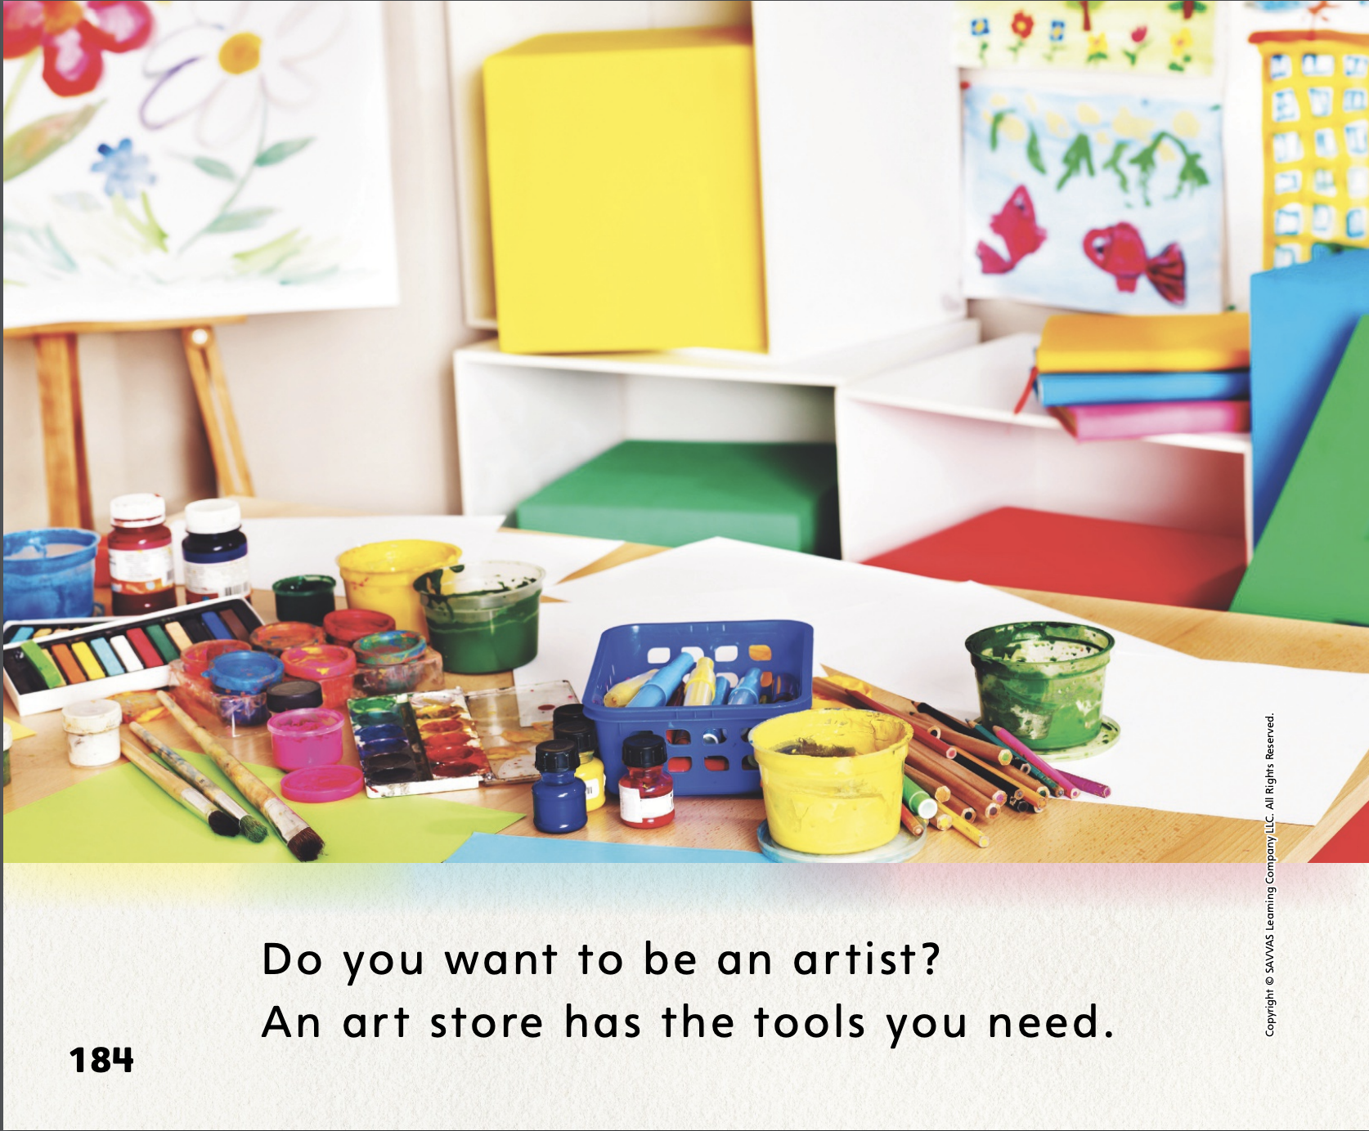

Page 184
First Read – A Visit to the Art Store
Notes:
Read together.
THINK ALOUD Before I read this text, I am going to look at the pictures to get an idea of what it is about. I see colored pencils and paints and paper, just like we have in our classroom art center. I think this text is going to be about art. Now I’ll spend a minute thinking about what I already know about art. Then I’ll read on to see what I can learn. My purpose, or reason, for reading this text is to learn more about artists and the tools they use to create art.

Slide 27

Page 185, 186
First Read – A Visit to the Art Store
Notes:
Read Together.

Slide 28
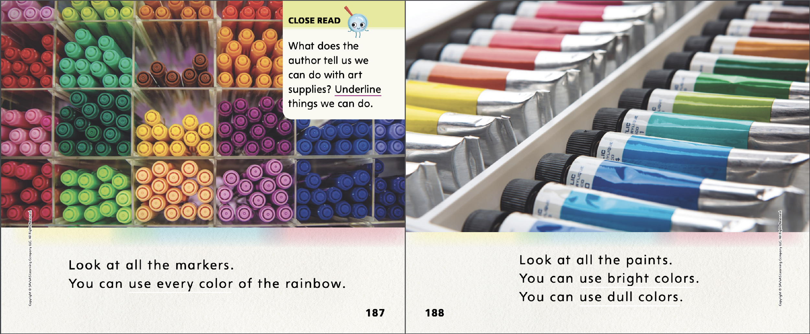
Page
187,188
First Read – A Visit to the Art Store
Notes:
Read together.
THINK ALOUD What did you learn? I will talk to a partner about what I learned from this text. I learned that an art store provides many of the tools an artist needs. I also learned about the many different colors of paint an artist might use. The photograph on this page helped show me this. Talking about what I learned helps me understand and remember it.

Slide 29
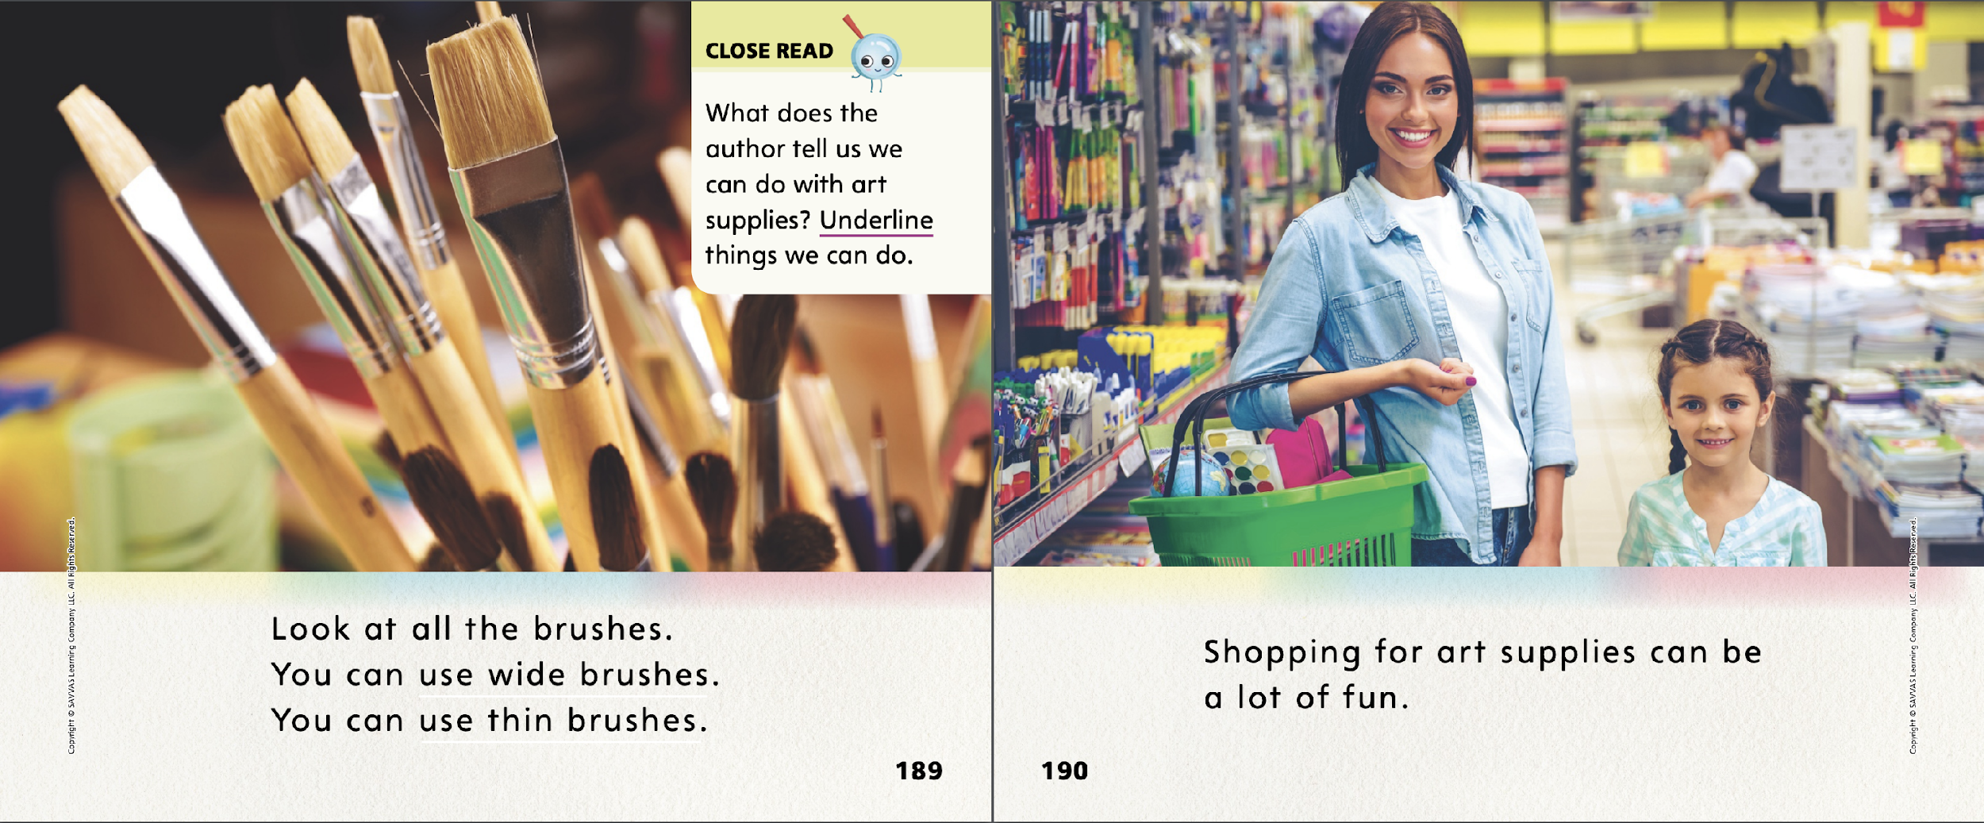
Page 189,190
First Read – A Visit to the Art Store
Notes:
Read Together.

Slide 30
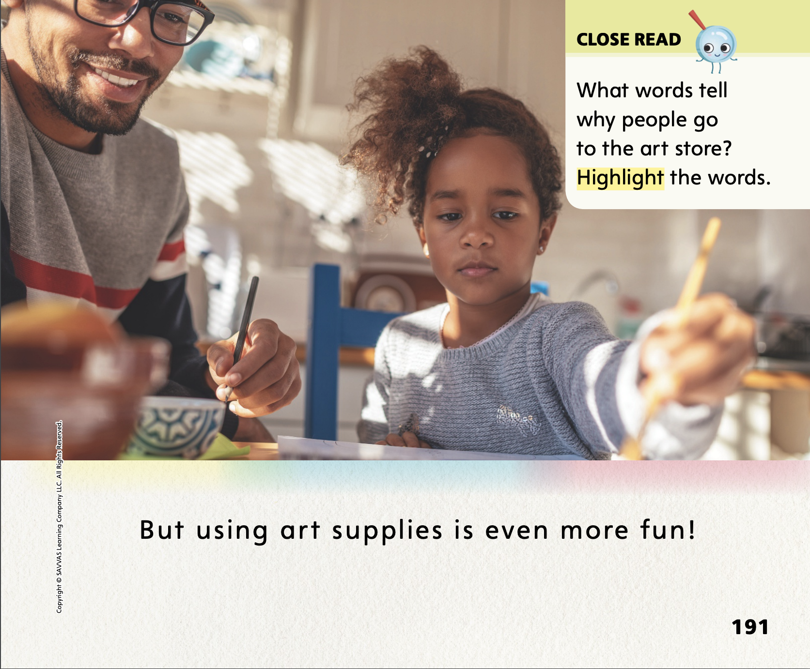
Page 191
First Read – A Visit to the Art Store
Notes:
Read Together.

Slide 31
Respond and Analyze
  Talk What did you learn about art stores from reading this text? Discuss with a partner.
  Illustrate Draw the artist’s tool from the text that you like using the most. Tell a partner why that artist’s tool is your favorite.
Notes:
Use these suggestions to prompt students’ initial responses to reading A Visit to the Art Store.
Talk What did you learn about art stores from reading this text? Discuss with a partner.
Illustrate Draw the artist’s tool from the text that you like using the most. Tell a partner why that artist’s tool is your favorite.

Slide 32
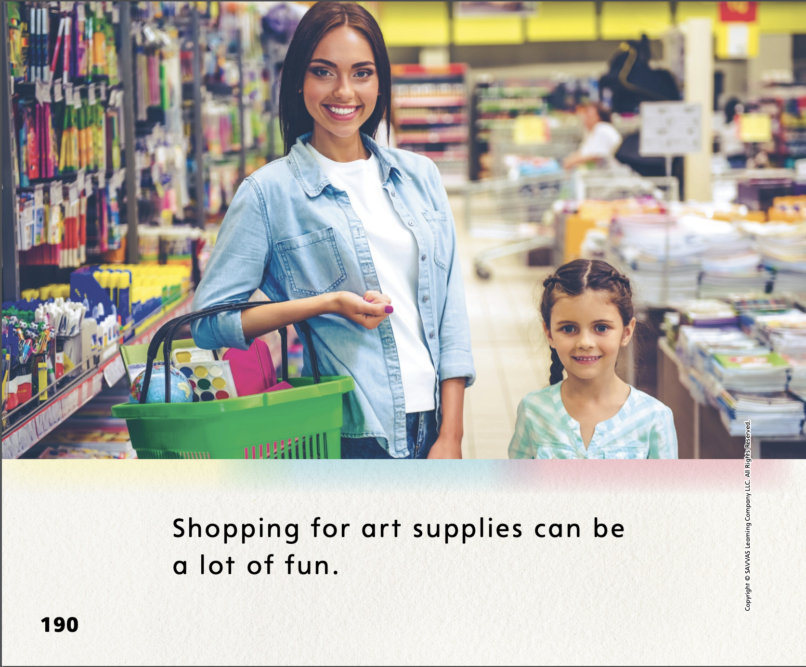
Page 190
Develop Vocabulary
Turn to page 190 in your Student Interactive.
Notes:
Explain to students that readers can learn or clarify word meanings by paying attention to the images and the other words in a text.
LOOK Look at the pictures.
THINK What do the pictures show? How would you describe the objects in the pictures?
RESPOND Can you tell the meanings of the words by looking at the images and the other words on the pages?
Have students turn to p. 190 of the Student Interactive. Ask them to look at the image on the page. Ask: Do you know what the phrase art supplies means? Can you explain what it means by using what you see in the picture or the other words on the page? If needed, provide additional examples from earlier selections and decodable stories.

Slide 33
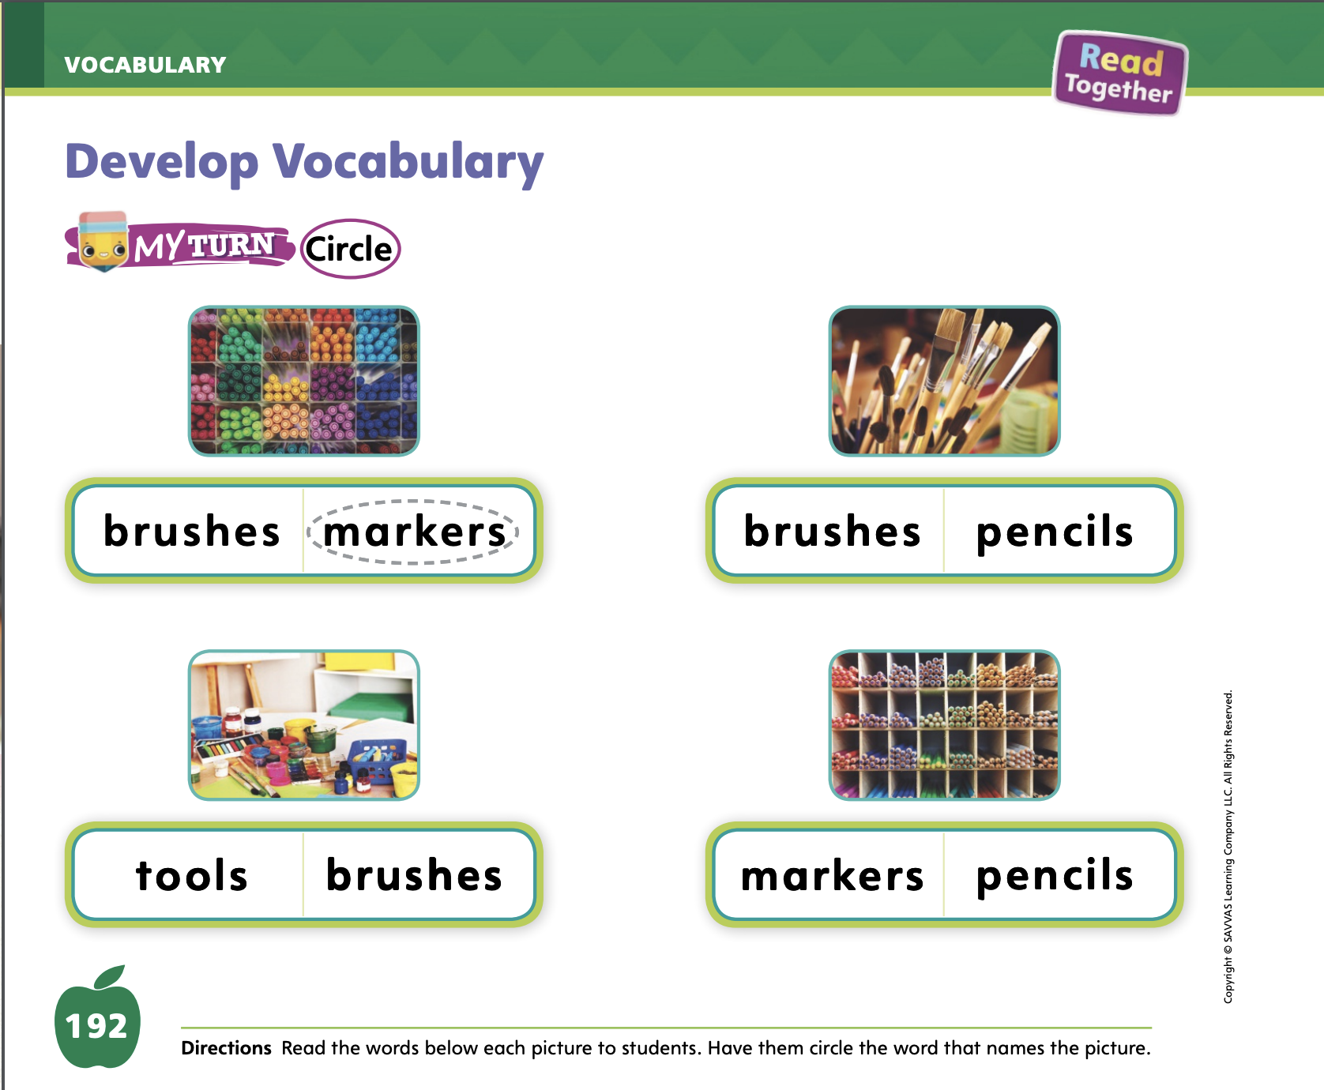
Page 192
Apply
Turn to page 192 in your Student Interactive and complete the activity.
Notes:
Have students use the strategies for developing vocabulary.
Have students complete the My Turn activity on p. 192 of the Student Interactive.

Slide 34
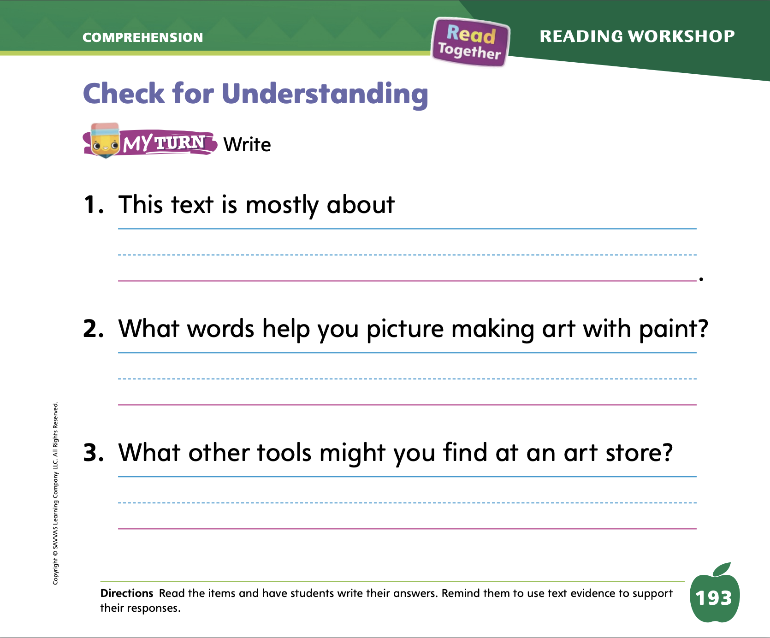
Page 193
Check for Understanding
Turn to page 193 in your Student Interactive and complete the activity.
Notes:
Have students complete the Check for Understanding on p. 193 of the Student Interactive.

Slide 35
Writing – Launch Writing Workshop
Ideas or suggestions help make our writing better.
Choose a book and draw a picture for the book.
Notes:
When we ask for ideas or suggestions about our work, it helps our writing get better. We have choices when people make suggestions. We can
accept the suggestion and make changes to our writing.
reject the suggestion and explain why.
think of another way to make our writing better.
Choose a stack book and draw a simple picture on a flip chart or board that could be added to the book. Tell students you would like some suggestions to make your drawing better. Model accepting or rejecting suggestions and editing your work to reflect the suggestions you take.
Explain to students that authors incorporate feedback from friends, family members, and their editors. Editors help authors make their stories better.

Slide 36
Independent Writing
Create a front and back cover and a title page for the book you are writing.
Review your book and make edits.
Notes:
Have students create or edit a front and back cover and a title page for the book they are planning to share.
Modeled Show a stack book and model making suggestions to make the cover better.
Shared Ask students what kind of suggestions they might accept or reject for a stack book.
Guided Prompt students to continue adding to their book by incorporating feedback.
If students have already created these features, have them review the book to make additional edits based on the feedback they have received from their Writing Club.
As students write, use the conference prompts in the Teacher’s Edition or Resource Download Center to provide support. Click path: Table of Contents -> Resource Download Center -> Writing Workshop Conference Notes
Call on a few students to share their book titles. Encourage the class to make a few suggestions. Have the writer accept or reject these suggestions and explain why

Slide 37
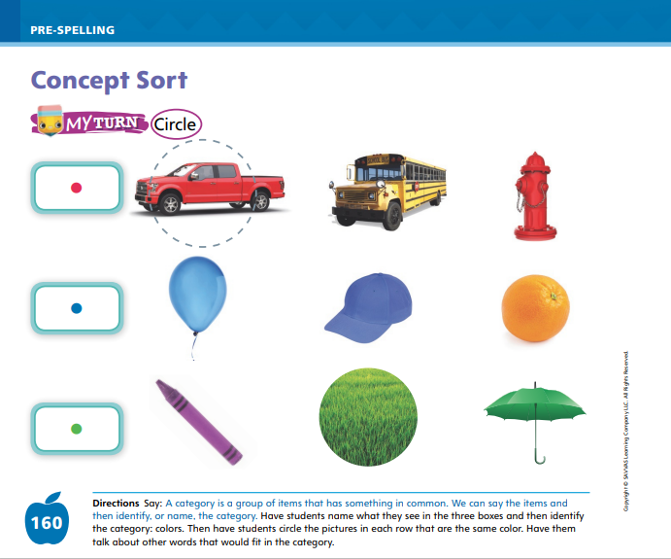
Page 198
Pre-Spelling
Turn to page 198 in your Student Interactive and complete the activity.
Notes:
Tell students that we can sort things into groups, or categorize them, depending on what they are. Explain: Some things are toys, but other things are not toys. We can put things that are toys in one category and things that are not toys in another category. If possible, hold up a toy and hold up something that is not a toy; you can also use the two pictures below as an example for students. Explain to students that the first item is a toy while the second item is not.
Model naming toys and non-toys and categorizing them. I can think of things that are toys: a board game, a teddy bear, a ball. I can also think of things that are not toys: a tree, a fork, a book. Have students open the Student Interactive to p. 198. Say: I see a doll. A doll is a toy, so I will put it in the toy box. Have students draw a line from the image of the doll to the image of the box.
Have students sort the other items shown on p. 198 of the Student Interactive by drawing lines between the toys and toy box. Give help as needed, or work through the activity together to help students sort the items.

Slide 38
Language and Conventions
____ is one student.
____ and ____ and ____ are three students.
Notes:
Explain to students that singular and plural nouns tell whether there is just one of something or more than one of something. Tell students that using singular and plural nouns correctly in conversations will help their listeners understand what they are talking about.
Point to one student in the class and say: ____ is one student. Point to a group of students and say: ____ and ____ and ____ are three students. Emphasize the distinction between student and students. If needed, give further examples of the same form.
Say short sentences such as these: There are five pies; there is one apple; there is one dog; there are four boxes; there are two girls; there is one car. Ask students to clap when they hear a plural noun.

Slide 39
Lesson 3

Slide 40
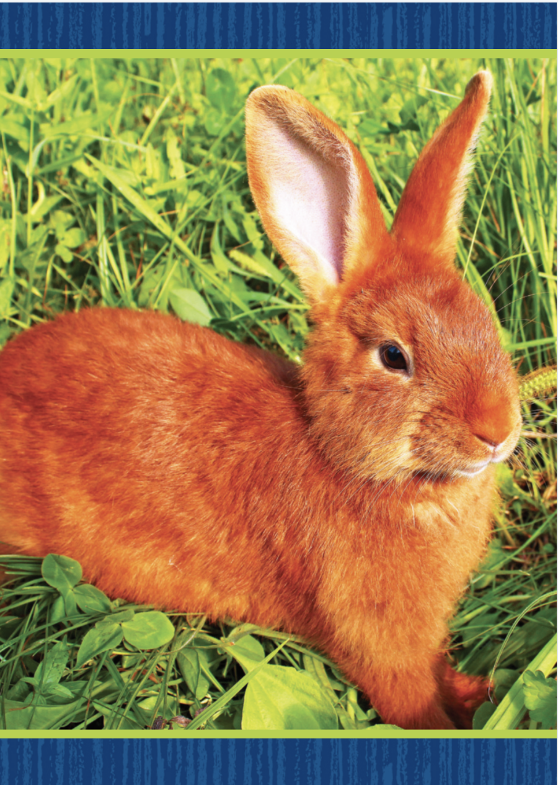

Page 171
Phonological Awareness
Turn to page 171 in your Student Interactive and complete the activity.
Notes:
Today we are going to learn a new sound. Listen carefully: /r/ /r/ /r/. The sound /r/ is made by placing your tongue just behind your teeth as you lower your mouth a little bit. Show students how to make the sound /r/ and have them practice it.
Display the rabbit Picture Card. This is a rabbit. Listen to the beginning sound as I say this word: /r/ -abbit. What sound does rabbit begin with? Students should supply the sound /r/. Then say the following words and have students use a thumbs-up if they hear the sound /r/ at the onset of the word: rest, ran, run, sun, rice, and pen. Click path -> Table of Contents -> Unit 1 Week 5 Informational Text -> Lesson 3
Point to the picture of the rock on p. 171 of the Student Interactive. Listen to the sounds of this word: /r/ /o/ /k/. Rock has the sound /r/ at the beginning of it. We will circle rock because it begins with the sound /r/. Have students complete the page by circling picture words that begin with the sound /r/.

Slide 41

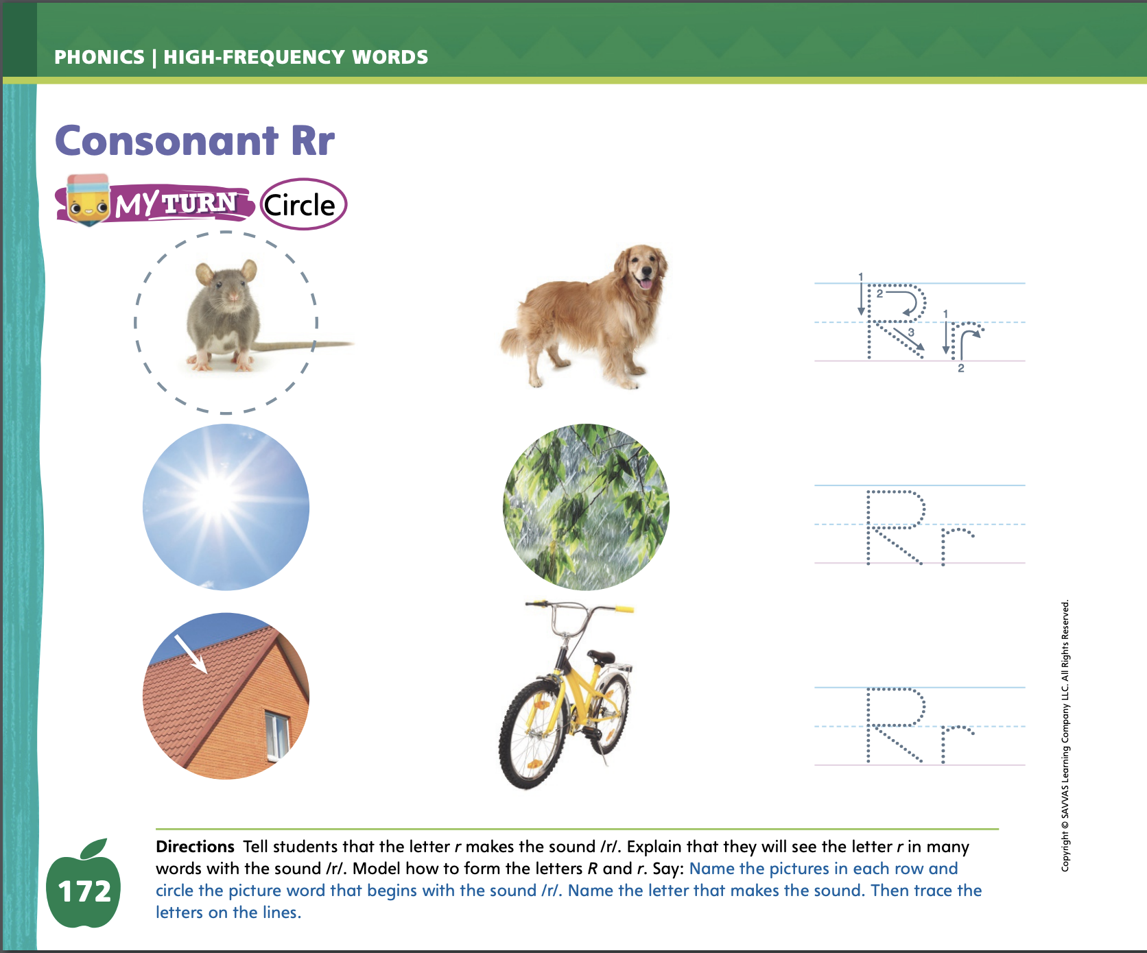
Page 172
Phonics
Turn to page 172 in your Student Interactive and complete the activity.
Notes:
Tell students that the sound /r/ is spelled with the letter r. Display the Rr Alphabet Card. Point to the river on the card and tell students the word river begins with /r/. Point to the letters on the card, and tell students the names of these letters are uppercase R and lowercase r. Write uppercase R and lowercase r on the board and slowly trace the letters as you say the sound /r/.
Have students turn to p. 172 in the Student Interactive. Let’s look at the picture of the rat and listen to the word rat: /r/ /a/ /t/. The word begins with /r/. What letter spells the sound /r/? Yes, the letter r. Let’s say the word, circle the picture, and write Rr on the line. Students should trace the uppercase and lowercase letters on the page. Have them point to the letter r and tell you what sound it represents. Click path -> Table of Contents -> Unit 1 Week 4 -> Lesson 3
Have students complete the activity on p. 172. If students need additional practice with letter recognition, use the Letter Recognition Unit on SavvasRealize.com or on pp. xvii–xliii in this Teacher’s Edition. The unit includes instruction, activities, and student practice sheets.

Slide 42
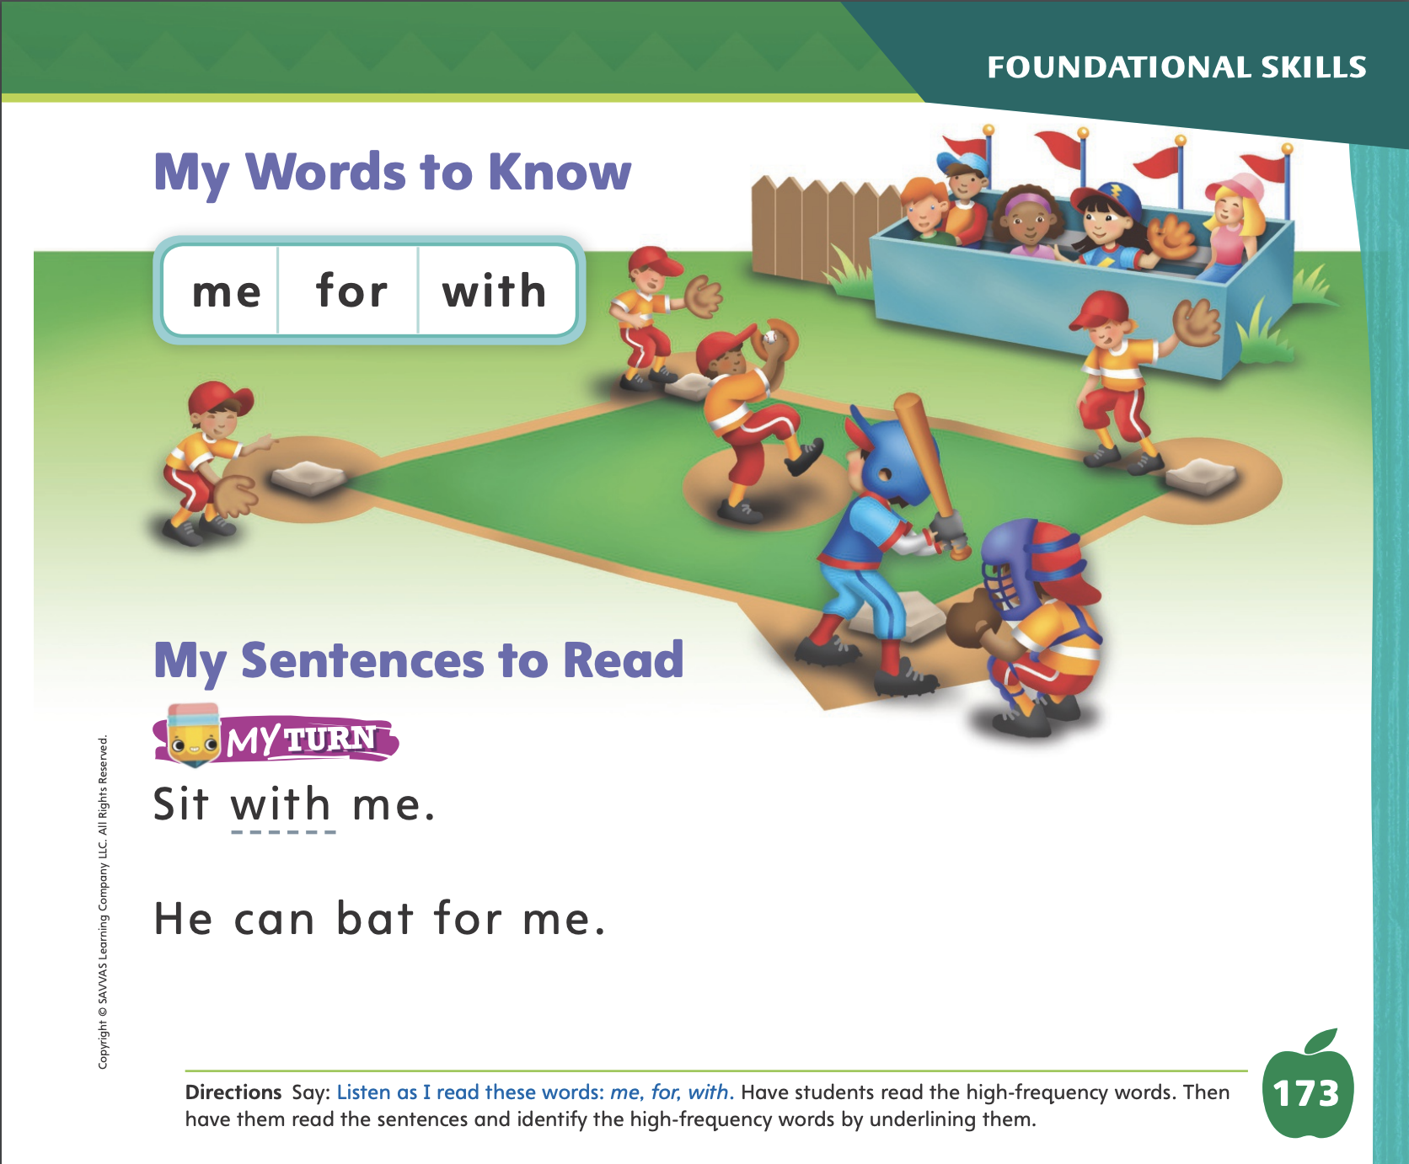
Page 173
High-Frequency Words
Turn to page 173 in your Student Interactive and complete the activity.
Notes:
Say: Today we will practice reading the high-frequency words me, for and with. Have students read the words at the top of p. 173 in the Student Interactive with you: me, for, and with.
Have students look at the words at the top of p. 173. Say: I will read a word, and I want you to point to it. Then we will read the word together. Read me, and have students point to it. Now let’s read the word together: me. Repeat with the other words. Encourage students to use the words in sentences.
Have students read the sentences on p. 173 with you. Ask them to identify the words me, for, and with in the sentences. Have them underline the high-frequency words in the sentences. Have them read the words with a partner.

Slide 43
Page 183
Close Read – Discuss Author’s Purpose
Notes:
Explain that an author writes texts for a purpose, or reason. There is something he or she wants to have happen.
If readers learn facts or learn how to do something, the author’s purpose, or reason for writing, is to explain about a topic.
If a text tries to get readers to do or believe something, the author’s purpose is to persuade.
If the text is fun to read or tells a story that is interesting, the author’s purpose is to entertain, or help others have fun.
Model: I want to find out the author’s purpose, or reason, for writing this text. I can look at the title and pictures for clues. The title is A Visit to the Art Store. The pictures show different kinds of art supplies. I think the author wants to explain, or give information, about an art store. Continue by turning to the Close Read notes on pp. 187 and 189 and having students underline what the author tells us.

Slide 44

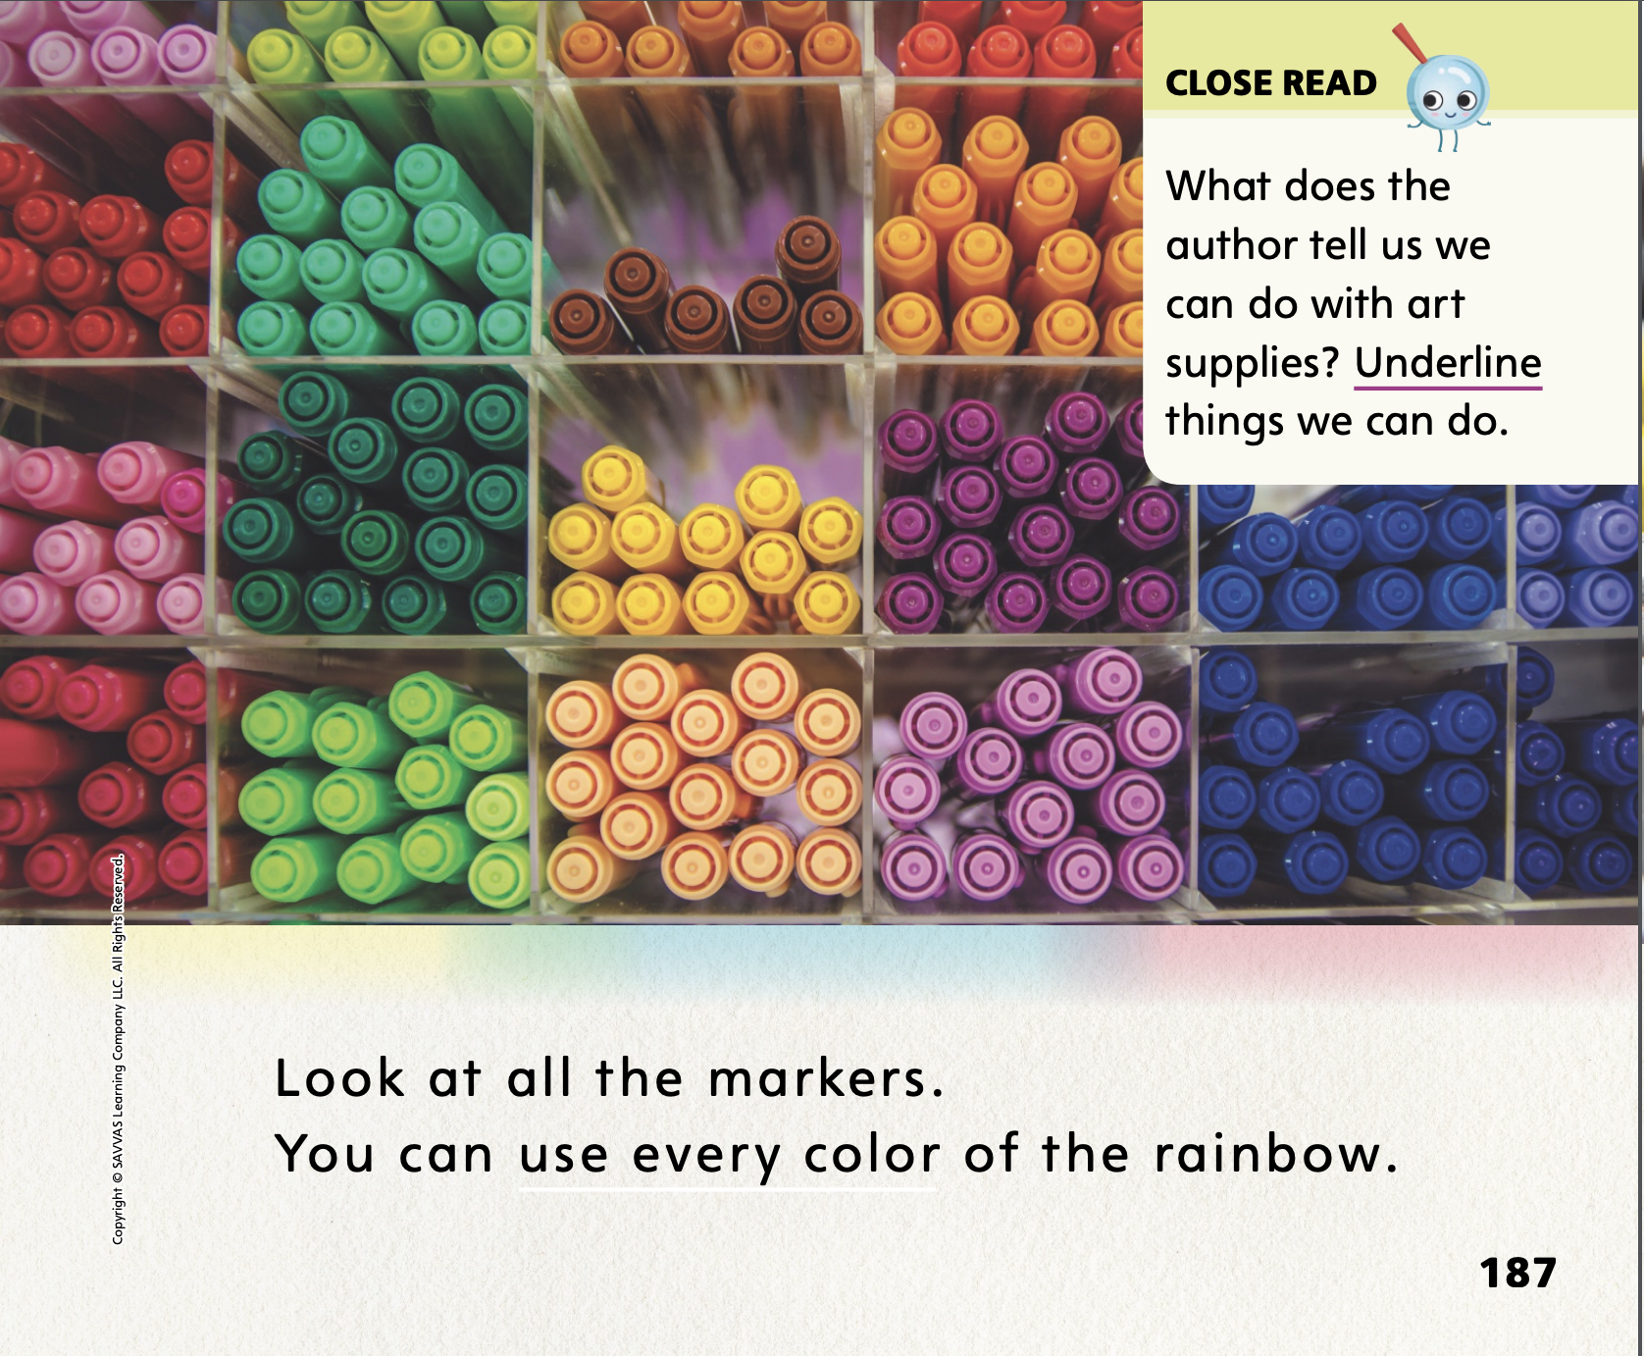
Page 186
Close Read – Discuss Author’s Purpose
Turn to page 186, 187 in your Student Interactive
Notes:
Tell students that an author has a purpose, or reason, for writing. Ask: The author of this text is telling us all about art supplies and what we can do with them. He is very excited about art! What does the author tell about art supplies on these pages? Guide students to underline things that the author says we can do with art supplies. DOK 1

Slide 45

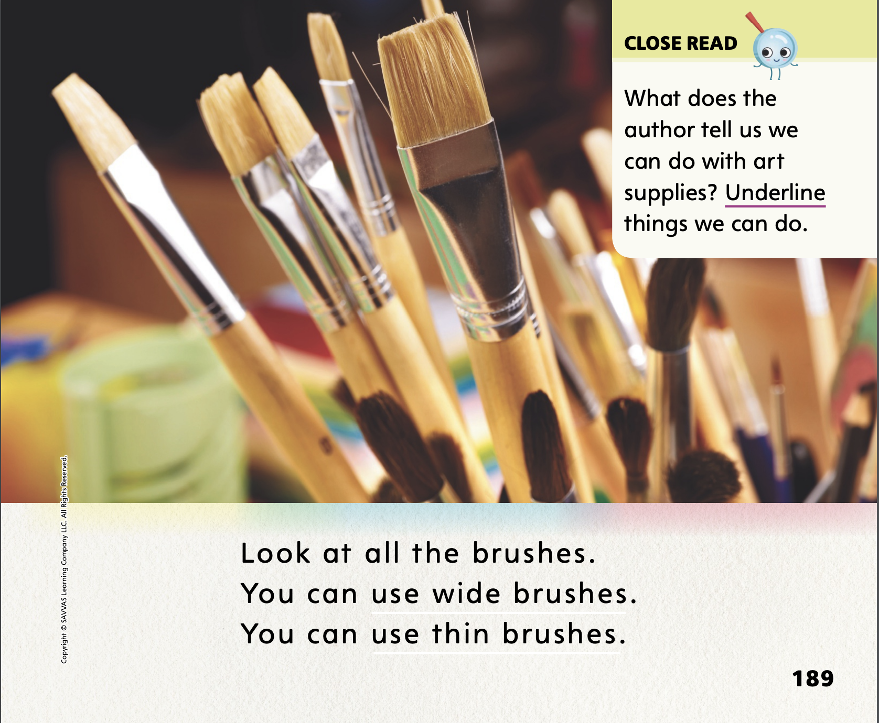
Page 186
Close Read – Discuss Author’s Purpose
Turn to page 188, 189 in your Student Interactive
Notes:
On p. 189, guide students to underline the things the author says we can do with art supplies. DOK 1

Slide 46
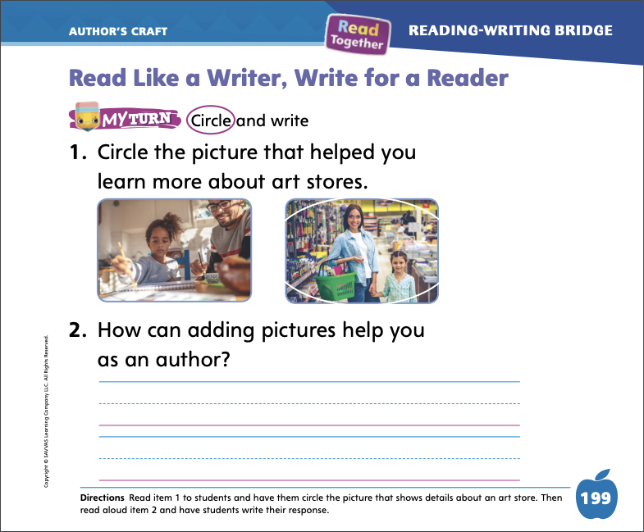

Page 199
Read Like a Writer, Write for a Reader
Turn to page 199 in the Student Interactive and complete the activity.
Notes:
Help students understand that authors can use pictures, or graphic features, to make the main idea of a text clearer.
As you read, ask yourself what the text is about.
Look at the pictures to help you understand what the author is telling you.
Use p. 186 in the Student Interactive to model an example: Authors use pictures to help me understand the words in the text. The author used this picture to tell me that art stores have colored pencils. Assist students as they discuss the author’s use of graphic features to achieve a purpose on other pages in the text.
Have students complete p. 199 in the Student Interactive.

Slide 47
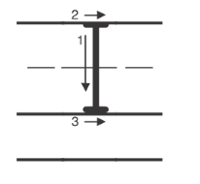
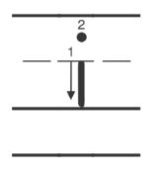
Handwriting
Notes:
Display upper- and lowercase Ii. Explain that words beginning with the letter Ii are written with an uppercase I or a lowercase i. Ask students to identify the uppercase I and the lowercase i.
Write the word I on the board. Point to the word I. This word is I. We always write this word with an uppercase I. Show students where to begin to write the uppercase I. Have them trace an uppercase I in the air or on the surfaces of their desks.
Write the word it on the board. This is the word it. Point to the lowercase i. This is the lowercase i. Watch as I trace this lowercase i with my finger. Have students trace lowercase i in the air and on the surfaces of their desks or on their hands Click path: Table of Contents -> Resource Download Center -> Handwriting Practice -> U1W4L1 Handwriting Practice
Have students complete Handwriting p. 23 from the Resource Download Center to practice writing Ii.

Slide 48
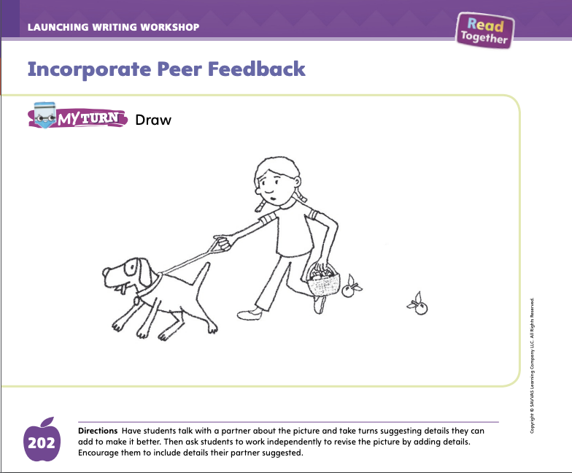
Page 202
Writing – Launch Writing Workshop
Turn to page 202 in your Student Interactive and complete the activity.
Notes:
Authors can listen to others to make their writing better.
Choose a stack book and model how the writer might have incorporated peer feedback. Say: The writer of this book had an editor read it and then make comments. Then the writer incorporated those comments. Let’s pretend we’re the editors for this book. What feedback would you give? Write some of the students’ responses. Great! Now let’s think like the author. How do you think the author used that feedback?
Write several sentences on the board that contain errors. Have students take turns providing feedback. Have a volunteer come up to the board and make the corrections per peer feedback. Discuss with the class how peer feedback improved the writing.
Have students turn to p. 202 in the Student Interactive and complete the My Turn activity.

Slide 49
Independent Writing
Make any edits or revisions to your book.
Notes:
During Independent Writing, students should think about the feedback they received in their Writing Clubs. They should make any edits or revisions based on that feedback.
Modeled Using a student’s work or stack book, model how to incorporate feedback.
Shared Take turns making positive suggestions about a student’s work or stack book.
Guided Prompt students to frame their suggestions with kindness.
As students write, use the conference prompts in the Teacher’s Edition or Resource Download Center to provide support. Click path: Table of Contents -> Resource Download Center -> Writing Workshop Conference Notes
Call on a few students to share their books and pictures. Have a few students provide feedback. Have the writer discuss how he or she can incorporate that feedback.

Slide 50
Language and Conventions
The girl opened the box.
The girls opened the boxes.
Notes:
Remind students that singular nouns name one person, animal, place, or thing, while plural nouns name more than one person, animal, place, or thing. Some nouns are made plural by adding -s. Some are made plural by adding -es.
Demonstrate to students the contrast between singular and plural nouns: First say: The girl opened the box. Then say: The girls opened the boxes. Emphasize the distinction between girl/girls and box/boxes.

Slide 51
Lesson 4

Slide 52
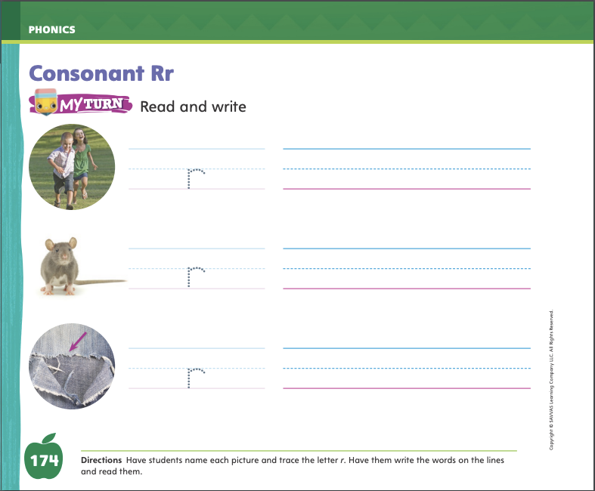
Page 174
Phonics
Turn to page 174 in your Student Interactive and complete the activity.
Notes:
Hold up the Rr Alphabet Card, river. This is a river. I hear the sound /r/ at the beginning of river. Say the sound /r/ with me.
Point to the Rr and say /r/. Do you hear the sound /r/? What letter spells the sound /r/? Have students identify the letter r. Write the letters Rr on the board. Have students draw the letters Rr in the air as you lead them.
Have students turn to p. 174 in the Student Interactive. Guide students as they look at the picture of the running children and write r on the line. Listen carefully as I say the sound /r/. Now let’s look at the first picture on page 174. Let’s say the sounds in the first word: /r/ /a/ /n/. Have students write the word ran on the line. Then have students read the word.
Have students complete p. 174 in the Student Interactive. Guide them as they encode and then decode the words.

Slide 53
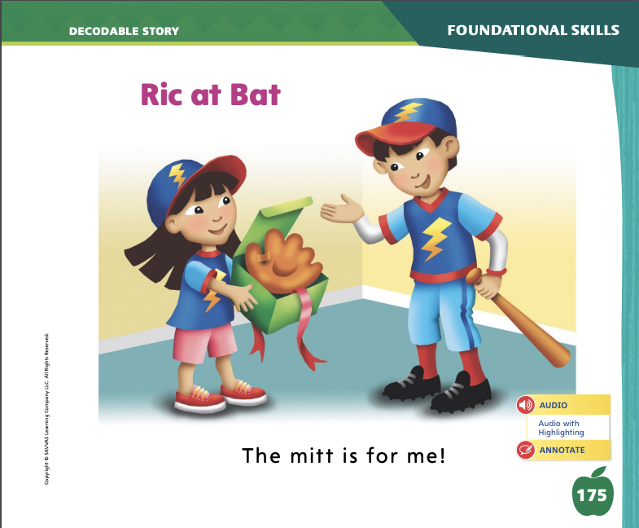
Page 175
Decodable Story
me
for
with
Turn to page 175 in your Student Interactive. Read “Ric at Bat” with your partner.
Notes:
Have students turn to p. 175 in the Student Interactive. We are going to read a story today about a brother and a sister. Point to the title of the story. The title of the story is Ric at Bat. I hear the sound /r/ in the word Ric. What other sound do I hear at the beginning of bat? (/b/) In this story, we will read other words that have sounds you have learned.
Remind students of this week’s high-frequency words: me, for, with. Tell them they will practice reading these words in the story Ric at Bat. Display the words. Have students read them with you. When you see these words in the story Ric at Bat, you will know how to identify and read them.

Slide 54
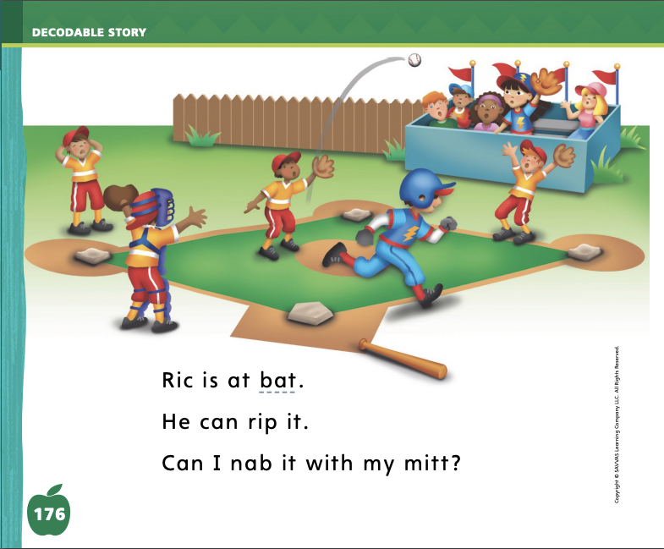
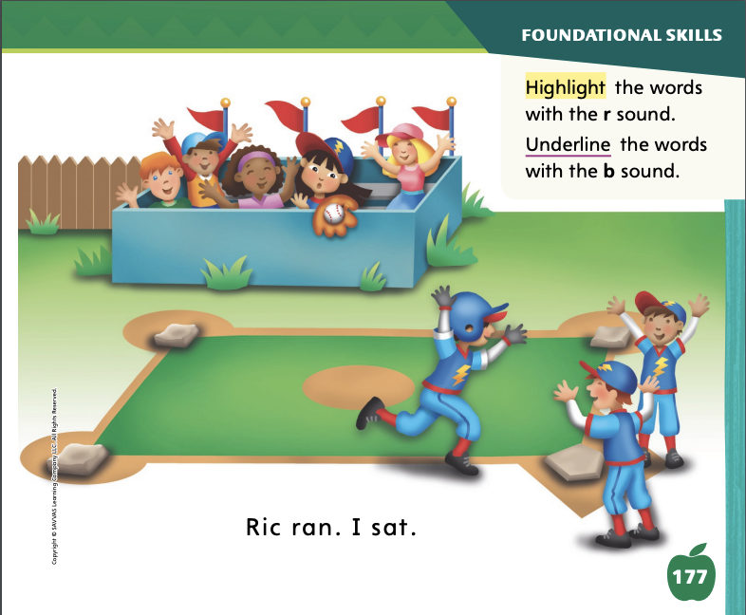
Page 176,177
Decodable Story
Notes:
Have students whisper read the story as you listen in. Have students reread the story page by page with a partner. Listen carefully as they use letter-sound relationships to read the sounds /b/ and /r/. Partners should reread the story. This time the other student begins.
After students have read the story, call their attention to the title. I see the letter r in the word Ric. What sound does the letter r spell? Help them identify, or say, the sound /r/. Then have them find and circle the word with the sound /r/ in the title on p. 175. Can you tell me that word? Help students decode Ric.
Call students’ attention to the first sentence on p. 176. Which word includes the sound /r/? Point to it. Help students identify, or say, the sound /r/. Then have them find and highlight the word Ric. Which word includes the sound /b/? Point to it. Help students identify, or say, the sound /b/. Then have them find and underline the word bat.
Have students look at the rest of the story sentences on pp. 176–177. Which words include the sounds /b/ and /r/? Point to them. Help students identify, or say, the sounds /b/ and /r/. Then have them find and highlight words with the sound /r/ spelled r and underline words with the sound /b/ spelled b.

Slide 55
Page 183
Make Connections
Notes:
Making connections between ideas or facts is one way readers deepen their understanding of a text and get more out of it. Making connections means seeing how these different ideas and experiences fit together. Students should:
Think about the main idea or ideas in the text. What are some of the facts they learned while reading?
Ask themselves, “Does this fact or idea remind me of a place I have been? Does it tell me about something in my own community?”
Make a connection by thinking about how the fact or idea explains something they have seen in their community or other parts of society.
Review pp. 190–191 in the Student Interactive with students. Then read aloud the Close Read note on p. 191. Model for students how to make connections between the text and society. The author says that people go to the art store because they want to have fun, and making art is fun. What does this tell me about people? People like to have fun. That is a fact about people, but it is connected to what the author says in this text about art stores.

Slide 56
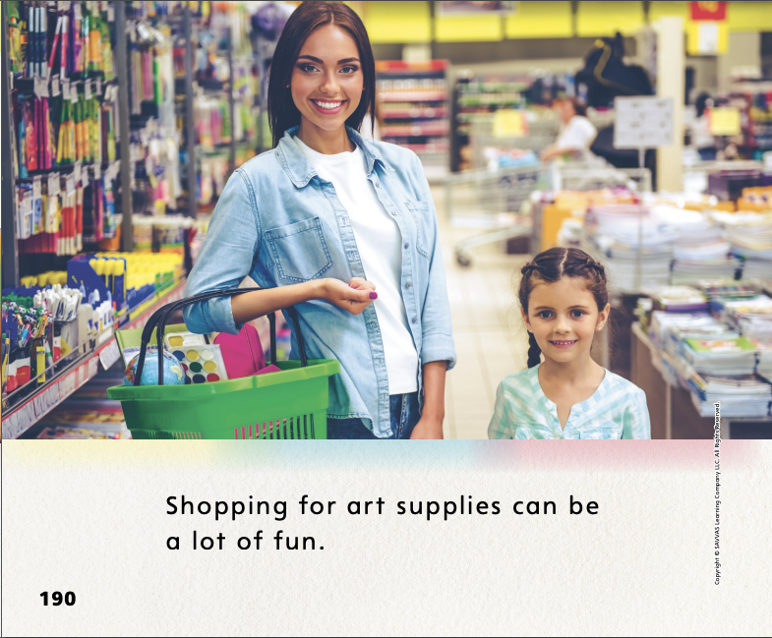
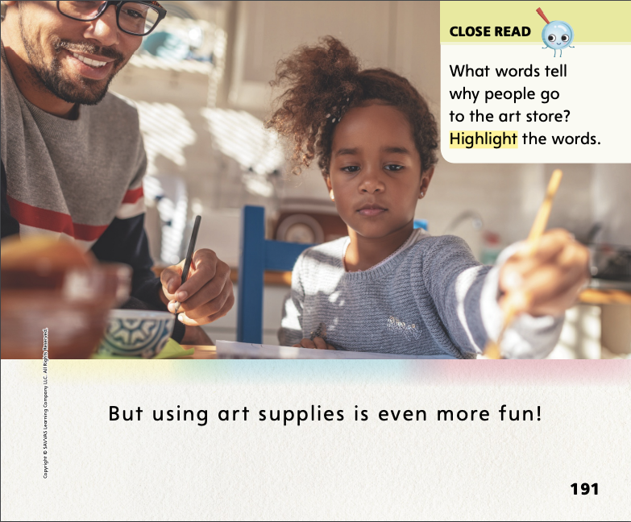
Page 190,191
Close Read – Make Connections
Turn to page 190, 191 in your Student Interactive
Notes:
Tell students that an author has a purpose, or reason, for writing. Ask: The author of this text is telling us all about art supplies and what we can do with them. He is very excited about art! What does the author tell about art supplies on these pages? Guide students to underline things that the author says we can do with art supplies. DOK 1

Slide 57
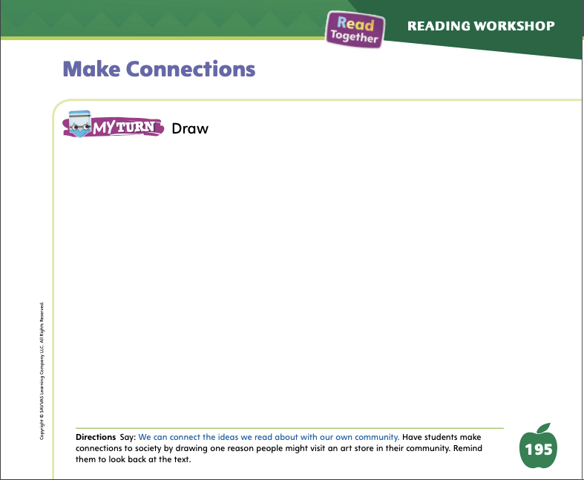
Page 195
Make Connections
Turn to page 195 in your Student Interactive and complete the activity.
Notes:
Have students use the strategies for making connections between a text and society.
Have students complete the My Turn activity on p. 195 of the Student Interactive. Have students share their drawings with the class and explain what they drew.

Slide 58
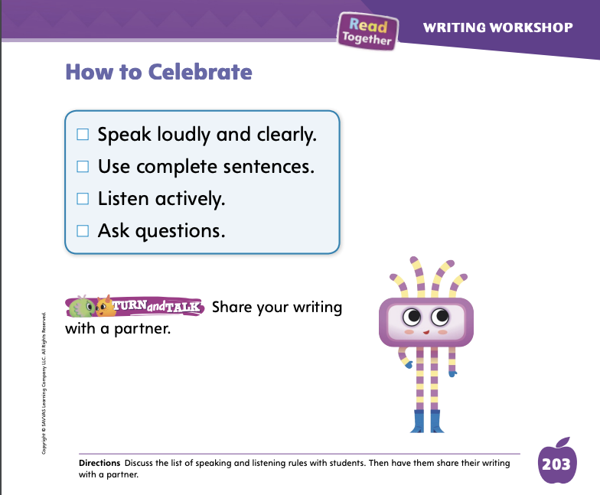
Page 203
Writing – Launch Writing Workshop
Turn to page 203 in your Student Interactive and complete the activity.
Notes:
When we are finished writing, we can celebrate our work. Authors celebrate by having their book printed. They may have book parties and book signings for readers. Your class will have a writing party to celebrate and share their work.
Have students turn to p. 203 in the Student Interactive. Read through the checklist and copy the sentences on a flip chart or poster to display in the classroom for easy reference.
Choose a stack book and tell students to imagine that you are the author. Tell students you will celebrate your work. Introduce yourself to the class. Model talking about your work.
When you are finished, think aloud: Now it’s time to listen to what people have to say about my writing. I am going to listen actively. I am going to answer their questions about my work.
Ask: Who has a question or suggestion for me? Model listening actively. Thank students for their questions or suggestions. Guide students to clap for you and each other for a job well done!

Slide 59
Independent Writing
Share your work in celebration!
Notes:
Have students share their work in a celebration!
Modeled Use a stack book and model how to present suggestions and responses.
Shared Using a stack book, show how to make a suggestion and have students use what they’ve learned to respond.
Guided Prompt students to pose suggestions and responses politely.

Slide 60
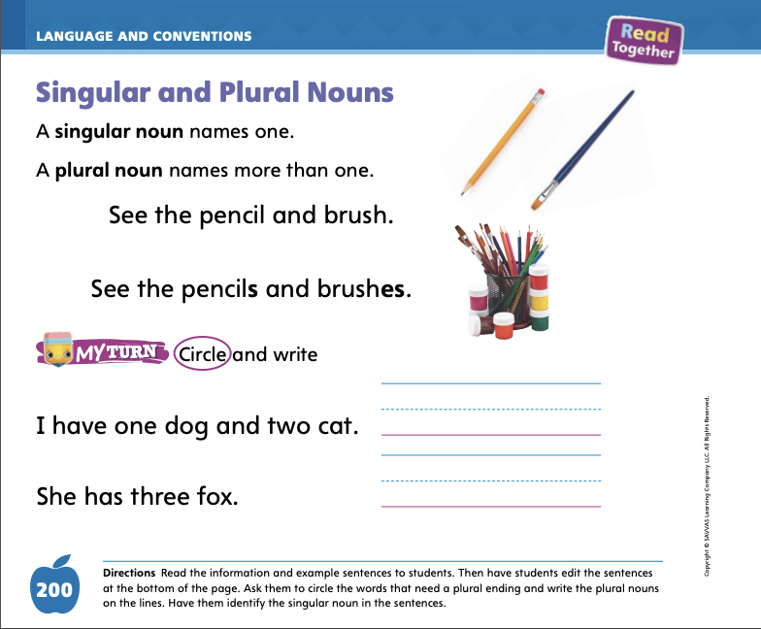
Page 200
Language and Conventions
Turn to page 200 in your Student Interactive and complete the activity.
Notes:
Have students open the Student Interactive to p. 200. Then have them edit the sentences at the bottom of the page by writing the plural nouns and identifying the singular nouns. Provide support as needed.

Slide 61
Lesson 5

Slide 62

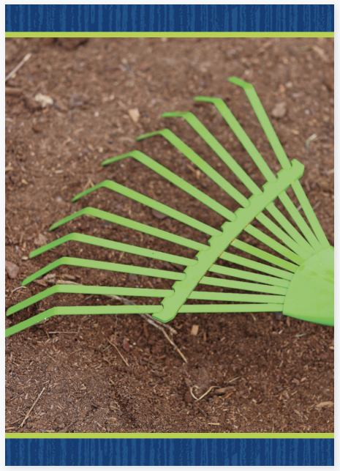
Phonological Awareness
back Ron
ran bill
bet run
bell rice
Notes:
Display the box Picture Card. Listen carefully as I pull apart the beginning and ending sounds of this word: box /b/ -ox. What is the beginning sound in box? Say it with me: /b/. We will blend this word together: box.
Hold up the rake Picture Card. Listen carefully as I pull apart the beginning and ending sounds of this word: rake /r/ -ake. What is the first sound in rake? Say it with me: /r/. Now let’s blend this word together: rake. Click path -> Table of Contents -> Unit 1 Week 5 Informational Text -> Lesson 5
Let’s pull apart and put together other words. What is the first sound in the word ban, /b/ -an, ban. (/b/) Say it with me as we pull the word apart: ban, /b/ -an. Now let’s put the word together: ban. Continue segmenting and blending onset and rime with the words back, Ron, ran, bill, bet, run, bell, and rice.

Slide 63
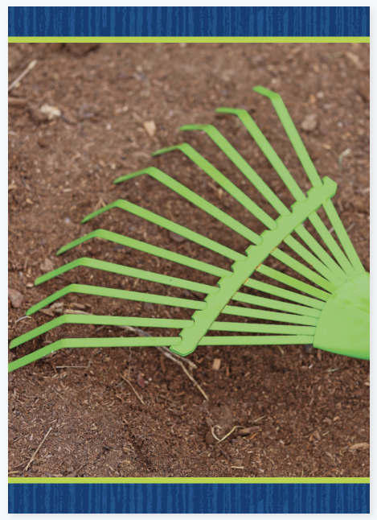
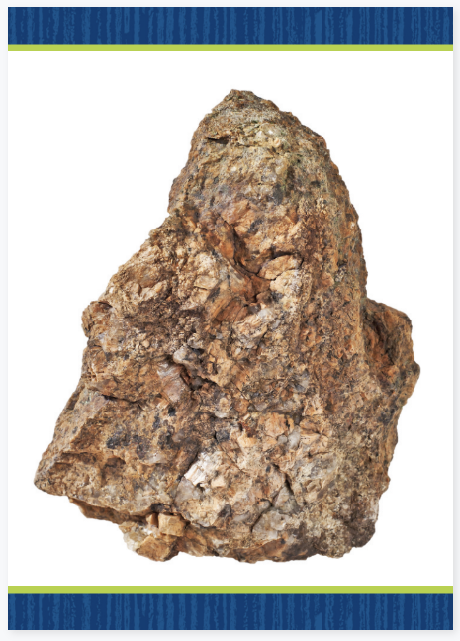

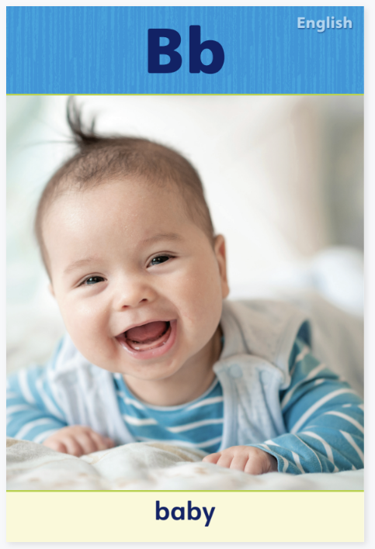

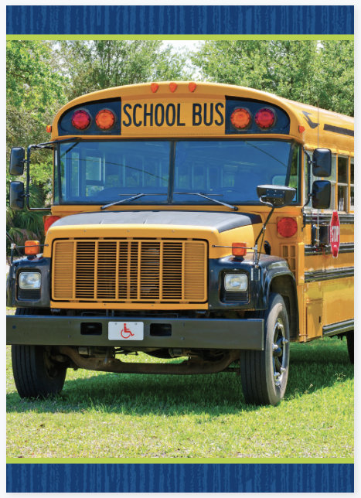

Phonics
Bb Rr
Notes:
Write the letters Bb and Rr on the board. Have students identify the letters as you point to them. Then review the sound for each letter: b/b/, r/r/.
Place the Alphabet Cards for Bb and Rr at the front of the room. Display the rake Picture Card and read the word: /r/ /ā/ /k/. Ask a student to place it next to the appropriate Alphabet Card. Repeat with the Picture Cards for rock, bubble, bus, and rug. Click path -> Table of Contents -> Unit 1 Week 5 Informational Text -> Lesson 5
Have students turn to p. 178 in the Student Interactive. Ask them to trace the initial r in rip and rib and identify, or say, the letters in each word. When we change a letter in a word, we make a new word. What letter changed in rip to make the word rib? Point to the letters that are different. After students identify the letter that changed, have students decode each word. Repeat for each pair of words

Slide 64
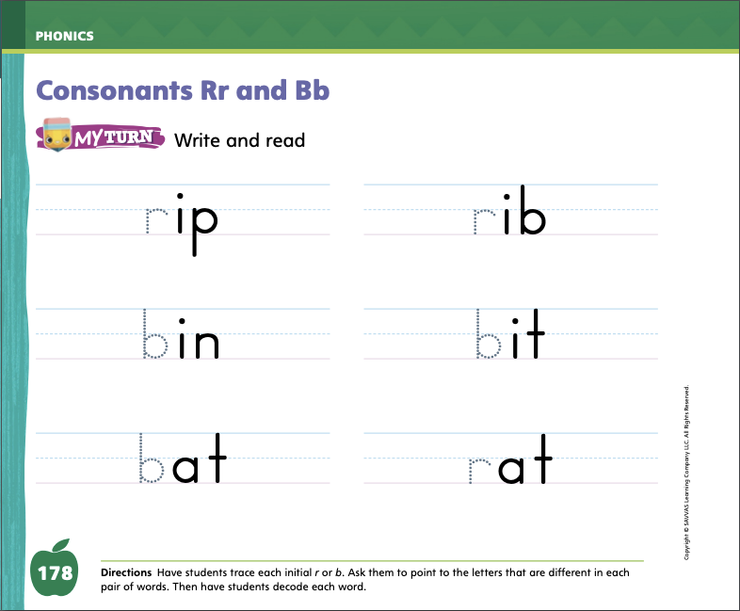
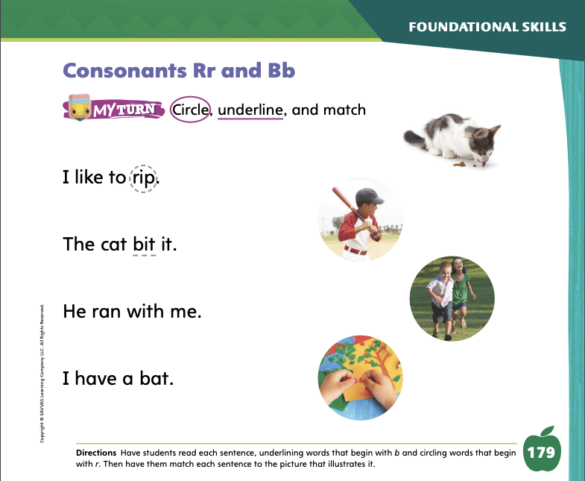
Page 178,179
Phonics
Turn to page 178, 179 in your Student Interactive and complete the activity.
Notes:
Have students turn to p. 178 in the Student Interactive. Ask them to trace the initial r in rip and rib and identify, or say, the letters in each word. When we change a letter in a word, we make a new word. What letter changed in rip to make the word rib? Point to the letters that are different. After students identify the letter that changed, have students decode each word. Repeat for each pair of words.
Have students look at p. 179 in the Student Interactive. Have them underline the words that begin with the sound /b/ and circle the words that begin with the sound /r/. Then have them match each picture to its sentence.

Slide 65
High-Frequency Words
my
we
make
Notes:
Remind students that high-frequency words are words that appear over and over in texts. Remind them they will be learning many words this year, and those words will help them become better readers. Display the word me and ask students what letters spell the word. Have students
say the word me as you write it on the board.
repeat with for and with.
read the words aloud.

Slide 66
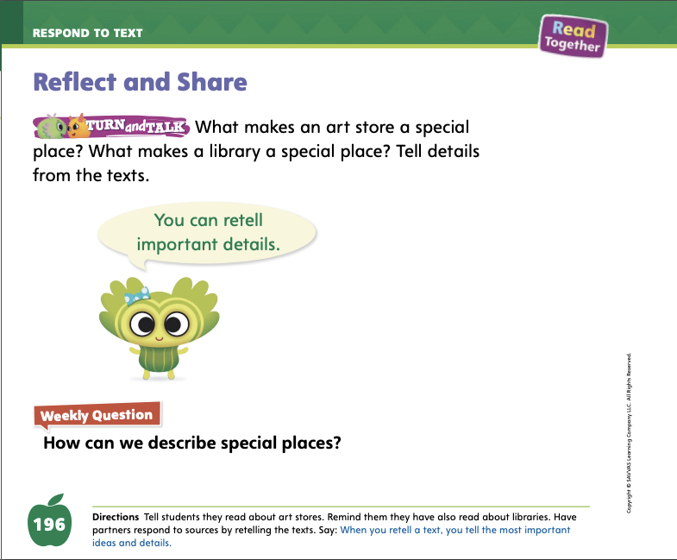
Page 196
Reflect and Share
Turn to page 196 in your Student Interactive.
Notes:
Tell students that they can improve their understanding of a text by retelling it in their own words. Explain that an important part of retelling a text is keeping the text’s meaning. That means that it is important to include the main ideas when retelling a text. When students compare different texts they have read, being able to retell the main ideas of each text will help them see similarities and differences.
The ideas that are important to retell are the main ideas of the text. What was the text mainly about?
Retelling more than one text in a simple way can show how two texts are similar. Were the main ideas of these texts similar? Are they connected in some way?
Think about other ways the texts are alike and different. For example, how are the pictures similar and different?
When students talk about texts, they can use words and phrases they’ve learned through the texts they’ve read, what has been read to them, and what they have already talked about. Phrases and words such as main idea, detail, alike, and different are all words students have learned that they can use in their conversations about texts.
Remind students that they read two texts about special places: the library text on p. 180 and A Visit to the Art Store. Model making connections by retelling. The text about libraries explains that you get books at a library. Similarly, A Visit to the Art Store explains that you get supplies at an art store. Tell students to use words and phrases they’ve learned when they talk about texts they’ve read.

Slide 67

Page 196
Apply
How can we describe special places?
Notes:
Have students use the strategies for comparing and retelling texts in a way that maintains meaning.
Have partners complete the activity on p. 196 of the Student Interactive by taking turns retelling the informational texts. One student starts by retelling the text about libraries, and the other retells A Visit to the Art Store. Then have the students switch texts and retell again, so that each student has a chance to retell both texts.
Have students respond to the Weekly Question. Encourage them to think about all the ideas and topics covered during the week when giving their responses. You can walk around the classroom and get each student’s response or run a class discussion of the weekly question.

Slide 68
Writing – Assessment
Think of an idea for a book.
Write a book about it.
Notes:
During this unit, students were introduced to the parts of a book, how to think like an author, how to accept feedback from peers, and how to ask questions about others’ writing. Students also learned how to participate in Writing Club.
Say: When writing a book we must think of an idea. Then we decide what type of book we will write. We include a front cover, a back cover, and a title page. We must also write words and draw pictures on each page. Hold up a stack book and review the parts of a book. Then read the book, explaining that the author wrote both words and pictures on each page.
Inform students that they are going to take a writing assessment. Using the skills they have learned in this unit, they should respond to the prompt. See the unit assessment on p. T417. Another form of assessment is to score students’ published writing using the rubric on p. T417.
Provide students the assessment prompt below. The prompt may be displayed for students to respond to on a separate sheet of paper. Alternatively, the prompt may be printed from SavvasRealize.com.
PROMPT Think of an idea for a book. Write a book about it.

Slide 69
Language and Conventions
The cats play together.
Which word in the sentence is an example of a plural noun?
A. cats
B. together
C. play
D. the
Notes:
Display the following sentence and guide students to complete the question.
The cats play together.
Which word in the sentence is an example of a plural noun?
cats
together
play
the

Slide 70
Unit 1: Week 5
Grade K

