Slide 1

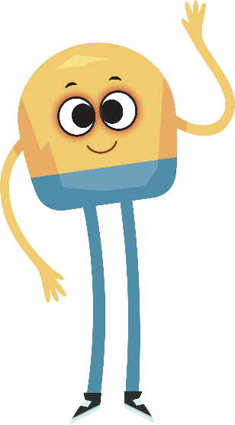

Unit 1: Week 6
Kindergarten

Slide 2
Copyright © Savvas Learning Company LLC. All Rights Reserved.
This publication is protected by copyright, and permission should be obtained from the publisher prior to any prohibited reproduction, storage in a retrieval system, or transmission in any form or by any means, electronic, mechanical, photocopying, recording, or otherwise. For information regarding permissions, request forms, and the appropriate contacts within the Savvas Learning Company Rights Management group, please send your query to:
Savvas Learning Company LLC, 15 East Midland Avenue, Paramus, NJ 07652
or
k12learningpermissions@savvas.com
myView Literacy® is an exclusive trademark of Savvas Learning Company LLC in the U.S. and/or other countries.

Slide 3

Lesson 1

Slide 4
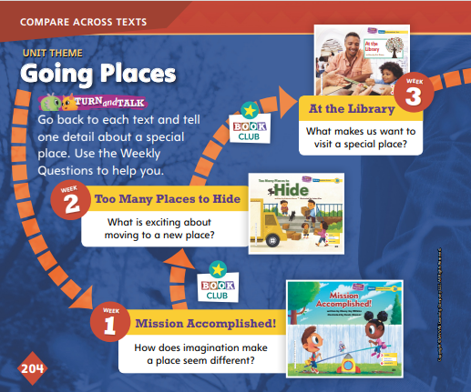
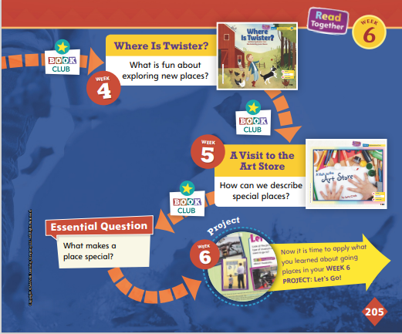
Page
204, 205
Compare Across Texts
Go back to each text and tell one detail about a special place. Use the Weekly Questions to help you.
Notes:
As a class, review the unit theme, Going Places, and the Essential Question: What makes a place special?
Explain that when you share information and ideas, it is important to speak audibly, or loudly, and clearly so others can hear and understand you. Remind students that they have been reading and talking about different kinds of special places all week.
Have students go back to the texts they read in this unit and work in pairs to complete the activity on pp. 204–205 in the Student Interactive. Remind them to speak audibly, or loudly, and clearly.

Slide 5

Page
204, 205
Compare Across Texts
Think about what makes a place special.
Share your response with the class.
Notes:
Remind students that the selections in this unit are connected by the unit theme, Going Places. Ask questions like the ones below to compare themes, topics, and genres across texts. Ask
In At the Library, we read about libraries. In A Visit to the Art Store, we read about art stores. Libraries and art stores are both special places. How are these two special places the same? How are they different? (Possible responses: You can get things at both places. They are different because you do not buy things at a library, but you do at an art store.)
In Where is Twister? we read about a dog who got lost in the forest. In Too Many Places to Hide, we read about a cat who could not be found. What were some special places in these stories? What did these places mean to the characters? (Possible responses: Special places were the new apartment and the forest. The apartment meant a lot because it was new and unfamiliar. The forest meant a lot because it was scary.)
Now have students look back over the texts they have read to write or draw their responses to the Essential Question: What makes a place special? Then explain to students that this week they will be working on a research project in which they will learn about two kinds of special places: art museums and history museums.

Slide 6

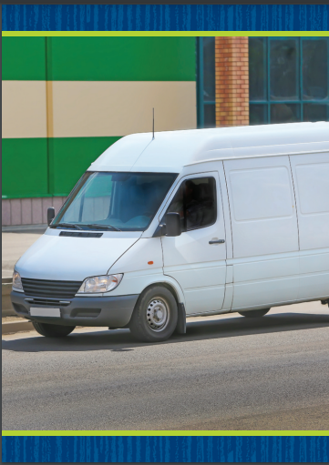
Phonological Awareness
Notes:
Tell students that today they will review the sound /a/. Remind them that the sound /a/ is made by opening your mouth slightly and dropping your jaw. Show students how to make the sound /a/ and have them practice it.
Display the man Picture Card. Say: This is a picture of a man. Listen to the sounds in man: /m/ /a/ /n/. What sound do you hear at the beginning of man? What sound do you hear at the end? Students should tell you /m/, /n/.
Then hold up the van Picture Card. Say: This is a picture of a van. Van and man have the sound /a/ in the middle and the sound /n/ at the end. What other words can you think of that have the sound /a/ in the middle like van and man? Possible responses are jam, can, ran, fan, cat, and hat.

Slide 7
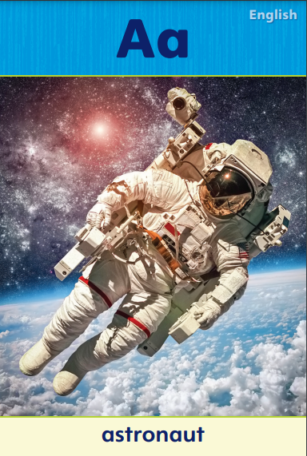
Phonics
sat
ran
man
tap
tab
Notes:
Display the Alphabet Card for Aa and point to the picture of the astronaut. Say: What sound do you hear at the beginning of astronaut? Students should identify the sound /a/. We already learned about the letter that spells the sound /a/. What letter is it? Point to the letters Aa. Students should say a.
Write the word sat on the board. Point to each letter as you say the sound: /s/ /a/ /t/. When I blend the sounds of these words together, I read the word sat. Say the letter-sounds with me: /s/ /a/ /t/. Model blending the word together. Then write the words ran, man, tap, and tab on the board, and repeat the activity.
Partners take turns reading the words on the board.

Slide 8
High-Frequency Words
she
see
look
Notes:
Write the high-frequency words she, see, and look.
Show students familiar letter sounds, such as s/s/, in see.
Point to the word she and read it.
Have students identify the word she by pointing to it, and then have them read it.
Repeat for each word.

Slide 9
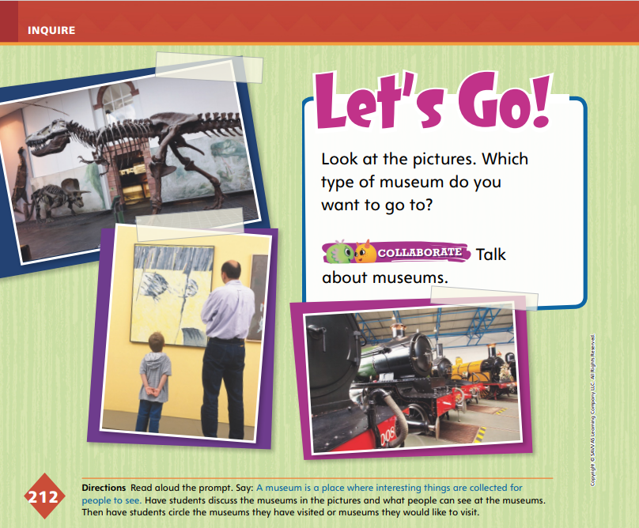
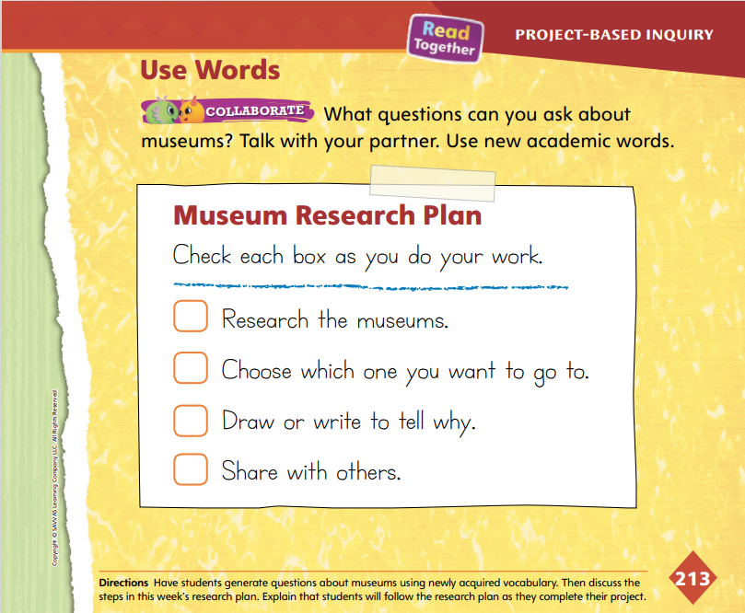

Page
212 ,213
Inquire – Introduce the Project
Which type of museum do you want to go to?
Talk about museums with your partner.
Notes:
Explain to students that this week they will work in pairs to research art and history museums and choose which one they prefer. They will write a persuasive text about the museum they choose.
Explain that a research plan tells the steps needed to complete a research project. Direct students to the Museum Research Plan on p. 213 in the Student Interactive. Tell students that they will follow this plan by doing each step in order throughout the week. Read aloud the first item: Research the museums. Use the model below to help students begin their project.
Say: The first step is to research museums. A museum is a place that displays collections of many interesting things. When I went to a history museum, I saw things from long ago. I know that art museums have beautiful paintings. I will research both of these kinds of museums.
Use questions to help students begin researching museums: What kinds of museums have you seen or visited? Look at the pictures on page 212 in the Student Interactive. What can people see at these museums?
Have students use the pictures on p. 212 to talk about museums and what people can see there. In pairs, have them circle the types of museums they have visited or would like to visit.
Read the remaining steps in the Museum Research Plan. Guide students to understand that research is based on asking questions and finding answers to these questions.

Slide 10
Page
212 ,213
Inquire – Use Words
What questions can you ask about museums?
  Talk with your partner.
  Use new academic words.
Notes:
Remind students that the Academic Vocabulary words special, move, map, and land all relate to the unit theme, Going Places.
Model using these words by describing the pictures on p. 212. Say: I see trains in one picture. Trains can help people and things move across the land. I would like to visit a museum that can tell me more about trains and how they work.
Have students use the newly acquired Academic Vocabulary to talk with a partner.
For differentiated support:
If students struggle to talk about museums, provide additional pictures of museums, or visit a museum’s Web site and browse pictures with students. Use Academic Vocabulary words in prompts to help students tell about what they see. For example, ask: What makes this museum special? What does this map tell us about this museum?
Invite students to write or draw what they already know about museums. Have them share their ideas with a partner and use the Academic Vocabulary as they tell about their writing or drawing.
Next Steps: Tell students that they will begin following a plan to research museums. Once they have gathered information about museums, they will be able to check off the first item in the Museum Research Plan. Explain that the next step is to consider the information and decide which museum they want to visit.

Slide 11
Lesson 2

Slide 12
Phonics
man
ran
bat
sat
-an
-at
Notes:
Tell students that today they are going to learn about word families. Words that end in the same sounds are in a word family.
Display the man Picture Card. This is a man. Turn the card over. The beginning sound in man is /m/. The letter m spells the beginning sound /m/. Circle the letter m. The word man ends with the sounds /a/ /n/. The letters a-n spell the ending sounds /a/ /n/. Underline the letters an.
Write the word ran and repeat the activity. The words man and ran have the same ending sounds, /a/ /n/, so they are in the same word family.
Write the word bat on the board. Have students identify the beginning sound and ending sounds in bat and the letters that spell the sounds. Then write the word sat on the board. Ask students to tell you if sat is in the same word family as bat and explain how they know.
Write the words tan, pat, Nan, rat, cat, pan, can, and mat on separate note cards. Then write the headings an and at on the board. Tell students that you will show them words that are in the an and at word families. Tell them to read the words and identify the word family for each word. Display the note cards one at a time. After students identify the word family for a word, tape the word under the appropriate heading on the board.

Slide 13
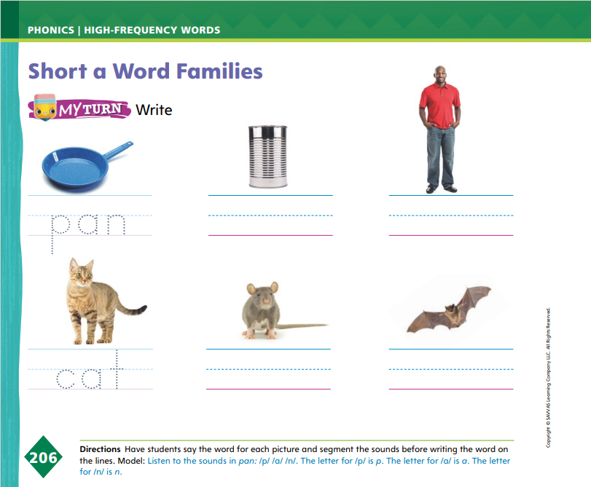
Page 206
Apply
Identify each picture.
Does it belong to the –an or –at family?
Write the word on the line.
Notes:
Have students identify each picture on p. 206 in the Student Interactive that belongs either to the -an or -at word family, and then have them write the words on the lines.
Have students identify the sounds of the letters that are different in each set of words.

Slide 14
High-Frequency Words
she
see
look
Notes:
Tell students that high-frequency words are words that they will hear and see over and over in texts.
Write and then read the words she, see, and look.
Have students read the words with you and clap each letter.

Slide 15
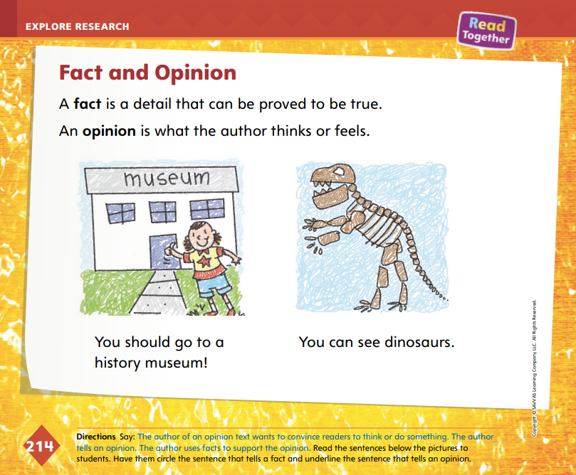
Page
214
Explore and Plan – Persuasive Text
Turn to p. 214 in your Student Interactive.
Notes:
Introduce persuasive text by explaining that a persuasive text is written to convince readers to think or do something. A persuasive text contains an author’s opinion and facts supporting the opinion. Have students turn to p. 214 in the Student Interactive. Use the model below to help students explore the characteristics of persuasive writing.
Say: Authors sometimes write to make the reader think a certain way. This is called persuasive writing. In persuasive texts, authors tell their opinion, or what they think or feel. Then authors tell facts, or something that is real or true, to get readers to agree with them. On this page, one picture shows someone who is excited to go to a museum. The other picture shows the bones of a dinosaur. I am going to read the sentences below the pictures and think about what the author might be trying to convince me to think or do.
Read aloud the sentences below the pictures. Say: The author is trying to convince me to go to a history museum.
Engage students in a discussion of the difference between fact and opinion. Guide students to understand that the sentence You should go to a history museum! is an opinion, and the sentence You can see dinosaurs is a fact. Use the student model to point out how a fact can support an opinion to make the opinion stronger, or more convincing.
Draw pictures to show students different opinions or details the author uses in a persuasive text to structure his persuasive argument. Use a piece that has pictures, diagrams, and captions to show students how information is organized in persuasive texts. Read aloud and point to the various images and captions to identify the structure of the text.

Slide 16
Page
214
Explore and Plan – Persuasive Text
Audience
Who might want to go to a museum? | What would make your classmates choose a certain kind of museum?
Notes:
Explain to students that authors write with a certain audience in mind. Have students consider the audience for their persuasive text.
Ask questions to help students think about audience, such as: Who might want to go to a museum? What would make your classmates choose a certain kind of museum? Record students’ responses. Remind students to think about their audience as they write their persuasive texts.
Next Steps: Remind students that they will research art and history museums to determine which they would rather visit. Tell students that they will learn how to find this information so that they can write their persuasive texts.

Slide 17
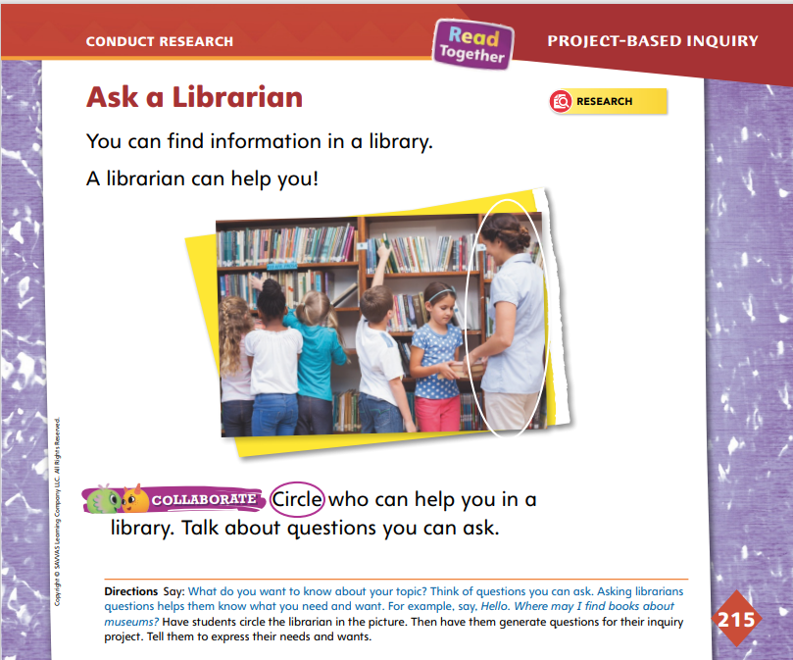
Page
215
Conduct Research
Notes:
Explain to students that in order to do research it is important to generate, or make up, questions about what you are researching. One place you can do this is a library. Tell them that a librarian is a person who works at a library to help readers find the right resources and information. Point to the picture on p. 215 in the Student Interactive, and have students identify the librarian.
Say: A library has many books, magazines, and other sources of information. Sometimes, it can be hard to find the right book or resource. A librarian can help you find what you need for your research. You can ask questions about what you are researching so that the librarian knows what kind of information you need or want. For example, I want to research art museums. I’m interested in seeing children’s art. I can ask a librarian, Where can I find information about art museums that have art created by children? Explain that when we generate questions about what we are researching, we can help a librarian understand what information we need in the library.
Help students narrow the topic of museums by asking questions, such as, What do you want to learn about life long ago? What animals do you think were alive long ago? What kind of art do you like to make? What do you like to paint or draw? Use students’ responses to suggest specific areas to research.

Slide 18
Page
215
Conduct Research
Circle the person who can help you in the library.
Notes:
Have student pairs circle the person who can help them in a library in the picture on p. 215. Then have students collaborate with their project partners to generate questions for inquiry. Assist partners as necessary. Make sure students’ questions are about art or history museums. Have students talk about questions they can ask a librarian.
Take a trip to the library or media center. Have project partners look for resources for research. Remind them that they can ask you or a librarian for help.
For differentiated support:
Support students by providing a sentence frame for them to ask questions: Where can I find information about (a history/an art) museum that has _____? Alternatively, have them draw something they are interested in learning more about and help them frame their idea as a question.
Students who easily generate inquiry questions can write their questions on a sheet of paper and underline key words to help them focus as they research.
Next Steps: When students have collected sources of information about museums, have them return to the Museum Research Plan on p. 213 in the Student Interactive and check the box “Research the museums.” Explain to students that the next step is to choose which museum they want to visit. Then they can start writing about the museum.

Slide 19
Lesson 3

Slide 20
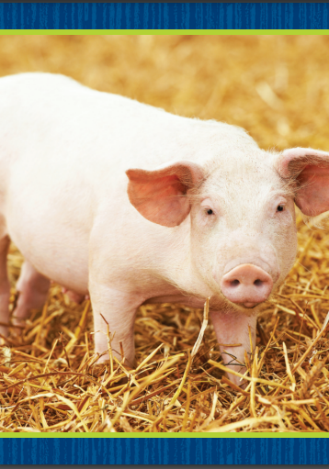

Phonological Awareness
Notes:
Tell students that today they will review the sound /i/. Remind them that the sound /i/ is made by opening their mouth slightly and saying the sound. Show students how to make the sound /i/ and have them practice it.
Display the pig Picture Card. This is a picture of a pig. Listen to the sounds in pig: /p/ /i/ /g/. Pig has the sound /i/ in the middle.
Then hold up the wig Picture Card. This is a picture of a wig. What sound do you hear in the middle of wig? Students should tell you /i/. Wig and pig have the sound /i/ in the middle. What other words can you think of that have the sound /i/ in the middle? Possible responses are jig, sit, pit, fig, and lip.

Slide 21

Phonics
sit
bit
tin
rim
pit
Notes:
Display the Ii Alphabet Card and point to the picture of the igloo. What sound do you hear at the beginning of igloo? Students should identify the sound /i/. We already learned about the letter that stands for /i/. What letter is it? Point to the letters Ii. Students should name the letter i.
Write the word sit on the board. Point to each letter as you say the sounds: /s/ /i/ /t/. When I blend the sounds of these words together, I read the word sit. Say the letter-sounds with me: /s/ /i/ /t/. Model blending the sounds to read the word. Then write the words bit, tin, rim, and pit on the board and repeat the activity.
Have partners take turns reading the words on the board.

Slide 22
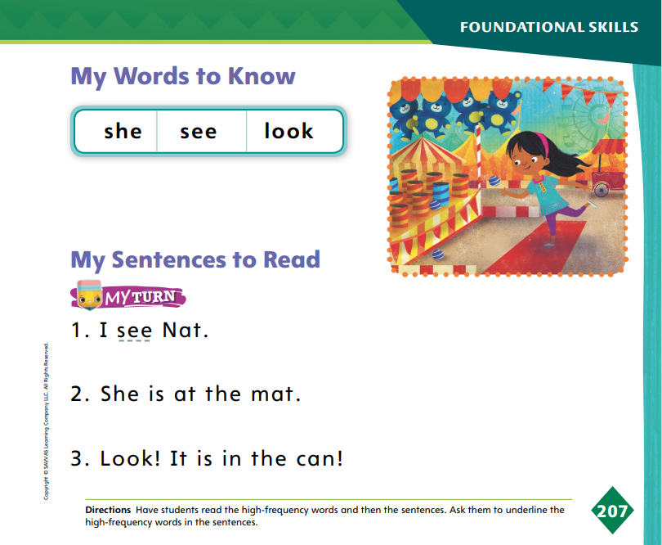
Page 207
High-Frequency Words
she
see
look
Turn to page 207 in your Student Interactive and complete the activity.
Notes:
Say: Today we will practice reading the high-frequency words she, see and look. Have students read the words at the top of p. 207 in the Student Interactive with you: she, see, look.
Have students look at the words at the top of p. 207. Say: I will read a word, and I want you to point to it. Then we will read the word together. Read she, and have students point to it. Now let's read the word together: she. Repeat with the other words.
Have students read the sentences on p. 207. Ask them to identify the words she, see, and look and underline the high-frequency words in the sentences. Then have them read the sentences again with a partner.

Slide 23
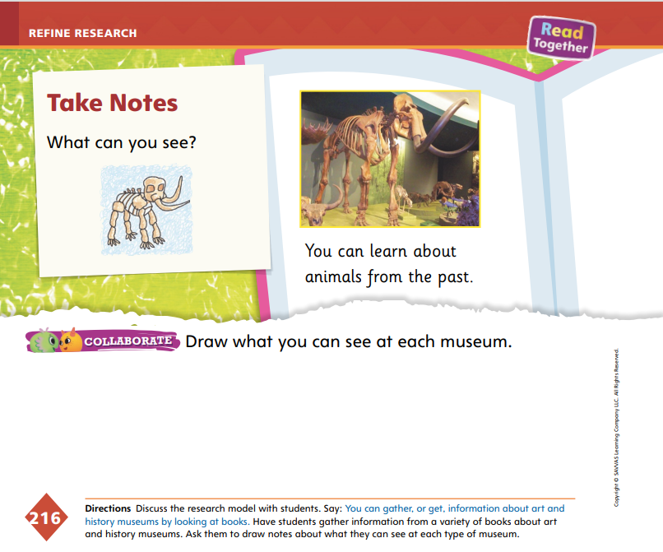
Page
216
Refine Research
Art | History
Notes:
Taking notes will help students easily recall and organize information gathered during research so that they can form a strong opinion. Explain to students that they can organize their notes using a simple T-chart.
Draw a T-chart on the board. Write the heading Art in the left column and the heading History in the right column. Say: I can keep my information organized using this T-chart. I will draw information about art museums in the left column. Point to the Art column. I will draw information about history museums in the right column. Point to the History column. Then ask students to tell a fact about art museums and a fact about history museums for you to draw in the appropriate column.
Have students turn to p. 216 in the Student Interactive. Read aloud the caption beneath the photograph. Prompt students to tell that the photograph shows the bones of an animal that was alive long ago. Say: This picture came from a resource about a history museum. It shows that we can see the bones of an animal from long ago at a history museum. If you find a fact like this that you want to remember, you can draw it in your T-chart.
Have students draw a T-chart and label the columns. Have them gather information from books to find facts about art or history museums to note in their charts. Provide assistance as necessary.
On p. 216, have students draw a vertical line to separate the drawing area in half. Have them draw what they can see at an art museum on one side and what they can see at a history museum on the other side. Allow students to label their drawings with words.
Next Steps: Have students think about whether they would rather visit an art or a history museum. Explain that they will begin drawing their persuasive texts. Remind students that they will express an opinion and tell a fact to support their opinion.

Slide 24
Lesson 4

Slide 25
Page 208
Phonics
-in
-ip
pin
rip
bin
tip
Listen carefully to the words and trace in or ip in the air if you hear the word part.
Notes:
Hold up a safety pin. This is a pin. The first sound in pin is /p/. The sound /p/ is spelled with the letter p. The ending part in pin is -in. Write -in as a heading on the board. The ending sound of pin is spelled -in.
Point to a garbage bin. Have students say the word and tell if it is in the -in word family. Write pin and bin on the board under the heading -in. The words pin and bin are members of the -in word family.
Rip a piece of paper. This is a rip. The first sound in rip is /r/. The sound /r/ is spelled with the letter r. The ending part in rip is -ip. Say the word tip. Write -ip as a heading on the board. Have students say the word and tell you if it is in the -ip word family. Write the words rip and tip under the -ip heading. The words rip and tip are both in the -ip word family.
Tell students that you will say a group of words. Tell them to listen carefully to the words and trace in or ip in the air if they hear the word part. Tell them that there will be one word in each group that isn’t in the -in or -ip family. Tell students to listen carefully. Use the following words for this activity, emphasizing the ending part in each word: Vin, tin, lap, kin; ship, flip, tip, bat; fin, pin, ham, tin; dip, hip, lip, Sam.

Slide 26
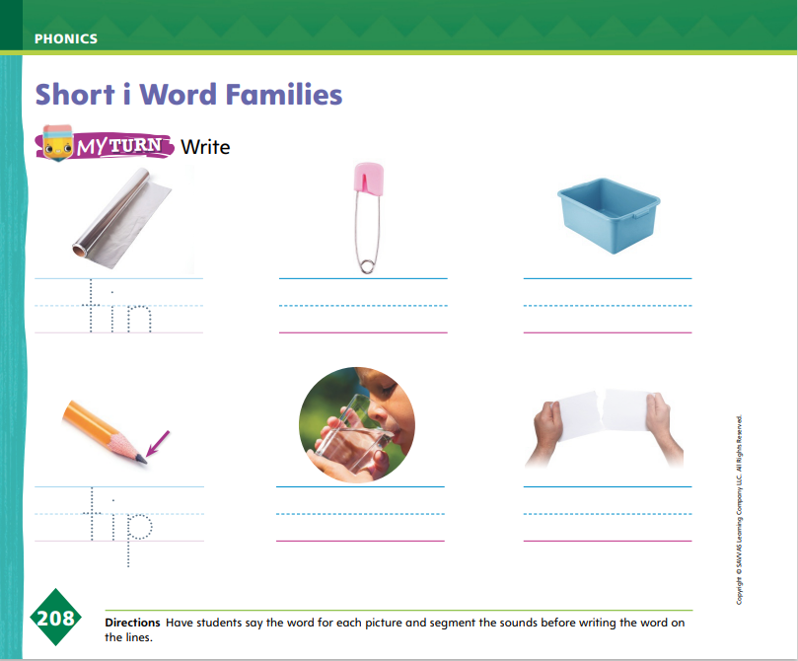
Page 208
Apply
Turn to p. 208 in your Student Interactive and write the words on the lines.
Notes:
Have students identify each picture on p. 208 of the Student Interactive that belongs either to the -in or -ip word family, and then have them write the words on the lines. Have students identify the sounds of the letters that are different in each set of words.

Slide 27
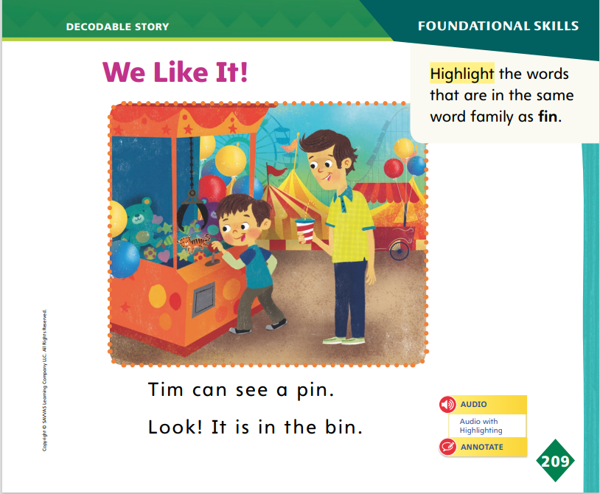
Page 209
Decodable Story
Turn to page 209 in your Student Interactive. Read “We Like It!” with a partner.
Notes:
Have students turn to p. 209 of the Student Interactive. We are going to read a story today about kids at an amusement park. Point to the title of the story. The title of the story is We Like It! I hear the sound /i/ in the word it. In this story, we will read other words with the sound /i/ spelled i and other sounds we have learned such as n/n/, a/a/, and p/p/.
Remind students of this week’s high-frequency words: she, see, look. Tell them that they will practice reading these words in the story We Like It! Display the words. Have students read them with you. Say: When you see these words in the story We Like It!, you will know how to identify and read them. You will also see some other Words to Know we have learned: we, like, with, a.
Have students whisper read the story as you listen in. Then have students reread the story page by page with a partner. Listen carefully as they use letter-sound relationships to decode. Have partners reread the story. This time the other student begins.

Slide 28
Page 209
Decodable Story
Highlight the words that are in the same word family as fin.
Notes:
After students have read the story, call their attention to the first sentence on p. 209. I see a word that is in the same word family as fin: pin. Both words have the ending part -in.
Help students identify, or say, the ending part -in. Then have them locate and highlight the words that are in the same word family as fin on p. 209 of the Student Interactive.

Slide 29
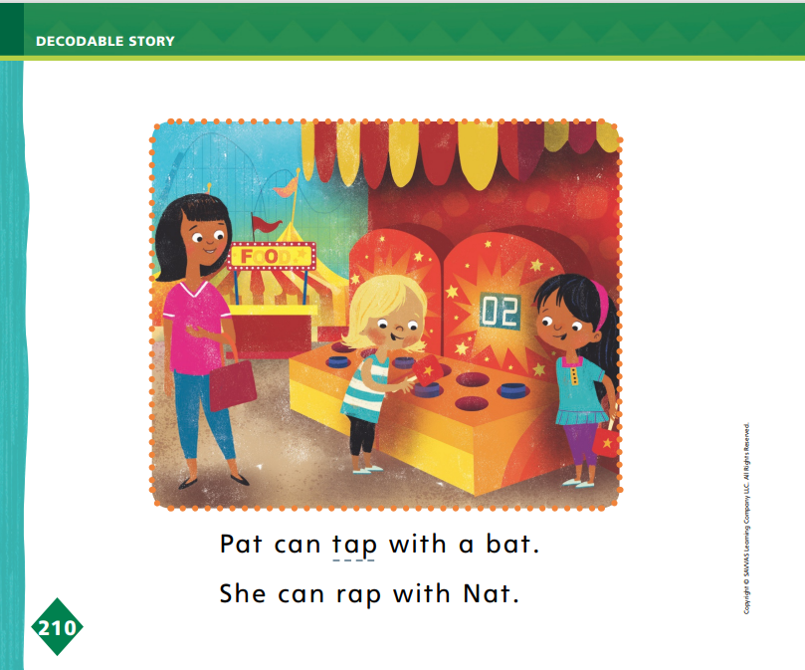
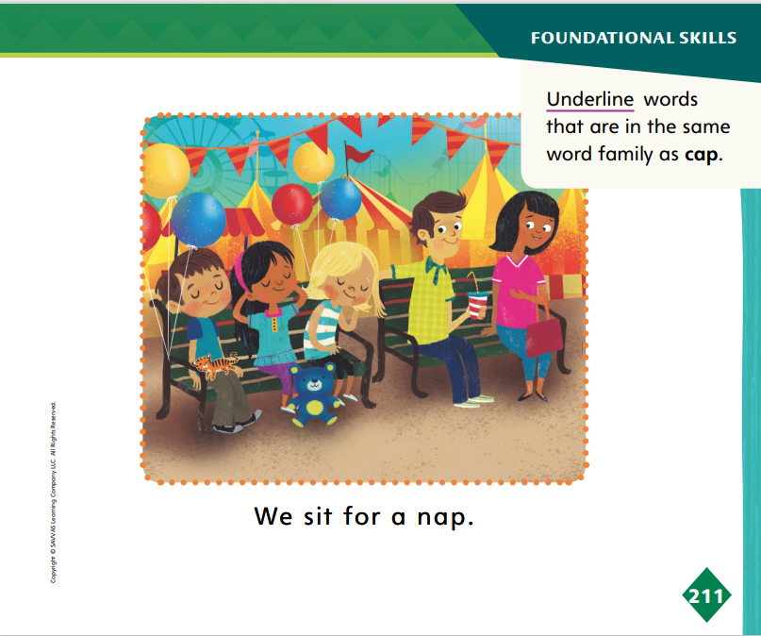
Page 210, 211
Decodable Story
Turn to page 210, 211 in your Student Interactive.
Underline the words in the –ap family.
Notes:
Have students turn to pp. 210–211. Say: Which words are in the -ap family? Students should supply the words tap, rap, and nap.
How do you know these words are in the -ap family? Students should say that all the words have the ending part -ap, so they are in the -ap family.
Have students underline the words tap, rap, and nap.

Slide 30
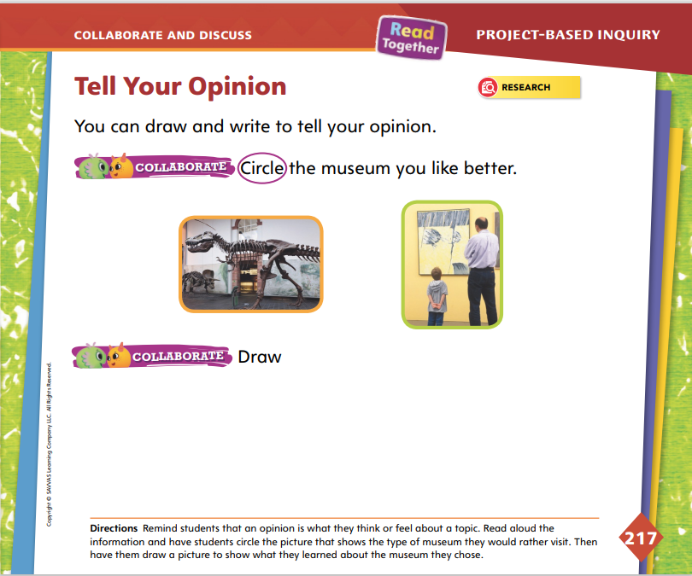
Page
217
Collaborate and Discuss
Turn to p. 217 in your Student Interactive.
Circle the museum you like better.
Notes:
Tell students that they will now share which type of museum they want to visit by drawing. Tell them that by sharing, they can demonstrate an understanding of the information they have gathered through research. Students may wish to revisit their notes to help them choose between an art and a history museum. Use the model and practice to help students state their opinion and support it with a fact in order to demonstrate understanding.
Direct students’ attention to p. 217 in the Student Interactive. Have them look at the pictures and identify the types of museums shown. Have students practice demonstrating an understanding of information they have gathered through research. Say: I like the history museum better. This is my opinion. I will circle the picture of a history museum to show my opinion. I want to visit a history museum because I want to learn about animals that were alive long ago, such as dinosaurs. I will draw a picture that shows a dinosaur at a history museum. It is a fact that history museums have information about dinosaurs. It supports my opinion because it tells something interesting about history museums.
Ask questions to help students draft their persuasive texts.
Do you want to visit a history museum or an art museum?
Did you draw a fact about the museum that you want to visit?
Is the fact interesting enough to convince your audience to visit the museum too?

Slide 31

Page
217
Apply
Draw a picture to show what you know about the museum you chose.
Write a neat copy on a separate sheet of paper after you have met with your teacher.
Notes:
After students have decided whether they would rather visit an art or a history museum and circled the appropriate picture on p. 217, they will draw a picture.
Tell students to draw a picture to show what they know about the museum they chose. Their drawing should show details about an art museum or a history museum. Remind students to consider the audience that they are trying to persuade as they draw their facts. Have students create a neat copy on a separate sheet of paper.
Meet with pairs to discuss their drawings. Prompt students to share their opinion and fact. Remind them that they will need to have a finished product to present to the class the next day. Have students offer ideas for sharing through multiple exchanges.
For differentiated support:
Have students review their notes on one of the museums. Ask: What do you like or not like about this museum? Would you want to visit this museum? Why? Record students’ responses. Then have students repeat for the other museum. Read aloud students’ responses and guide them to express an opinion. Have them draw their opinion.
If students easily draw and tell their opinion, have them review their notes on museums and choose another fact to draw to support their opinion. Allow students to write words or sentences to label their drawings.
Next Steps: Invite students to return to the Museum Research Plan on p. 213 in the Student Interactive. Read aloud the second and third steps. Have students check the box “Choose which one you want to go to.” Tell students that they should complete their persuasive writing before they check the box “Draw or write to tell why.” Remind them that they will share their persuasive writing with the class

Slide 32
Lesson 5

Slide 33


Phonological Awareness
Notes:
Display the cap Picture Card. This is a picture of a cap. Listen to the sounds as I say cap slowly: /k/ /a/ /p/. How many sounds does the word /k/ /a/ /p/ have? Yes, it has three sounds. Now I will blend the sounds together to say the word: /k/ /a/ /p/, cap.
Listen carefully as I say a word: rip. What is the first sound in rip? Say it with me: /r/. What is the second sound in rip? Say it with me: /i/. What is the third sound in rip? Say it with me: /p/. Now let’s blend the sounds together to say the word: /r/ /i/ /p/, rip. Have students segment and blend the sounds for big, pan, and dip.

Slide 34


Phonics
bat
rat
Notes:
Tell students that today they will review two other letters and their sounds: consonants b and r.
Display the Bb and Rr Alphabet Cards. Point to Alphabet Card Bb. The consonant b spells the sound /b/ at the beginning or end of a word. Then point to Alphabet Card Rr. The consonant r spells the sound /r/ when it is at the beginning of a word like river.
Have students review the consonants b and r. Display the word bat. Listen as I say the word bat: /b/ /a/ /t/. The word bat starts with the consonant b and has the short a sound spelled a in the middle: bat. Have students read the word bat.
Display the word rat. Listen as I say the word rat: /r/ /a/ /t/. The word rat starts with the consonant r and has the short a sound in the middle: rat. Have students read the word.
In pairs, have students spell the words rat and bat aloud.

Slide 35
High-Frequency Words
she
see
look
Notes:
Remind students that high frequency words are words that appear over and over in texts.
Say the word she and ask students what letters spell the word.
Have students say the word she as you write it on the board.
Have students repeat with see and look.
Have them read the words aloud.

Slide 36
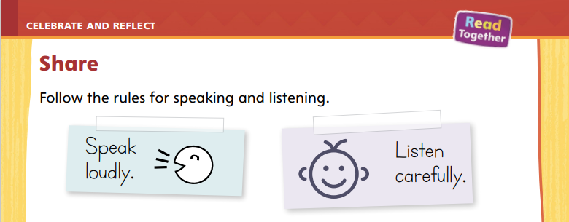
Page
218
Celebrate and Reflect
Turn to p. 218 in your Student Interactive.
Present your project to your classmates as you follow the rules for speaking and listening.
Notes:
Tell students that they will share their research projects with the class. Explain that there are different ways for them to share their projects, such as by showing their writing and drawings or by talking about their project. Students should choose an appropriate mode of delivery, such as speaking orally or writing, and practice delivering their presentations with their partners. Tell students to speak loudly and clearly. Remind them to practice showing their writing or drawings as they speak. Use the Active Listening Routine to help students be good listeners.
Active Listening Routine Model the active listening routine to set expectations for audience members.
Look - Keep your eyes on the person who is talking. Keep your mouth closed and your hands still.
Think - Think about what the person is sharing.
Respond - Wait until the person is finished talking before asking a question

Slide 37
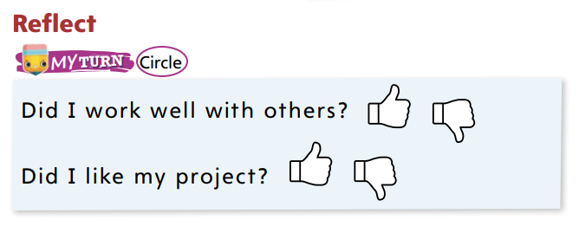
Page
218
Celebrate and Reflect
Turn to p. 218 in your Student Interactive and complete the activity.
Notes:
Allow time for students to reflect on the phases of the project.
Help students recall how they asked questions, gathered information, drafted an opinion, and shared their projects.
Ask questions, such as What was the first step in your research plan? How did you find information? What did you do at the end of the project? What did you learn about your own likes and dislikes as you researched museums?
Guide students to complete the activity at the bottom of p. 218 in the Student Interactive.

Slide 38
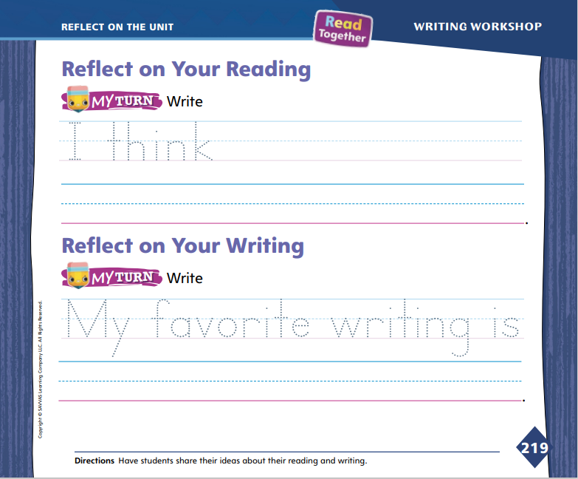
Page
219
Reflect on the Unit
Turn to p. 219 in your Student Interactive and complete the activities.
Notes:
Review the Unit Goals page at the beginning of the unit with students. Have them reflect on their reading and writing skills. Review and discuss the Essential Question: What makes a place special?
Display the unit table of contents. Ask volunteers to briefly summarize each reading selection. Students’ summaries should include the title of the selection and a fact from the selection. Ask other volunteers to offer thoughts and opinions about the selection, such as I think libraries are fun to visit. I think an art store is a special place.
Have volunteers tell what they learned about writing. Ask students to share their favorite writing. Use prompts, such as What kind of writing did you like best? What kind of writing would you like to do again?
Invite students to identify their opinions on a text from the unit and their favorite piece of writing. Direct students to trace the dotted letters under each Reflect activity on p. 219 in the Student Interactive. Help them record their responses on the lines.

Slide 39
Unit 1: Week 6
Kindergarten

