Slide 1
Unit 3: Week 2
Grade K

Slide 2
Copyright © Savvas Learning Company LLC. All Rights Reserved.
This publication is protected by copyright, and permission should be obtained from the publisher prior to any prohibited reproduction, storage in a retrieval system, or transmission in any form or by any means, electronic, mechanical, photocopying, recording, or otherwise. For information regarding permissions, request forms, and the appropriate contacts within the Savvas Learning Company Rights Management group, please send your query to:
Savvas Learning Company LLC, 15 East Midland Avenue, Paramus, NJ 07652
or
k12learningpermissions@savvas.com
myView Literacy® is an exclusive trademark of Savvas Learning Company LLC in the U.S. and/or other countries.

Slide 3
Lesson 1

Slide 4
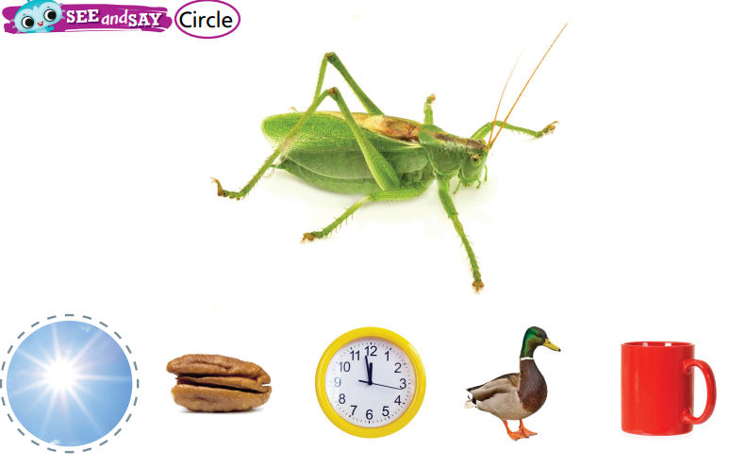
Page 56
Phonological Awareness
Turn to page 56 in your Student Interactive.
Notes:
Tell students that today they will learn a new sound. Listen carefully as I say the new sound: /u/. The sound /u/ is made by opening your mouth slightly and saying the sound /u/.
Show students how to make the sound /u/ and have them practice it. Try saying the sound /u/ several times.
Have students turn to p. 56 in the Student Interactive and point to the picture of the bug. Listen to the sounds as I say this word: /b/ /u/ /g/. What sound do you hear in the middle of bug? Yes, the sound /u/.
Tell students they will be circling the picture words that have the same middle sound as bug. Name each picture on p. 56 with students.
Then have them circle the picture words with the middle sound /u/. Remind them that some of the picture words do not have the sound /u/ in the middle.

Slide 5
Phonics
rug
fit
run
fun
ran
bun
dog
bus
lime
Notes:
Display Alphabet Card Uu and point to the picture of the umbrella. Have students say umbrella with you. Let’s say the sound at the beginning of the word: /u/. The sound /u/ is spelled with the letter u. Click path -> Table of Contents -> Unit 3 Week 2 Fairy Tales -> Lesson 1
Point to the letters Uu on the Alphabet Card. Tell students the word umbrella begins with the sound /u/, so it begins with the letter u.
Write the letters U and u on the board.
Tell students that you will say a group of words, and some of them will have the sound /u/ but some will not. Tell students they will listen for the middle sound /u/ in a word.
If they hear the sound /u/, they will trace the letters Uu on the tabletop.
Use the following words for this activity, emphasizing the sound /u/: rug, fit, run, fun, ran, bun, dog, bus, lime.

Slide 6
Page 57
Phonics
Turn to page 57 in your Student Interactive and complete the activity.
Notes:
Have students complete p. 57 in the Student Interactive

Slide 7
High-Frequency Words
any
come
play
Notes:
Display the high-frequency words any, come, and play.
Point to the word any and read it.
Have students point to the word any and read it.
Repeat for come and play

Slide 8
Page 54,55
Interact with Sources
Turn to page 54 in your Student Interactive.
Notes:
Remind students of the Essential Question for Unit 3: Why do we like stories?
Point out the Weekly Question: How are two versions of the same story alike and different?
Explain that students will read two fairy tales this week.
Have students follow along as you turn to p. 54 of the Student Interactive and point to the picture of the pigs.
Explain that stories that begin the same way can have different endings.
Point out the two different endings on p. 55. Then read the infographic, “Telling Stories Different Ways.”
Use the following prompts to guide discussion:
Ask students to look at the picture on p. 54 and tell what they see.
Look at ending 1. Have students explain what is happening in the picture.
Look at ending 2. Have students explain what is happening in the picture.
Ask students to explain how the two endings are different.
Have students turn to a partner to talk about how the two versions of the story are alike and different.
Remind students of the Weekly Question: How are two versions of the same story alike and different?
Tell students that they just learned that stories can start the same way but be different, with different events and different endings.
Explain that this week students will learn more about comparing stories.

Slide 9
Listening Comprehension
The Three Javelinas
1. Juan, loves to cook
2. Frank, loves to clean
3. Selma, loves to shop
Notes:
Tell students that they will listen to a fairy tale.
Fairy tales are traditional stories that tell about make-believe events and characters.
Have students listen as you read aloud the story “The Three Javelinas.”
Encourage students to be active listeners by looking at you and thinking about what you are saying as you read aloud.
Purpose: Have students listen actively for elements of fairy tales, such as make-believe events and characters.
READ: the entire text aloud without stopping for the Think Aloud callouts.
REREAD: the text aloud, pausing to model the Think Aloud strategies related to fairy tales.
Use the chart to help students identify the characters in the story.

Slide 10
Page 68,69
Fairy Tale
Turn to page 68 in your Student Interactive.
Notes:
Tell students that a fairy tale has make-believe characters and events.
Every story has characters. Characters are the people or animals that are in a story.
Events are what happens in a story. The events in a story form the plot of a story.
Readers look for the characters and events in a story. Knowing the characters and events helps a reader better understand the story.
Model finding the characters and events in a fairy tale. You listened to a fairy tale “The Three Javelinas.” In the story, three javelinas, or animals that are like pigs, move to separate places but decide to live together in the end. The javelinas are the characters. The events are that they move to different places and then decide to live together.
Read aloud p. 68 of the Student Interactive. Point out the title, events, and characters of the text.
Prompt students to demonstrate knowledge of the distinguishing characteristics of well-known children's literature by talking about the characters and events in other fairy tales they know.
Have students use the strategies to identify the characters and events in a fairy tale.
Read the Anchor Chart on page. 69 in the Student Interactive together. Editable Anchor Chart Click Path: Table of Contents -> Reading Anchor Charts -> Unit 3 Week 2: Fairy Tales: Editable Reading Anchor Chart

Slide 11
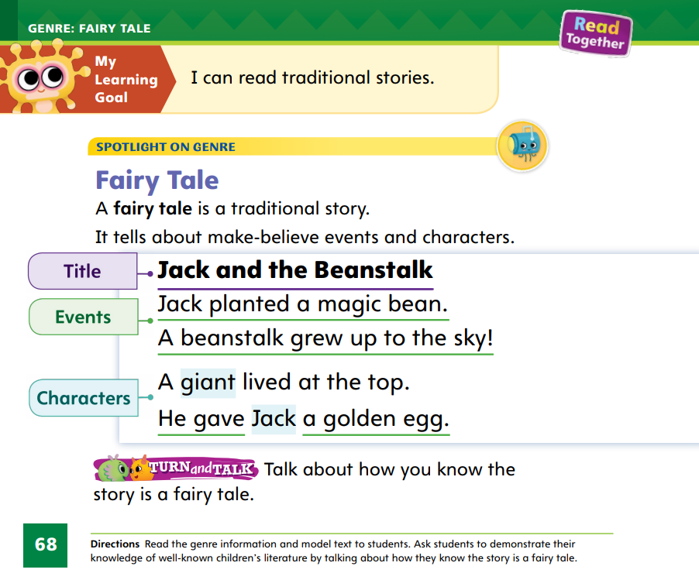
Page 68
Apply
Talk about how you know the story is a fairy tale.
Notes:
Have students work with a partner to complete the Turn and Talk activity on p. 68 of the Student Interactive.
Then have volunteers share their responses. Point out that fairy tales often take place in magical places, such as the sky!

Slide 12
Page 91
Academic Vocabulary
Turn to page 91 in your Student Interactive and complete the activity.
Notes:
Explain to students that antonyms are words that have opposite meanings.
Different word parts at the beginning or end of two similar words can give them opposite meanings.
Compare two words such as lock and unlock or careful and careless. Are the words the same except for word parts at the beginning or end that are different?
Do the word parts give them opposite meanings? If so, they may be antonyms.
Word parts change the meaning of words. The word unlock is the opposite of lock because un- means “not.” Careful means the opposite of careless because the word part- ful has the opposite meaning of the word part less.
Have students complete the activity on p. 91 in the Student Interactive.

Slide 13
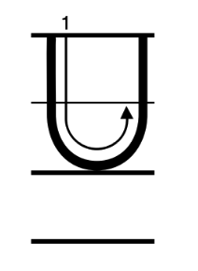
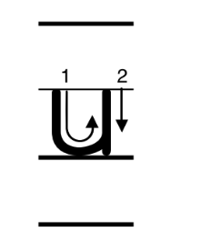
Handwriting
Notes:
Display the following uppercase and lowercase letters: Uu.
Model writing each letter, calling students’ attention to starting on the left, drawing straight down, curving around, and going back up to the right.
Have students complete Handwriting p. 140 from the Resource Download Center for additional practice with writing Uu and including appropriate spacing between letters. Click path: Realize -> Table of Contents -> Resource Download Center -> Handwriting Practice -> U3W2L1 Handwriting Practice

Slide 14
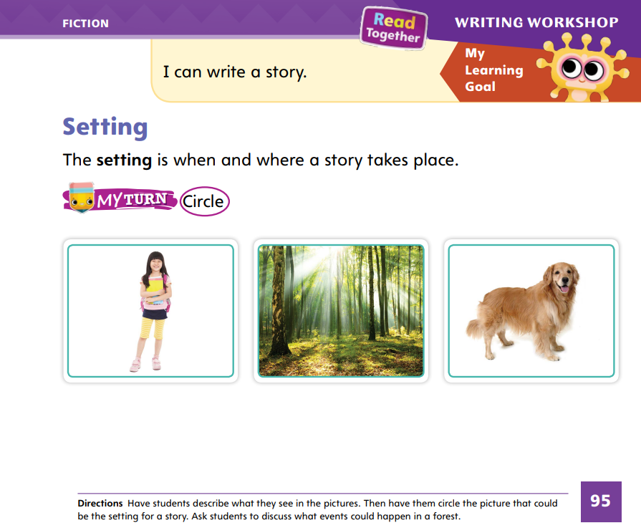
Page 95
Writing – Fiction
Turn to page 95 in your Student Interactive.
Notes:
The setting of a story is when and where a story takes place.
On a flip chart or board, write Setting and draw two columns with the following headers above each column: Where and When.
Hold up a book from your stack that you read during the immersion days.
Open to a page that shows a good picture of the setting and ask: Where does this story take place?
Have students tell you where the story takes place (for example, school, forest, boat).
Write their answers in the Where column of your chart. Then ask: When does this story take place?
Have students tell you when the story takes place (for example, summer, afternoon, in the future, after school).
Write their answers in the When column of your chart. Repeat with additional stack books until you have gathered a good list of settings.
Say: A where and a when make up a setting. When authors write stories, they include lots of details about the setting to make the story more interesting. Details about the setting also help the reader picture it. Pretend we are writing a story that takes place in a garden. We might give details about the garden. We could say there are yellow flowers. There are tomato plants. The sun is shining. The flowers smell like perfume. What other details could we add about the setting?
Prompt students to suggest details that describe a garden.
Then have them suggest details for each where and when item on the list you created.
Work with students to complete the activity on p. 95 of the Student Interactive.

Slide 15
Independent Writing
Review your stories and add details to your setting.
Continue writing.
Notes:
During independent writing time, students should review their stories and add details to their settings. When they finish adding details, they can continue writing.
Modeled Use stack texts to identify details that describe the setting.
Shared Have students choose a setting and discuss it together.
Guided Prompt students to think about the parts of their setting and how they can add detail to it
See the Conference Prompts on p. T33
Ask a few students to share their settings with the class.
The class can ask questions and suggest details that would make the settings more interesting.

Slide 16
Language and Conventions
___ went to the store.
___ likes the swim.
Name the pronouns.
Rewrite with different pronouns.
Notes:
Tell students that pronouns are words that take the place of nouns.
Ask students to list examples of subjective case pronouns and write them on the board.
Display this sentence frame for students: ___ went to the store.
Ask students to name pronouns that could complete the sentence.
Rewrite the sentence with different pronouns.
Have students work with a partner to complete the following sentence frame: ___ likes to swim.

Slide 17
Lesson 2

Slide 18
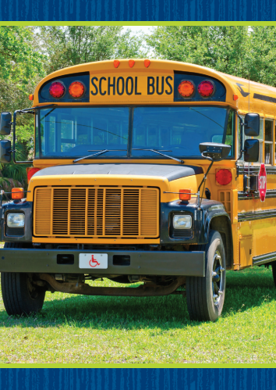
Phonics
bus
fun
Notes:
Hold up the bus Picture Card. This is a picture of a bus. Listen to the sounds in the word: /b/ /u/ /s/. I hear the sound /u/ in the middle of bus. Say the sound /u/ with me. Click path -> Table of Contents -> Unit 3 Week 2 Fairy Tales -> Lesson 2
Show students the spelling of the word on the back of the card. Point to the u and say /u/. Do you hear the sound /u/? What letter spells the sound /u/?
Have students identify the letter u. Write the letters Uu on the board. Have students trace the letters Uu in the air as you lead them.
Point to the letters Uu on the board. Then write the word fun. Listen carefully as I read the word: /f/ /u/ /n/, fun. Do you see any of the letters you have learned already?
Have a volunteer identify that in the word they have learned the letters f, u, and n.

Slide 19
Page 58
Apply
Turn to page 58 in your Student Interactive and complete the activity.
Notes:
Have students complete p. 58 in the Student Interactive.

Slide 20
High-Frequency Words
any
come
play
Notes:
Tell students that high frequency words are words that they will hear and see over and over in things they read.
Write and read the sight words any, come, and play.
Have students
repeat the words after you.
spell each word, clapping as they say each letter

Slide 21
Page 70
Preview Vocabulary
catch
gobbled
Notes:
Introduce the words catch and gobbled from p. 70 in the Student Interactive.
Have students share or pantomime what they already know about the words. Ask questions such as: What do you do when you catch a ball? Have you ever gobbled food?
Based on the vocabulary, what do you think the story will be about?
Provide definitions of vocabulary words as needed. Definitions appear on the selection pages that follow. These words will help us understand the characters and events in The Gingerbread Man.

Slide 22
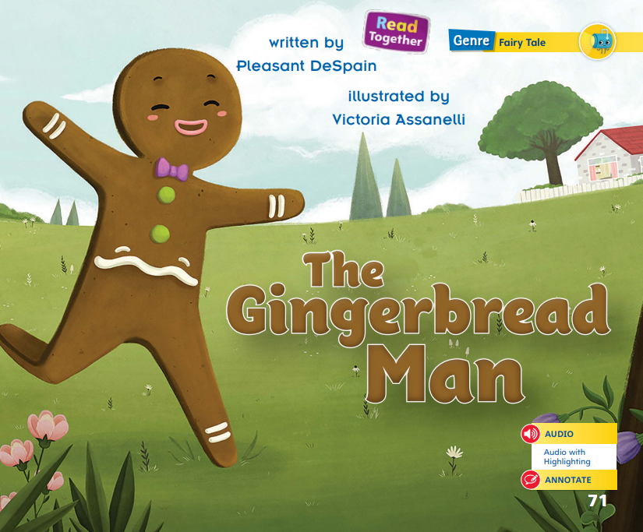
Page 71
First Read - The Gingerbread Man
Notes:
Point out that students will read two texts in this lesson: “The Gingerbread Man” and “The Story of Cornbread Man”. As they read, encourage students to think about the Week 2 Question: How are two versions of the same alike and different?
Discuss the First Read Strategies with students.
Explain that looking at the title and pictures before reading can help them figure out what the story will be about.
Listen to the title and look at the picture. What questions do you have before you read the story?
Follow along in the story to understand what it is about.
Look at the pictures to better understand the story.
Generate, or ask, questions about the story to deepen understanding.
Talk to a partner about the story.
Read Together.
Use the First Read notes to help them connect with the texts and guide their understanding.

Slide 23
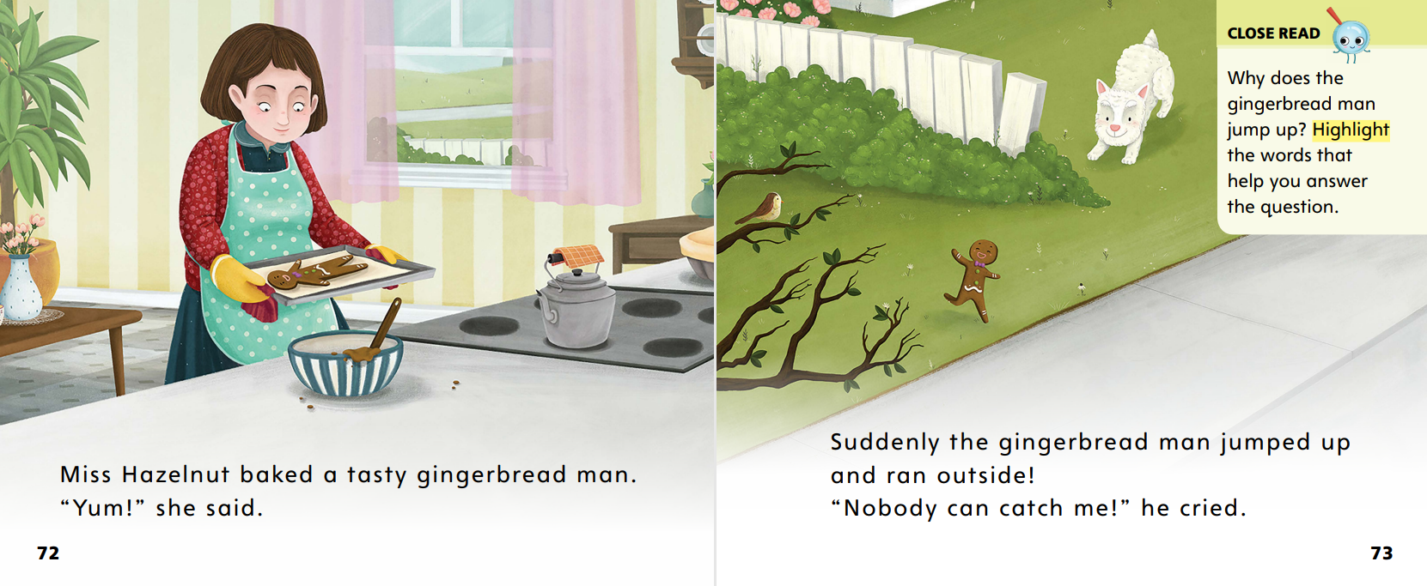
Page 72,73
First Read – The Gingerbread Man
Notes:
Read together.
Think Aloud: Looking at and noticing things in the pictures can help me better understand what I read. Looking at the pictures on this page helps me understand what the gingerbread man looks like.

Slide 24
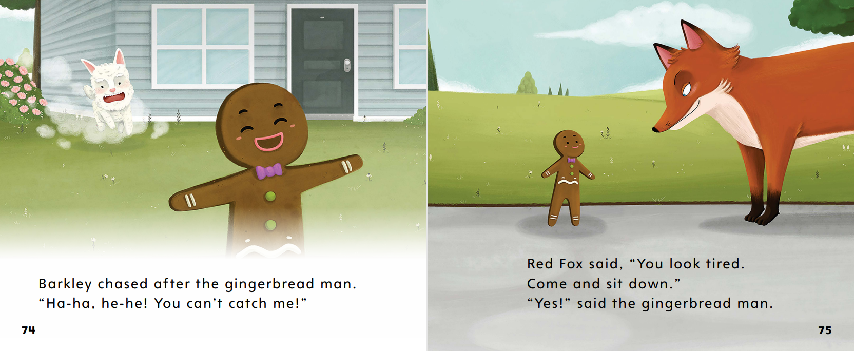
Page 74,75
First Read – The Gingerbread Man
Notes:
Read together.
Think Aloud: Following the events in a story helps me better understand the plot. I am going to stop after each page to make sure I know what is happening. The gingerbread man is running away. Then he runs into Red Fox. Red Fox tells him to sit down. At the end, Red Fox eats the gingerbread man! Reading that the fox eats the gingerbread man helps me understand why the fox asked the gingerbread man to sit with him.

Slide 25
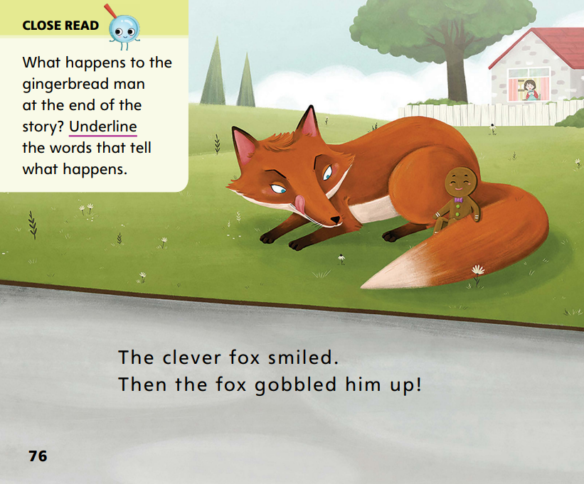
Page 76
First Read – The Gingerbread Man
Notes:
Read together.

Slide 26
Preview Vocabulary
baking
jumped
Notes:
Introduce the words baking and jumped from pp. 79 and 81 in the Student Interactive.
Have students share or pantomime what they already know about the words.
Provide prompts as needed: Have you ever helped your mother or father when they were baking? What are some examples of times when you have jumped?
Ask students to look for these words as you read.

Slide 27
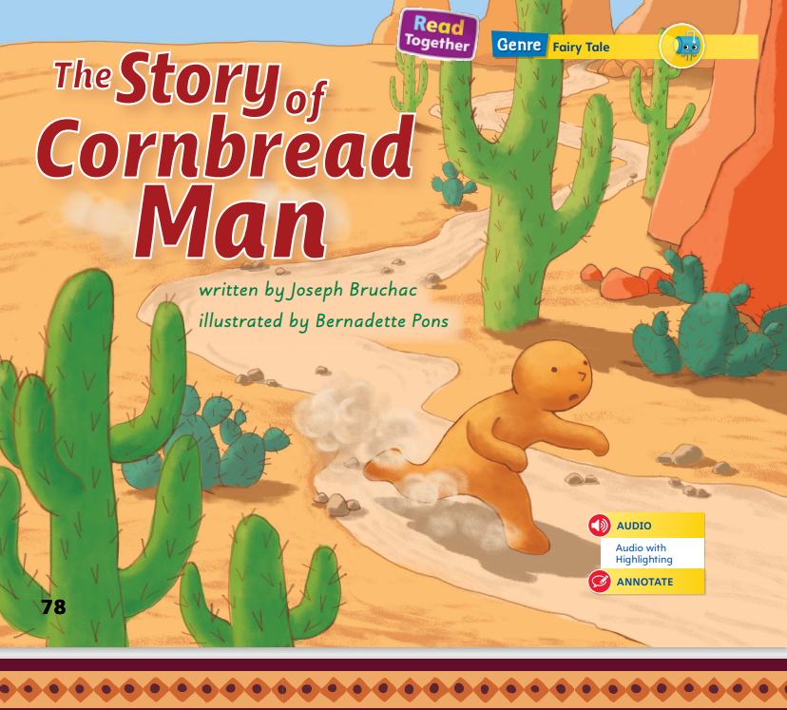
Page 78
First Read – The Story of Cornbread Man
Notes:
Compare Texts: Before students read “The Story of Cornbread Man”, tell them that afterwards they will compare and contrast it with “The Gingerbread Man”.
Discuss the First Read Strategies with students.
Tell students that they can compare and contrast the characters and events in two stories. How do you think it will be different?
Listen to the title and look at the pictures. How do you think this story will be like The Gingerbread Man?
Read or listen to the story. During the first reading, work to understand what the story is about.
Look at the pictures to help you understand the story.
Generate, or ask, questions about the story to deepen understanding.
Talk to a partner to compare and contrast the characters and events in this story with the characters and events in The Gingerbread Man.
Students may read independently, in pairs, or as a class.
Use the First Read notes to help them connect with the texts and guide their understanding.

Slide 28
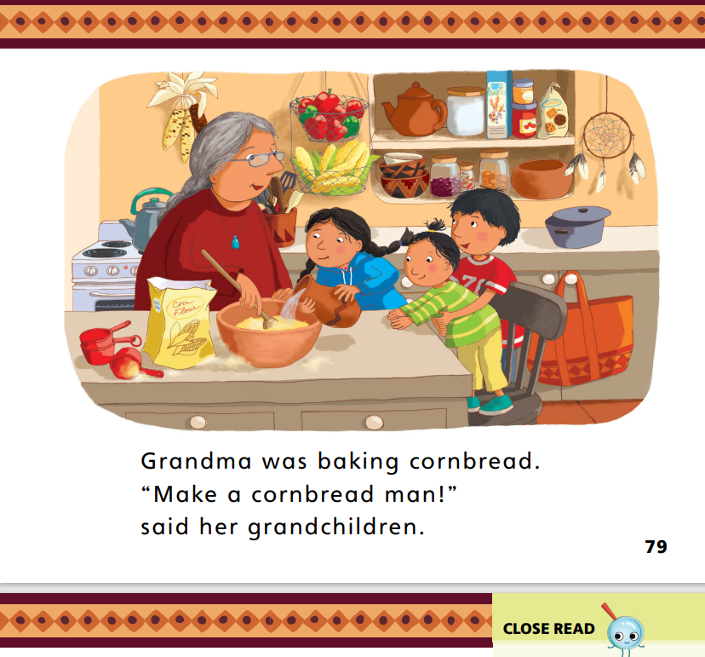
Page 79
First Read – The Story of Cornbread Man
Notes:
Read together.
Think Aloud: This story is similar to The Gingerbread Man. They both begin with someone baking something that looks like a man. I wonder if the same thing will happen in this story that happened in The Gingerbread Man.
Prompt students to recall what happened in The Gingerbread Man. Have students talk to a partner about whether they think the same things will happen in this story.

Slide 29
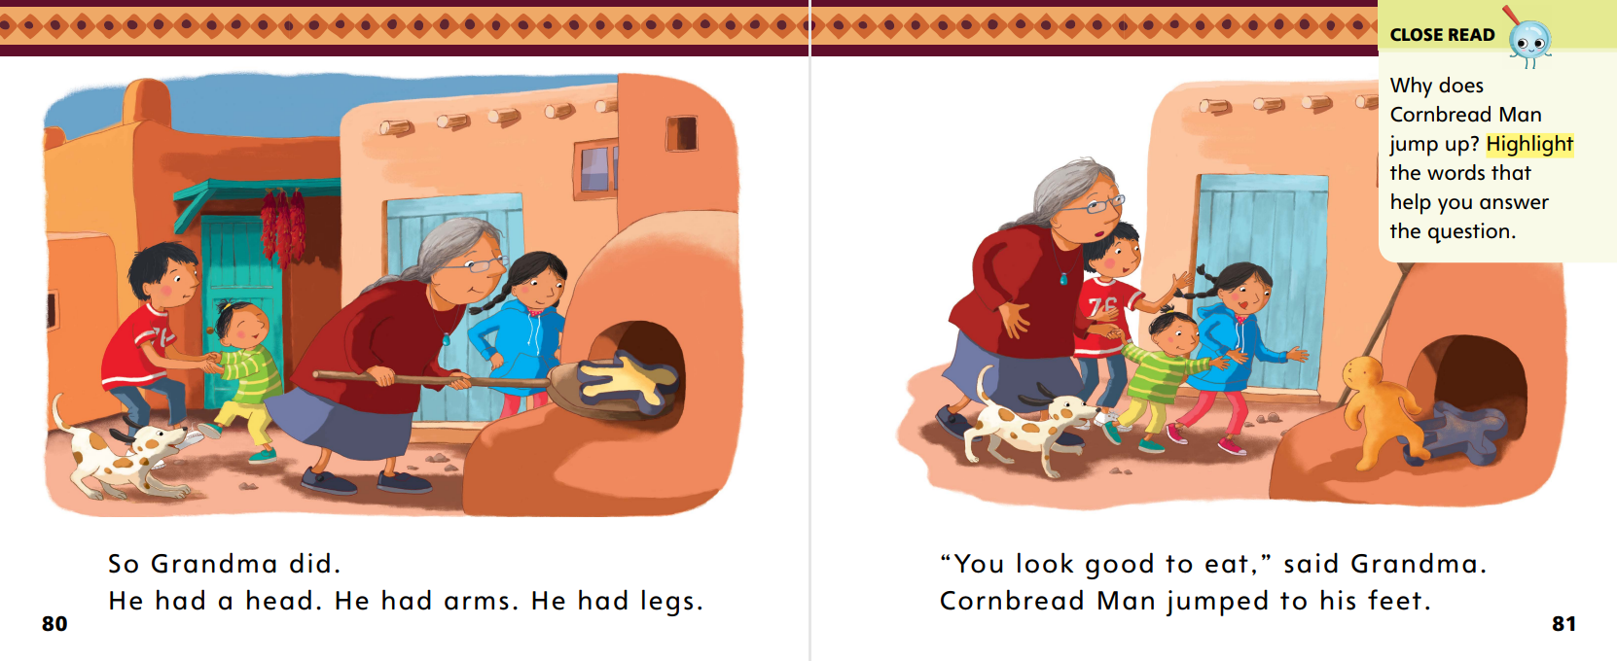
Page 80,81
First Read – The Story of Cornbread Man
Notes:
Read together.

Slide 30
Page 82,83
First Read – The Story of Cornbread Man
Notes:
Read together.
Think Aloud : Pictures can help me understand what happens in a story. On page 84, I see a picture of Cornbread Man talking to an animal. In The Gingerbread Man, the gingerbread man talks to an animal—the fox. At the end of that story, the fox eats the gingerbread man. If I look at the pictures in this story, I might be able to figure out if this story ends the same way.
Prompt students to look at the pictures on each page and describe what they see. Does the animal eat Cornbread Man? How do you know?

Slide 31
Page 84,85
First Read – The Story of Cornbread Man
Notes:
Read together.

Slide 32
Page 86
Develop Vocabulary
What did Cornbread Man do?
He ________ up and ran away.
Notes:
Tell students that readers can sometimes use pictures to figure out the meaning of words in a story.
We can understand the meaning of the words baking and jumped by looking at the pictures.
Read the word and the sentence in which it is used.
Think about the meaning of the word and the pictures on the page.
Ask how the pictures can help you understand the word.
Have students turn to p. 86 in the Student Interactive. Read the vocabulary words aloud.
Display and read the sentence aloud without the missing word. What is Cornbread Man doing in the picture? He’s jumping to his feet.
Write the word jumped on the line and have students trace each letter on the tabletop as you write.

Slide 33
Page 86
Apply
Turn to page 86 in your Student Interactive and complete the activity.
Notes:
Have students practice developing vocabulary by completing p. 86 of the Student Interactive.
Have a student act out the words hopped and jumped.
Then have students discuss how hopped differs from jumped.

Slide 34
Page 87
Check for Understanding
Turn to page 87 in your Student Interactive and complete the activity.
Notes:
Have students complete the Check for Understanding on p. 87 of the Student Interactive.

Slide 35
Writing – Fiction
Notes:
The characters are the people or animals in a story.
Show students a book from the stack. Say: The author of this book included characters. Characters are the people or animals in a story. Let’s look for the characters in this book. Begin reading the book.
Have students identify the characters by name as they are introduced. The author also includes words and pictures that tell more about the characters. Let’s look at the words and pictures to find out more about the characters.
Continue reading the book, stopping to point out details in the words and pictures that tell more about the characters.
Draw a web graphic organizer on the board.
Using the book you just read, write the main character’s name in the center circle.
Ask students to recall traits about the character.
Write them in the surrounding circles.
Then say: The characters in a story have personalities just like you and me. When you write your own stories, make sure you include details about your characters.

Slide 36
Independent Writing
Let’s continue writing.
Remember to include characters and give details about characters in the words and pictures.
Notes:
During independent writing time, students should continue writing their books. Remind them to include characters and give details about the characters in the words and pictures.
Modeled: Read a stack text aloud and talk through what traits the characters have and how we know.
Shared: Have students look through a stack text for character traits.
Guided: Prompt students to think about how a writer might show or describe a character’s traits.
See the Conference Prompts on p. T334.
Have a few students share the names of characters in their stories. Prompt students to tell about the characters’ personality and physical traits.

Slide 37
Page 92
Letter Sort
Uu
Cc
Turn to page 92 in your Student Interactive.
Notes:
Write the letters U and u on the board
Name the letters together with students.
Point to the letters and remind students that U is an uppercase letter and u is a lowercase letter.
Write the letters C and c on the board.
Ask students to identify the uppercase and lowercase letters and tell how they are similar and different.
Remind students that all letters can be written either as uppercase or lowercase.
Have students turn to p. 92 in the Student Interactive. I see an uppercase C in the left column. Uppercase letters are used for names and at the beginning of sentences. I see a lowercase c in the right column. I can draw a line from uppercase C to lowercase c to match the letters. Have students draw a line between the two letters.
Have students match the other uppercase and lowercase letters on p. 92.
Give help as needed or work through the activity together to help students find the matching letters.

Slide 38
Language and Conventions
Ada helped me.
Create sentences with a noun, a verb, and an objective case pronoun.
Notes:
Answer any questions students may have about pronouns.
Then explain that her, me, and him are another type of pronoun. They are objective case pronouns. Share sentences containing objective case pronouns with students.
Display this sentence: Ada helped me. Ask: Which word is a noun? (Ada) Which word is a verb that tells what Ada did? (helped) Which word is an objective case pronoun that tells who Ada helped? (me)
Have students work in pairs to create oral sentences containing a noun, a verb, and an objective case pronoun.
Have students share their sentences with the class.
Then have volunteers identify the noun, verb, and objective case pronoun in each sentence.

Slide 39
Lesson 3

Slide 40
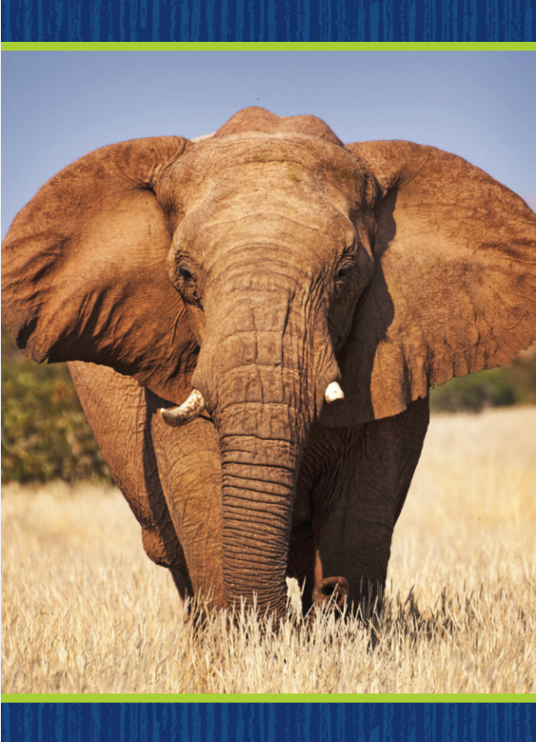
Page 59
Phonological Awareness
Turn to page 59 in your Student Interactive.
Notes:
Display the elephant Picture Card. Today we will learn more about syllables. Remember that a syllable is a word part. A syllable has one vowel sound. We can break apart and put together syllables in a word. We can clap each time we hear a new syllable and count how many syllables there are. Let’s begin with the word el (clap) e (clap) phant (clap), elephant. Now clap with me: el (clap) e (clap) phant (clap), elephant. I hear three syllables. Click path -> Table of Contents -> Unit 3 Week 2 Fairy Tales -> Lesson 3
Point to the picture of the van on p. 59 of the Student Interactive. How many syllables does it have? Listen: van (clap). How many syllables do you hear?
Students should say one. Name the pictures on p. 59 with students.
Have students complete the page by segmenting, blending, and identifying the syllables in each picture word and coloring the wedges that have a picture word with more than one syllable.

Slide 41
Page 60
Phonics
Turn to page 60 in your Student Interactive.
Notes:
Display Alphabet Card Vv. Ask students to tell you what they see on the card. Click path -> Table of Contents -> Unit 3 Week 2 Fairy Tales -> Lesson 3
Point to the picture of the volcano and tell students the word volcano begins with the sound /v/. The sound /v/ is spelled with the letter v.
Point to the letters on the card and tell students the names of these letters are uppercase V and lowercase v.
Write uppercase and lowercase Vv on the board and slowly trace the letters as you say the sound /v/.
Have students turn to p. 60 in the Student Interactive.
Let’s say the picture word violin and listen to the beginning sound: /v/-iolin. The word begins with /v/. Can you identify, or tell me, what letter spells the sound /v/? Students should say the letter v.
Have them trace the uppercase and lowercase letters on the page.
Ask them to point to the letter and tell you what sound it represents.

Slide 42
Page 61
High-Frequency Words
any
Turn to page 61 in your Student Interactive.
come
play
Notes:
Tell students that some words are not spelled the way they sound.
They should learn these words by looking at the letters and remembering them. Have students read the words at the top of p. 61 in the Student Interactive with you: any, come, play.
Have students look again at the words at the top of p. 61. Tell them to point to each word as you say it. Say come. Pause to let students find and point to the word. Say any. Say play. Repeat the activity until students are familiar with each word.
Have students read the sentences on p. 61 with you.
Ask them to identify the words any, come, and play in the sentences and underline them.
Then have students read the sentences with a partner.

Slide 43
Page 71, 78
Compare and Contrast Stories
Notes:
When you compare stories, you look for things that are alike. When you contrast stories, you look for things that are different.
Read the stories and notice the characters. Do you see anything that the stories have in common?
Notice the events in the stories. How are the events similar? How are they different?
Have students look back at The Gingerbread Man and The Story of Cornbread Man.
Point out that the two stories have similarities and differences. What are the events in The Gingerbread Man? What are the events in The Story of Cornbread Man? How are the events alike and different? Guide students to orally compare and contrast the events in the stories.
Compare Texts Now have students turn to the Close Read notes on pp. 76 and 85 in the Student Interactive and underline the words that tell what happens at the end of each story.

Slide 44
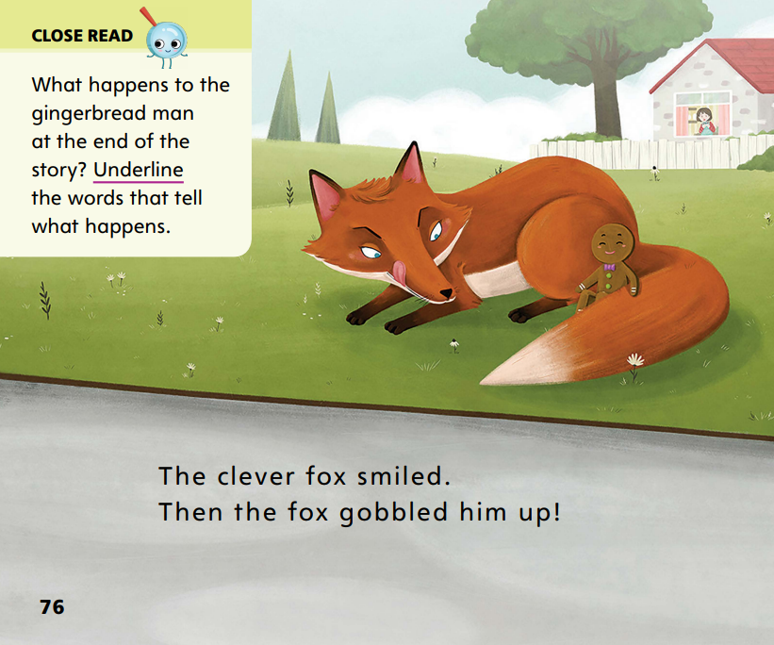
Page 76
Close Read – Compare and Contrast
Turn to page 76 in your Student Interactive.
Notes:
Read the Close Read note with students. Ask students to underline the words that tell what happens at the end of the story. Tell them that they will use what they underline to compare and contrast this story to The Story of Cornbread Man. DOK 2

Slide 45
Page 85
Close Read – Compare and Contrast
Turn to page 85 in your Student Interactive.
Notes:
Read the Close Read note with students. Have students underline the sentence that tells them Cornbread Man ran away. Tell students that they will use what they underline to compare and contrast this story to The Gingerbread Man. DOK 3

Slide 46
Page 88
Compare and Contrast Stories
Turn to page 88 in your Student Interactive and complete the activity.
Notes:
Have students use the strategies for comparing and contrasting stories.
Have students complete p. 88 in the Student Interactive.

Slide 47
Page 93
Read Like a Writer, Write Like a Reader
Turn to page 93 in your Student Interactive and complete the activity.
Notes:
Authors choose descriptive words to help readers visualize, or create pictures in their minds, of what they are reading.
Authors choose words that appeal to readers’ senses of sight, hearing, touch, taste, or smell.
Vivid, interesting words can help readers visualize, or picture, what they are reading.
Have students turn to p. 93 in the Student Interactive.
Explain that the author uses descriptive words to tell about what the gingerbread man and Cornbread Man do. In the sentence “Cornbread Man jumped to his feet,” the author uses the word jumped to tell how he moves. These words help me visualize how Cornbread Man moves.
Have students complete p. 93 in the Student Interactive.

Slide 48
Handwriting
Notes:
Display the following uppercase and lowercase letters: Ss.
Model writing each letter, calling students’ attention to starting at the top right of the letters and curving down to the left and then over to the right and then down and around to the left.
Have them practice forming the letters by tracing their fingers on the tabletop. Click path: Table of Contents -> Resource Download Center -> Handwriting Practice -> U3W2L3 Handwriting Practice

Slide 49
Page 96
Writing – Fiction
Turn to page 96 in your Student Interactive.
Notes:
Characters can be based on real life people or animals, or they can be created from someone's imagination.
Tell students that authors create characters by imagining a person or animal and giving that person or animal character traits. Character traits are what the characters look like, what they feel, and what they want to do. Sometimes authors start by thinking of themselves or someone they know and then changing the traits to make a new character.
Say: Today I will show you how to develop characters for your stories. I’m going to make a character who is a teacher, like me. But instead of a person, this teacher is a cat. Her name is Miss Kitty. She is white with gray ears. She likes to sing and is good at telling jokes.
Prompt students to think of other traits for your character.
Draw the character on the board or flip chart and add pictures or words as students suggest ideas for the character.
On the board or flip chart, write a sentence that describes the character you have created. Say: One detail about Miss Kitty is that she likes to sing. I’ll write about that. Write: Miss Kitty likes to sing all day. She never stops!
Prompt students to say other sentences about Miss Kitty and transcribe them on the board.
Tell students that they will create their own characters and think of details about them.
To practice, direct them to p. 96 in the Student Interactive. Guide them to draw at least two characters in the park.

Slide 50
Independent Writing
Let’s review your characters in our book.
Let’s add details about how your characters feel and what they want.
Notes:
During independent writing time, have students review their books and pay attention to the characters.
Have them add details about what their characters look like, how they feel, and what they want.
Modeled: Walk students through creating a character. They can base the character on themselves or someone else.
Shared: Have students think of details for the character.
Guided: Prompt students to produce sentences that tell the details about the character.
When students finish adding details about their characters, have them continue writing.
Have a few students tell the class about their characters. Tell students to listen actively and ask questions about other students’ characters.

Slide 51
Language and Conventions
her
me
him
Language and Conventions
Notes:
Remind students that pronouns replace nouns.
Also tell them that the pronouns her, me, and him are objective pronouns.
Objective pronouns replace nouns that receive the action.
To reinforce objective case pronouns, form several simple sentences that use people as objects and then restate the sentences using her, me, and him as objective case pronouns.
Ask students to name the objective case pronoun and the noun it replaces in each sentence.

Slide 52
Lesson 4

Slide 53
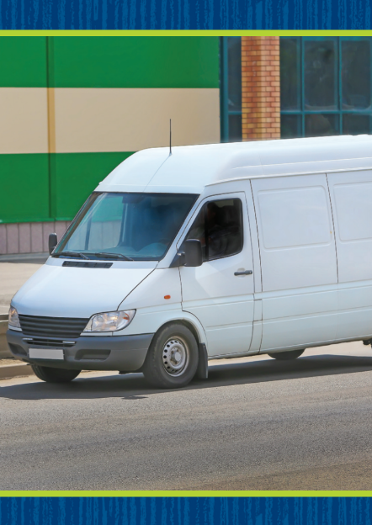
Phonics
van
Notes:
Hold up the van Picture Card. This is a picture of a van. Listen to the sounds in the word: /v/ /a/ /n/. I hear the sound /v/ at the beginning of van. Say the sound /v/ with me. Show students the spelling of the word on the back of the card. Click path -> Table of Contents -> Unit 3 Week 2 Fairy Tales -> Lesson 4
Point to the v and say /v/. Do you hear the sound /v/? What letter makes the sound /v/?
Write the letters Vv on the board. Have students trace the letters Vv in the air as you lead them.
Point to the letters on the Vv Alphabet Card. Listen carefully to the following words: /v/ /e/ /t/, /v/ /e/ /s/ /t/. What sound do you hear at the beginning of each word?
Have volunteers identify the sound /v/. Have students name the letter that spells the sound /v/ (v). Continue with the following words: vase, van, velvet.

Slide 54
Page 62
Phonics
Turn to page 62 in your Student Interactive and complete the activity.
Notes:
Have students complete p. 62 in the Student Interactive.

Slide 55
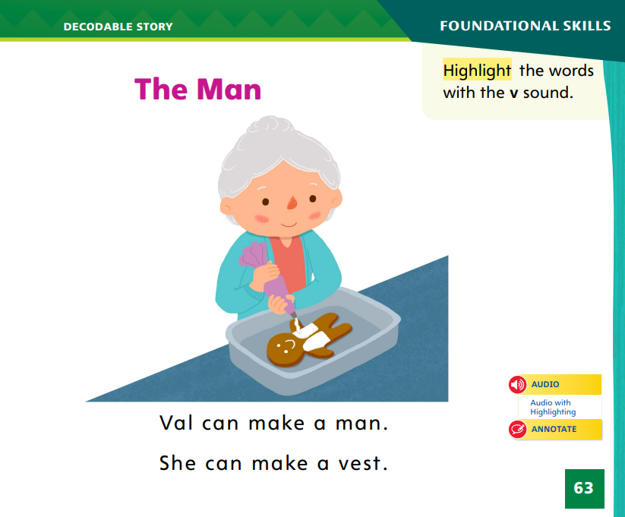
Page 63
Decodable Story
any
Turn to page 63 in your Student Interactive. We will Read “The Man”.
come
play
Notes:
Have students turn to p. 63 in the Student Interactive.
We are going to read a story today about a woman who bakes. Point to the title of the story.
The title of the story is The Man. I hear a word with /a/ in the title. What is it? Yes, it is man. In this story, we will read other words that have sounds we have already learned and words with our new sounds /v/ and /u/.
Review this week’s high frequency words: any, come, play. Tell students they will practice reading these words in the story The Man.
Display the words. Have students read them with you. When you see these words in the story The Man, you will know how to identify and read them.

Slide 56
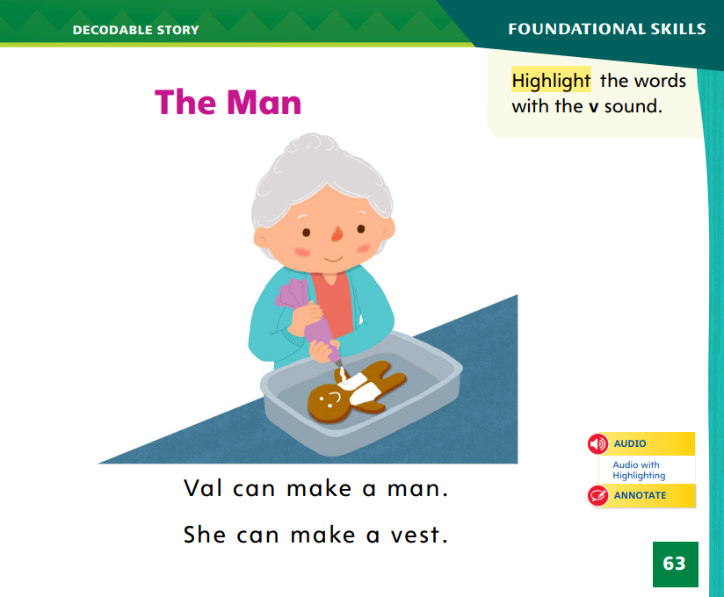
Page 63
Decodable Story
Turn to page 63 in your Student Interactive.
Notes:
Have students whisper read the story as you listen in.
Then have students reread the story page by page with a partner. Listen carefully as they use letter sound relationships to decode.
Partners should reread the story. This time the other student begins.
After students have read the story, call their attention to the first sentence on p. 63. I hear a word with the sound /v/. I see the letter v in that word. What sound does the letter v spell? Help them identify, or say, the sound /v/.
Then have them find and highlight the word with the sound /v/ in the first sentence on p. 63. In the second sentence, I hear another word with the sound /v/. Help students identify the word vest and highlight it. We can ask questions about words we don’t know. I don’t know what the word vest means. What questions can I ask about it? Sample questions: What is a vest? Is it something you can eat? Is it something you can wear? Can the illustration help me figure out what it is? Now let’s answer some of those questions. A vest might be something you can eat, because Val is making a cookie with a vest. A vest might be something to wear. I can look at the illustration and see that Val is adding white icing to the cookie. I think that a vest is something to wear.
Tell students to ask and answer questions about words they don’t know that they read in texts.

Slide 57
Page 64,65
Decodable Story
Notes:
Have students whisper read the story as you listen in.
Then have students reread the story page by page with a partner. Listen carefully as they use letter sound relationships to decode. Partners should reread the story. This time the other student begins.
After students have read the story, call their attention to the first sentence on p. 63. I hear a word with the sound /v/. I see the letter v in that word. What sound does the letter v spell? Help them identify, or say, the sound /v/.
Then have them find and highlight the word with the sound /v/ in the first sentence on p. 63. In the second sentence, I hear another word with the sound /v/. Help students identify the word vest and highlight it.
We can ask questions about words we don’t know. I don’t know what the word vest means. What questions can I ask about it? Sample questions: What is a vest? Is it something you can eat? Is it something you can wear? Can the illustration help me figure out what it is? Now let’s answer some of those questions. A vest might be something you can eat, because Val is making a cookie with a vest. A vest might be something to wear. I can look at the illustration and see that Val is adding white icing to the cookie. I think that a vest is something to wear.
Tell students to ask and answer questions about words they don’t know that they read in texts.
Have students turn to pp. 64–65. Which words include the sound /u/? Point to them.
Help students identify, or say, the words with the sound /u/. Then have them find and underline the words with the sound /u/.
Have them point out at least three high-frequency words they see, either from this week or from another week.

Slide 58
Page 71, 78
Make Inferences
Notes:
Tell students that they can use information in the text along with what they already know to make inferences about what an author suggests but does not say in a text. An inference is a guess based on text evidence and what you know about life. Students can
Ask themselves what the text says directly.
Consider what they know already about this idea or topic.
“Read between the lines” to guess what might be true.
When I make an inference, I use evidence in the text along with information I already know to see if I can guess information that is not stated in the text. Both words and pictures can be used to make inferences. When I look at page 74, the picture helps me see that the gingerbread man is not afraid of Barkley.
Read the Close Read note on p. 73 in the Student Interactive aloud. The gingerbread man jumps up and runs away because Miss Hazelnut wants to eat him. I know because people use the words tasty and yum to talk about things to eat. Have students highlight the words tasty and yum. Repeat for the Close Read note on p. 81.

Slide 59
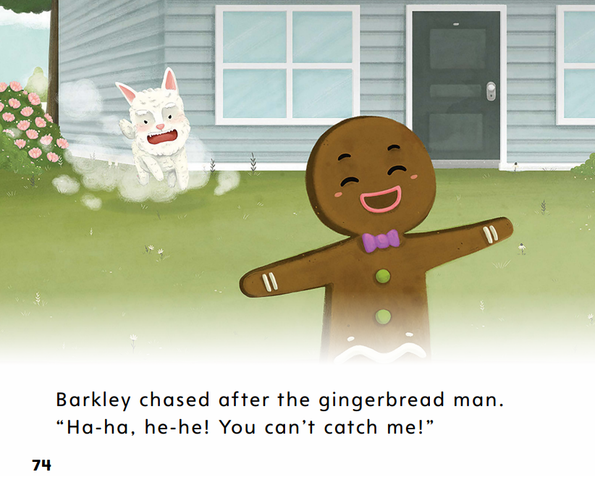
Page 74
Make Inferences
Turn to page 74 in your Student Interactive.
Notes:
When I make an inference, I use evidence in the text along with information I already know to see if I can guess information that is not stated in the text. Both words and pictures can be used to make inferences. When I look at page 74, the picture helps me see that the gingerbread man is not afraid of Barkley.

Slide 60
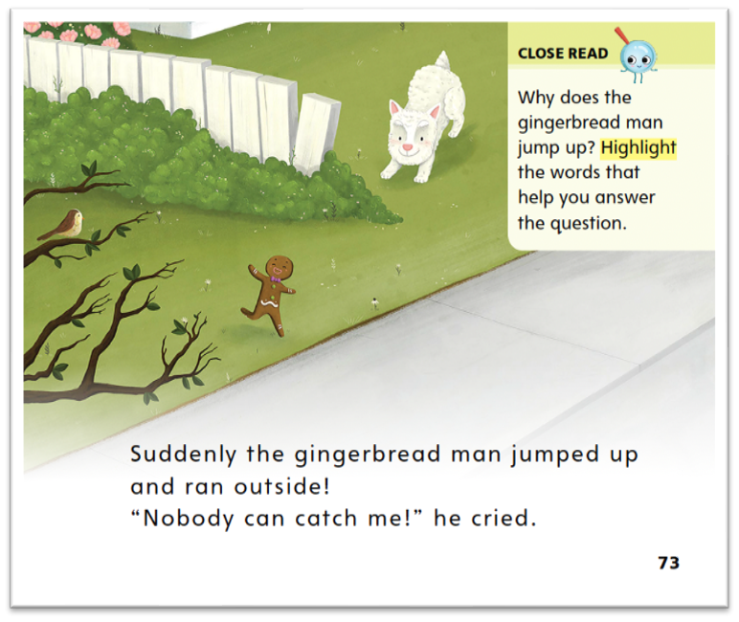
Page 73
Make Inferences
Turn to page 73 in your Student Interactive.
Notes:
Read the Close Read note with students. Ask them why the gingerbread man jumps up. I think the gingerbread man jumps up and runs away because he is afraid Miss Hazelnut is going to eat him. People use the words tasty and yum to talk about something they are going to eat. DOK 2

Slide 61
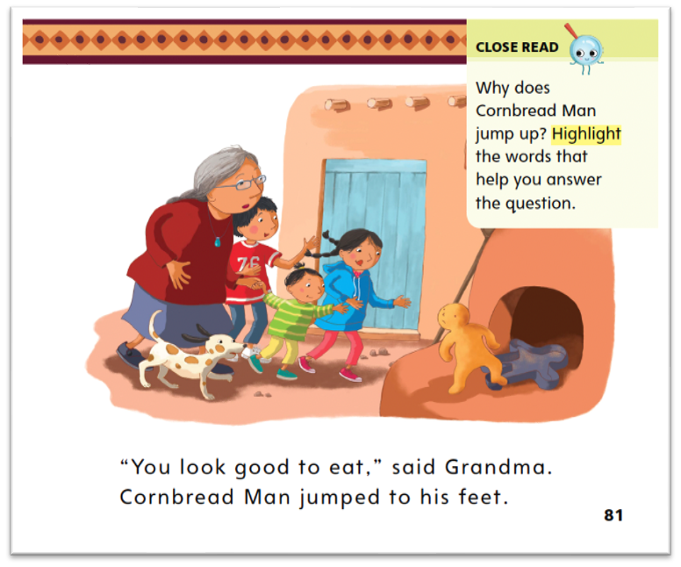
Page 81
Make Inferences
Turn to page 81 in your Student Interactive.
Notes:
Read the Close Read note with students. Cornbread Man jumps up. I think he is afraid because he knows Grandma wants to eat him. I know she wants to eat him because she says, “You look good to eat.”
Prompt students to say whether this is the same reason the gingerbread man jumps up in the story The Gingerbread Man. DOK 2

Slide 62
Page 89
Make Inferences
Turn to page 89 in your Student Interactive and complete the activity.
Notes:
Have students use the strategies for making inferences
Have students complete p. 89 in the Student Interactive.

Slide 63
Writing – Fiction
first
next
last
Notes:
A story plot consists of actions or a sequence of events. The plot often tells about a problem and how characters react to it and solve it.
Read a stack book aloud. After reading, model identifying the events in the story. Use sequence words such as first, next, and last.
Say: The plot is what happens in a story. The plot includes many events. Usually there is a problem that the characters have to solve. What was the problem in this story?
Work with students to identify the problem. How was the problem solved?
Work with students to tell how the characters solved the problem.
Hold up another stack book that you read aloud during the immersion days. Say: Let’s talk about the plot in this book. What happens first?
Help students walk through the plot by asking what happens first, next, and last.
Then ask students to describe the problem in the story and how the characters solved it. Repeat with another stack book if students need more help identifying the sequence of events.
Finally, say: Authors write events for their stories. These events make up the plot. As you write your own fictional stories, think about what events, or actions, might happen to your characters. What problem do they need to solve?

Slide 64
Independent Writing
Think about events for your story. Include a problem and resolution.
Continue writing your fiction books.
Notes:
After this lesson, students should transition into independent writing.
Prompt students to think about events for their story, including a problem and resolution. Then have them continue writing their fiction books.
Modeled: Use stack texts to identify the problem and resolution of a story.
Shared: Encourage students to think about a favorite story and identify the problem in the story and how it was solved.
Guided: Prompt students to identify the events of the plot, including the problem and resolution in the story.
Click path: Table of Contents -> Resource Download Center -> Writing Workshop Conference Notes
Have a few students share the plots for their stories, including the problem and resolution. Prompt students to suggest other possible resolutions to the problem.

Slide 65
Page 94
Language and Conventions
Turn to page 94 in your Student Interactive and complete the activity.
Notes:
Have students edit for an objective case pronoun to complete the practice activity on p. 94 in the Student Interactive.

Slide 66
Lesson 5

Slide 67
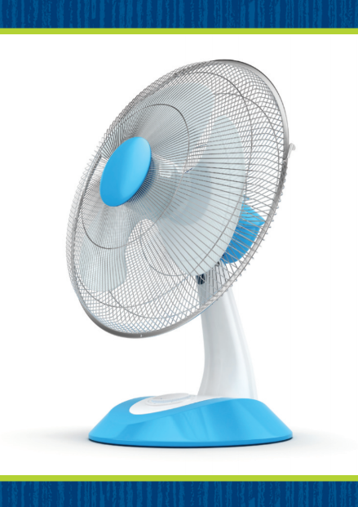
Phonological Awareness
Notes:
Display the van Picture Card van. Listen to the sounds in van: /v/ /a/ /n/. What sound do you hear in the middle of van? Click path -> Table of Contents -> Unit 3 Week 2 Fairy Tales -> Lesson 5
Students should say /a/. What sound do you hear at the end? Students should say /n/. Then hold up the fan Picture Card. This is a picture of a fan. Fan rhymes with van. When words rhyme, it means they have the same middle and ending sounds. Fan and van have the sound /a/ in the middle and the sound /n/ at the end.
Prompt students to think of other words that rhyme with van and fan. What other words can you think of that rhyme with van and fan? Possible responses include: man, Jan, Dan, ran, ban, can, pan, tan.

Slide 68
Phonics
vet
van
Vv
Uu
jump
just
vat
bug
hut
Notes:
Write the letters Vv and Uu on the board. Have students identify the letters as you point to them. Then review the sound for each letter: v/v/, u/u/. Ask students to say the sound as you point to each letter. Ask them to give you examples of some words with the sounds.
Divide the class in half. One half is the V-Team. The other is the U-Team. Place teams on opposite sides of the room.
Write the words vet, van, jump, just, vat, bug, and hut on the board. We will read these words together. If you hear the sound /v/, the V-Team will applaud. If you hear the sound /u/, the U-Team will applaud.
Point to each letter as you read each word aloud. Let’s read the first word together: /v/ /e/ /t/, vet.
The V-Team should clap. Repeat the activity with the rest of the words.

Slide 69
Page 66,67
Phonics
Turn to pages 66 and 67 in your Student Interactive.
Notes:
Have students turn to p. 66 in the Student Interactive and read the words with a partner.
Have students look at p. 67 in the Student Interactive. Have them complete the words with u or v. Then have them read the sentences.

Slide 70
High-Frequency Words
come
play
any
Notes:
Remind students that high frequency words are words they will hear, see, and use often.
Remind them they will be learning many of these words this year, and the words will help them become better readers.
Say the word come and ask students what letters spell the word. Have students
say each letter as you write it on the board.
say and spell the word, clapping for each letter.
repeat with play and any.

Slide 71
Page 90
Reflect and Share
Turn to page 90 in your Student Interactive.
Notes:
Tell students that talking about stories often begins with retelling them.
When students retell stories, they work to remember the most important ideas and message from the text.
Students should
make sure they understand what the stories are about.
think about ideas or information they could share with others.
speak loudly and clearly as they share information and ideas.
listen actively to others so they can connect ideas.
Model sharing ideas and information using the Weekly Question on p. 90 in the Student Interactive.
I know that stories can sometimes be similar and different. When I look for things that are similar, I am comparing stories. When I look for things that are different, I am contrasting stories. I can also retell stories and tell how they compare and contrast.

Slide 72
Page 90
Apply
How are two versions of the same story alike and different?
Notes:
Have students complete p. 90 in the Student Interactive.
Have students use evidence from the stories they have read this week to respond to the Weekly Question.
Tell them to write or draw their response on a sheet of paper and then share it with a partner.

Slide 73
Page 97
Writing – Fiction
Turn to page 97 in your Student Interactive.
Notes:
An author plans out the plot of a story before writing.
Planning out the events of the story helps the author identify the challenges and solutions that make up the plot.
Tell students that it is often easy to figure out the resolution of the story because it usually comes at the end of the book. Hold up a stack book that your class is familiar with. This book has a plot that includes a problem and a solution. Does anyone remember the problem? Call on a student to name the problem. Now, does anyone remember the solution? Call on another student to tell you the resolution. The author wrote the problem and solution for this book. The author decided what the problem would be and how it would be solved.
Have students look at p. 97 in the Student Interactive. Discuss what is happening in the picture and ask students to identify the problem. Then say: Today I will teach you how to generate, or think of, ideas for the end of a story. To come up with ideas, we will brainstorm and draw our ideas. How will this story end? How will the tortoise win the race? Let’s think of ideas. I know! One way the tortoise can win the race is by taking a shortcut. I’ll draw a picture on the board of the tortoise sneaking through the grass. What other ways can the tortoise win the race?
Based on students’ ideas, adjust your drawing or begin a new drawing on the board. When students have generated many ideas for an ending, say: We thought of many ideas for a solution. Did we all think of the same way to end the story? No. There are many ways to end a story, and when you are the author, you get to choose. Have students draw an ending in the Student Interactive.

Slide 74
Language and Conventions
Jim ran to me.
Which word in the sentence is an objective case pronoun?
A. Jim
B. ran
C. To
D. me
Notes:
Display the following sentence and guide students to answer the question.
(1) Jim ran to me.
Which word in the sentence is an objective case pronoun?
A Jim
B ran
C to
D me
Provide more practice with present tense by having students complete Language and Conventions, p. 88, from the Resource Download Center. Click path: Table of Contents -> Resource Download Center -> Language and Conventions -> U2 W3

Slide 75
Unit 3: Week 2
Grade K

