Slide 1

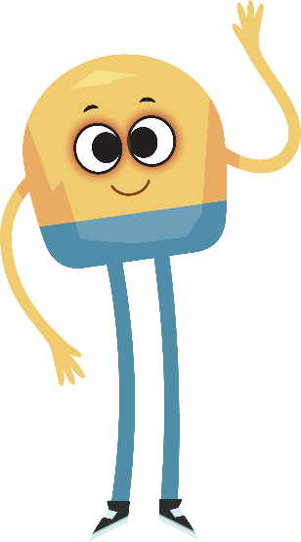

Unit 3: Week 4
Grade K

Slide 2
Copyright © Savvas Learning Company LLC. All Rights Reserved.
This publication is protected by copyright, and permission should be obtained from the publisher prior to any prohibited reproduction, storage in a retrieval system, or transmission in any form or by any means, electronic, mechanical, photocopying, recording, or otherwise. For information regarding permissions, request forms, and the appropriate contacts within the Savvas Learning Company Rights Management group, please send your query to:
Savvas Learning Company LLC, 15 East Midland Avenue, Paramus, NJ 07652
or
k12learningpermissions@savvas.com
myView Literacy® is an exclusive trademark of Savvas Learning Company LLC in the U.S. and/or other countries.

Slide 3

Lesson 1

Slide 4
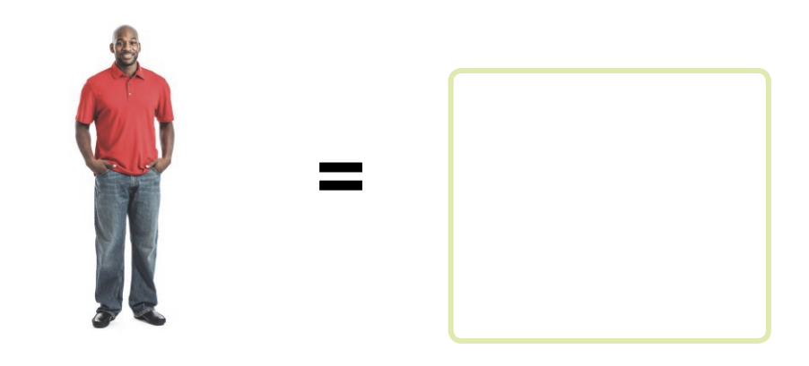
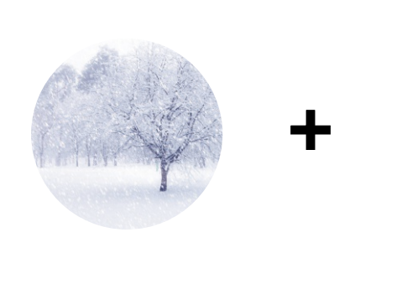
Page 138
Phonological Awareness
Notes:
See and Say: Have students turn to p. 138 in the Student Interactive. Tell them to look at the pictures of snow and a man. Point out the plus sign and tell students that the sign means to put the two word parts together. Listen to the word parts snow and man. If I say those word parts together, what word do I get? Prompt students to say snowman. Then tell them to draw a picture of a snowman in the box. Have students complete the activity.
Have students turn to p. 138 in the Student Interactive. Tell them to look at the pictures of snow and a man. Point out the plus sign and tell students that the sign means to put the two word parts together. Listen to the word parts snow and man. If I say those word parts together, what word do I get? Prompt students to say snowman. Then tell them to draw a picture of a snowman in the box. Have students complete the activity.

Slide 5
Phonics
rat rate
at ate
tam tame
Notes:
Write rat on the board. Have students read the word with you. What sound do you hear in the middle of rat? Have students identify sound /a/. Circle the letter a. The letter a spells the sound /a/ in rat. This is the sound for short a.
Write the word rate on the board, and read it aloud. Have students repeat after you. Point out that rate and rat have the same beginning and ending sounds, but they have different middle sounds. Rate has the sound for long a. Adding e to rat changes the middle sound from /a/ to /ā/. Circle a and e in the word rate. The letters a_e spells the sound /ā/.
Have students say rat and rate several times, comparing the sounds in the words as you point to the letters in the words on the board.
Continue the routine with the words at, ate; Tam, tame.

Slide 6
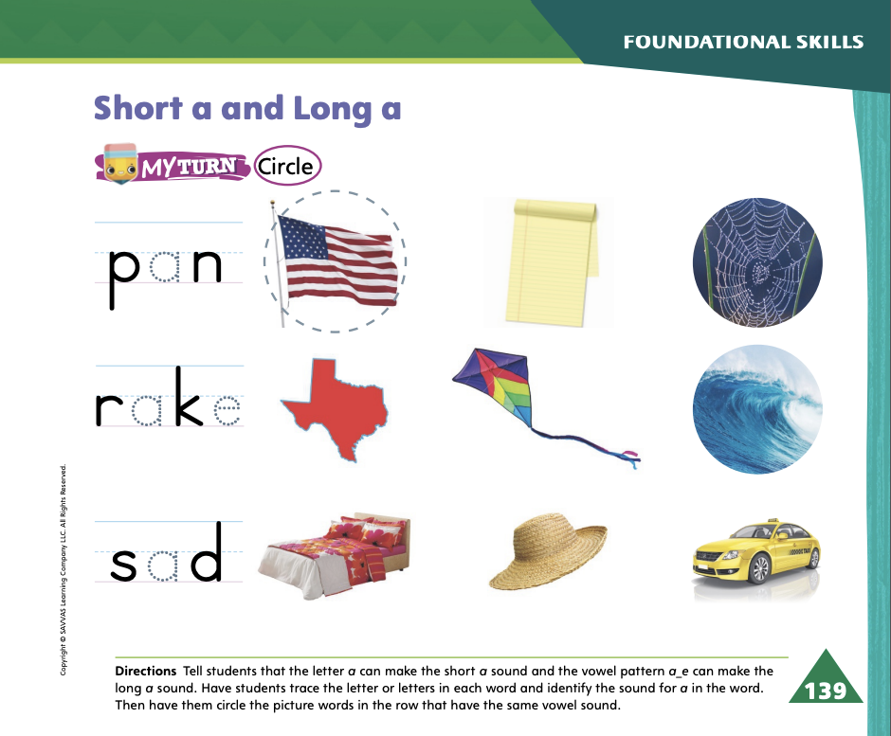
Page 139
Apply
Turn to page 139 in your Student Interactive and complete the activity.
Notes:
Have students look at p. 139 in the Student Interactive. Have them trace the letter in the first word and read the word. Then tell them to circle the other words in the first row with the same sound /a/ as in pan. Does flag have the same middle sound as pan? If it does, circle it. Students should circle the picture of the flag. Continue to complete the page.

Slide 7
High-Frequency Words
away
give
little
Notes:
Display the words: away, give, and little. Tell students that they need to practice reading these words.
Point to the word away and read it.
Have students point to the word away and read it.
Repeat for give and little.

Slide 8
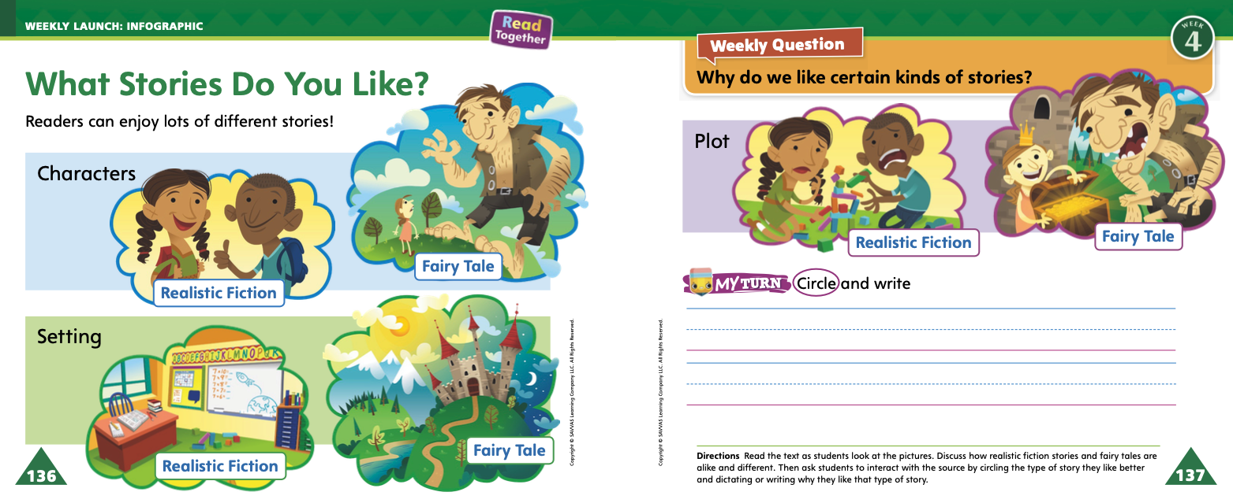
Page 136, 137
Interact with Sources
What do you notice about the different parts of the stories?
Circle your favorite story.
Notes:
Remind students of the Essential Question for Unit 3: Why do we like stories? Then point out the Weekly Question: Why do we like certain kinds of stories? Explain that students will learn about different kinds of stories this week.
Have students follow along as you turn to pp. 136–137 of the Student Interactive and point to the pictures of the characters and setting for the stories shown on the page. Explain that the pictures show two different types of stories.
Then read aloud the infographic “What Stories Do You Like?” Use the following prompts to guide discussion:
Ask students to point to the three different parts of the infographic: characters, setting, and plot.
Ask students how the characters in the first picture of realistic fiction are different from the characters in the second picture of the fairy tale. Tell students that the characters are who the story is about.
Repeat the process with the “setting” section of the infographic. Explain that the setting is where and when a story takes place.
Repeat the process with the “plot” section of the infographic. Explain that the plot is what happens in a story.
4. Encourage students to ask questions about the infographic to clarify any information they do not understand.
5. Have students interact with sources by using the pictures and text TURN on pp. 136–137 to decide which type of story they like best. Have them circle that type. Then have them write about why they like that type the best.

Slide 9
Listening Comprehension
“So Many Stories”
1. Mom takes Sam and Taliba to the library
2.
3.
4.
5.
Notes:
Tell students that you are going to read a fiction text aloud. Remind them that fiction tells stories. Tell students to be active listeners by looking at you and thinking about what is happening in the story as you read.
Purpose Have students listen actively to determine whether the text is fiction.
READ the entire text aloud without stopping for the Think Aloud callouts.
REREAD the text aloud, pausing to model Think Aloud strategies related to the genre.
Use the chart to help students identify the events that happen in the story.

Slide 10
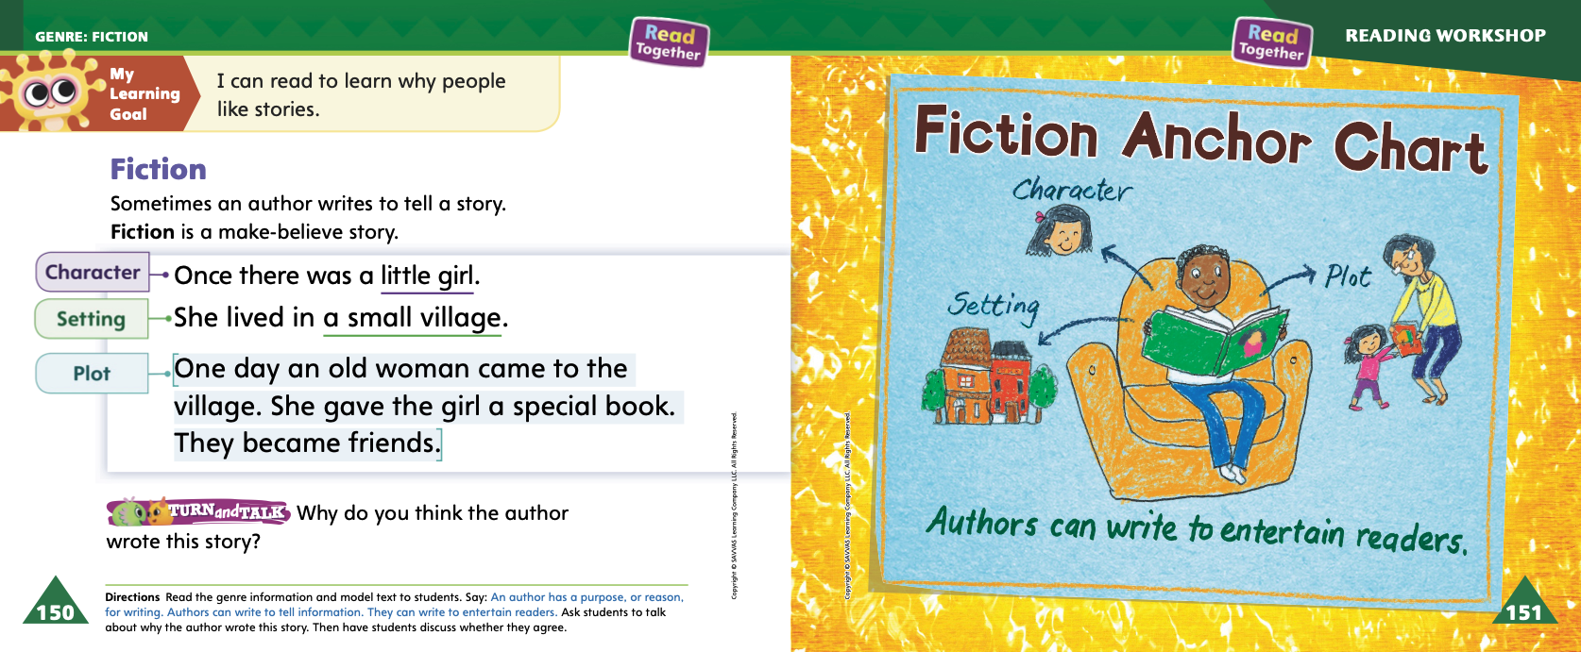
Page 150, 151
Fiction
Turn to page 151 in your Student Interactive.
Notes:
Tell students that today they will learn about fiction.
Read aloud p. 150 of the Student Interactive. Point out that the story on this page has a character, a setting, and a plot. Tell students they can look for clues as they read to find the author’s purpose
Authors also can write to entertain readers.
I can look for clues that the author is telling a story. These clues show that the author is writing fiction.
Editable Anchor Chart Click Path: Table of Contents -> Reading Anchor Charts -> Unit 3 Week 4: Fiction Editable Reading Anchor

Slide 11
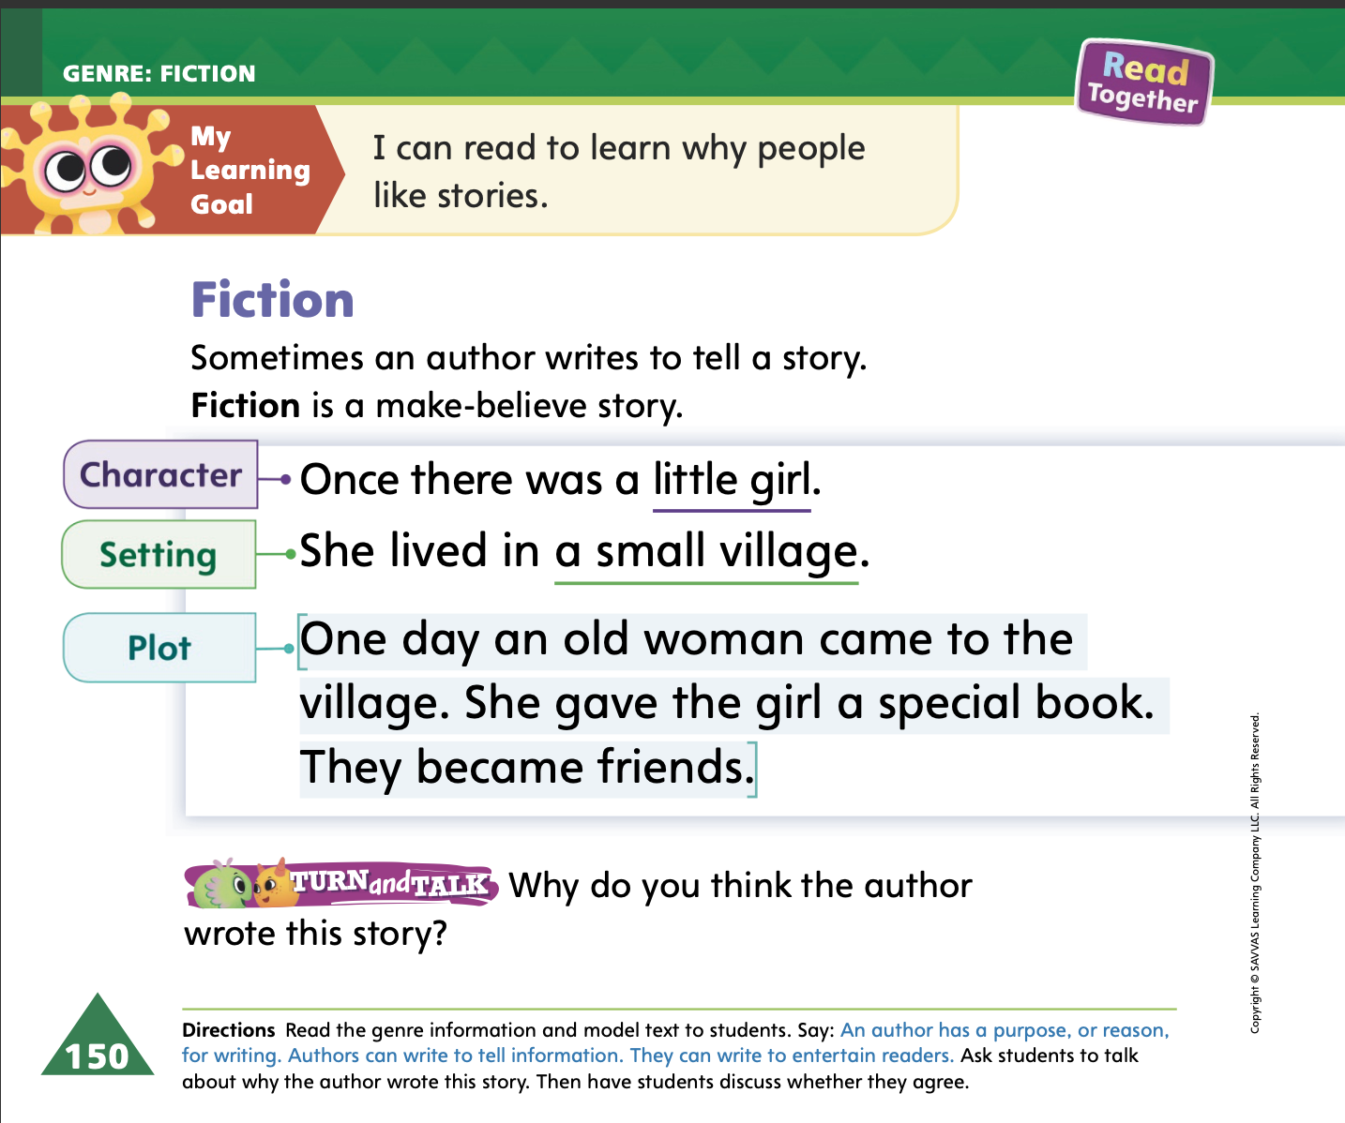

Page 150
Apply
Why do you think the author wrote this story?
Notes:
Have students turn and talk with a partner about why the author wrote the story on p. 150 of the Student Interactive.
Then have partners share their ideas with the class.

Slide 12
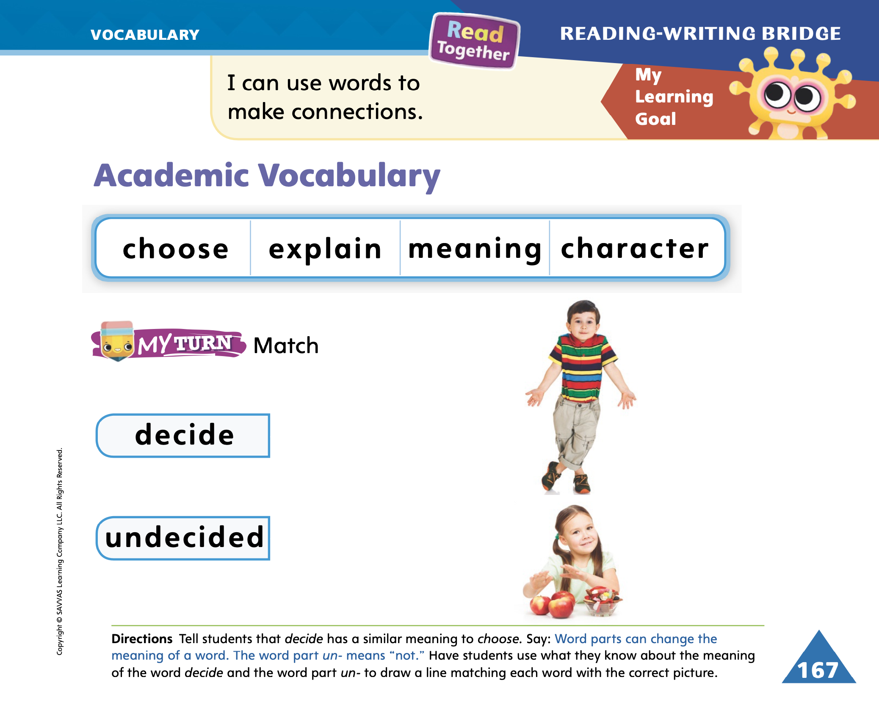
Page 167
Academic Vocabulary
characters
Turn to page 167 in your Student Interactive and complete the activity.
Notes:
Explain that word parts are groups of letters that work together to make or change a word or its meaning. Explain that recognizing and learning parts of a word can help students read and understand word meanings.
Read aloud the Academic Vocabulary words with students from p. 167 in the Student Interactive. Define the words, if needed. If I add an s to the end of character, it changes the meaning of the word. The word characters means more than one character.
Have students complete the My Turn activity on p. 167 in the Student Interactive. Then have students use what they know about the word explain and the word part -ed to define the meaning of explained.

Slide 13
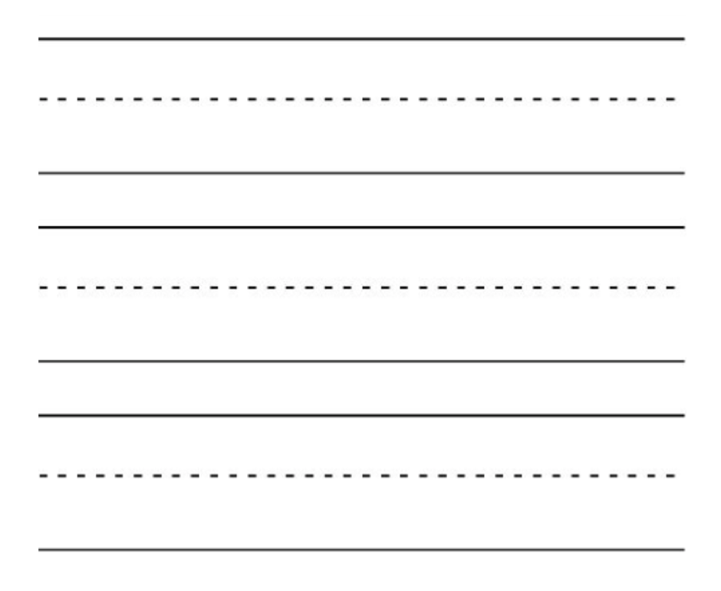
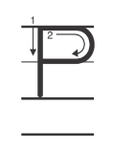
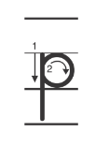
Handwriting
Notes:
Display the uppercase and lowercase Pp.
Model how to make the uppercase letter P. Show students how to start at the top and draw a straight line and then a curved line. Repeat with the lowercase letter p. Ask students to follow your modeling by tracing the letters in the air with their finger.
Have students use Handwriting p. 144 in the Resource Download Center to practice writing Pp. Click path: Realize -> Table of Contents -> Resource Download Center -> Handwriting Practice -> U3W4L1 Handwriting Practice

Slide 14
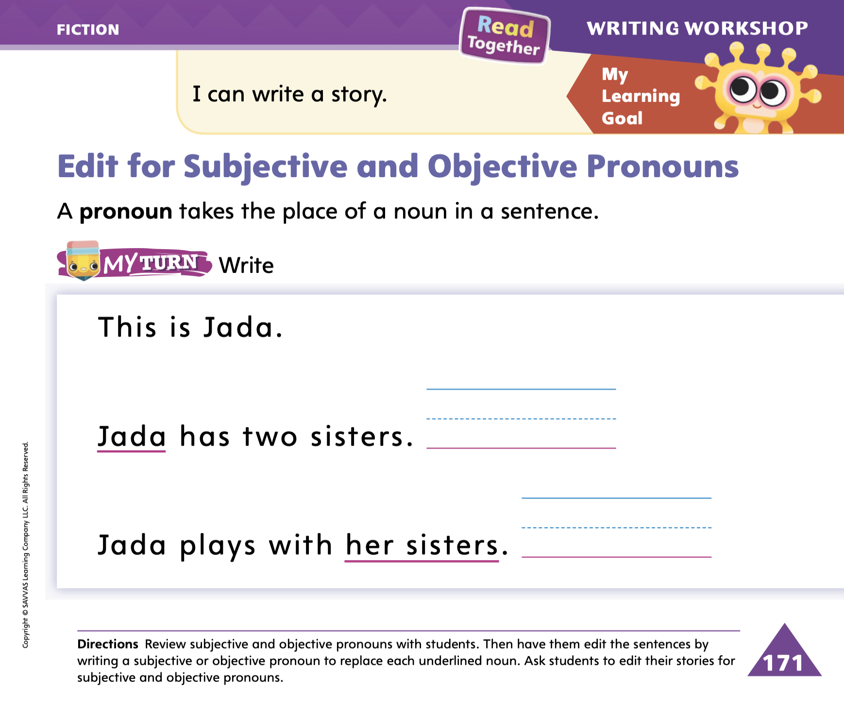
Page 171
Writing – Fiction
Turn to page 171 in your Student Interactive.
Notes:
1. Subjective pronouns replace nouns in the naming part of a sentence. Objective pronouns replace nouns in the action part of a sentence. Authors use pronouns for several reasons, such as:
Pronouns eliminate the need to repeat names and nouns in a story.
Pronouns identify who or what the author is talking about.
2. Recall the plot of a stack book that your class is familiar with. On the board, write a summary of the story. Do not use any pronouns as you write. When you have completed the summary, read it aloud to the class.
3. Ask students if they notice anything strange about your story. Allow them to suggest answers. Then say: In my story, I used the character names many times. It sounds strange, doesn’t it? Authors don’t use the characters’ names over and over. Instead, authors use pronouns. Pronouns make the story easier to understand. Let’s write a list of pronouns. Write a list of pronouns on the board so students can reference it during the lesson.
4. Go back to your story and circle all the names and nouns for which pronouns can be substituted. Model how to edit a draft by changing a few of the nouns to pronouns. Ask students to tell you what pronoun can be put in place of each circled word, providing assistance as needed. When pronouns have been substituted accordingly, reread the story aloud.
5. Direct students to complete p. 171 in the Student Interactive.

Slide 15

Independent Writing
Continue editing your draft.
Replace some of the names of characters with pronouns.
Notes:
During independent writing time, students should edit their drafts by replacing the names of characters with pronouns, where appropriate.
If students struggle, choose one of the following options to provide further support.
Modeled Use stack texts to point out subjective and objective pronouns.
Shared As students come up with sentence ideas, help them think of where to incorporate pronouns
Guided Prompt students to vary their sentences in order to use pronouns.
When students are done, they can continue writing their stories.
As students write, use the conference prompts in the Teacher’s Edition or Resource Download Center to provide support. Click path: Table of Contents -> Resource Download Center -> Writing Workshop Conference Notes
Ask for a few student volunteers to read their stories aloud to the class. Engage students in a discussion about which pronouns were used and how this usage makes the story better or easier to read.

Slide 16
Language and Conventions
The dog is yours, and the cat is mine.
Notes:
Remind students that some pronouns show that something belongs to someone, such as mine, ours, his, hers, theirs, and yours
Provide students with a sentence that uses a possessive case pronoun, and have students identify it. Say the sentence: The dog is yours, and the cat is mine. Explain that the words yours and mine both show that something belongs to someone
Ask students to come up with their own sentences to describe things in the classroom that belong to them or their classmates. Make corrections as needed as students say their sentences.

Slide 17
Lesson 2

Slide 18
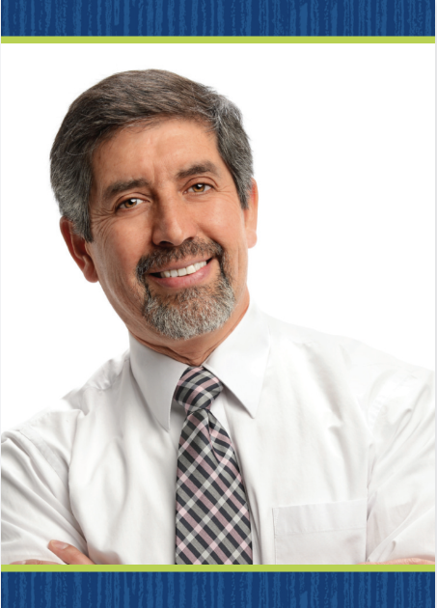
Phonics
man
mane
tap
tape
Notes:
Hold up the man Picture Card. This is a picture of a man. I hear these sounds in the word man: /m/ /a/ /n/. I hear the sound /a/ in the middle of man. The sound /a/ is spelled a. Say the sound /a/ with me. Click path -> Table of Contents -> Unit 3 Week 4 Fiction -> Lesson 2
Write man on the board. Write mane under man. Tell students that when you add the letter e to the end of the word man, the sound changes to / /. The long a is spelled a_e.
Have students listen as you say the words with the short and long sounds for a: /a/ and / /. We already learned how to write the letters Aa. Let's practice writing them in the air. Have students trace the letters Aa in the air as you lead them
Write the word tap on the board. Listen carefully to the following word: /t/ /a/ /p/. Do you hear the sound /a/ in this word? What would the word be if we added an e to the end? Write the word tape on the board and have students read the word with you.

Slide 19
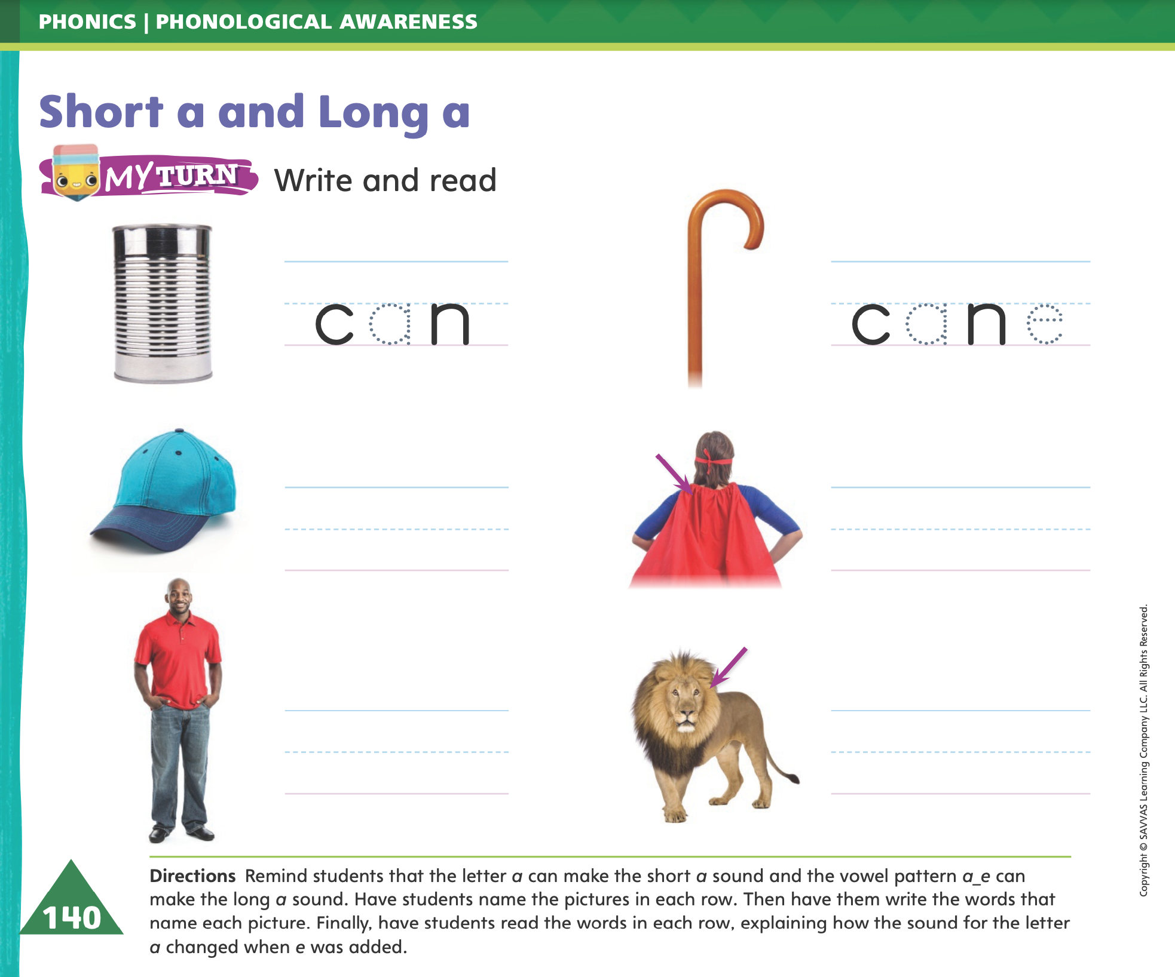
Page 140
Apply
Turn to page 140 in your Student Interactive and complete the activity.
Notes:
Have students complete p. 140 in the Student Interactive

Slide 20
High-Frequency Words
away
give
little
Notes:
Tell students that high- frequency words are words that they will hear and see over and over in texts they read.
Write and read the words away, give, little.
Have students
Read each word
Spell each word

Slide 21
Page 152
Preview Vocabulary
castle
pretend
explorer
adventure
Notes:
Introduce the words castle, pretend, explorer, and adventure on p. 152 in the Student Interactive.
Have students share what they already know about the words. Ask questions such as: What does a castle look like? What animal can you pretend to be? What does an explorer do? Have you ever gone on an adventure? Where did you go?
Say: These words are used in The Best Story. Knowing the words before reading will help you to understand the story better.

Slide 22

First Read Strategies
Notes:
Discuss the First Read Strategies. In this first read, have students read for understanding and enjoyment.
Explain to students that they can use text features and repeated structures to predict what will happen in a text.
Have students make predictions about The Best Story, providing assistance as needed. After students complete the First Read, ask: What kinds of stories do the children like?
FIRST READ STRATEGIES
READ Read or listen to the story. During the first reading, work to understand what the text is about.
LOOK Look at the pictures to understand who the characters are and where the story takes place.
ASK Ask questions about the text to deepen understanding.
TALK Talk to a partner about the text.

Slide 23
Page 153
First Read – The Best Story
Notes:
Read together

Slide 24
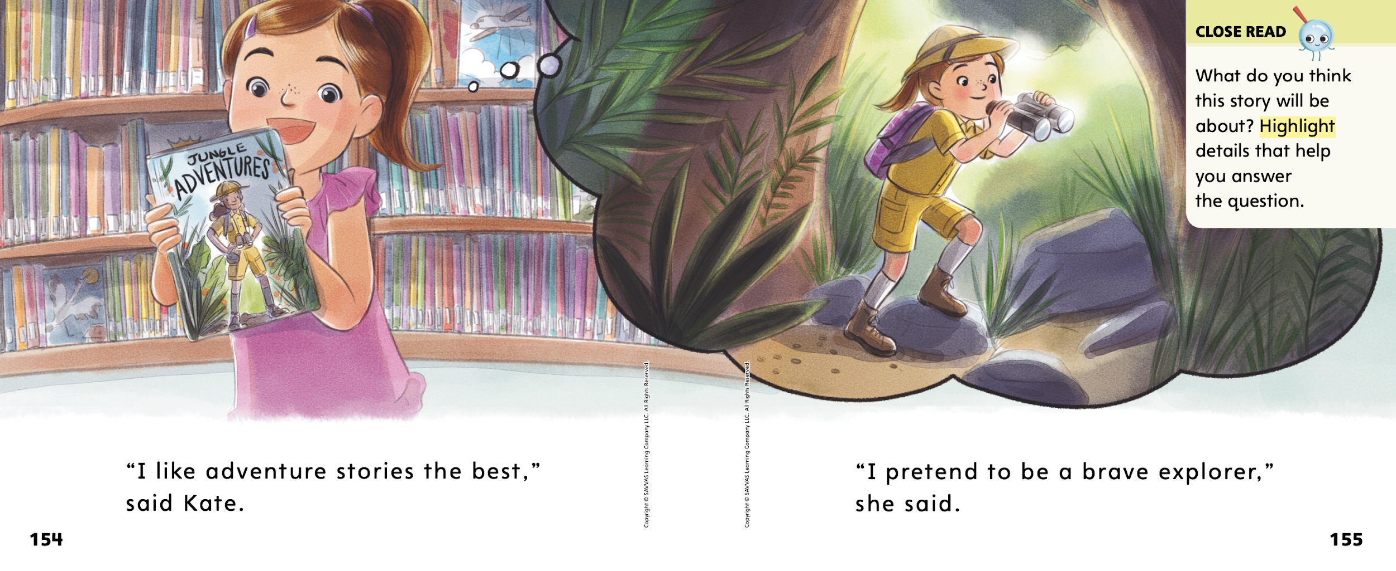

Page 154, 155
First Read – The Best Story
Notes:
Read Together.
THINK ALOUD The first page of the story has a vocabulary word. I think knowing this word will help me know what the story is about. The word adventure means something exciting. Kate likes to read stories about exciting events. I think this will be what this story is about.

Slide 25
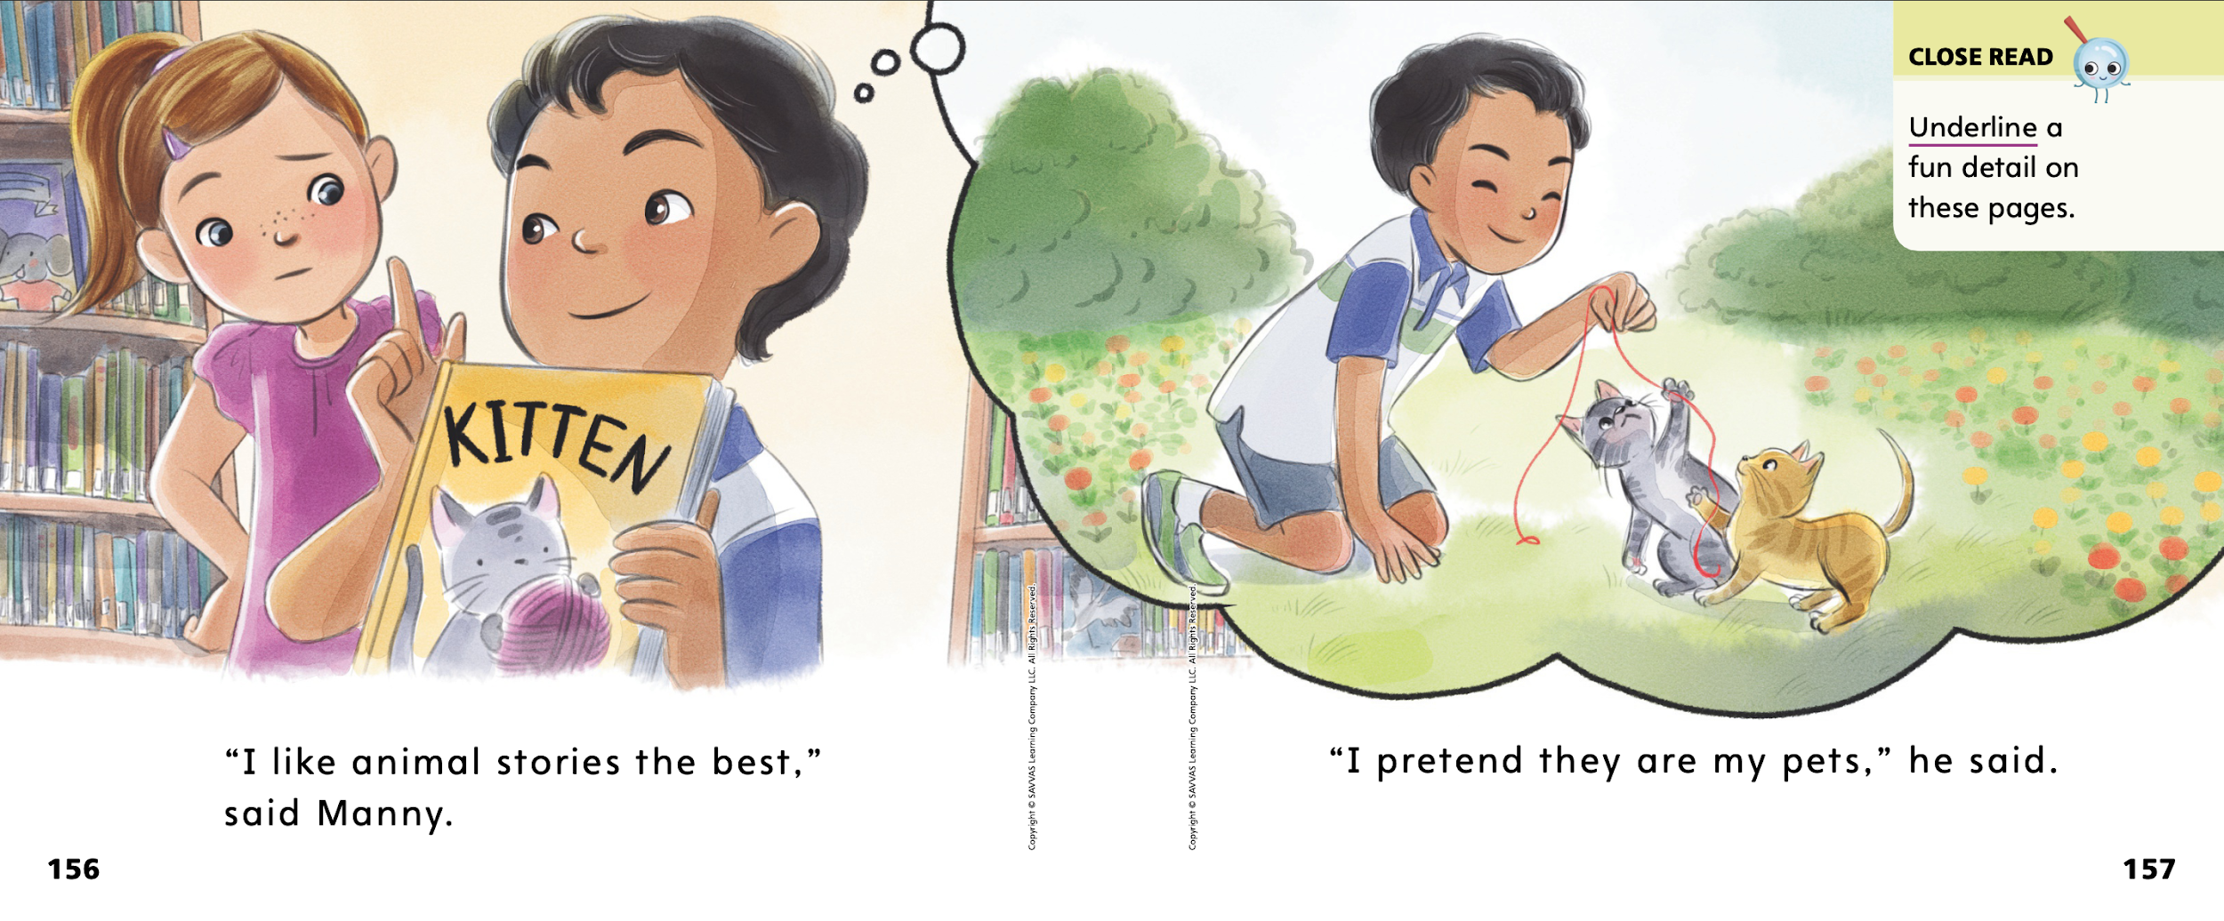
Page 156, 157
First Read – The Best Story
Notes:
Read together.

Slide 26
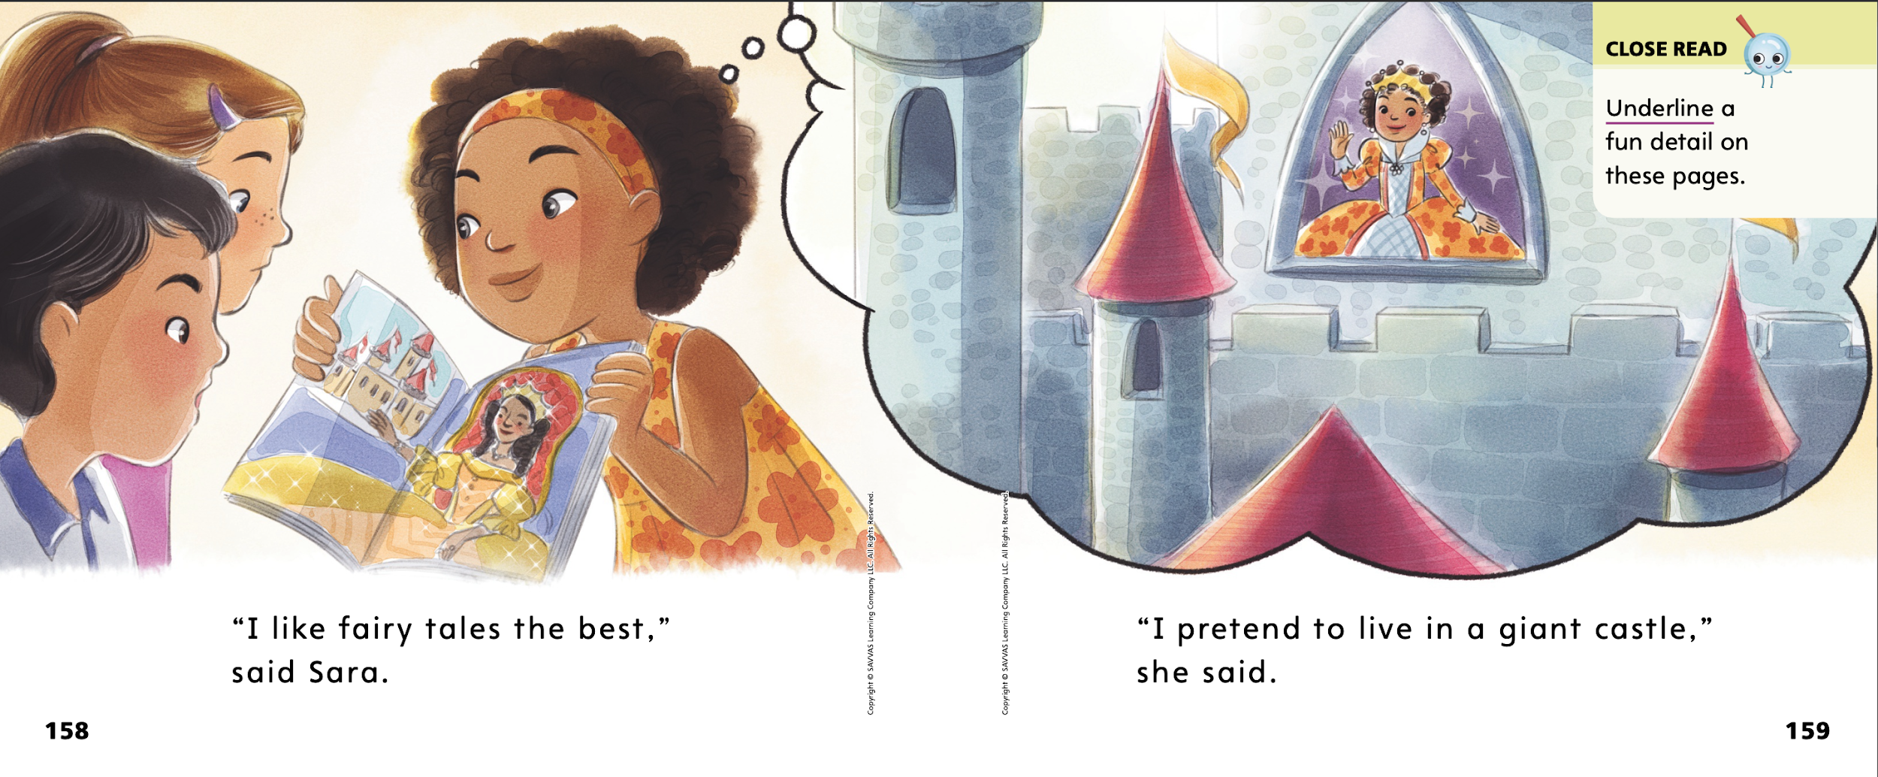
Page 158, 159
First Read – The Best Story
Notes:
Read together.
THINK ALOUD I can ask questions before reading and while reading. Asking questions can help me understand the text. For example, I might ask myself, “Why did the author write this story?” I see that there are characters in the story and they are talking to each other. The characters and events are made up. I think the answer to my question is that the author wrote this story to entertain readers. Now I will read to enjoy the story, just like the author wanted!

Slide 27
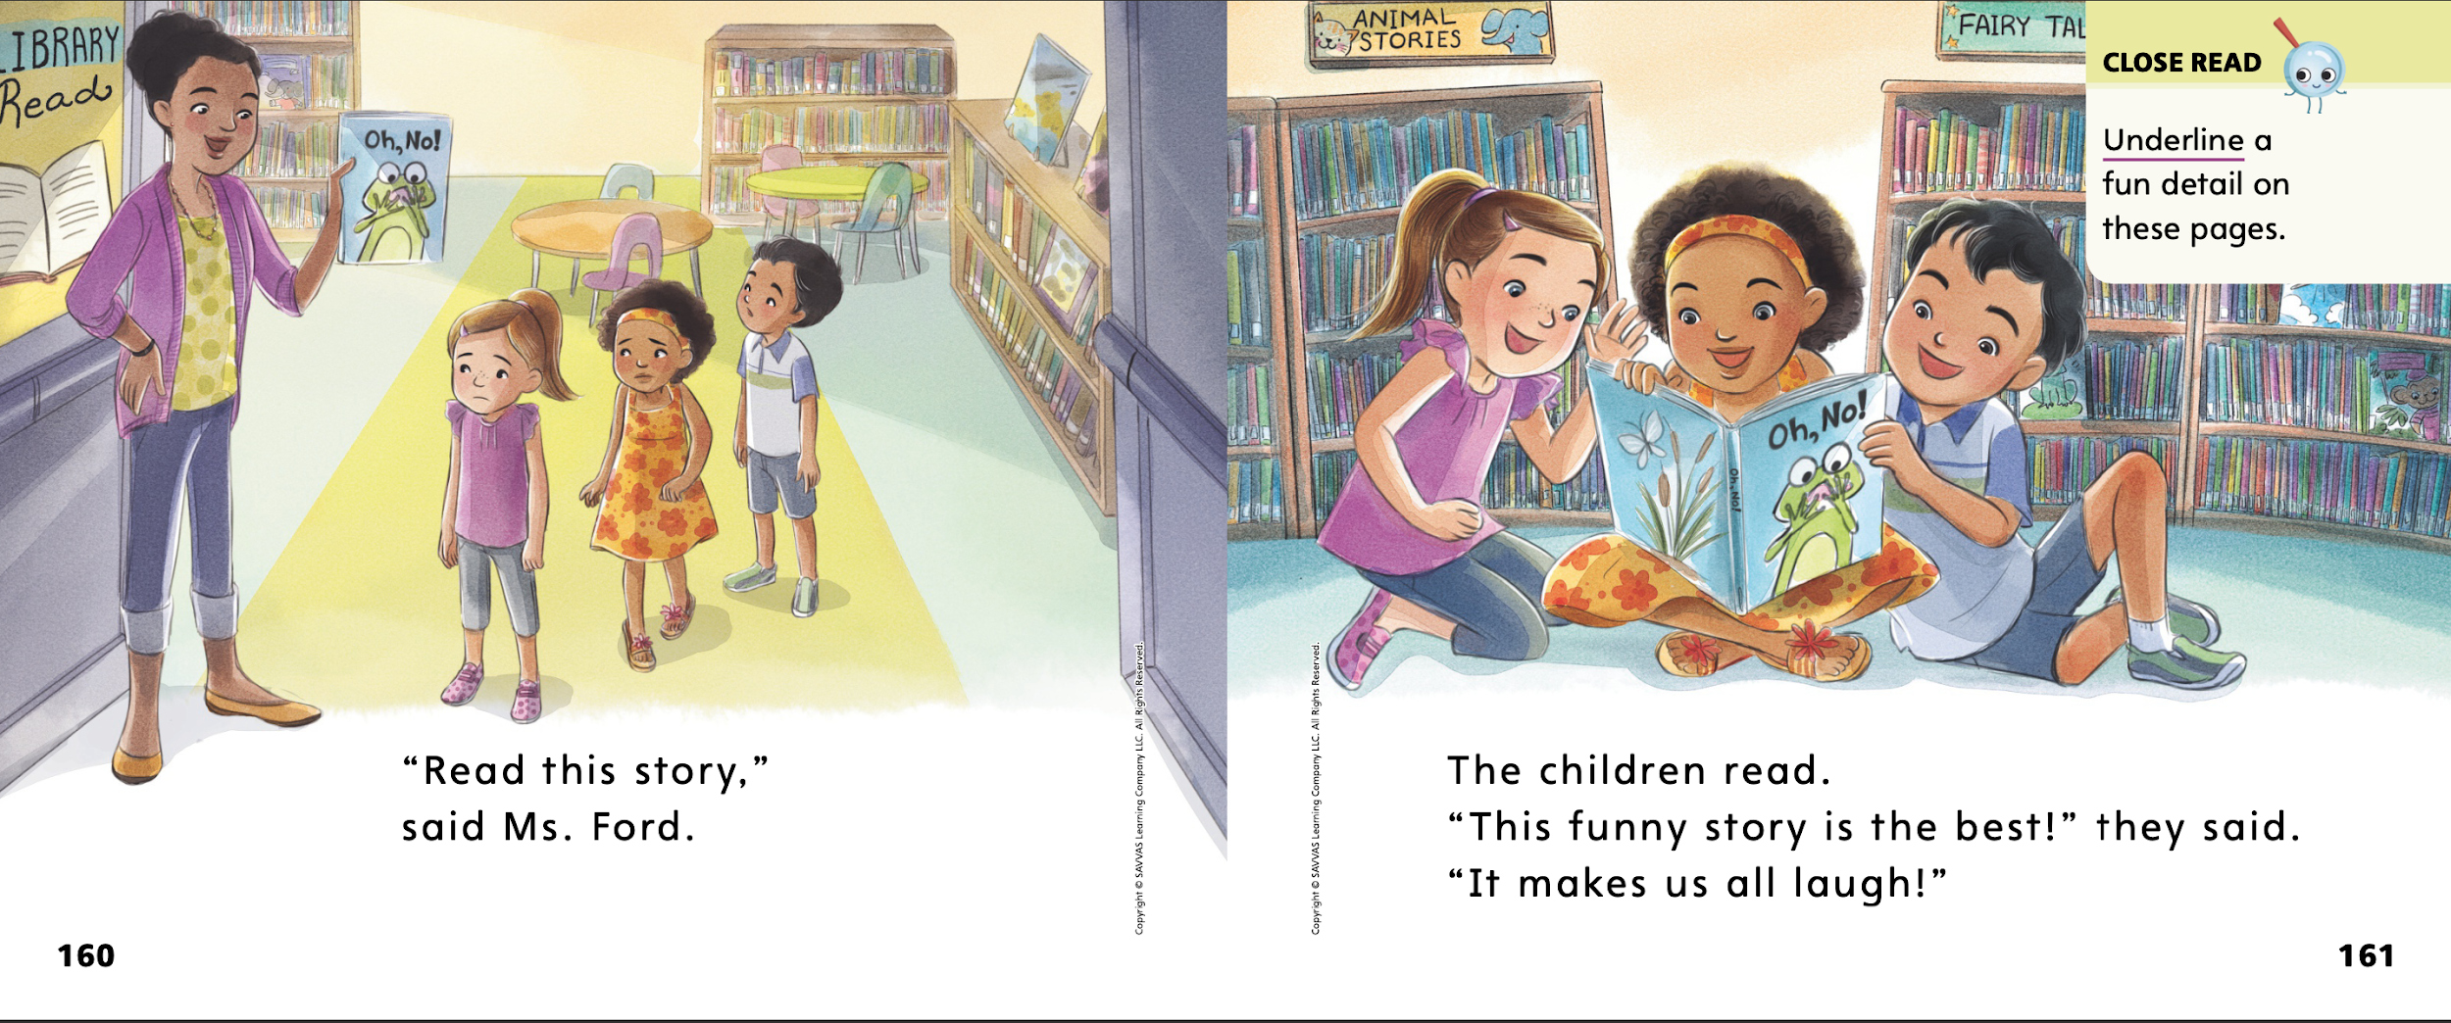
Page 160, 161
First Read – The Best Story
Notes:
Read together.

Slide 28
Respond and Analyze
Talk Find a page that you thought was interesting. What did you like about it?
How did the illustration help you understand the text?
Analyze Why do you think the story was called The Best Story?
Notes:
Use these questions to prompt students’ initial response to reading The Best Story.
Talk Ask students to find a page or illustration that they thought was interesting. Invite them to tell what they liked about the page and how the illustration helped them understand the text on the page.
Analyze Ask students why they thought the story was called The Best Story.

Slide 29
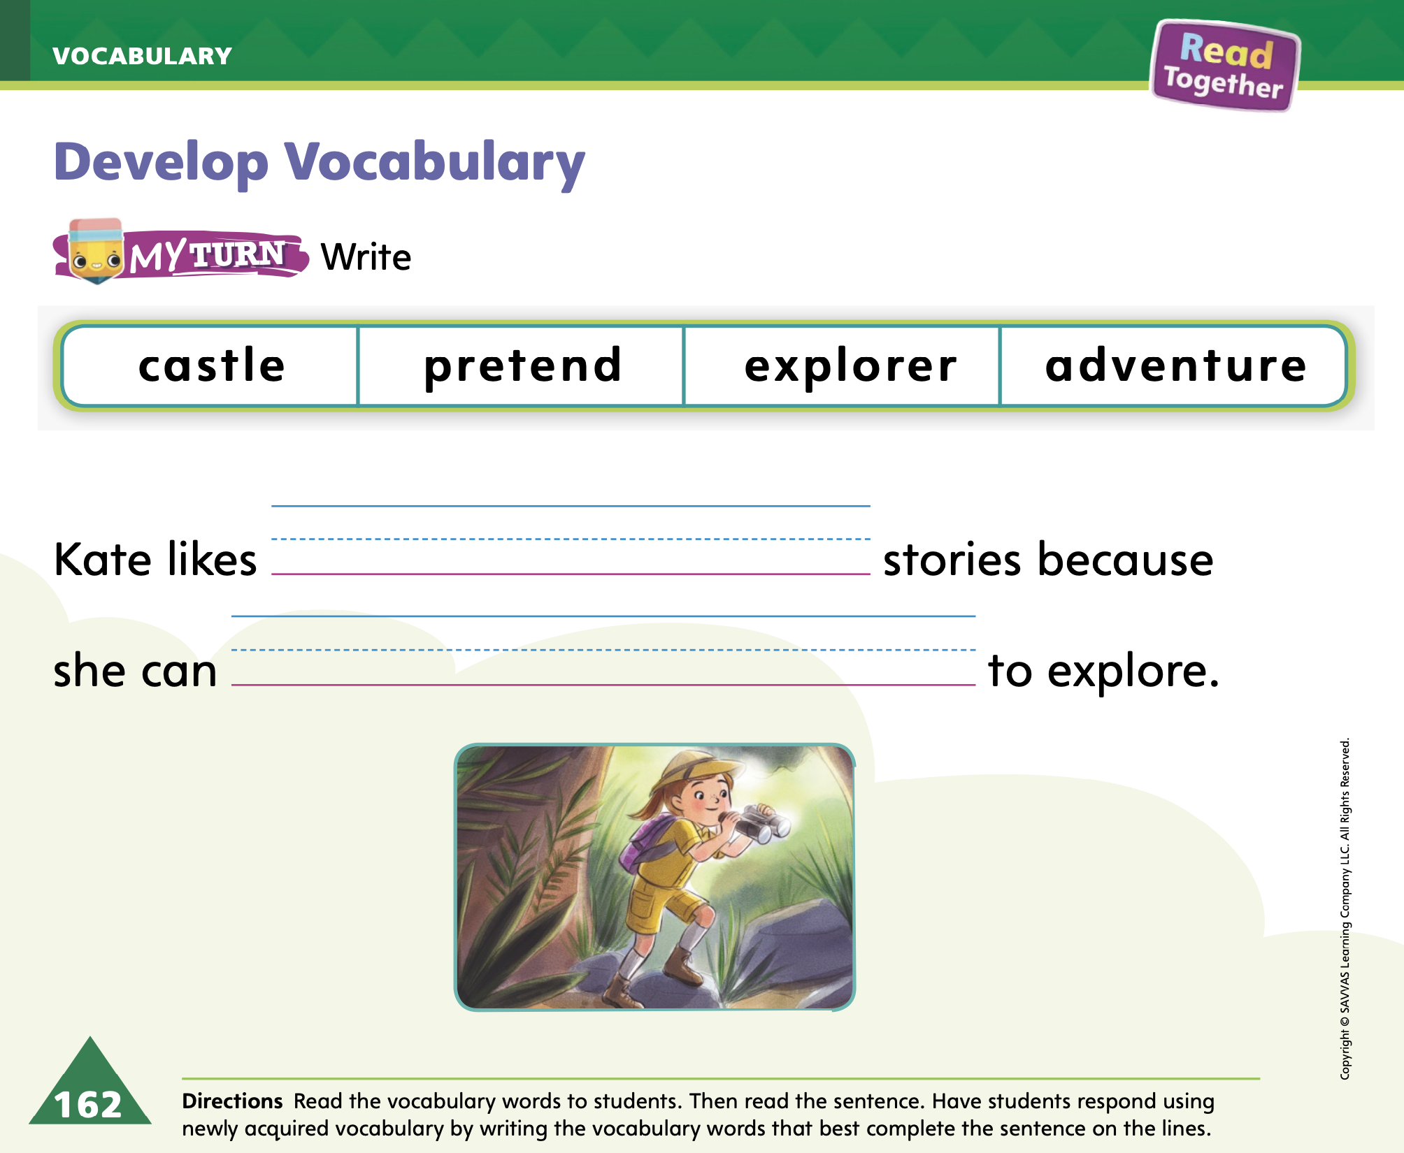
Page 162
Develop Vocabulary
Turn to page 162 in your Student Interactive and complete the activity.
Notes:
Explain to students that the author uses words that help describe what is fun and interesting about reading fiction stories. Help students identify these precise and descriptive words.
READ Read the word.
THINK Think about the meaning of the word. Use the pictures around the difficult word to help you think about the meaning.
ASK Ask yourself questions such as: What pictures can help me determine the meaning of the word?
Help students begin working on the activity on p. 162 in the Student Interactive. The picture helps me understand what an adventure story is. The person is in the jungle having fun and looking at wildlife with binoculars. That looks like a great adventure.
Guide students through another example if needed. Some students may need help understanding that the word pretend is used on p. 155 because Kate is not really on an adventure. She is reading about a jungle adventure and thinking about it in her mind, or pretending.

Slide 30
Page 163
Check for Understanding
How does the story end?
Why did the illustrator include thought bubbles?
Which character’s opinion do you agree with?
Notes:
Have students complete the Check for Understanding on p. 163 of the Student Interactive.

Slide 31
Writing – Fiction
A complete sentence is one that includes both a naming part (subject) and an action part (verb).
Notes:
A complete sentence is one that includes both a naming part (subject) and an action part (verb). A sentence needs both parts to be complete. Authors edit their writing to ensure every sentence includes
both parts.
Ask students to choose a book from the stack for you to read. Begin by stating that you are looking for complete sentences. Say: A complete sentence is a group of words that are separated by spaces. This is a word. Point to a word in the book. All of the words together make a sentence. Show an example of a sentence from the book.
Next, tell students that a complete sentence has a naming part and an action part. Read the first sentence of the book aloud. Point out the naming part and the action part. Read the next few sentences, pointing out the naming part and action part. As students understand, ask them to help you find each part of the sentence. Say: A sentence has a naming part and an action part. When you write your drafts, make sure you write using complete sentences.

Slide 32
Independent Writing
Review your draft.
Correct any incomplete sentences.
Notes:
During independent writing time, students should review their drafts from this unit, paying attention to sentences. For each sentence, students should point out the naming part and the action part
If a sentence is missing one part, have the student edit it for completeness.
If students struggle, choose one of the following options to provide further support.
Modeled Write sentences from a stack text, underlining the naming part and the action part
Shared If students struggle with writing, have them say their sentences as you transcribe them
Guided Prompt students with hints to look for naming and action parts in sentences
As students write, use the conference prompts in the Teacher’s Edition or Resource Download Center to provide support. Click path: Table of Contents -> Resource Download Center -> Writing Workshop Conference Notes
At the end of writing time, Call on a few students with whom you conferred to read a complete sentence from their fiction book.

Slide 33
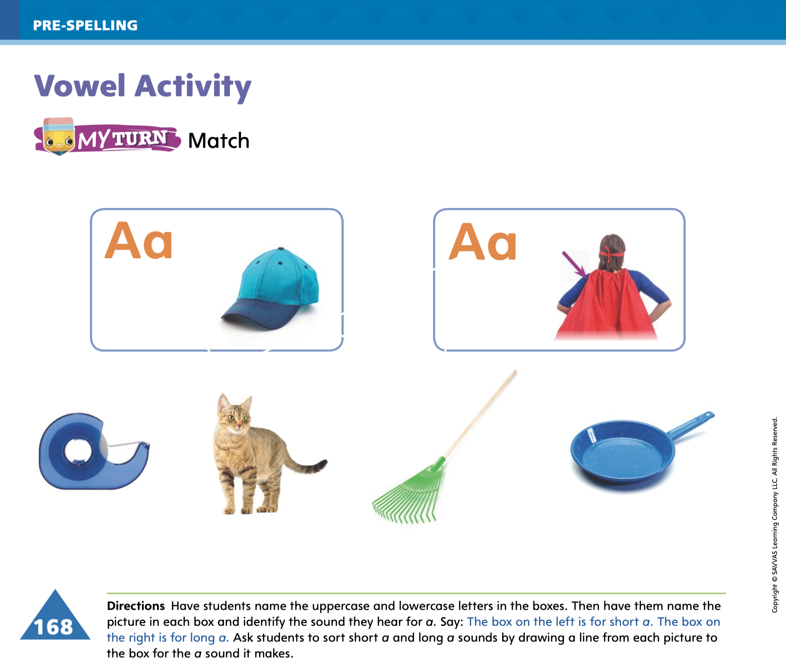
Page 168
Vowel Activity
Turn to page 168 in your Student Interactive and complete the activity.
Notes:
Remind students that each vowel in the alphabet has a short vowel sound and a long vowel sound. Use the letter a as an example. Write the words rat and rate. Point to rat, say it, and explain that rat has the short a sound: /a/. Repeat with rate, explaining that it has the long a sound: / /. Explain that the reason the a changes sound is that the words rat and rate are spelled differently.
Demonstrate how to match words with the same vowel sounds on p. 168 in the Student Interactive. I see a picture of a cap on one side. Cap has the short vowel sound /a/. I see a picture of a cape on the other side. Cape has the long vowel sound / /. I can look at the pictures in the middle and draw a line from the pictures of the cap and the cape to the pictures below whose names have the same vowel sounds. Point to the picture of a pan. Pan has the same short a sound as cap. I will draw a line between the two pictures. Demonstrate how to draw a line between the two pictures.

Slide 34
Language and Conventions
I am under my umbrella.
Notes:
Explain to students that a preposition is a word that shows how two ideas or items are related. It is sometimes called a position word because it often answers the question where. Tell students that words such as in, on, over, under, and by are prepositions.
Give an example of a sentence with a prepositional phrase, such as I am under my umbrella. Say: The sentence tells where I am. I am under something. Under is the preposition because it answers where. The phrase gives more information: under my umbrella.
Provide practice using the prepositions under, on, and in in oral sentences. Place a book under your desk. Ask students to tell where your book is using a full sentence. Place the book on the desk and ask students where the book is. Finally, hold the book in your hands and ask students where the book is.

Slide 35
Lesson 3

Slide 36
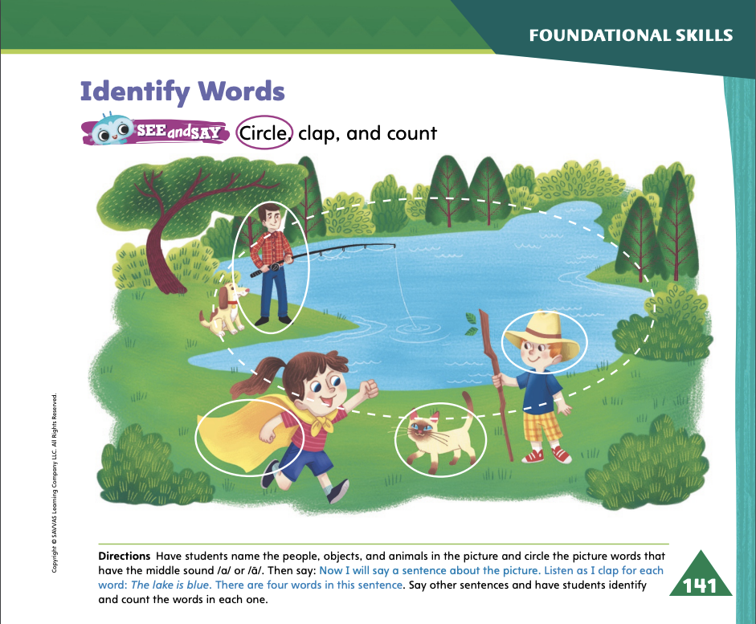

Page 141
Phonological Awareness
Turn to page 141 in your Student Interactive and complete the activity.
Notes:
Tell students they will learn how to identify and count words in a sentence. Display the lake Picture Card. Say: This is a picture of a lake. Listen to the middle sound in the word: /l/ /a / /k/. Now I will say a sentence using the word lake. Let’s clap for each word: I go to the lake. How many times did we clap? Yes, five times. There are five words in this sentence. Click path -> Table of Contents -> Unit 3 Week 4 Fiction -> Lesson 3
Point to the pictures on p. 141 in the Student Interactive
See and Say: Let’s look at the pictures and tell whether the picture words have the short or long a sound. Look at the picture of a lake. Does lake have a long or short a sound?

Slide 37


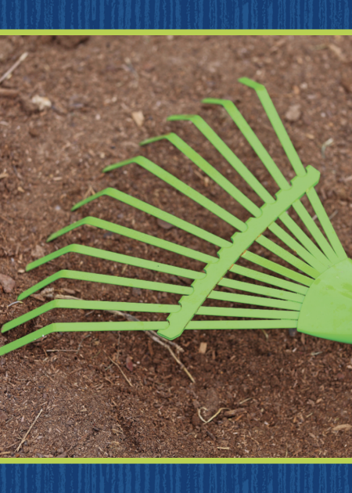

Page 142
Phonics
Notes:
Tell students Tell students the letter a can spell the sound /a/ and the pattern a_e can spell the sound / /. Display the black Picture Card Say: This is the color black. I hear the sound /a/ in the middle of black. What letter spells the sound /a/? Click path -> Table of Contents -> Unit 3 Week 4 Fiction -> Lesson 3
Show students the spelling on the back of the card. Point to the letter a and tell students the sound /a/ in black is spelled with the letter a. Repeat the routine for long a spelled a_e using the rake Picture Card.

Slide 38
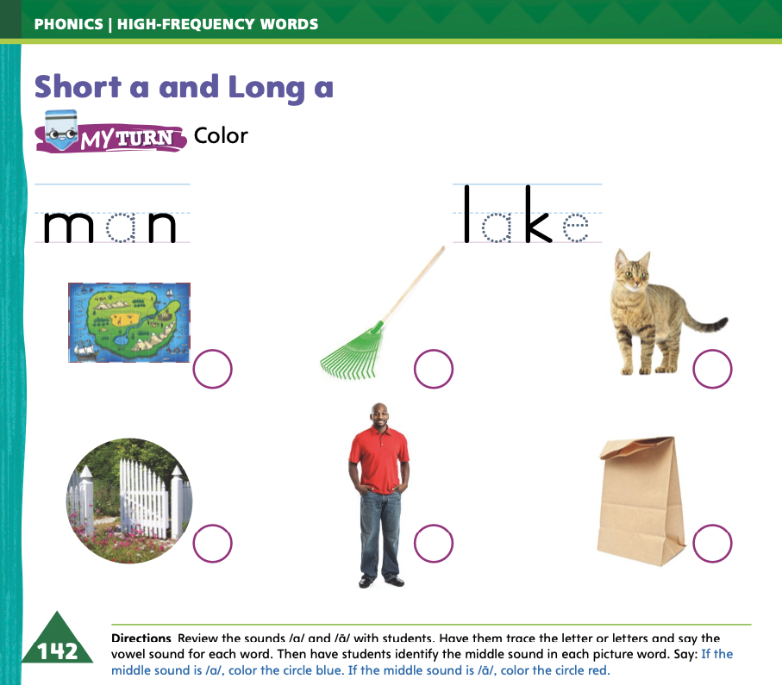
Page 142
Phonics
Turn to page 142 in your Student Interactive and complete the activity.
Notes:
Have students turn to p. 142 in the Student Interactive. Tell students they will identify the middle sound in each picture word. Then they will color the circle by each short a word blue and the circle by each long a word red.
Read the words at the top of the page with students as they trace the dotted letters. Then point to the picture of the map.
Say: Listen to the sounds in map: /m/ /a/ /p/. What sound do you hear in the middle? Yes, map has the short a sound, /a/. Let’s color the circle blue.

Slide 39
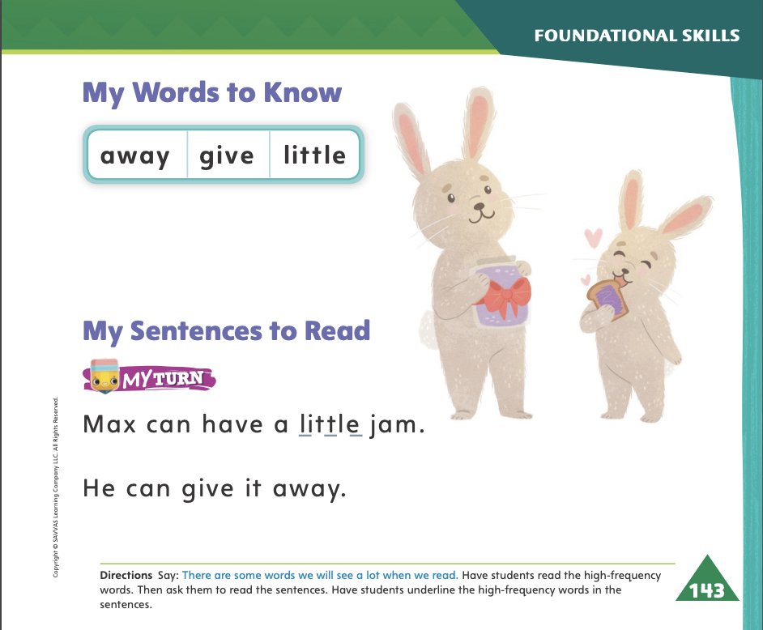
Page 143
High-Frequency Words
Turn to page 143 in your Student Interactive and complete the activity.
Notes:
Say: Today we will practice reading the high-frequency words, away, give and little. Have students read the words at the top of p. 143 in the Student Interactive with you: away, give, little.
Have students look at the words at the top of p. 143. Say: I will read a word, and I want you to point to it. Then we will read the word together.
Read away, and have students point to it. Say: Now let’s read the word together: away. Repeat with the other words.
Have students read the sentences on p. 143 with you. Ask them to identify the words away, give, and little in the sentences and underline the words. Then have them read the sentences with a partner.

Slide 40
Page 153
Discuss the author’s purpose
Notes:
Tell students that authors write for a variety of reasons. Two of the main reasons authors write are to entertain and to give information. Help students realize the difference between these two main purposes.
Stories that entertain are often fiction stories. The author writes them to tell a story using characters and a setting.
Texts that give information are called nonfiction, or informational text. The author writes them to tell facts about a topic.
Authors may also write to convince readers to think or do something, or to give an opinion.
Readers can look at the pictures and text to look for clues about why
the author wrote a certain selection. Books meant to entertain often use illustrations of the characters and events. Books meant to inform might use photographs, maps, or other graphics.
Remind students of the author’s purpose for writing The Best Story. Model how you figured out what the author’s purpose was.
I know that The Best Story is meant to entertain me. It has fun characters. They are named Kate, Manny, and Sara. There’s also a teacher named Mrs. Ford. The story tells about everyone’s favorite kinds of books. It takes place in a library.
All of these clues make me think that The Best Story is a fiction book. I know that fiction books are meant to be fun and entertaining.

Slide 41
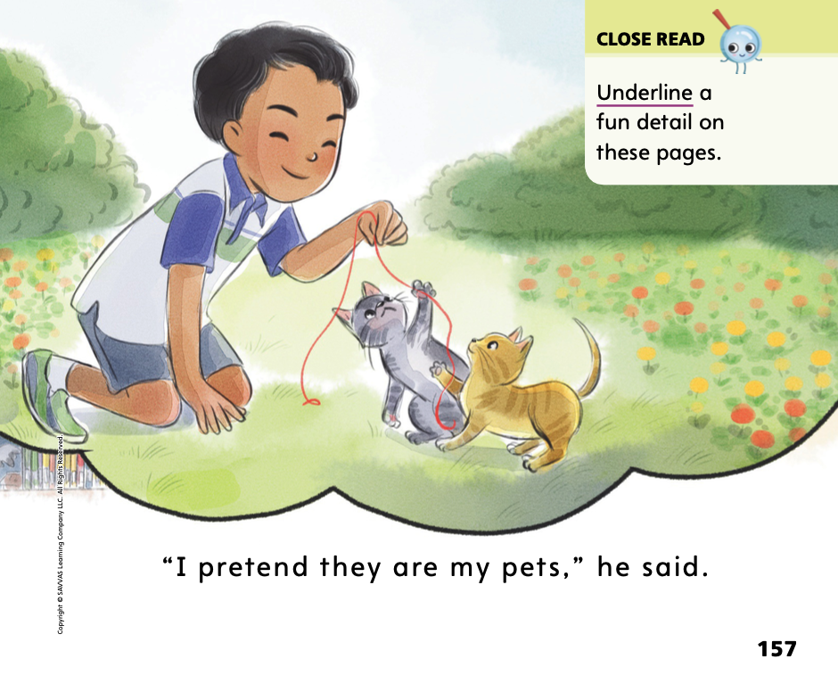
Page 157
Close Read – Discuss Author’s Purpose
Turn to page 157 in your Student Interactive
Notes:
1. Direct students to the Close Read box on p. 157. Ask them why the author included these fun details. DOK 2

Slide 42
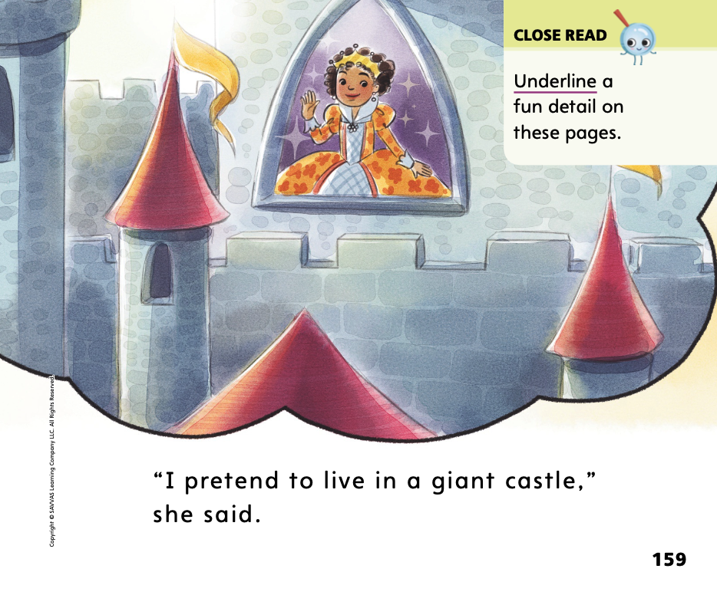
Page 159
Close Read – Discuss Author’s Purpose
Turn to page 159 in your Student Interactive
Notes:
Direct students to the Close Read box on p. 159. Ask them to point out and underline a fun detail on pp. 158–159. DOK 3

Slide 43
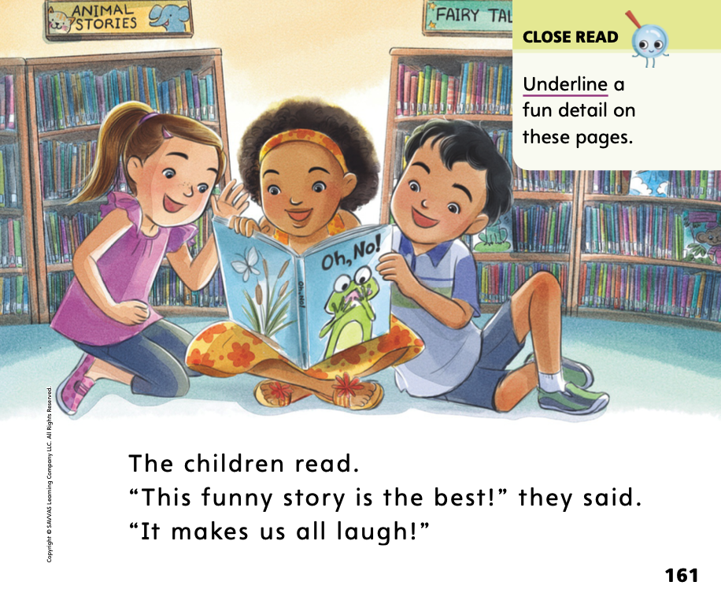
Page 161
Close Read – Discuss Author’s Purpose
Turn to page 161 in your Student Interactive
Notes:
After reading pp. 160–161, ask students to find another fun detail on these pages. Ask students why they think the author included these details. DOK 3

Slide 44
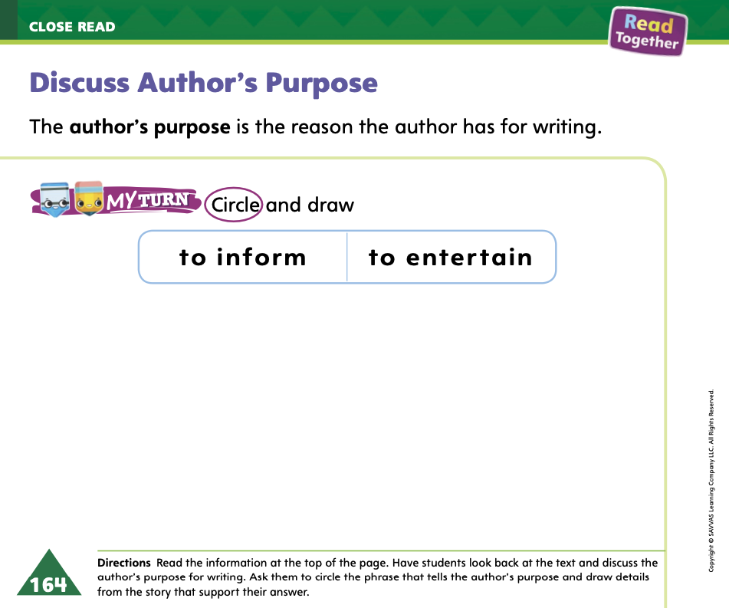
Page 164
Discuss Author’s Purpose
Turn to page 164 in your Student Interactive and complete the activity.
Notes:
Have students use the strategies for discussing author’s purpose.
Have students complete p. 164 in the Student Interactive.

Slide 45
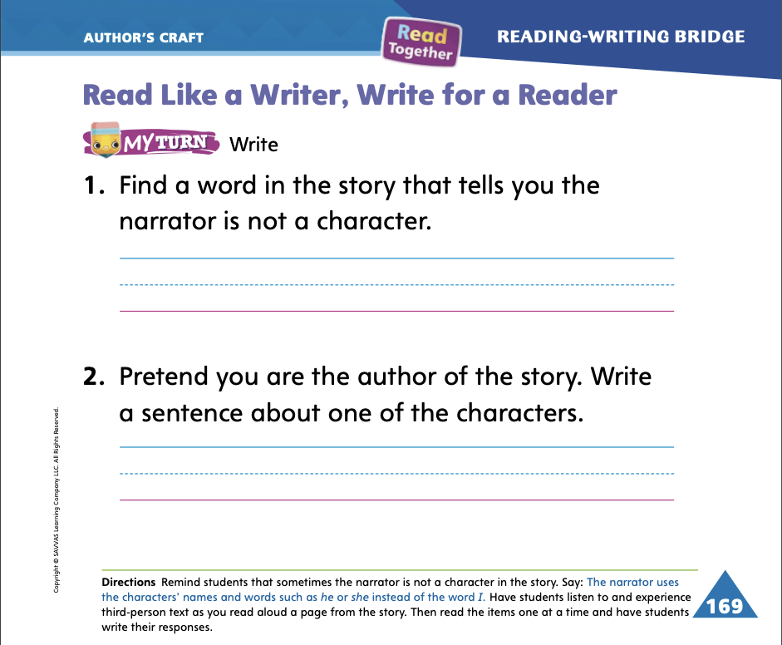
Page 169
Read Like a Writer, Write Like a Reader
Turn to page 169 in your Student Interactive and complete the activity.
Notes:
Explain to students that a narrator, or storyteller, is an important part of a story. The narrator tells the story. Sometimes the narrator is one of the characters in the story. Other times the narrator is outside the story and is not a character in the story.
When a narrator is not a character in the story, it is called having a third-person narrator.
The narrator of The Best Story is not a character. This text has a third-person narrator.
Ask students to turn to pp. 154–155 in the Student Interactive. Have students listen to and experience the third-person text as you reread it aloud. I think this story is told in the third person. The narrator talks about Kate and what Kate says. The narrator is not a character in the story.
Have students complete p. 169 in the Student Interactive.

Slide 46
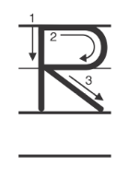
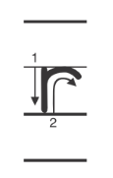
Handwriting
Notes:
Display uppercase and lowercase Rr
Model how to write uppercase R. Show students how to begin at the top and draw a straight line, and then add a curved line and a slanted line. Repeat with lowercase r, showing how to make a straight line and a curved line. Ask students to make the letters in the palm of their hand using their finger as you model each letter again.
Have students use Handwriting p. 145 from the Resource Download Center to practice writing Rr. Click path: Table of Contents -> Resource Download Center -> Handwriting Practice -> U3W4L3 Handwriting Practice

Slide 47
Writing – Fiction
She reads the book.
The rain.
The girl her dog.
Notes:
1. A complete sentence tells a whole thought. It includes a naming part and an action part. Complete sentences are composed of words separated by spaces.
2. Say: When you are editing your writing for complete sentences, it is important to read each sentence out loud so you can listen for completeness. A complete sentence tells a whole thought. It has a naming part and an action part.
3. Write the following sentences on the board. Alternatively, choose sentences from a stack book, changing some to be incomplete.
She reads the book.
The rain.
The girl her dog.
4. Read the first sentence aloud and ask students if it is a complete sentence. (yes) Select a volunteer to identify the naming part and underline it (She); select a different volunteer to identify the action part and circle it (reads the book). Read the next sentence aloud and ask students if it is complete. (no) Explain to students that this sentence is missing one part—the action part. Think aloud as you try different options such as: The rain fell. The rain came down all day. The rain got my hat wet. Students should help you select the action part to complete the sentence. Show them how to edit the sentence on the board. Follow the same steps for the third sentence.

Slide 48
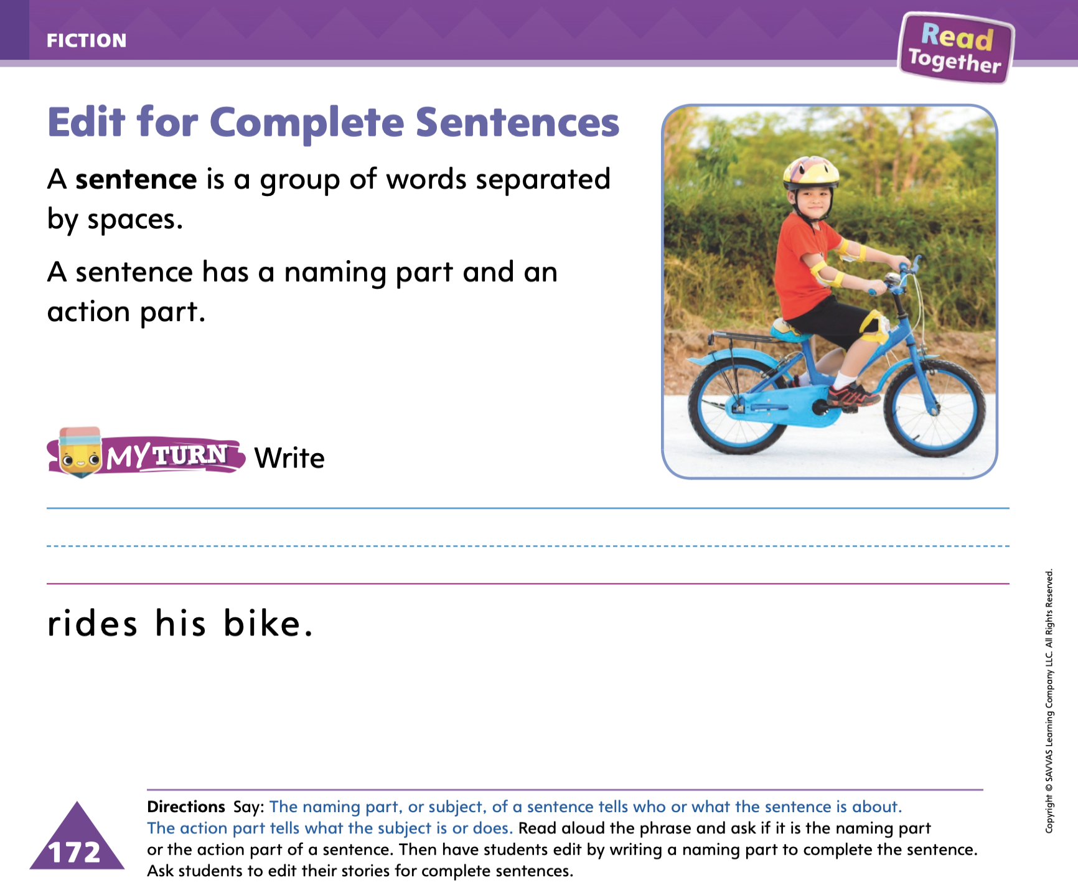
Page 172
Writing – Fiction
Turn to page 172 in your Student Interactive and complete the activity.
Notes:
1. Have students turn to p. 172 in the Student Interactive and complete the activity. Provide assistance as needed.

Slide 49
Independent Writing
You will edit your fiction book today.
Fix any sentences that do not include a naming or action part.
Notes:
Have students edit their drafts for complete sentences. They should reread their stories and fix any sentences that do not include a naming and an action part. Then they can continue writing.
If students struggle, choose one of the following options to provide further support.
Modeled Think aloud as you choose a naming part and action part to write a complete sentence.
Shared Ask students for a naming part and action part and transcribe the sentence.
Guided Ask students how a character could be a naming part and a problem could be an action part.
As students write, use the conference prompts in the Teacher’s Edition or Resource Download Center to provide support. Click path: Table of Contents -> Resource Download Center -> Writing Workshop Conference Notes
Call on two students to share their editing. Students should read their edited drafts aloud and explain what changes they made and why.

Slide 50
Language and Conventions
I put my book in my bag.
Notes:
Write the following sentence on the board: I put my book in my bag.
Read the sentence. Then have students tell you which word in the sentence is a preposition. After they identify in as a preposition, explain that the word in answers the question “Where is the book?”
Model another example: In the sentence,I put my book in my bag, the word in tells where the book is. If I change the preposition, it will tell you a different place I put my book. For example: I put my book under my bag. I put my book on my bag. Provide additional examples as needed so that students can easily identify prepositions in a variety of sentences.

Slide 51
Lesson 4

Slide 52
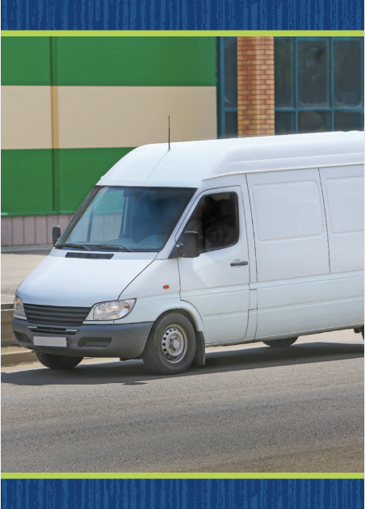

Page 144
Phonics
van
vane
can
cane
Notes:
Hold up the van Picture Card. This is a a picture of a van. I hear the short a sound in the middle of van: /v/ /a/ /n/. Click path -> Table of Contents -> Unit 3 Week 4 Fiction -> Lesson 4
Flip over the card and show students the spelling of the word. Point to the v and say /v/. Point to the a and say /a/. Point to the n and say /n/. Do you hear the middle sound /a/?
Write van on the board, and underneath it write vane What happens to a word that has a letter a when we add an e to the end? Yes, it spells the long a sound. How do you pronounce vane? Read it with me. Students should read /v/ / / /n/.
Write the words can and cane on the board. Both words have the letter a. One has the short a sound and one has the long a sound. Listen: /k/ /a/ /n/, /k/ / / /n/. Which word has the short a sound? Yes, can. Which letters make up the word? Students should say the letters c, a, and n. Repeat the activity for the word cane.

Slide 53
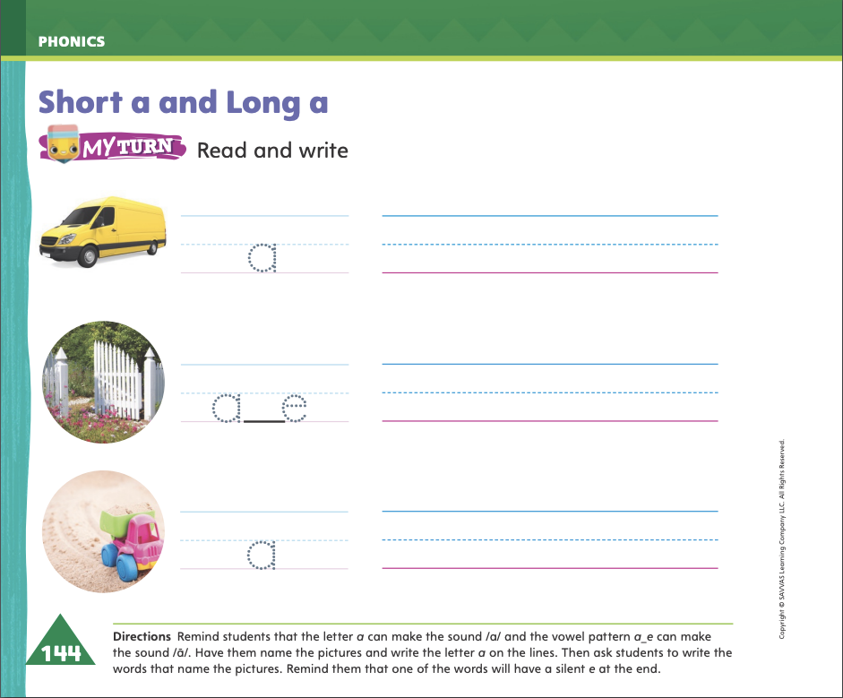
Page 144
Apply
Turn to page 144 in your Student Interactive and complete the activity.
Notes:
Have students complete p. 144 in the Student Interactive.

Slide 54
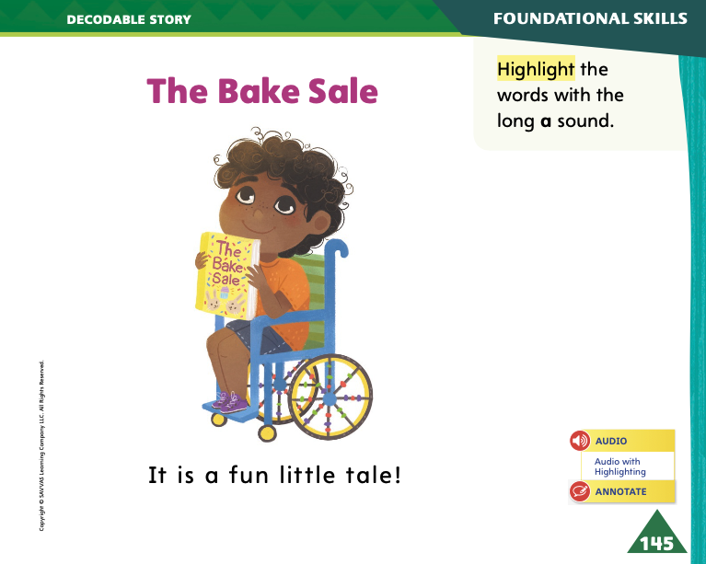
Page 145
Decodable Story
away
give
little
Turn to page 145 in your Student Interactive. Read “The Bake Sale”.
Notes:
Have students turn to p. 145 in the Student Interactive. We are going to read a story today about a bake sale. Point to the title of the story. The title of the story is The Bake Sale. I hear two words with the sound / / in the title. Which words have the sound / /? Students should come up with Bake and Sale. In this story, we will read other words that have sounds you have learned.
Remind students of this week’s high-frequency words: away, give, little. Tell them they will practice reading these words in the story The Bake Sale. Display the words.
Have students read them with you. When you see these words in the story The Bake Sale, you will know how to identify and read them

Slide 55
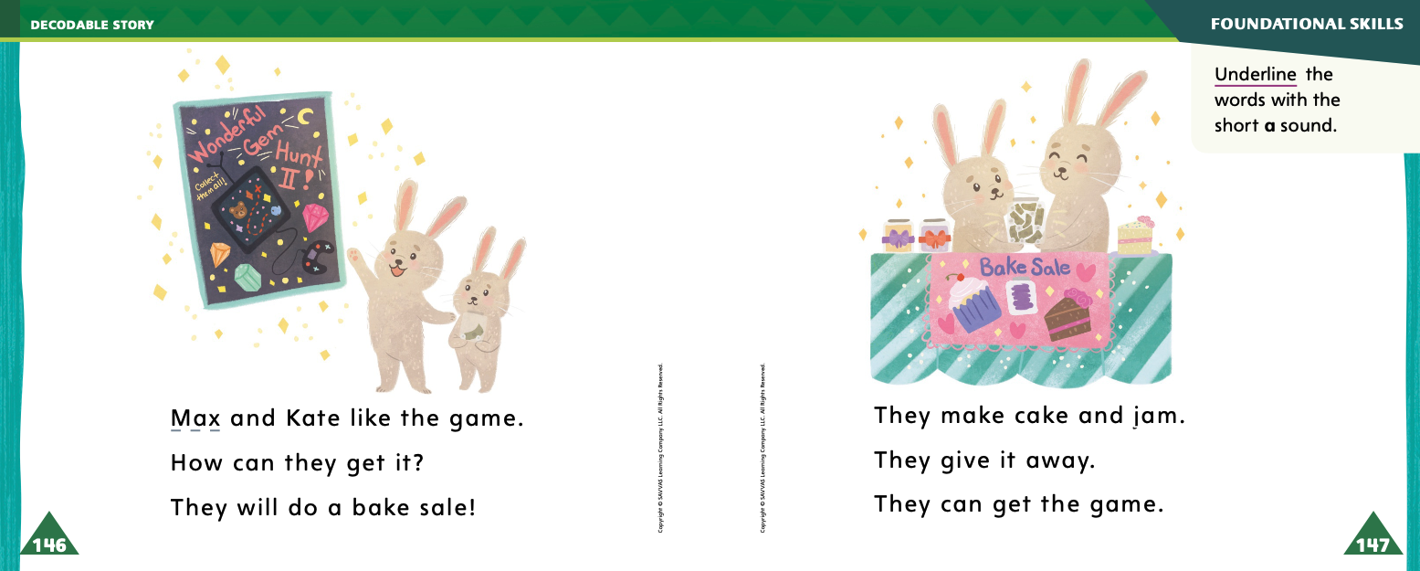
Page 146, 147
Decodable Story
Notes:
Have students whisper-read the story as you listen in. Next, have students reread the story page by page with a partner. Listen carefully as they use letter- sound relationships to decode. Partners should reread the story. This time the other student begins.
After students have read the story, call their attention to the title. Say: I see the pattern a_e in this word: bake. What is the middle sound in the word bake? Help them identify, or say, the sound / /. Then have them find and highlight the word Bake. Say: Can you tell me another word in the title with the sound / ā/ in it? Help students identify, or say, Sale. Then they should highlight Sale in the title.
Call students’ attention to the sentence on p. 145. Say: Which word includes the sound / /? Point to it. Help students identify, or say, the sound / /. Then have them find and highlight the word tale
Have students turn to pp. 146–147. Say: Which words include the sound /a/? Point to them. Help students identify, or say, the words. Then have them find and underline the words Max, and, can, and jam.
Tell students that sometimes words can mean something different than what we expect. Say: I know what a cake is. It is a sweet food. It usually has frosting on it. I’ve also heard the phrase a piece of cake. It can mean one piece, or slice, of cake. But sometimes, someone will say, That was a piece of cake! That’s what someone might say if they think something is easy. Maybe you think that writing your name is a piece of cake! Tell students to listen and look for words or phrases that might mean something different than what they expect.

Slide 56
Page 153
Make and Confirm Predictions
Notes:
Tell students that a prediction is a careful guess about what might happen in a text, based on what readers already know and on clues they gather as they read. Explain to students that:
Students can make predictions about a fiction story by thinking about what they already know from their own lives and by looking at the title, illustrations, and repeated text structure.
As students read, they confirm their predictions if story events match what they thought would happen.
Students learn to become better readers when they make and confirm predictions. Each new Close Read may help them confirm predictions they made during earlier reads.
Guide students through the process of predicting and confirming predictions. Look at the first two pages of The Best Story with students.
I can read the title and look at the picture on the title page. This can give me a hint about what the story will be about.
The title is The Best Story. I see that there is an illustration of children in a library. They are holding up a book. The title is about a story. I predict this story will be about reading. I am not sure, but it may be about what the children like to read, or the best story they have ever heard. I can also look at how the information is organized to predict the main idea of the story.
As I read, I’ll see if my prediction matches story events. That’s called confirming my prediction.

Slide 57
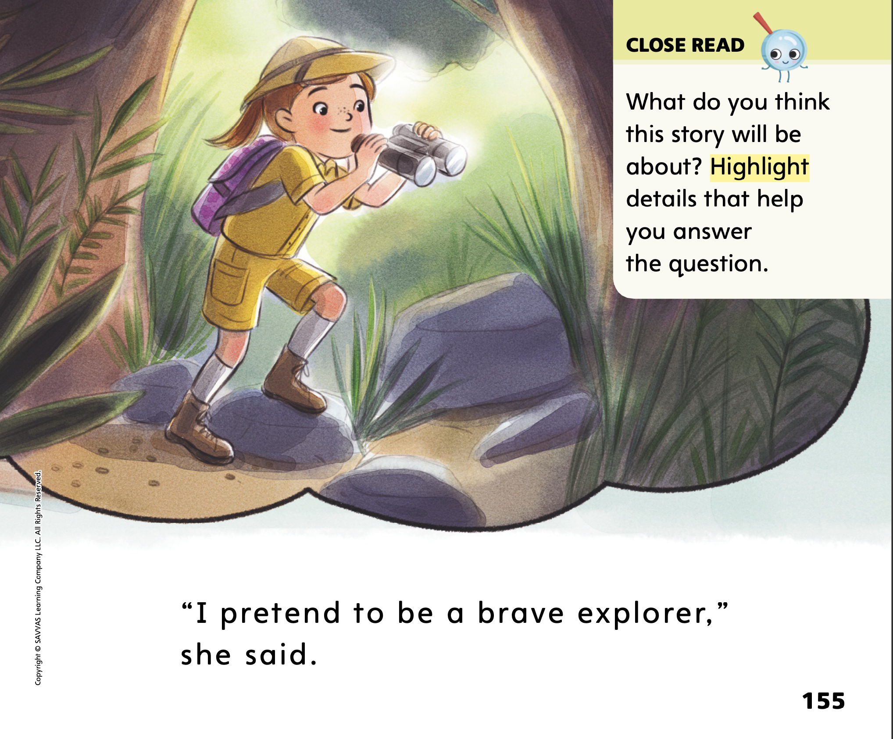
Page 155
Close Read – Make and Confirm Predictions
Turn to page 155 in your Student Interactive.
Notes:
Read aloud the Close Read box on p. 155. Ask students to highlight words that tell what the story will be
about. At the end of the story, have them check their predictions. DOK 2

Slide 58
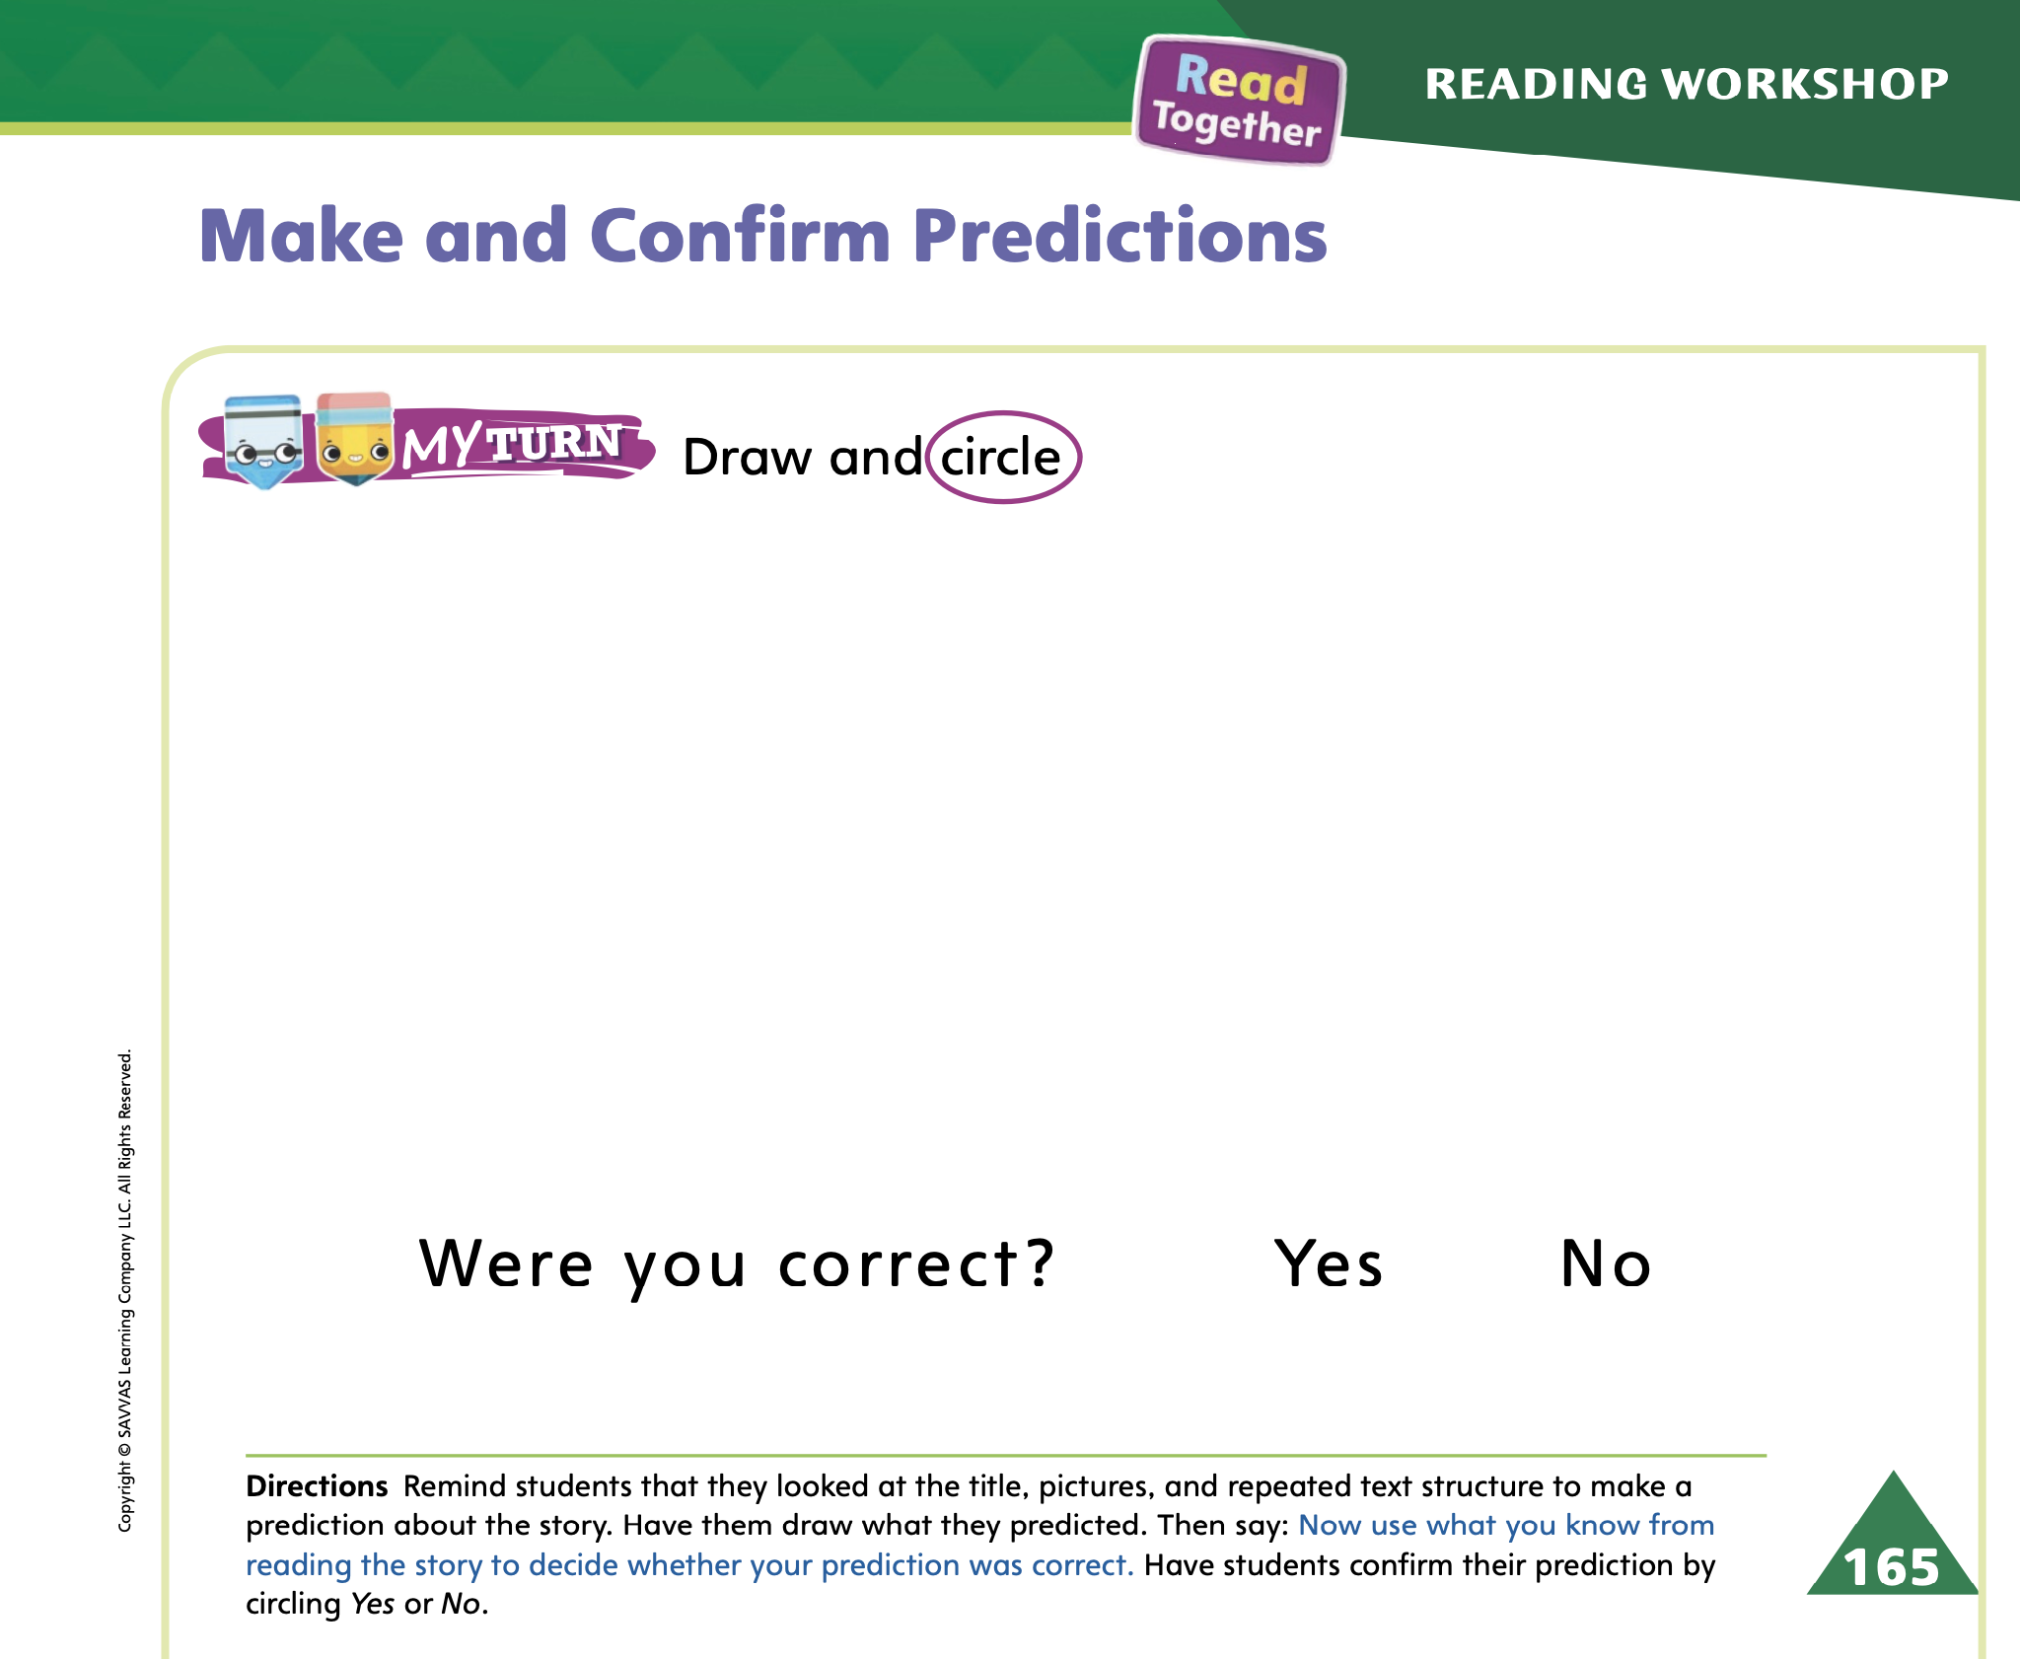
Page 165
Make and Confirm Predictions
Turn to page 165 in your Student Interactive and complete the activity.
Notes:
Have students use the strategies for making and confirming predictions.
Have students complete p. 165 in the Student Interactive.

Slide 59
Writing – Fiction
a
an
the
Notes:
The words a, an, and the are articles. They come before a noun or an adjective in a sentence.
The is an article that identifies a specific person, place, or thing.
An is an article that comes before words that start with a vowel. An identifies a general person, place, or thing.
A is an article that comes before words that start with a consonant. A refers to a general person, place, or thing.
Tell students that today they will learn about articles. The words the, an, and a are articles.
Using a stack book that includes at least two articles in the title, read the book’s title to students. Identify the first article, the, for example. Remind students that the is used to identify something specific. Explain what specific item is being identified in the book’s title.
Write the title on the board; then cross out the first article and replace it with another (replace the with a, for example). Explain to students how the edit you just made changes the meaning of the title. Do this for the second article in the title. Then do it for at least two more stack book titles. Say: Authors choose between the words the, an, and a. When you revise your own fiction draft, make sure you are using these words correctly.

Slide 60
Independent Writing
Review your fiction book for articles
Fix any sentences that do not include a naming or action part.
Notes:
During independent writing time, students should review their books for proper use of articles.
For students who need additional support with brainstorming, partner students to discuss possible ideas. Use the following options for additional support:
Modeled Think aloud as you identify articles and how they can change the meaning of a sentence.
Shared Have students give example sentences using articles.
Guided Ask students to name an article they used in their story and explain why they used it and not a different one.
When they have completed editing for articles, they should continue writing.
As students write, use the conference prompts in the Teacher’s Edition or Resource Download Center to provide support. Click path: Table of Contents -> Resource Download Center -> Writing Workshop Conference Notes
Call on a few students with whom you conferred to share their book titles with the class. Each student should read aloud the title and explain how he or she edited it. If the student did not edit the title, he or she should explain how the title would be different if one of the articles were changed.

Slide 61
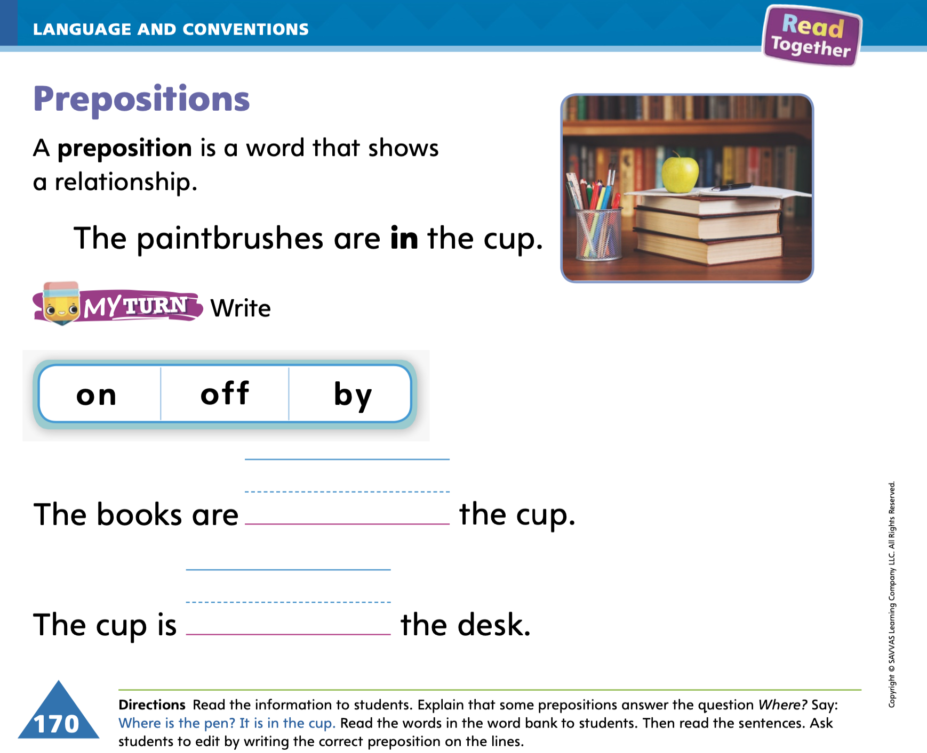
Page 170
Language and Conventions
Turn to page 170 in your Student Interactive and complete the activity.
Notes:
Have students identify, read, and write the prepositions on p. 170 in the Student Interactive

Slide 62
Lesson 5

Slide 63
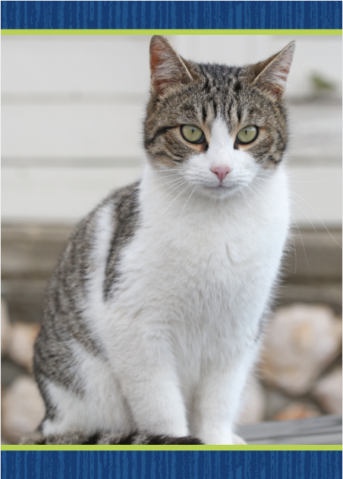
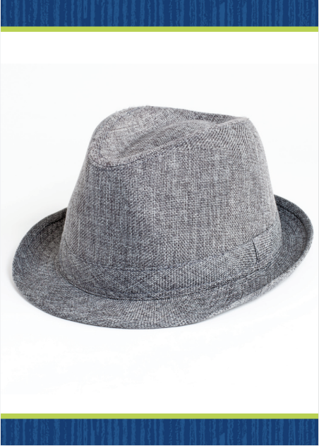

Phonological Awareness
Notes:
Display the cat Picture Card. Say: This is a picture of a cat. Listen carefully as I say some words: cat, mat, bat. What can you tell me about these words?” Students should say they rhyme. Say: “How do you know they rhyme?” Students should say that they have the same middle and ending sounds but different beginning sounds.
Hold up the hat Picture Card. Listen carefully as I say this word: /h/ /a/ /t/. Does hat have the same middle and ending sounds as cat, mat, and bat? Students should say yes.
Students need to recognize the change in spoken words when a phoneme is changed. Model with the words fit and sit. Say: Listen as I say the word fit: /f/ /i/ /t/. Now listen as I say the word sit: /s/ /i/ /t/. What changed in the word fit to make the word sit? (The sound /f/ changed to the sound /s/.) \
Display the lake Picture Card, and say the word lake. Ask a student to repeat the word and tell you one word that rhymes with it. Repeat the activity several more times so you have at least five words in the -ake word family. Answers can include: fake, make, bake, take, cake, Jake, rake, wake. Click path -> Table of Contents -> Unit 3 Week 4 Fiction -> Lesson 5

Slide 64
Phonics
rag
gate
Aa
take
sap
Notes:
Write the letters Aa and examples of both long and short a words on the board: rag, gate, take, sap. Have students read the words as you point to them and identify the vowel sound in each one.
Divide students into four teams. Provide each team with paper and pencil. Tell each team to write the words on the board along the top of their paper. Then as a group, they should write as many words as they can that rhyme with the word on the top of each column. Assist students as they need help. When students have completed their lists, have them read the words to one another.

Slide 65
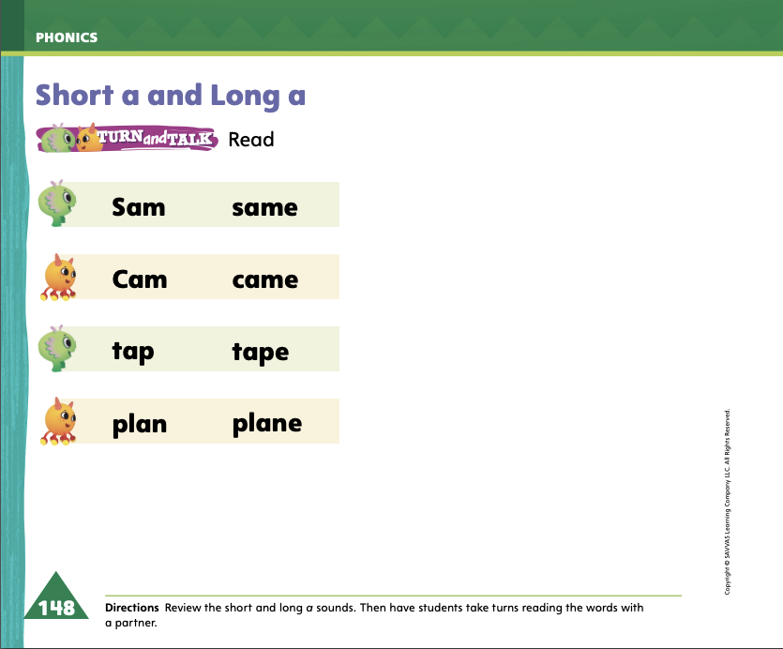
Page 148
Phonics
Turn to page 148 in your Student Interactive and complete the activity.
Notes:
Have students turn to p. 148 in the Student Interactive and alternate reading the words with a partner.

Slide 66
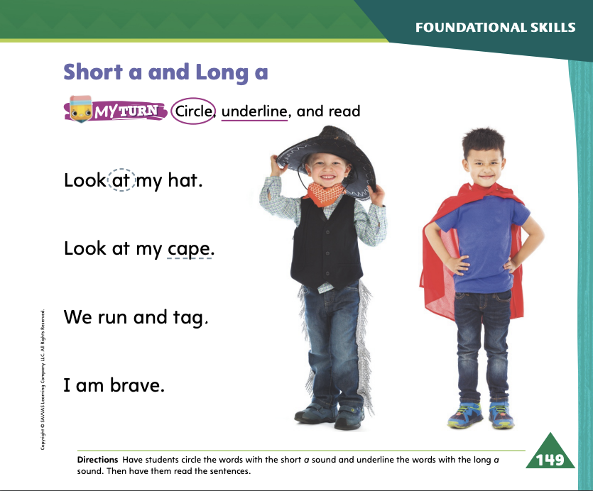
Page 149
Apply
Turn to page 149 in your Student Interactive and complete the activity.
Notes:
Have students look at p. 149 in the Student Interactive. Ask them to read the sentences with a partner. Then have them complete the page.

Slide 67
High-Frequency Words
away
give
little
Notes:
1. Remind students that high-frequency words are words that appear over and over in texts. Remind them that they will be learning many of these words this year, which will help them become better readers. Say the word away and ask students which letters spell the word. Have students
say the letters as you write the letters on the board.
say and spell the word, clapping their hands for each letter.
repeat with give and little.
2. For additional student practice with high-frequency words, have students complete My Words to Know p. 135 from the Resource Download Center.
3. Additional practice can be found in the Resource Download Center: Click path: Table of Contents -> Resource Download Center -> High Frequency Words Practice> U3W4 High Frequency Words Practice

Slide 68
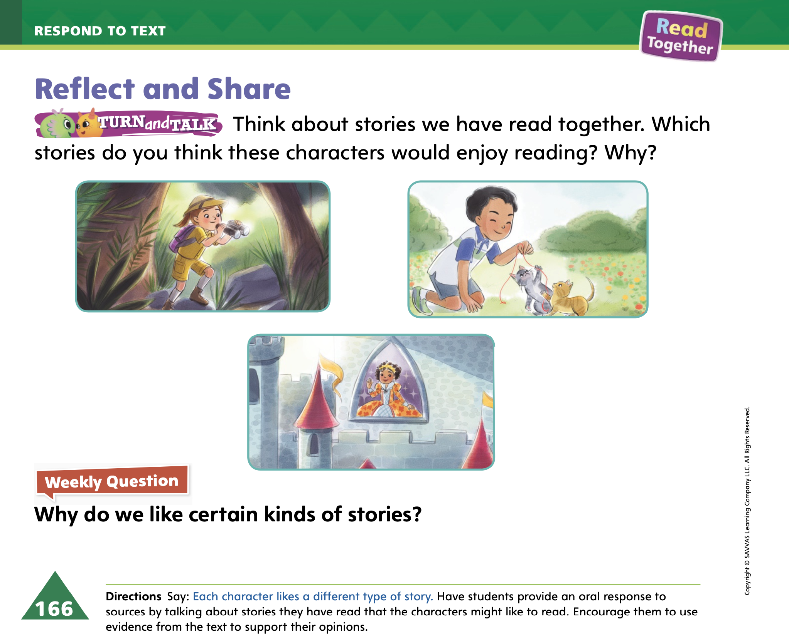
Page 166
Reflect and Share
Turn to page 166 in your Student Interactive.
Notes:
1. Explain that after students read a text, talking about it with classmates can increase their understanding and enjoyment of the text. Tell students that after they read a text, they should:
think about what they learned about the characters and story.
think about how those characters are alike or different from other
stories they know.
listen actively to others’ ideas and connect their ideas with their own.
ask and answer questions using complete sentences.
2. Ask students to turn to p. 166 in the Student Interactive. Reread the text for students
3. The question is why I like certain kinds of stories. What’s your favorite kind of story? My favorite kind of story is a fairy tale. I like fairy tales because there are enchanting characters and fantastic stories set in other lands. I can draw a picture of my favorite fairy tale. I’ll draw Jack climbing a giant beanstalk in Jack and the Beanstalk because that shows how wonderful fairy tales can be.
4. Tell students to provide text evidence from stories they enjoy in their discussions.

Slide 69
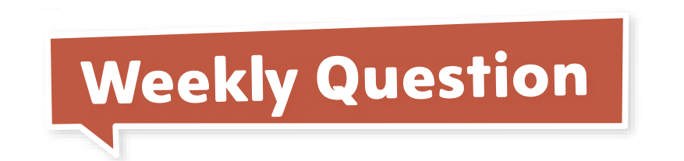
Page 166
Apply
Why do we like certain kinds of stories?
Notes:
Have students use the strategies for comparing texts.
Have students complete p. 166 in the Student Interactive.
Have students use evidence from the texts they have read this week to respond to the Weekly Question. Tell them to discuss in small groups or write or draw their responses on separate sheets of paper.

Slide 70
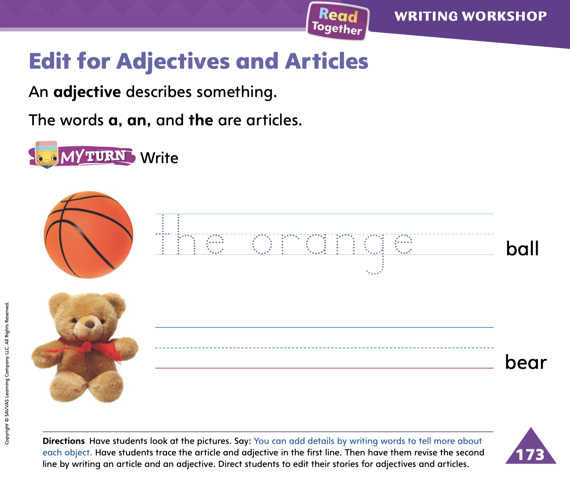
Page 173
Writing – Fiction Story
Turn to page 173 in your Student Interactive and complete the activity.
Notes:
Adjectives are words that describe the shape, color, size, texture, sound, or number of a noun. Adjectives make sentences more descriptive and give readers a clearer picture of a person, place, or object.
Choose an object from the classroom and hold it up for students to see. Tell them you are going to write a few sentences about the object. Alternatively, you may use a sentence from a stack text but remove the adjectives.
Begin by writing a simple sentence with just a naming part and action part. For example: The mug was on the desk. Then show students how to edit the sentence by adding adjectives. To do this, write a new sentence above it. For example: The tall red mug was on an old, brown, wooden desk. When you are finished writing, engage students in a conversation about which sentence is more descriptive. Remind students that adjectives are words that describe a person, place, or thing. Underline the adjectives in your sentences, thinking aloud about which noun each one describes. Say: Adjectives can be a color, shape, size, or number. We include adjectives when we write our books so that readers can picture what we are writing about. We can add details to our stories by adding adjectives.
Direct students to complete the activity on p. 173 of the Student Interactive. Then have them edit their own books, looking for places to add adjectives.

Slide 71
Language and Conventions
Humpty Dumpty is sitting on the wall.
Which word in the sentence is a preposition?
is
on
the
wall
Notes:
1. Display the following sentence and guide students to complete the question.
Humpty Dumpty is sitting on the wall. Which word in the sentence is a preposition?
A is
B on
C the
D wall
2. Have students complete Language & Conventions p. 151 from the Resource Download Center. Click path: Table of Contents -> Resource Download Center -> Language and Conventions -> U3 W4

Slide 72
Unit 3: Week 4
Grade K

