Slide 1
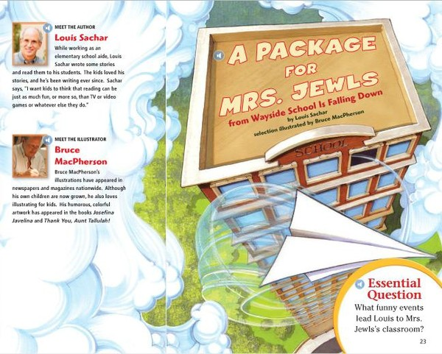
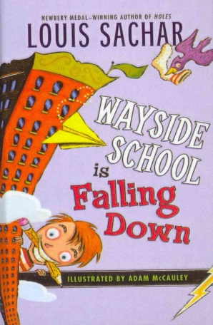
A Package for Mrs. Jewls
Vocabulary Power Point

Slide 2
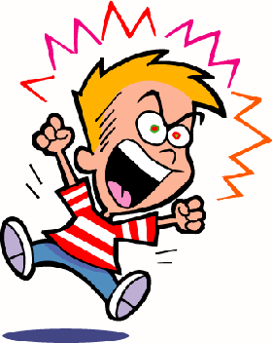
Disturbing
Adjective
Upsetting; dismaying
It is very disturbing to see
children that throw tantrums
when they don’t get
their way.

Slide 3
Interrupt
Verb
Doing something that hinders or stops the action or conversation of
My favorite T.V. show was interrupted by a Public Service Announcement.

Slide 4
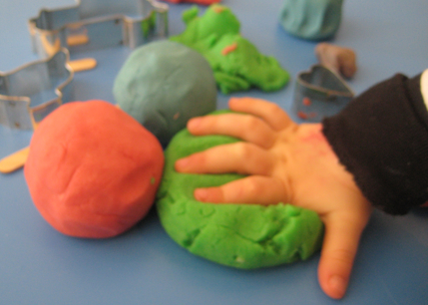
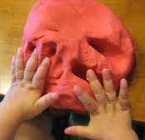
Squash
Verb
To beat down or flatten; to crush
Children enjoy squashing and molding clay.

Slide 5
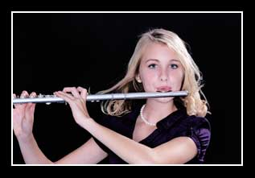
Specialty
Noun
A special pursuit, talent, or skill
The musician can play many instruments but her specialty is the flute.

Slide 6
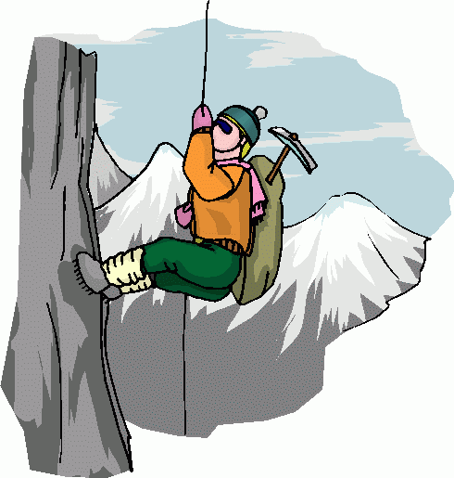
Struggle
Verb
To make strenuous efforts; to strive
The man struggled
to climb the mountain.

Slide 7
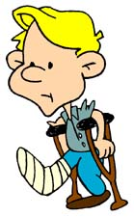
Stagger
Verb
To move or stand unsteadily; to totter
The boy on crutches
seemed to stagger
as he walked.

Slide 8
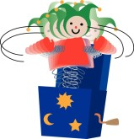
Wobble
Verb
To move unsteadily from side to side
When the Jack popped out of the box, it wobbled from side to side.

Slide 9
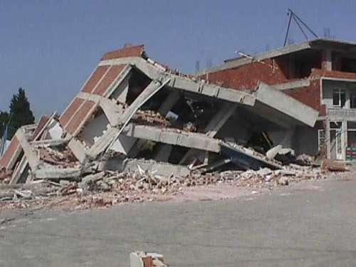
Collapse
Verb
To fall down suddenly; cave in
The building collapsed due to the earthquake.

Slide 10
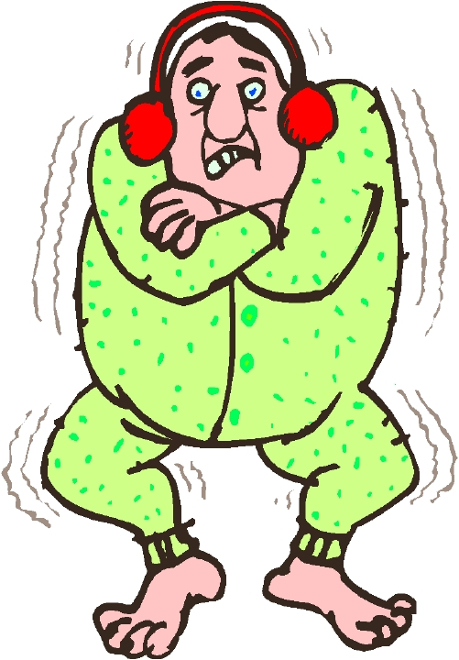
Numb
Adjective
Deprived of the power to feel or move normally
The man’s whole body
went numb because he
was out in the cold for
too long.

Slide 11
Shift
Verb
To move or transfer from one place or position to another
The men lifted and shifted the couch to a different spot in the room.

Slide 12
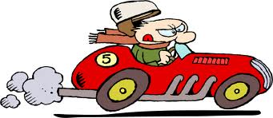
Acceleration
Noun
The act of increasing speed or velocity
The race car driver exhibited a lot of acceleration as he began the race.

Slide 13
Inertia
Noun
A property of matter at rest or in a uniform motion
The books show inertia by being forms of matter at rest on the bookshelf.

Slide 14
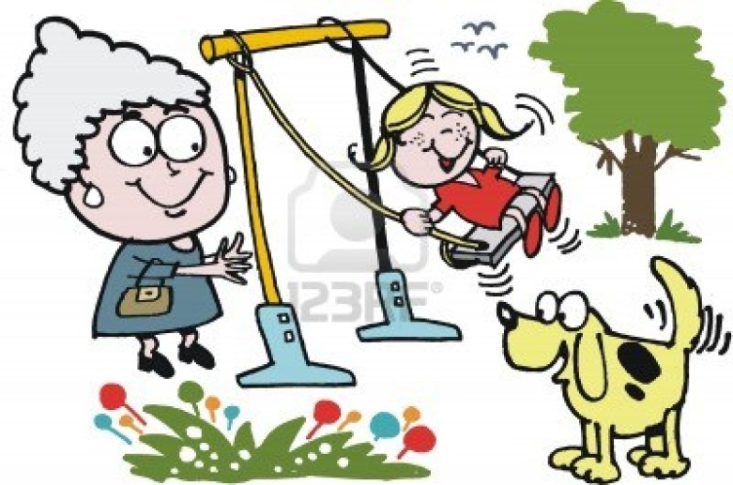
Momentum
Noun
Force or speed of movement
My grandma gave me
more momentum on
the swing by pushing
me.

Slide 15
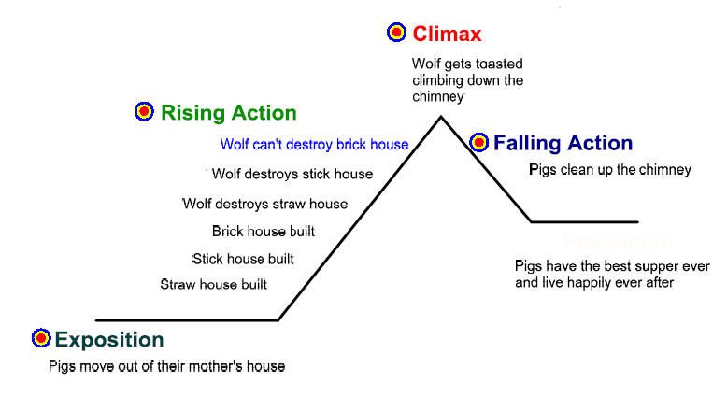
Plot
Noun
The main storyline of a literary work
We used a diagram to show the plot of the story.

Slide 16
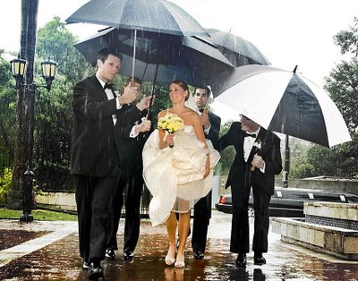
Irony
Noun
An outcome of events contrary to what was, or might have been, expected
Irony is very evident when it is raining on your wedding day.

Slide 17
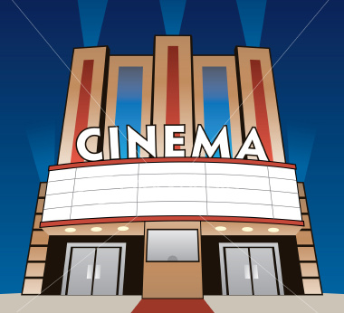
Resolution
Noun
The act or process of resolving an issue
The resolution to the rainy day, was the plan to go to the movies.

